Slide 1
Lecture 04: Requirements Engineering – II
Specification
CSC210A Software Development Fundamentals
B. Tech. 2017
Course Leader(s):
Ms.Sahana.P.Shankar
sahana.cs.et@msruas.ac.in
Ms. Supriya, M. S.
supriya.cs.et@msruas.ac.in

Slide 2
Lecture Objectives
At the end of this lecture, student will be able to
Describe SRS specification steps
Identify various subsections of SRS documents
Relate the user characteristics with expected requirements
Develop software requirements document

Slide 3
Lecture Contents
Requirement Specification
Standards for SRS
SRS structure

Slide 4
Requirements Specification
Aimed at technical audience
Such as designers, testers, and project managers
Restates the requirements as a specification of how the proposed system shall behave
Written by the requirement analyst and is used by the other software developers
The analyst must ensure no information is lost or changed when refining the requirements into a specification

Slide 5
Requirements Specification - Steps Documenting Process
Describe all inputs and outputs in detail, including
the sources of inputs
the destinations of outputs
the value ranges
data format of inputs and output data
data protocols
window formats and organizations
timing constraint
Restate the required functionality in terms of the interfaces' inputs and outputs

Slide 6
IEEE Standard for SRS
Intodruction to the Document
1.1 Purpose of the Product
1.2 Scope of the Product
1.3 Acronyms, Abbreviations, Definitions
1.4 References
1.5 Outline of the rest of the SRS
General Description of Product
2.1 Context of Product
2.2 Product Functions
2.3 User Characteristics
2.4 Constraints
2.5 Assumptions and Dependencies
Specific Requirements
3.1 External Interface Requirements
3.1.1 User Interfaces
3.1.2 Hardware Interfaces
3.1.3 Software Interfaces
3.1.4 Communications Interfaces
3.2 Functional Requirements
3.2.1 Class 1
3.2.2 Class 2
…
3.3 Performance Requirements
3.4 Design Constraints
3.5 Quality Requirements
3.6 Other Requirements
Appendices

Slide 7
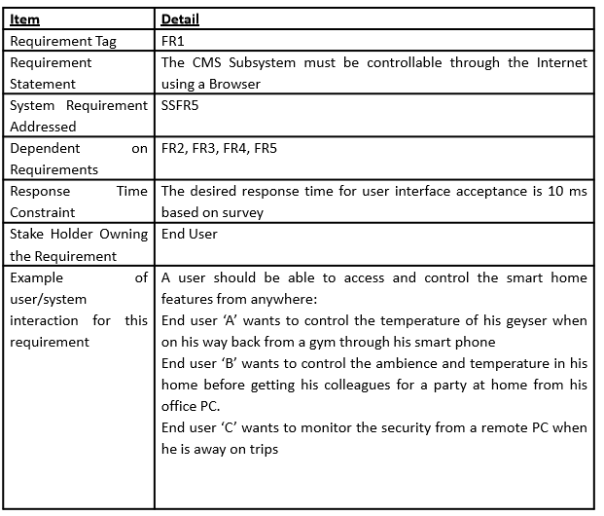
Requirements Specification
Notes:
7

Slide 8
Summary
The formality and format of a specification varies with the size and the complexity of the software to be built
This format is a standard that is specified by working groups and engineering bodies
Requirements must be well documented, clear, un ambiguous and complete when specified

