Slide 1
Lecture 05: Object Oriented Analysis and Design Through UML
CSC210A Software Development Fundamentals
B. Tech. 2017
Course Leader(s):
Ms.Sahana.P.Shankar
sahana.cs.et@msruas.ac.in
Ms. Supriya, M. S.
supriya.cs.et@msruas.ac.in

Slide 2
Lecture Objectives
At the end of this lecture, student will be able to
Explain the concepts of object oriented modeling
Discuss objects, classes and methods
Identify the advantages of object modelling
Identify the basic building blocks of UML
Notes:
2

Slide 3
Lecture Topics
Object orientation
Basic building blocks of Unified Modeling Language (UML)
Things/Elements
Relationships
Structural diagrams
Behavioral diagrams

Slide 4
OO Design
Object oriented methodologies are the most popular and sophisticated design methodologies
A design is object oriented if it decomposes a system into a collection of runtime components called objects that encapsulate data and functionality
Objects are uniquely identifiable runtime entities
Objects can be designated as the target of a message or request
The implementation of an object can be reused and extended via inheritance

Slide 5
Terminology
Objects
The runtime structure of an OO system
A collection of data plus all operations for creating, reading, altering, and destroying those data
Objects can have
attributes (such as color, size, location)
operations or behaviors (such as takeoff, land, repair)
Class
Group of objects that have attributes and behaviors in common
Each object is an instance of a class
Method
A specific implementation of an operation for a certain class

Slide 6

Objects and Classes
Examples of objects grouped into classes

Slide 7
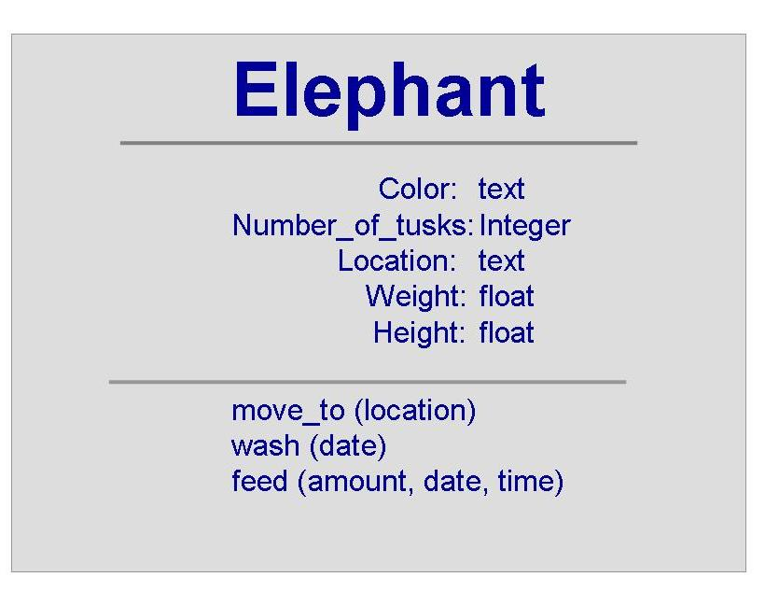
Objects and Classes (continued)
We can represent a class using a box
Box represents
object’s name
attributes
behaviors

Slide 8
The OO Development Process
Describing classes using OO representation requires three perspectives
Static views: descriptions of the object, attributes, behaviors, and relationships
Dynamic views: describe communication, control/timing, and the state and changes in state
Restrictions: describe constraints on the structure

Slide 9
OO Requirements
Usually done in user’s language and discusses the concepts and scenarios likely in the application domain
The concepts include information services and responsibilities
Domain knowledge enables the developers
to understand the context in which the system will be used
to describe the requirements in a way that the user will understand

Slide 10
OO Design
Usually uses an OO requirements representation
System design
Identifies and represents objects and classes, plus details of each object’s attributes and behaviors
Also identifies interactions and relationships
Program design
Inserts computational features in the models and class library details
Considers nonfunctional requirements to enhance design

Slide 11
OO Coding and Testing
Coding proceeds by translating the models to an OO programming language
It is necessary to refine the hierarchical structures and make adjustments as the requirements grow and mature
Testing involves some of the same activities that are performed when testing any kind of system

Slide 12
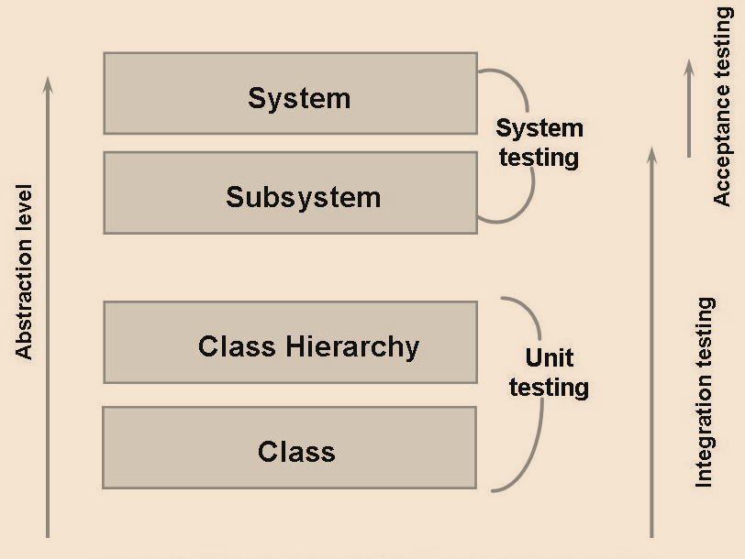
OO Coding and Testing (continued)
Graphical representation of how the abstraction level relates to various types of tests that are performed

Slide 13
Models
Model
A simplification of reality
It provides the blueprint of a system
Models may encompass
General plan
Detailed plan
A model may be
Structural – emphasizes the organisation of the system
Behavioural - emphasizes the dynamics of the system

Slide 14
Aims of Modelling
Models help us to visualize a system as it is or as we want it be
Models permit us to specify the structure or behavior of the system
Models give us a template that guides us in constructing a system
Models document the decisions we have made

Slide 15
Modelling
Two ways to approach a model in software
Algorithmic perspective
The main building blocks of all software is the procedure or function
As requirements change and system grows, it turn out to be very hard to maintain
Object oriented perspective
The main building blocks of all software is objects or classes
Every object has identity, state and behavior

Slide 16
Unified Modelling Language (UML)
Unified Modelling Language (UML)
A family of graphical notations, that help in describing and designing software systems, particularly software systems built using the object-oriented (OO) style
It is a very expressive language
Addresses all the views needed to develop and then deploy such systems
UML is process independent

Slide 17
Unified Modelling Language (UML)
Three Amigos
Grady Booch, Ivar Jacobson, and Jim Rumbaugh
UML notation was first formed in the Booch/Rumbaugh Unified Method
UML is relatively open standard
UML is controlled by the Object Management Group (OMG), an open consortium of companies
(OMG is best known for CORBA)
UML is appropriate for modelling systems like
Enterprise information systems, Web-based applications, Hard real time embedded systems, Defense/aerospace, Medical electronics, Banking, etc.

Slide 18
Unified Modelling Language (UML)
UML is a language for
Visualizing
UML models things graphically
Specifying
Building models that are precise, unambiguous, and complete
Constructing
Its models can be directly connected to a variety of programming languages
Documenting
UML addresses the documentation of a system architecture, expresses requirements and tests, models the activities of project planning and release management, etc.

Slide 19
Building Blocks of the UML
UML encompasses three kinds of building blocks
Things/Elements
Abstractions that are first class citizens in a model
Relationships
Tie things together
Diagrams
Groups interesting collections of things

Slide 20
Summary
Models are a simplification of reality
They provide the blueprint of a system
Models may encompass general plans or detailed plans
Object-oriented analysis and design (OOAD) is a software engineering approach that models a system as a group of interacting objects.
UML is a language for visualizing, specifying, constructing and documenting artifacts of software-intensive systems

