Slide 1
Lecture 06: UML Diagrams
CSC210A Software Development Fundamentals
B. Tech. 2017
Course Leader(s):
Ms.Sahana.P.Shankar
sahana.cs.et@msruas.ac.in
Ms. Supriya, M. S.
supriya.cs.et@msruas.ac.in

Slide 2
Lecture Objectives
At the end of this lecture, student will be able to
Explain the various relationships found in UML diagrams
Discuss the various elements in UML diagrams
Identify the basic building blocks of UML
Identify the purpose and use of various diagrams available in UML
Notes:
2

Slide 3
Lecture Topics
Basic building blocks of Unified Modeling Language (UML)
Things/Elements
Relationships

Slide 4
Basic Building Blocks of UML
Things/elements
Relationships
Diagrams
Class Diagram
Object Diagram
Use Case Diagram
Sequence Diagram
Collaboration Diagram
Statechart Diagram
Activity Diagram
Component Diagram
Deployment Diagram
Dependency
Association
Generalisation
Realisation
Structural — nouns of UML models.
Behavioural — dynamic (verbal) parts of UML models.
Grouping — organisational parts of UML models.
Annotation- explanatory parts of UML models.
Notes:
4
A graphical language for visualizing, specifying, constructing, and documenting the artifacts of a software intensive system. It offers vocabulary & rules for communication and focus on conceptual & physical representations of a system.
Specifying: building models that are Precise, Unambiguous, Complete; UML symbols are based on well-defined syntax and semantics; UML addresses the specification of all important analysis, design, and implementation decisions.
Constructing: Models are related to OO programming languages; Round-trip engineering requires tool and human intervention to avoid information loss; Forward engineering — direct mapping of a UML model into code; Reverse engineering — reconstruction of a UML model from an implementation.
Documenting: Architecture, Requirements, Tests, Activities (Project planning, Release management)
UML Not a process but a language which uses standard graphical notations. UML is semi-formal and captures Business Process from enterprise information systems to distributed Web-based applications and even to hard real time embedded systems.
You will see these basic building blocks in next slides which comprises structural modelling (describes structure of system), behavioral modelling (describes behavior of the system) and architectural modelling (describes architecture of the system),

Slide 5
Things in the UML
Four kinds of things in the UML
Structural things
Mostly static parts of a model
Behavioral things
Dynamic parts of a UML
Grouping things
Organizational parts of a UML
Annotational things
Explanatory parts of UML models

Slide 6
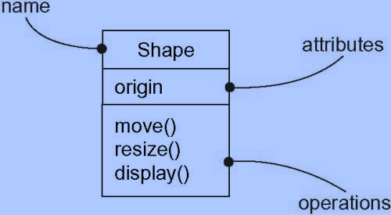
Structural Things
Nouns of the UML models
Represents elements that are either conceptual or physical
Seven kinds of structural things
Class
Description of a set of objects that share the
same attributes, relationships, and semantics
A class implements one or more interfaces
Rendered as a rectangle
Notes:
6

Slide 7
Classes
Names
Every class must have a name that distinguish it from other classes
Attributes
A named property of a class that describes a range of values that instances of the property may hold
A class may have any number of attributes or no attributes at all
Operations
The implementation of a service that can be requested from any object of the class to affect behavior

Slide 8
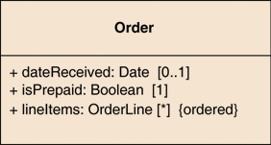
Attributes
The attribute notation
Describes a property as a line of text within the class box itself
The full form of an attribute
visibility name: type multiplicity = default {property-string}
An example of this is:
- name: String [1] = "Untitled" {readOnly}
Only the name is necessary

Slide 9
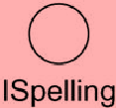
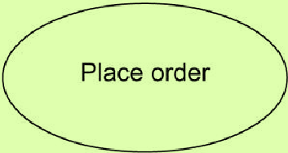
Structural Things
Interface
A collection of operations that specify a service of a class or component
Describes the externally visible behavior of that element
An interface rarely stands alone
Typically attached to the class or component
Rendered as circle with its name
Use Case
A description of set of sequence of actions that a system performs to yield an observable result to particular user
Rendered as an ellipse with solid line,
including its name
Notes:
9

Slide 10
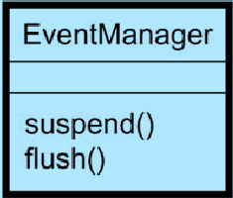
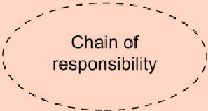
Structural Things
Active class
Can initiate control activity
Just like a class except that its objects represent
elements whose behavior is concurrent with other elements
Its objects own one or more processes or threads
Rendered just like class, but with heavy lines
Collaboration
Defines an interaction
It is a society of roles and other elements that work together to provide some behavior that is bigger than the sum of the elements
Collaborations have structural, as well as behavioral dimensions
Rendered as an ellipse with dashes lines, with its name
Notes:
10

Slide 11
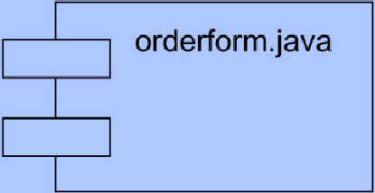
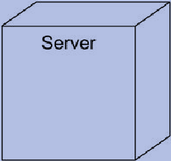
Structural Things
Component
Represent physical things
A component is a physical and replaceable part of a system
Rendered as a rectangle with tabs, including its name
Node
A physical element that exists at run time
Represents a computational resource, having at least one memory
Rendered as a cube, including its name
Notes:
11

Slide 12

Behavioral Things
Verbs of a model
Represents behavior over time and space
Two types
Interaction
A behavior that comprises a set of messages exchanges among a set of objects within a particular context to get a result
Rendered as a directed line, including the name of its operation

Slide 13
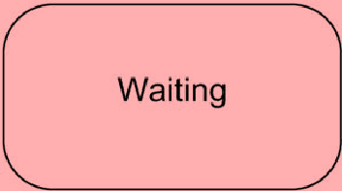
Behavioral Things
State machine
A behavior that specifies the sequences of states an object or an interaction goes through during its lifetime in response to events
The behavior of a class or collaboration of classes may be specified
Rendered as a rounded rectangle, with its name and its sub states
A state machine involves
States
Transitions – the flow from state to state
Events – things that trigger a transition
Activities – the response to events

Slide 14
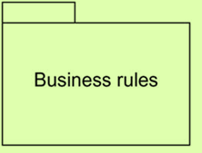
Grouping Things
Boxes into which a model can be decomposed
Packages
A general purpose mechanism for organizing elements into groups
Structural and behavioral things can be placed in a package
A package is purely conceptual
Rendered as a tabbed folder, including its name, and sometime its contents

Slide 15
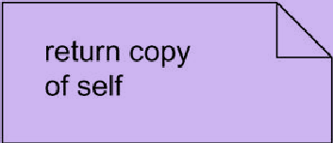
Annotational Things
Comments that may be applied to describe, illuminate, and remark about any element in a model
Note
A symbol for rendering constraints and comments attached to an element or a collection of elements
Rendered as a rectangle with a dog-eared corner, with a textual or graphical element

Slide 16
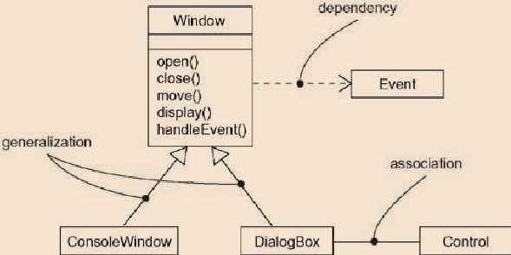
Relationships in the UML
A relationship is a connection among things
Four kinds of relationships in the UML
Dependency
Association
Generalisation
Realisation

Slide 17
Types of Class Relationships
association
composition
aggregation
generalization
dependency
navigation

Slide 18
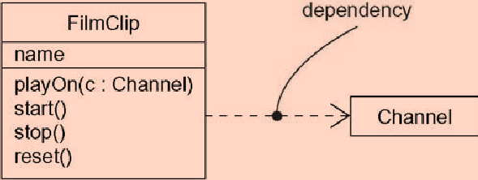
Dependency
Semantic relationship between two things
Always directed
Change to one thing (the independent thing) may affect the semantics of the other thing (the dependent thing)
Rendered as a dashed line,
possibly directed, and
occasionally including a label
Independent element
dependent
element

Slide 19
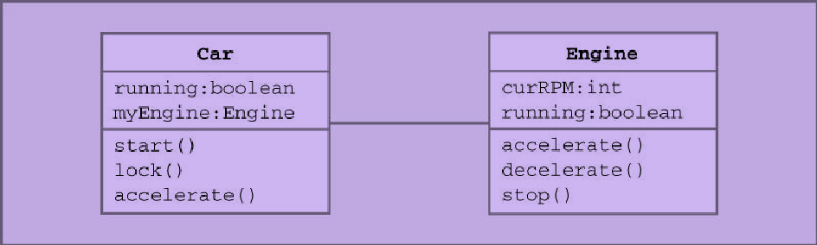
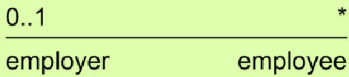
Association
Structural relationship that describes a set of links, a link being a connection among objects
Use association when you want to show structural relationships
Denotes permanent, structural relationship
Rendered as a solid line, possibly directed, occasionally including a label, and often containing other adornments, such as multiplicity and role names

Slide 20
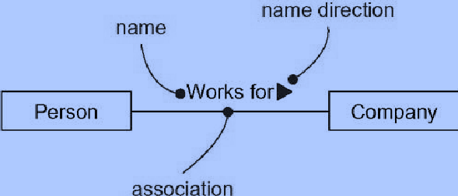
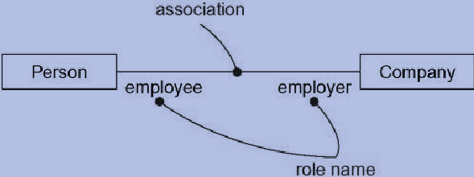
Association
Association names
Roles

Slide 21
Multiplicity
The multiplicity of a property
An indication of how many objects may fill the property
The most common multiplicities are
1 (An order must have exactly one customer)
0..1 (A corporate customer may or may not have a single sales rep.)
* (A customer need not place an Order -zero or more orders)
Multiplicities are defined with a lower bound and an upper bound
The lower bound may be any positive number or zero
The upper is any positive number or * (for unlimited)

Slide 22
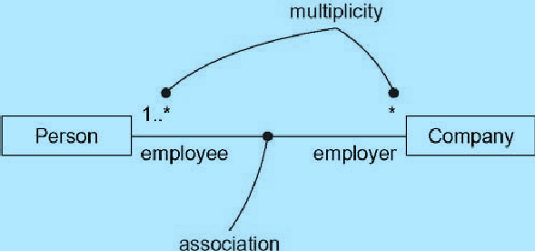
Multiplicity
* is short for 0..*
1 is equivalent to 1..1
Optional
Implies a lower bound of 0
Mandatory
Implies a lower bound of 1 or
possibly more
Single-valued
Implies an upper bound of 1
Multivalued
Implies an upper bound of more than 1, usually *

Slide 23


Bidirectional and Binary Associations
A bidirectional association
A pair of properties that are linked together as inverses
Binary association
Association that connects exactly two classes

Slide 24
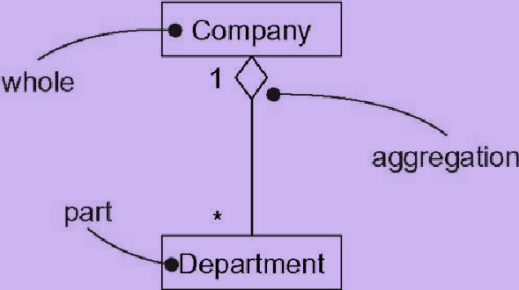
Aggregation
A special kind of association, representing a structural relationship between a whole and its parts
Represents a “has-a” relationship
Objects of the whole has objects of the part
Aggregation is specified by a plain association with an open diamond at the whole end

Slide 25
Generalization
Objects of the specialized element (the child) are substitutable for the objects of the generalized element (the parent)
Child shares the structure and behavior of the parent
A class may have zero, one, or more parents
Rendered as a solid line with a hollow arrowhead pointing to the parent
generalized
specialized

Slide 26
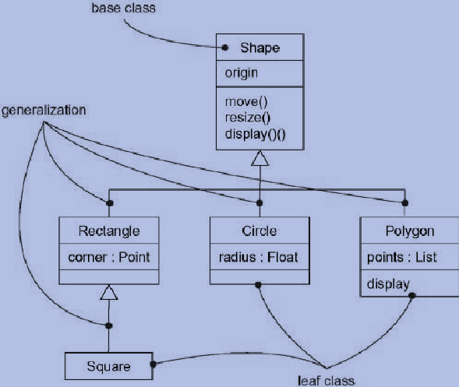
Generalization

Slide 27
Realization
A semantic relationship between classifiers, wherein one classifier specifies a contract that another classifier guarantees to carry out
Realization can be occurred two places
Between interfaces and the classes or components that realize them
Between Use Cases and the collaborations that realize them
Rendered as a cross between a generalization and a dependency relationship
implementation
contract

Slide 28
Diagrams in the UML
A diagram is the graphical presentation of a set of elements, most often rendered as a connected graph of vertices (things) and arcs (relationships)
The UML includes nine diagrams
Class diagram
Object diagram
Use Case diagram
Sequence diagram
Collaboration diagram
Statechart diagram
Activity diagram
Component diagram
Deployment diagram

Slide 29
Summary
There are three building blocks which characterize UML
Elements
Relationships
Diagrams
Four categories of elements in UML include:
Structural
Behavioral
Grouping
Annotation
There are four basic types of relationships in UML
Dependency
Association
Generalization
Realization
UML provides both structural and behavioral diagrams

