Slide 1
Lecture 07: Use Case Diagram
CSC210A Software Development Fundamentals
B. Tech. 2017
Course Leader(s):
Ms.Sahana.P.Shankar
sahana.cs.et@msruas.ac.in
Ms. Supriya, M. S.
supriya.cs.et@msruas.ac.in

Slide 2
Lecture Objectives
At the end of this lecture, student will be able to
Identify the basic building blocks of UML Use Case diagram
Explain the concepts of object oriented analysis
Model and analyze a software system with Use Case diagrams
Design the context of given software system with object oriented approach
Notes:
2

Slide 3
Lecture Topics
Behavioral diagrams
Use Case diagram
Elements in Use Case diagram
Relationships in Use Case diagram

Slide 4
Behavioral Diagrams
The diagrams to visualize, specify, construct, and document the dynamic aspects of the system
The dynamic aspects of a house encompasses airflow through the rooms of a house
The UML includes five behavioral diagrams
Use Case diagram
Sequence diagram
Collaboration diagram
State chart diagram
Activity diagram

Slide 5
Use Case Diagram
A Use Case diagram lets you view the whole system as a black box
You can see what's outside the system and how that system reacts to the things outside
You can't see how that system works on the inside
Use Case diagrams commonly contain
Use Cases
Actors
Dependency, generalization, and association relationships

Slide 6
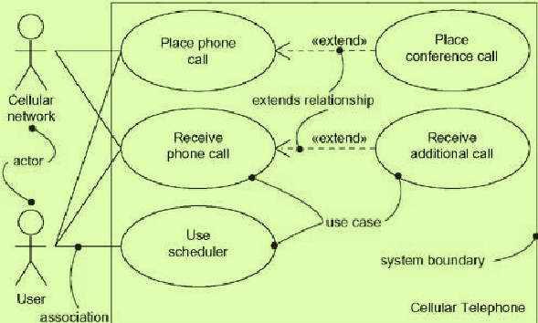
A Use Case Diagram

Slide 7
Common Uses of Use Case Diagrams
To model the context of a system (from the actors)
Emphasizes the actors that surround the system
Involves drawing a line around the whole system and asserting which actors lie outside the system and interact with it
Which actors carry out which use cases?
To model the requirements of a system (from the events)
Specify what that system should do (from a point of view of outside the system), independent of how that system should do it
Specify the desired behavior of the system
Which use cases include other use cases?

Slide 8
Elements of a Use Case Diagram
Use Cases
Sequences of actions, including variants, that the interacting system can perform together with the system actors
Actor
A coherent set of roles played by a user when interacting with the system
System boundary
The limit between the physical system and the actors that interact with it
Use Case
name
Actor name

Slide 9
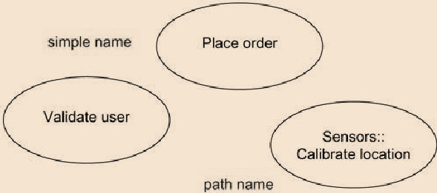
Use Case
A Use Case
A technique for capturing the functional requirements of a system
Represent an external view of the system
A Use Case does not describe
User interfaces, performance goals, non-functional requirements

Slide 10
Use Cases
Common information that can be added to a use case
A pre-condition
Describes what the system should ensure is true before the system allows the use case to begin
Useful for telling the programmers what conditions they don't have to check for in their code
A guarantee
Describes what the system will ensure at the end of the use case
Success guarantees hold after a successful scenario; minimal guarantees hold after any scenario
A trigger
Specifies the event that gets the use case started

Slide 11
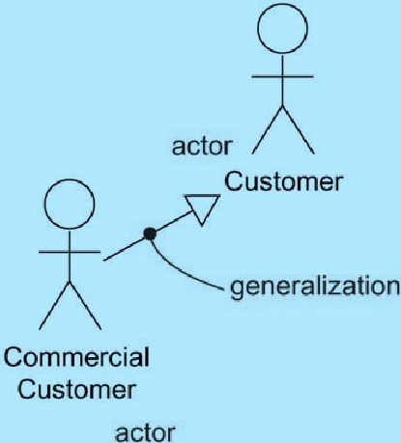
Actors
An actor
Represents a coherent set of roles that users of Use Cases play when interacting with the Use Cases
Is anyone or anything that interacts with the system causing it to respond to events
Typically, an actor represents a role that a human, a hardware device, or even another system plays with a system
They live outside the system
It is also possible to relate actors using
generalizations
Actors are rendered as stick figures

Slide 12
Identifying Participants
What users or groups use the system to perform a task?
What users or groups are needed so that the system can perform its functions?
What external systems use the system to perform a task?
What external systems, users, or groups send information to the system?
What external systems, users, or groups receive information from the system?

Slide 13
Actors
Initiator versus participant
When there is more than one actor in a Use Case, the one that generates the stimulus is called the initiator and the others are participants
Primary versus secondary
The actor that directly interacts with the system is called the primary actor, others are called secondary actors

Slide 14
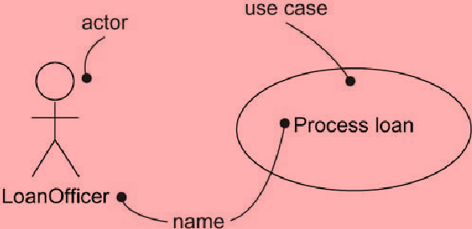
Use Cases and Actors
Actors may be connected to Use Cases only by association
An association between an actor and a Use Case indicates that the actor and the Use Case communicate with one another, each one possibly sending and receiving messages

Slide 15
Example for High Level Use Case
Use Case | Buy items
Actors | Customer, Cashier
Description | A Customer arrives at a checkout with Items to purchase. The Cashier records the purchase items and collects payment. On completion, the Customer leaves with the items

Slide 16
Include and Extend Stereotypes
Include: rendered using the “include” stereotype
The behavior of a Use Case includes that of a base Use Case
The included Use Case never stands alone
Only instantiated as part of some larger base that includes it
Extend: rendered using the “extend” stereotype
The behavior of a Use Case extends that of a base Use Case
The base Use Case may stand alone
Under certain conditions, its behavior may be extended by the behavior of another Use Case

Slide 17
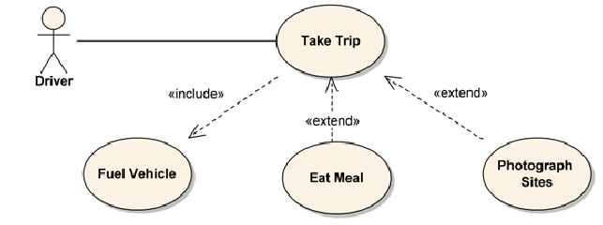
Include and Extend

Slide 18
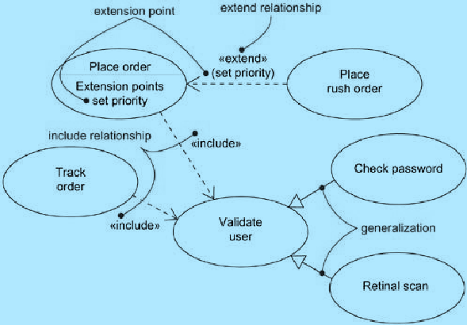
Include and Extend Stereotypes

Slide 19
Summary
The building blocks of UML used in Use Case diagram are:
Elements
Actor : Any external entity, including
Hardware like scanner
Servers and Clients
Human users
Use Case
Functionality

Slide 20
Summary
Relationships
Dependency
Between Use Cases
Includes
Extends
Association
Between Actor and Use Case
Generalization
Between Actors

