Slide 1
Lecture 08: Sequence Diagram
CSC210A Software Development Fundamentals
B. Tech. 2017
Course Leader(s):
Ms.Sahana.P.Shankar
sahana.cs.et@msruas.ac.in
Ms. Supriya, M. S.
supriya.cs.et@msruas.ac.in

Slide 2
Lecture Objectives
At the end of this lecture, student will be able to
Identify the basic building blocks of UML sequence diagram
Explain the concepts of object oriented analysis
Model and analyze the behavior of a software system with Sequence diagrams
Design the behavior of given software system with object oriented approach
Notes:
2

Slide 3
LectureTopics
Interaction diagrams
Sequence diagram
Elements in Sequence diagram
Relationships in Sequence diagram

Slide 4
Interaction Diagram
Address the dynamic view of a system
Interaction diagram is the collective name given to sequence diagrams and collaboration diagrams
Consists of a set of objects and their relationships, including the messages that may be dispatched among them
Interactions can be used whenever objects are linked to one another

Slide 5
Interaction Diagram contd.
Interaction diagrams commonly contain
Objects
Links
Messages
Using interaction diagrams, there can be flows in two ways
Focus on how messages are dispatched across time
Focus on the structural relationships among the objects in an interaction and then consider how messages are passed within the context of that structure

Slide 6
Sequence Diagram
A sequence diagram is an interaction diagram that emphasizes the time-ordering of messages
It shows a set of objects and the messages sent and received by those objects
Two features that distinguish them from collaboration diagrams
Object lifeline
Vertical dashed line that represents the existence of an object over a period of time

Slide 7
Sequence Diagram
Focus of control
Shows when the participant is active in the interaction
The focus of control is a tall, thin rectangle that shows the period of time during which an object is performing an action, either directly or through a subordinate procedure
The top of the rectangle is aligned with the start of the action
The bottom is aligned with its completion (and can be marked by a return message)

Slide 8
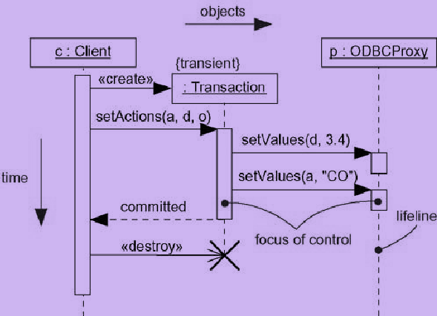
A Sequence Diagram

Slide 9
Creating and Deleting Participants
To create a participant
Draw the message arrow directly into the participant box
If the participant immediately does something once it's created, start an activation right after the participant box
To delete a participant
Deletion is indicated by big X
A message arrow going into the X indicates one participant explicitly deleting another
An X at the end of a lifeline shows a participant deleting itself

Slide 10
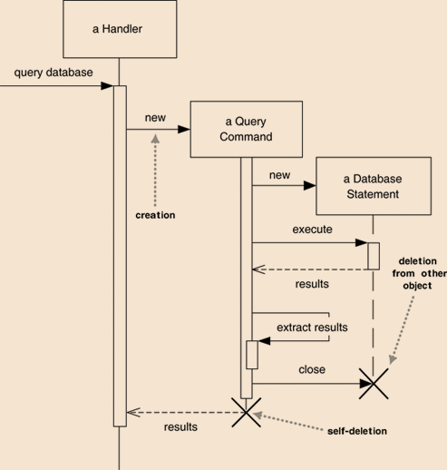
Creating and Deleting Participants

Slide 11
Summary
Interaction diagrams represent the dynamic view of a system
Interaction diagram is the collective name given to sequence diagrams and collaboration diagrams
A sequence diagram is an interaction diagram that emphasizes the time-ordering of messages

Slide 12
Summary
Elements
Objects and Actors
Lifelines
Packages
Alternative flows
Messages
Synchronous
Asynchronous
Return messages

