Slide 1
Lecture 09: Class Diagrams
CSC210A Software Development Fundamentals
B. Tech. 2017
Course Leader(s):
Ms.Sahana.P.Shankar
sahana.cs.et@msruas.ac.in
Ms. Supriya, M. S.
supriya.cs.et@msruas.ac.in

Slide 2
Lecture Objectives
At the end of this lecture, student will be able to
Identify the basic building blocks of UML Class diagram
Explain the concepts of object oriented design
Model the structure a software system with Class diagrams
Design the static perspective of given software system with object oriented approach
Notes:
2

Slide 3
Lecture Topics
Structural diagrams
Class diagram
Elements in Class diagram
Relationships in Class diagram

Slide 4
Structural Diagrams
The diagrams to visualize, specify, construct, and document the static aspects of the system
Static aspects of a house encompass walls, doors, windows, pipes, etc.
The UML includes four structural diagrams
Class diagram
Object diagram
Component diagram
Deployment diagram
This session introduces class diagrams

Slide 5
Class Diagram
Address the static design view of a system
Graphically, a class diagram is a collection of vertices and arcs
This view supports the functional requirements of the system
Majority of UML diagrams are class diagrams
A class diagram
Describes
The types of objects in the system
The various kinds of static relationships that exist among them
Shows
The properties and operations of a class
The constraints that apply to the way objects are connected

Slide 6
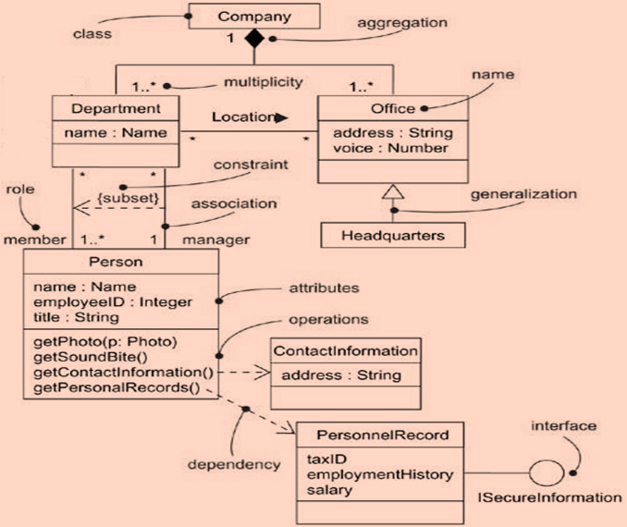
A Class Diagram

Slide 7
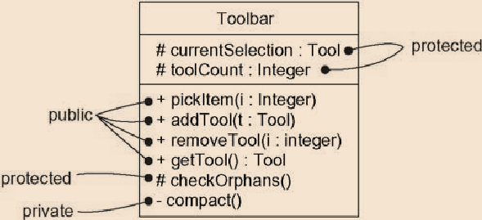
Visibility
The visibility of a feature specifies whether it can be used by other classifiers (classes, interfaces, data types, signals, components, nodes, Use Cases, and subsystems)
In the UML, three levels of visibility
Public +
Any outside classifier with visibility to
the given classifier can use the feature
Protected #
Any descendant of the classifier can
use the feature
Private -
Only the classifier itself can use the
feature

Slide 8
Summary
Class diagram address the static design view of a system
A class diagram describes
The types of objects in the system
The various kinds of static relationships that exist among them
A class diagram describes
The properties and operations of a class
The constraints that apply to the way objects are connected
A class diagram is made up of
Classes
Interfaces
Packages

Slide 9
Summary
Relationships between classes can be
Association : Relationship between peers
Generalization: Reverse of inheritance
Dependency: Usage of one class object in another class functions
Realization: Classes realize interfaces
Composition: Set of objects make up a class
Aggregation: A collection of things that are not mandatory

