Slide 1
Lecture 10: State Chart Diagrams
CSC210A Software Development Fundamentals
B. Tech. 2017
Course Leader(s):
Ms.Sahana.P.Shankar
sahana.cs.et@msruas.ac.in
Ms. Supriya, M. S.
supriya.cs.et@msruas.ac.in

Slide 2
Lecture Objectives
At the end of this lecture, student will be able to
Identify the basic building blocks of UML State diagrams
Explain the concepts of object oriented design
Model the behavior of objects in a software system with State diagrams
Design the behavior of objects in a given software system with object oriented approach
Notes:
2

Slide 3
Lecture Topics
State diagrams
State chart diagram
State machine and transitions
Activity diagram
Interaction overview diagrams
Elements in State diagram
Relationships in State diagram

Slide 4
State-chart Diagram
State-chart diagrams address the dynamic view of a system
A state-chart diagram shows a state machine, consisting of
States
Transitions
Events
Activities
They used to model the behavior of an interface, class or collaboration
In object-oriented approaches, you draw a state machine diagram for a single class to show the lifetime behavior of a single object

Slide 5
State-chart Diagram
State diagrams are good at
Describing the behavior of an object across several use cases
State diagrams are not very good at
Describing behavior that involves a number of objects collaborating
A State machine
A behavior that specifies the sequences of states an object goes through during its lifetime in response to events, together with its responses to those events

Slide 6
State Machine
A state
Condition or situation during the life of an object during which it satisfies some condition, performs some activity, or waits for some event
An event
The specification of a significant occurrence that has a location in time and space
An action
Executable atomic computation that results in a change in state of the model or the return of a value
Transition
Indicates a movement from one state to another

Slide 7
Transition
Each transition has a label that comes in three parts
trigger-signature [guard]/activity
The trigger-signature
A single event that triggers a potential change of state
The guard
If present, is a Boolean condition that must be true for the transition to be taken
The activity
Some behavior that's executed during the transition
It may be any behavioral expression

Slide 8
Transition
All three parts to a transition are optional
A missing activity indicates that you don't do anything during the transition
A missing guard indicates that you always take the transition if the event occurs
A missing trigger-signature is rare but does occur. It indicates that you take the transition immediately, which you see mostly with activity states

Slide 9
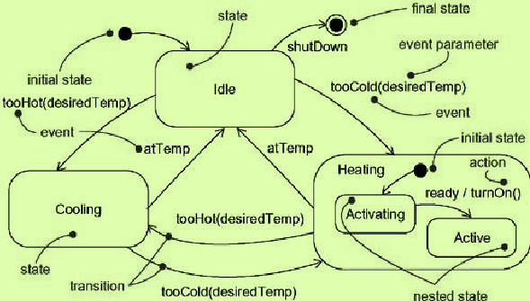
State Machine
Graphically
A state is rendered as a rectangle with rounded corners
A transition is rendered as a solid directed line

Slide 10
State Machine Diagrams
The final state indicates that the state machine is completed, implying the deletion of the controller object
When an event occurs in a state,
You can take only one transition out of it
If you use multiple transitions with the same event
The guards must be mutually exclusive
If an event occurs and no transition is valid
The event is ignored

Slide 11
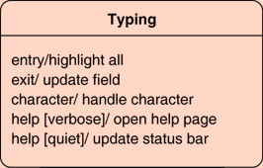
Internal Activities
Internal activities
To react to events without transition in states
Putting the event, guard, and activity inside the state box itself
An internal activity is similar to a self-transition: a transition that loops back to the same state

Slide 12
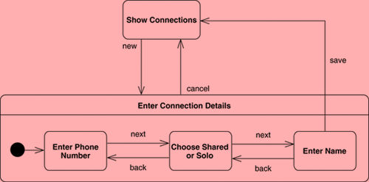
Super-states
Make Several states that share common transitions and internal activities as sub-states and move the shared behavior into a super-state

Slide 13
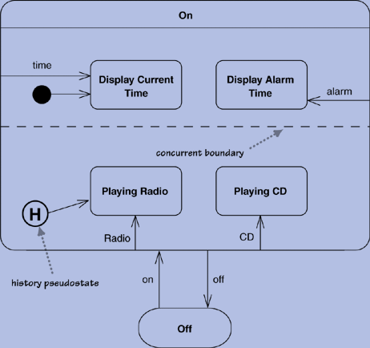
Concurrent States
States can be broken into several orthogonal state diagrams that run concurrently
Figure shows a pathetically simple
alarm clock that can play either
CDs or the radio and show either
the current time or the alarm time
The choices CD/radio and
current/alarm time are orthogonal
choices

Slide 14
Activity Diagram
Address the dynamic view of a system
An activity diagram is a special kind of a state-chart diagram
It shows the flow from activity to activity within a system
Activity diagrams
Are used in modelling the function of a system
Emphasize the flow of control among objects
Collection of vertices and arcs
A technique to describe procedural logic, business process, and work flow
They support parallel behavior (unlike flowcharts)

Slide 15
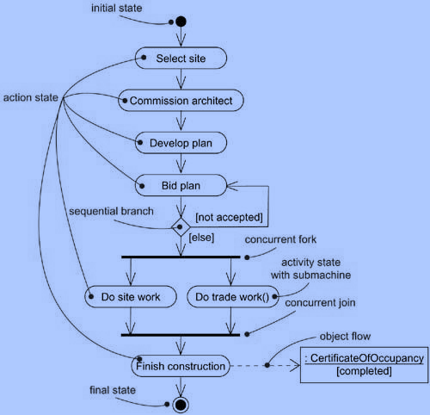
Activity Diagram

Slide 16
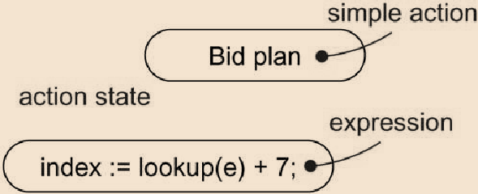
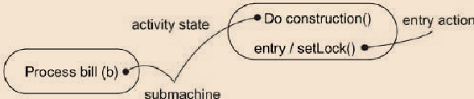
Activity Diagram
Activity diagrams commonly contain
Action states
Executable atomic computations
They can not be further decomposed
The nodes on an activity diagram
Activity states
Can be further decomposed
Their activity can be represented by other activity diagrams

Slide 17
Activity Diagram
Transitions
To specify the flow of control from one action/activity state to the next action/activity state
Represented as a simple directed line
Objects
Objects may be involved in the flow of control associated with an activity diagram

Slide 18
Activity Diagrams
Fork
A fork has one incoming flow and several outgoing concurrent flows
Join
With a join, the outgoing flow is taken only when all the incoming flows reach the join
Decision
A decision, called branch in UML 1, has a single incoming flow and several guarded out-bound flows

Slide 19
Activity Diagrams
Guard
Each outbound flow has a guard
A Boolean condition placed inside square brackets
Each time you reach a decision, you can take only one of the outbound flows, so the guards should be mutually exclusive
Merge
A merge has multiple input flows and a single output
A merge marks the end of conditional behavior started by a decision

Slide 20
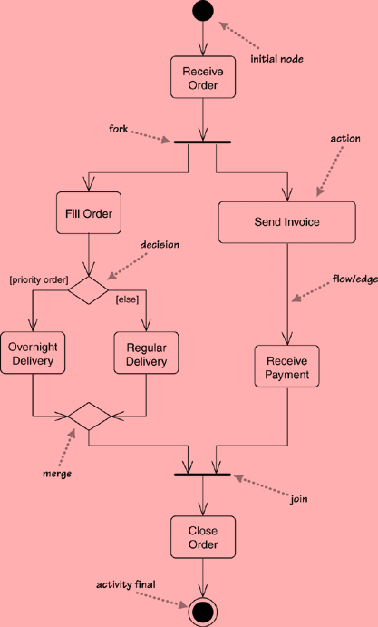
A Simple Activity Diagram

Slide 21
Tokens
The initial node creates a token, which then passes to the next action, which executes and then passes the token to the next
At a fork
One token comes in, and the fork produces a token on each of its outward flows
On a join
As each inbound token arrives, nothing happens until all the tokens appear at the join; then a token is produced on the outward flow

Slide 22
Interaction Overview Diagrams
Interaction overview diagrams
A grafting together of activity diagrams and sequence diagrams
They are either
Activity diagrams in which the activities are replaced by little sequence diagrams
A sequence diagram broken up with activity diagram notation used to show control flow
These are new for UML 2

Slide 23
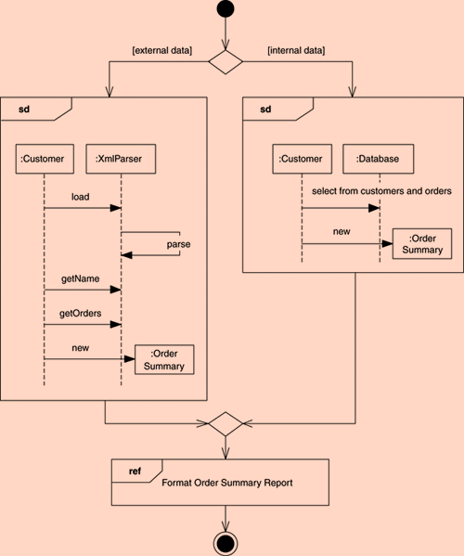
Interaction Overview Diagrams

Slide 24
Summary
State diagrams are good at describing the behavior of an object across several use cases
State diagrams are not very good at describing behavior that involves a number of objects collaborating
A State machine specifies the sequences of states an object goes through during its lifetime in response to events, together with its responses to those events
A state-chart diagram shows a state machine, consisting of
States
Transitions
Events
Activities

