Slide 1
Machine Learning Applications in Cancer Diagnosis
Department of Computer Science and Engineering
CSC405A: Seminar
Name: S Sadhana and Sahil Salim
Reg No:18ETCS002102 and 18ETCS002104

Slide 2
Outline
Introduction
Motivation for choosing the Topic
Methodology of Cancer Diagnosis
Machine Learning Models and Techniques
Evaluation Metrices
Student’s opinion/perspective
Relevance to society
Conclusions
References

Slide 3
Introduction
Cancer is a fatal illness often caused by genetic disorder aggregation and a variety of pathological changes. Cancerous cells are abnormal areas often growing in any part of human body that are life-threatening.
Machine learning is a branch of artificial intelligence that employs a variety of statistical, probabilistic and optimization techniques that allows computers to “learn” from past examples and to detect hard-to-discern patterns from large, noisy or complex data sets. This capability is particularly well-suited to medical applications, especially those that depend on complex proteomic and genomic measurements. As a result, machine learning is frequently used in cancer diagnosis and detection.

Slide 4
Motivation
Early detection of cancer is the top priority for saving the lives of many. Typically, visual examination and manual techniques are used for cancer diagnosis. This manual interpretation of medical images demands high time consumption and is highly prone to mistakes.
For this reason, computer-aided diagnosis (CAD) systems were brought to assist doctors to improve the efficiency of medical image interpretation. Feature extraction is the key step to adopt machine learning.
Deep learning has the advantage of generating directly from raw images the high-level feature representation. In addition to deep learning, Graphics Processing Units (GPU)are also being used in parallel, for feature extraction and image recognition.

Slide 5
Methodology of Cancer Diagnosis
Pre-Processing:
Improving the quality of an image to be used further by the removal of unwanted image information (noise).
Several inaccuracies may occur in the classification if this issue is not entertained properly
low contrast among skin lesion and surrounding healthy skin, irregular,border and the skin artifacts, which are hairs, skin lines, and black frames
The right combination of pre-processing tasks gives more accuracy.

Slide 6
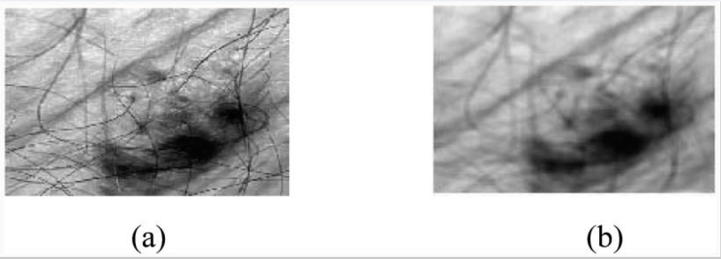
Methodology of Cancer Diagnosis
Techniques used in Pre-Processing
Median Filtering
Fig1.1 Median filtering: (a) original image, (b) result after median filtering.

Slide 7
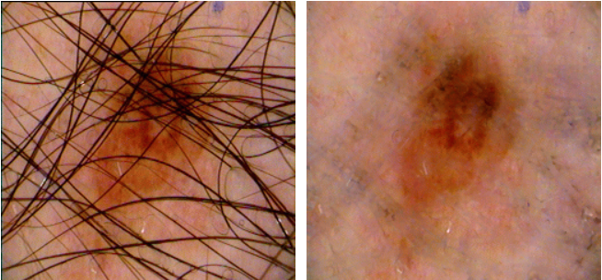
Methodology of Cancer Diagnosis
DullRazor technique for thick hair removal
The DullRazor algorithm is as follows:
It identifies the dark hair locations by a generalized grayscale morphological closing operation,
It verifies the shape of the hair pixels as thin and long structure, and replace the verified pixels by a bilinear interpolation, and
It smooths the replaced hair pixels with an adaptive median filter.
(a)
(b)
Fig1.2Hair removal by the DullRazor technique: (a) original image, (b) image after removal of hair.

Slide 8
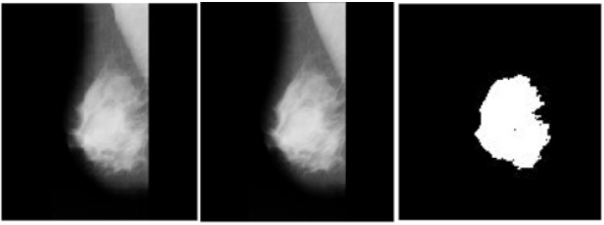
Methodology of Cancer Diagnosis
Segmentation
Segmentation is basically the separation of a region of interest (ROI) from the background of the image. ROI is the part of the image that we want to use.
(a) (b) (c)
Fig.1.3 (a) Original Image, (b) Preprocessed Image, (c) Segmented Image.

Slide 9
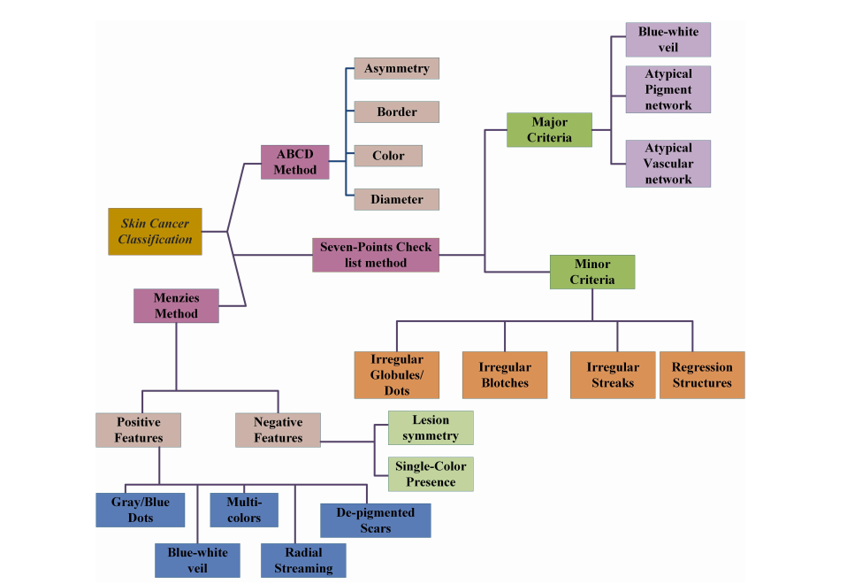
Methodology of Cancer Diagnosis
Classification
Fig 1.4 : Typically used classification methods

Slide 10
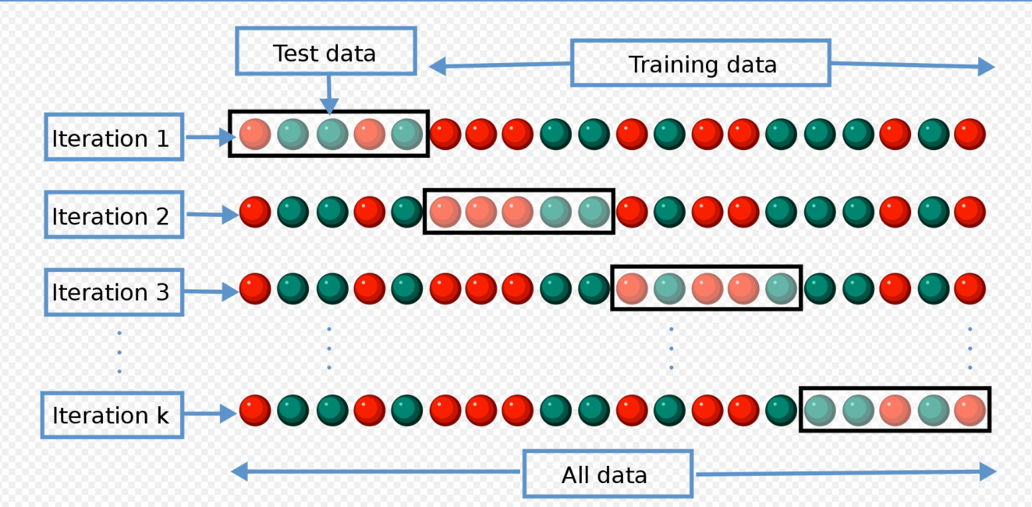
Machine Learning Techniques
Training and Testing Data
The training phase extracts the features from the dataset
Testing phase is used to determine how the appropriate model behaves for prediction.
Cross-validation is used for the avoidance of overﬁtting
Fig 1.5 K fold cross-validation

Slide 11
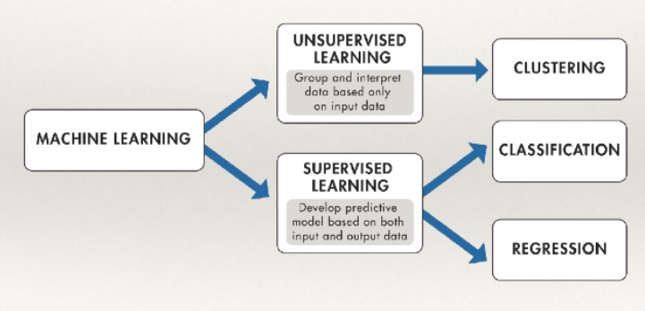
Machine Learning Techniques
Classification
Fig.1.6 Supervised vs Unsupervised Learning

Slide 12
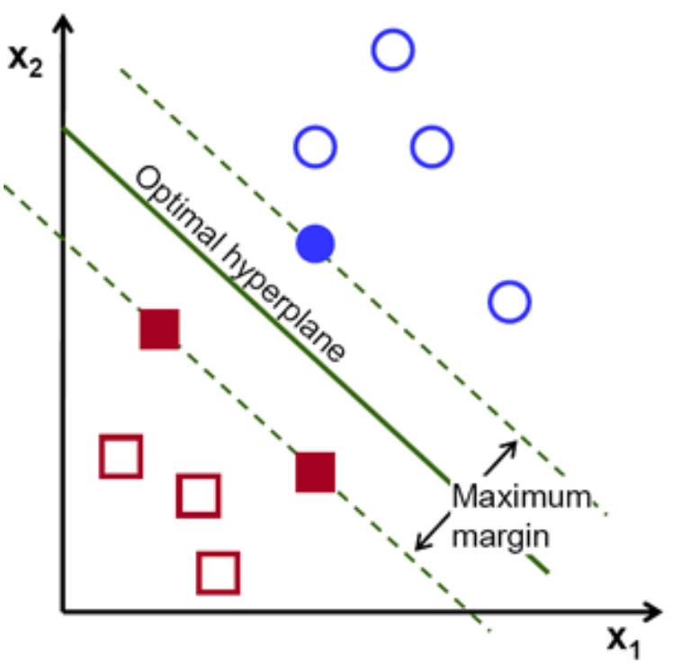
Machine Learning Models
Support Vector Algorithm:
Objective :To find a hyperplane in an N-dimensional space that distinctly classifies the data points.
The dataset categories cannot be divided using hyperplane, so feature space has to be enlarged using Gaussian radial basis function (RBF) or even higher order poly-nomial function.
Fig.1.7 Hyperplane

Slide 13
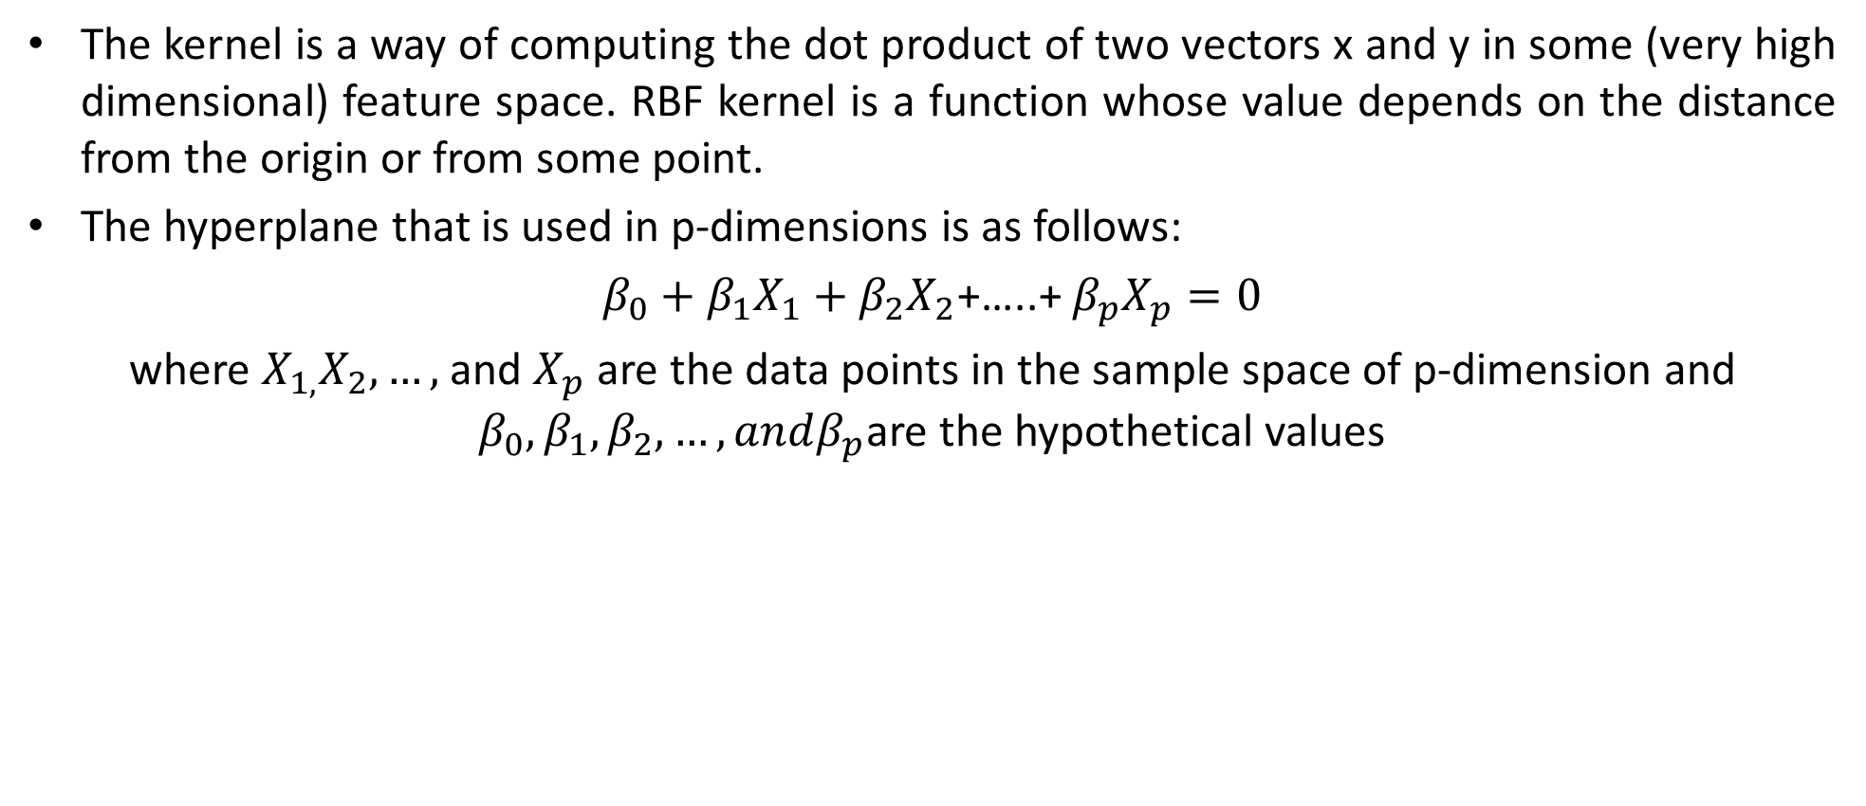
Machine Learning Models
The kernel is a way of computing the dot product of two vectors x and y in some (very high dimensional) feature space. RBF kernel is a function whose value depends on the distance from the origin or from some point.
The hyperplane that is used in p-dimensions is as follows:
$β_{0}+β_{1}X_{1}+β_{2}X_{2}$+…..+ $β_{p}X_{p}=0$
where $X_{1,}X_{2},…,$and $X_{p}$ are the data points in the sample space of p-dimension and $β_{0},β_{1},β_{2},…, andβ_{p}$are the hypothetical values

Slide 14
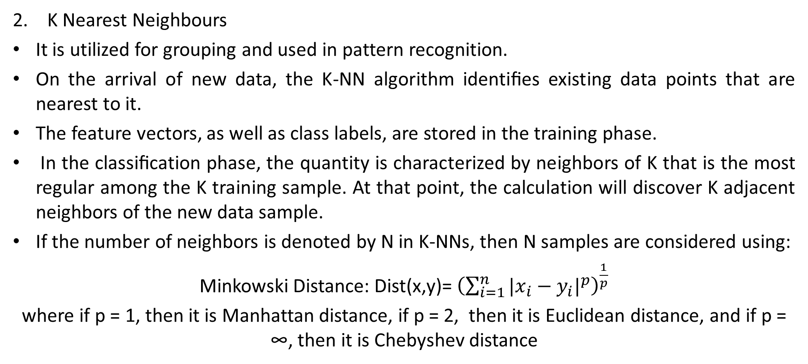
Machine Learning Models
K Nearest Neighbours
It is utilized for grouping and used in pattern recognition.
On the arrival of new data, the K-NN algorithm identiﬁes existing data points that are nearest to it.
The feature vectors, as well as class labels, are stored in the training phase.
In the classiﬁcation phase, the quantity is characterized by neighbors of K that is the most regular among the K training sample. At that point, the calculation will discover K adjacent neighbors of the new data sample.
If the number of neighbors is denoted by N in K-NNs, then N samples are considered using:
Minkowski Distance: Dist(x,y)= ${\left(\sum_{i=1}^{n}{|{x_{i}−y_{i}|}^{p}}\right)}^{\frac{1}{p}}$
where if p = 1, then it is Manhattan distance, if p = 2, then it is Euclidean distance, and if p = ∞, then it is Chebyshev distance

Slide 15
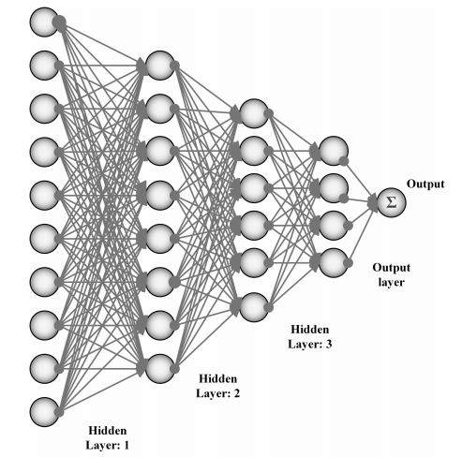
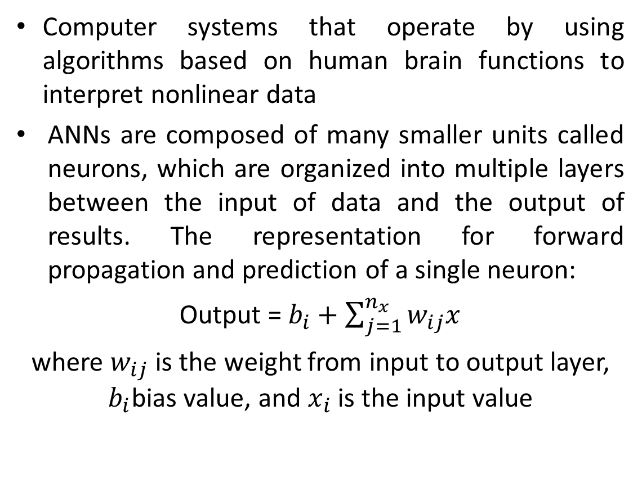
Machine Learning Models
Artificial Neural Networks
Computer systems that operate by using algorithms based on human brain functions to interpret nonlinear data
ANNs are composed of many smaller units called neurons, which are organized into multiple layers between the input of data and the output of results. The representation for forward propagation and prediction of a single neuron:
Output = $b_{i}+\sum_{j=1}^{n_{x}}{w_{ij}x}$
where $w_{ij}$ is the weight from input to output layer, $b_{i}$bias value, and $x_{i}$ is the input value
Fig .1.8 Artificial Neural Network

Slide 16
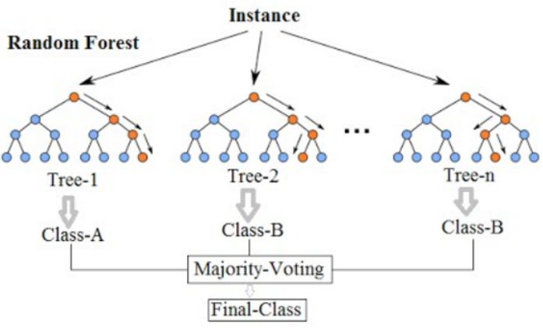
Machine Learning Models
Random Forests
RF generates a forest of classiﬁcation trees from a given data-set, rather than a single classiﬁcation tree
The workﬂow of random forest is given below.
From the training set, picked K data points randomly.
From these K data points, generate the decision trees.
From generate trees, choose the number of N-tree and repeat steps (i) and (ii).
Form the N-tree that predicts the category to which the data points relate for a new data point, and assign the new data point via the category with the highest probability.
Fig.1.9 Random Forest

Slide 17
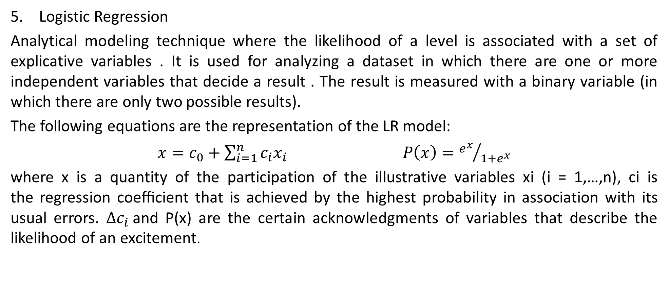
Machine Learning Models
Logistic Regression
Analytical modeling technique where the likelihood of a level is associated with a set of explicative variables . It is used for analyzing a dataset in which there are one or more independent variables that decide a result . The result is measured with a binary variable (in which there are only two possible results).
The following equations are the representation of the LR model:
$x=c_{0}+\sum_{i=1}^{n}{c_{i}x_{i}}$ $P\left(x\right)={e^{x}}/{{1+e}^{x}}$
where x is a quantity of the participation of the illustrative variables xi (i = 1,…,n), ci is the regression coeﬃcient that is achieved by the highest probability in association with its usual errors. ${∆c}_{i}$and P(x) are the certain acknowledgments of variables that describe the likelihood of an excitement.

Slide 18
Evaluation Metrics
An evaluation metric quantifies the performance of a predictive model. For classification problems, metrics involve comparing the expected class label to the predicted class label or interpreting the predicted probabilities for the class labels for the problem.
True positive (TP) is the correct classification of the positive class
True negative (TN) is the correct classification of the negative class
False positive (FP) is the incorrect prediction of the positives
False negative (FN) is the incorrect prediction of the negatives

Slide 19
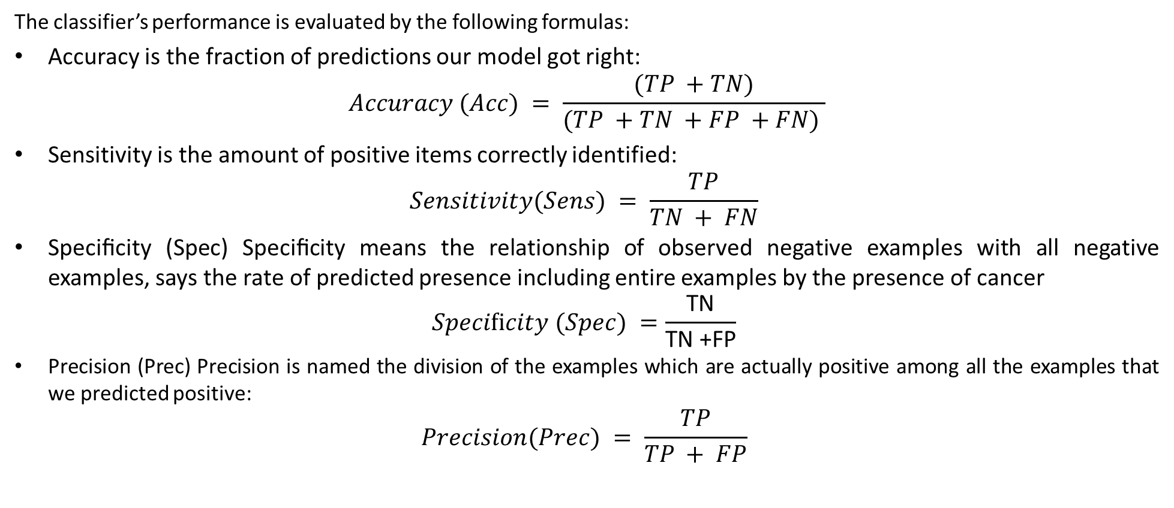
Evaluation Metrics
The classifier’s performance is evaluated by the following formulas:
Accuracy is the fraction of predictions our model got right:
$$Accuracy (Acc) = \frac{(TP +TN)}{(TP +TN +FP +FN) }$$
Sensitivity is the amount of positive items correctly identified:
$$Sensitivity(Sens) = \frac{TP}{TN + FN}$$
Speciﬁcity (Spec) Speciﬁcity means the relationship of observed negative examples with all negative examples, says the rate of predicted presence including entire examples by the presence of cancer
$$Speciﬁcity (Spec) =\frac{\text{TN}}{\text{TN} \text{+}\text{FP}}$$
Precision (Prec) Precision is named the division of the examples which are actually positive among all the examples that we predicted positive:
$$Precision(Prec) = \frac{TP}{TP + FP}$$

Slide 20
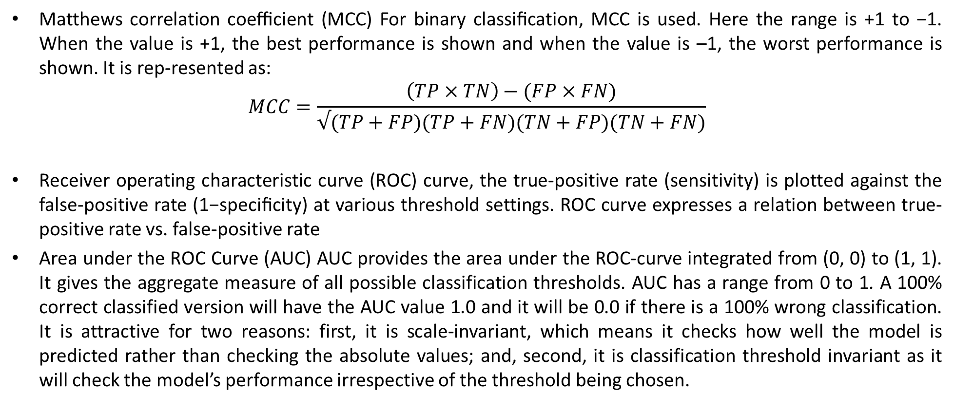
Matthews correlation coeﬃcient (MCC) For binary classiﬁcation, MCC is used. Here the range is +1 to −1. When the value is +1, the best performance is shown and when the value is –1, the worst performance is shown. It is rep-resented as:
$$MCC=\frac{\left(TP×TN\right)−(FP×FN)}{√(TP+FP)(TP+FN)(TN+FP)(TN+FN)}$$
Receiver operating characteristic curve (ROC) curve, the true-positive rate (sensitivity) is plotted against the false-positive rate (1−speciﬁcity) at various threshold settings. ROC curve expresses a relation between true-positive rate vs. false-positive rate
Area under the ROC Curve (AUC) AUC provides the area under the ROC-curve integrated from (0, 0) to (1, 1). It gives the aggregate measure of all possible classification thresholds. AUC has a range from 0 to 1. A 100% correct classified version will have the AUC value 1.0 and it will be 0.0 if there is a 100% wrong classification. It is attractive for two reasons: first, it is scale-invariant, which means it checks how well the model is predicted rather than checking the absolute values; and, second, it is classification threshold invariant as it will check the model’s performance irrespective of the threshold being chosen.

Slide 21
Student’s opinion/perspective
Machine learning methods generally improve the performance or predictive accuracy of most diagnoses, especially when compared to conventional statistical or expert-based systems.
Most studies are generally well constructed and reasonably well validated, certainly greater
attention to experimental design and implementation appears to be warranted, especially
with respect to the quantity and quality of biological data.
Overall, I believe that if the quality of studies continues to improve, it is likely that the use of machine learning classifier will become much more commonplace in many clinical and hospital settings.

Slide 22
Motivation to Society
The early diagnosis of cancer can improve the prognosis and chance of survival significantly, as it can promote timely clinical treatment to patients. Further accurate classification of benign tumors can prevent patients undergoing unnecessary treatments. Thus, the correct diagnosis of cancer and classification of patients into malignant or benign groups is an important research domain.
Modern machine learning algorithms serve as powerful tools to improve medical practice by reducing human labor and possible errors. They can potentially improve a patient’s diagnosis and treatment precision by complementing human perception.
Machine Learning is expected to allow efficient utilization of resources and to save time and unnecessary medical expenses to patients, their doctors and the society at large.

Slide 23
Conclusion
The basic features and working principle of each of the ﬁve common machine learning techniques were illustrated.
Machine learning technique can act as a clinical assistant for the diagnosis of breast cancer will be very helpful for new doctors or physicians in case of misdiagnosis.
One of the major challenges of implementing machine learning is the a lack of availability of datasets. Every learning algorithm requires a large amount of training for accurate results to be measured.
The developed model by ANNs is more consistent than any other technique stated , this could be due to the fact that ANNs can consider outliers and nonlinear interactions among variables. The ANN model includes parameters that are important at the individual level, even if they are not significant in the overall population.ANNs have an excellent aptitude for learning the relationship between the input/output mapping from a given dataset without any prior information or assumptions about the statistical distribution of the data.

Slide 24
References
[1] Munir, Khushboo; Elahi, Hassan; Ayub, Afsheen; Frezza, Fabrizio; Rizzi, Antonello. 2019. "Cancer Diagnosis Using Deep Learning: A Bibliographic Review" Cancers 11, no. 9: 1235.
[2] Islam, Md & Haque, Md & Iqbal, Hasib & Hasan, Md & Hasan, Mahmudul & Kabir, Muhammad Nomani. (2020). Breast Cancer Prediction: A Comparative Study Using Machine Learning Techniques. SN Computer Science. 1. 290. 10.1007/s42979-020-00305-w.

