Slide 1

Python for Data Science
19CSE432: Lecture 1
B. Tech. 2021
Course Leader:
Dr. Yatish Bathla
yatishbathla@outlook.com
Dr. Mohan Kumar
mohan.cs.et@msruas.ac.in

Slide 2
Course Objectives
At the end of this course, student will be able to understand
Core concepts of python: objects, functions, Review of syntax and core constructs, standard library, external libraries, Edit-Compile-Run
Python for data science: building data science tasks and workflows, Core and advanced collections, Operations, Comprehensions, Namespaces and scopes, Generators, Exception handling, Filesystem and OS interface, Data modelling, processing (pandas), data analysis (NumPy), debugging, and testing code (IPython), Interactive visualisations (matplotlib), SciPy, scikit-learn and statsmodels
Parallel programming: CPU bound threads, GIL bottleneck and workarounds, Thread pooling, Inter Process Communication (IPC), Distributed computation, Asynchronous operations

Slide 3
Course Objectives
At the end of this course, student will be able to
Testing: Python Unit Testing module, Acceptance Testing of python software, Test Driven Development (TDD) and Behaviour Driven Development (BDD), Debugging and Python debugger
Advanced Python Programming: Functional Programming, zip and map, OO Programming, Class Factories and run time attributes, Abstract Base Classes (ABCs) and protocol declaration

Slide 4
Course Structure
Course is divided as follow:
Theory and Explanation: Tuesday and Thrusday (3 Lectures)
Coding and Demonstration: Monday (2 Lectures)

Slide 5
Course Evaluation
Evaluation of Student performance is done by:
Assignment: 25%
MidTerm Exam: 25%
Final Exam: 50%

Slide 6
Lecture Objectives
At the end of this lecture, student will be able to understand
Overview of Python, advantages and application
Comparision with other programming language
Basic concepts of Python language
Execution of program

Slide 7
Topics
What is Python
Some Python Applications
Comparision with Other Programming language
Python Basics
Standard and External Libraries
Zen of Python
Edit, Compile and Run

Slide 8
What is Python?
Uncomplicated and robust programming language that delivers both the power and complexity of traditional compiled languages along with the ease-of-use of simpler scripting and interpreted languages.
Some of the features are: High-level, Object-oriented, Scalable, Extensible, Portable, Easy-to-learn, Easy-to-read, Easy-to-maintain, Robust, Effective as a Rapid Prototyping Tool, Memory Manager, Interpreted and (Byte-) Compiled

Slide 9
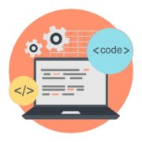

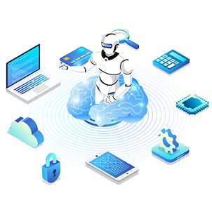

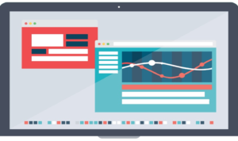
Some Python Applications
Web Development
Game Development
Machine Learning and Artificial Intelligence
Data Science and Data Visualization
Desktop GUI

Slide 10
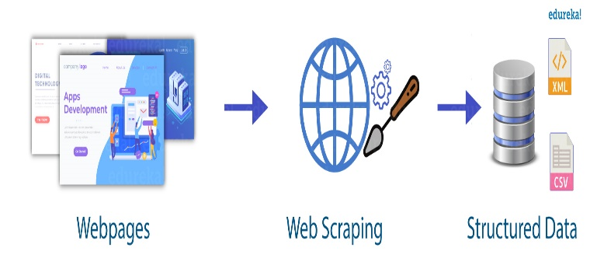

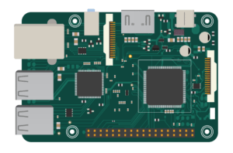

Some Python Applications
Web Scraping Applications
Business Applications
CAD Applications
Embedded Applications
Audio and Video Applications

Slide 11
Comparison with Other Programming language
Java
Python programs are generally expected to run slower than Java programs, but they also take much less time to develop.
Javascript
Both supports a programming style that uses simple functions and variables without engaging in class definitions. But, Python supports writing much larger programs and reuse through object-oriented programming style.
C++
Python code is often 5-10 times shorter than equivalent C++ code

Slide 12
Comparison with Other Programming language
Perl
Perl emphasizes support for common application-oriented tasks while, Python emphasizes support for common programming methodologies
Tcl
Tcl, which traditionally stores all data as strings, is weak on data structures, and executes typical code much slower than Python
R
R programming is better suited for statistical learning, with unmatched libraries for data exploration and experimentation. Python is a better choice for machine learning and large-scale applications, especially for data analysis within web applications

Slide 13
Python Basics
Python primary( >>> ): interpreter let you know that it is expecting the next Python statement
Secondary ( … ) prompts: waiting for additional input to complete the current
hash/pound ( # ): sign signals that a comment begins right from the # and continues till the end of the line
Operators: Addition, subtraction, multiplication, division, an exponentiation operator, the double star/asterisk ( ** ) and modulus/remainder are all part of the standard set of operators.
Variables and Assignment: Rules for variables in python are the same. But, it is is case-sensitive and dynamically-typed

Slide 14
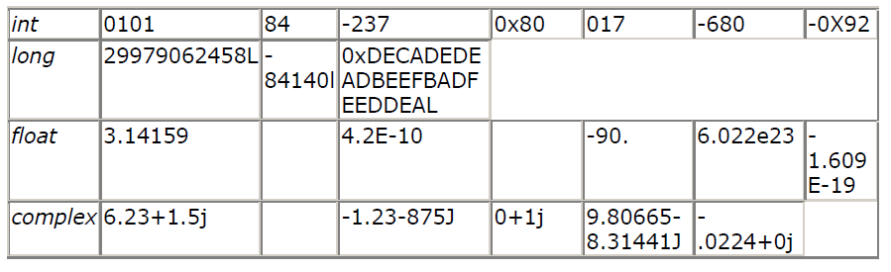
Python Basics
Numbers: int, long, float, complex
String: Allows for either pairs of single or double quotes. of strings can be taken using the slice operator ( [ ] and [ : ] )
Lists and tuples: generic "buckets" with which to hold an arbitrary number of arbitrary Python objects. Lists are enclosed in brackets and their elements and size can be changed, while tuples are enclosed in parentheses and cannot be updated

Slide 15
Python Basics
Dictionaries: Dictionaries are Python's hash table type. Keys can be almost any Python type, but are usually numbers or strings. Values, on the other hand, can be any arbitrary Python object.
conditional statement:
- If statement: standard if statement, else statement that is used with if, "else-if" statement named elif
- While statement: with every code sub-block, indentation (and dedentation) are used to delimit blocks of code
- for loop: Python's for statement act more like a traditional loop, in other words, a numerical counting loop.

Slide 16
Python Basics
Functions: Functions are called using the functional operator ( ( ) ), functions must be declared before they are used, and the function type is the type of the value returned.
Classes: container for static data members or function declarations, called a class's attributes. Functions which are part of classes are called methods.
Modules: logical way to physically organize and distinguish related pieces of Python code into individual files

Slide 17
Standard and External Libraries
Standard Libraries: collection of exact syntax, token, and semantics of Python. It comes bundled with core Python distribution. It contains well over 200 modules. for example, Data modelling, processing (pandas), data analysis (NumPy), debugging, and testing code (IPython), Interactive visualisations (matplotlib), SciPy, scikit-learn and statsmodels etc.
External Libraries: Modules provide additional functionality to the basic Python package, much like a new piece of equipment adds functionality to a lab space. For example Loguru, MonkeyType, etc

Slide 18
Zen of Python
collection of 19 "guiding principles" for writing computer programs that influence the design of the Python programming language.
Beautiful is better than ugly.
Explicit is better than implicit.
Simple is better than complex.
Complex is better than complicated.
Flat is better than nested.
Sparse is better than dense.
Readability counts.
Special cases aren't special enough to break the rules.
Although practicality beats purity.
Errors should never pass silently.
Unless explicitly silenced.
In the face of ambiguity, refuse the temptation to guess.
There should be one– and preferably only one –obvious way to do it.[a]
Although that way may not be obvious at first unless you're Dutch.
Now is better than never.
Although never is often better than right now.[b]
If the implementation is hard to explain, it's a bad idea.
If the implementation is easy to explain, it may be a good idea.
Namespaces are one honking great idea – let's do more of those!

Slide 19
Edit, Compile and Run
Download Python
Download IDE (for example Visual Studio Code) to run Python code
Edit, Compile and run Python code using IDE

Slide 20
Summary
Python is high-level, dynamically typed and interpreted.
Some of the Python Applications are Django, Flask, Pyramid, PyGame, Tkinter, Tryton, TimPlayer, Cplay, Fandango, Raspberry Pi
Some of the popular libaries for data sciences are Pandas, NumPy, Ipython, matplotlib

