Slide 1

Python for Data Science
19CSE432: Lecture 11
B. Tech. 2021
Course Leader:
Dr. Yatish Bathla
yatishbathla.cs.et@msruas.ac.in
Dr. Mohan Kumar
mohan.cs.et@msruas.ac.in

Slide 2
Lecture Objectives
At the end of this lecture, student will be able to understand
Coding part of Interactive Visualisations
Coding part of Data Processing and Visualization packages

Slide 3
Topics
Interactive Visualisations (IPython Basics, Matplotlib Integration and Pylab Mode, Interactive Debugger, Advanced IPython Features, IPython HTML notebooks, packages such as Bokeh)
Visualisation (A Brief matplotlib API Primer, Figures and Subplots, Colors, Markers, and Line Styles, Ticks, Labels, and Legends, Annotations and Drawing on a Subplot, Saving Plots to File, matplotlib Configuration)

Slide 4
IPython Basics
Anaconda: It is a distribution of the Python and R programming languages for scientific computing, that aims to simplify package management and deployment. The distribution includes data-science packages suitable for Windows, Linux, and macOS
Install Anaconda on Windows
https://www.youtube.com/watch?v=5mDYijMfSzs
Install Anaconda on Mac
https://www.youtube.com/watch?v=daVgEXjv6DE
Install Anaconda on Linux
https://www.youtube.com/watch?v=DY0DB_NwEu0

Slide 5
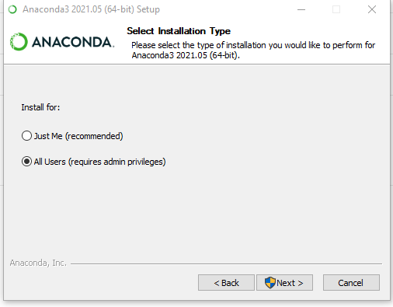
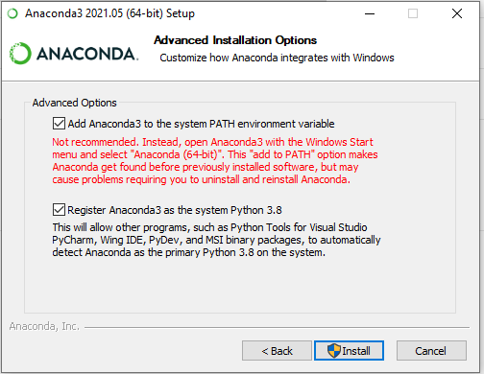
IPython Basics

Slide 6
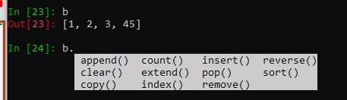
IPython Basics
Feature
C:\windows\system32>ipython
Initialize variable: a = 5
data = {i : 10 for i in range(7)}
Import a Library: from numpy.random import randn
data = {i : randn() for i in range(7)}
List: b = [1, 2, 3]
Tab completion: pressing <Tab> will search the namespace for any variables

Slide 7
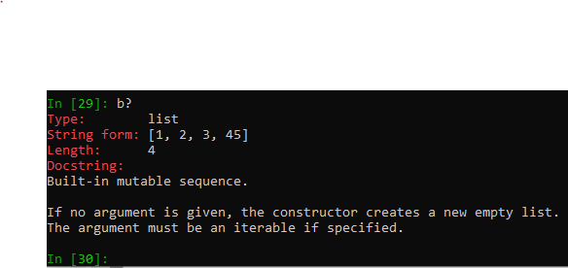
IPython Basics
import datetime
datetime.<Tab>
Introspection: b?
%run Command:
%run "C:\Users\ybathla\Desktop\Ipython\\ipython_testing.py"

Slide 8
IPython Basics
%run Command: %run ”File path \\filename”
%run "C:\Users\ybathla\Desktop\Ipython\\ipython_testing.py”
File Details:
def f(x, y, z):
return (x + y) / z
a = 5
b = 6
c = 7.5
result = f(a, b, c)
Verify results:
Type a,b,c or result

Slide 9
IPython Basics
Copy Paste Below Code leads to the IndentationError
x = 5
y = 7
if x > 5:
x += 1
y = 8
we should instead use the %cpaste magic functions

Slide 10
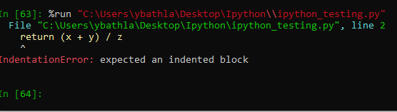
IPython Basics
Exceptions and Tracebacks
If an exception is raised while %run-ing a script or executing any statement, IPython will by default print a full call stack trace (traceback) with a few lines of context around the position at each point in the stack.

Slide 11
IPython Basics
Magic Commands
a = numpy.random.randn(100, 100)
matrix multiplication, using: %timeit numpy.dot(a, a)
%reset?: command line programs to be run within the IPython system.
Example:
a = 1
'a' in get_ipython().user_ns
%reset –f
'a' in get_ipython().user_ns

Slide 12
IPython Basics
Qt-based Rich GUI Console
ipython qtconsole --pylab=inline

Slide 13
IPython Basics
Matplotlib Integration and Pylab Mode
Ipython --pylab
import matplotlib.pyplot as plt
fig, ax = plt.subplots()

Slide 14
IPython Basics
Input and Output Variables
a="Hello Python"
_iX → X is the number where input is called, i is the input
_X → The output is being called
%hist : Magic command for History
%xdel a: Magic command to remove usage of a line
%logstart: Magic Command to start the log

Slide 15
IPython Basics
Interacting with the Operating System
!python → Enable shell
%bookmark db C:\windows\system32
cd db
%bookmark -l

Slide 16
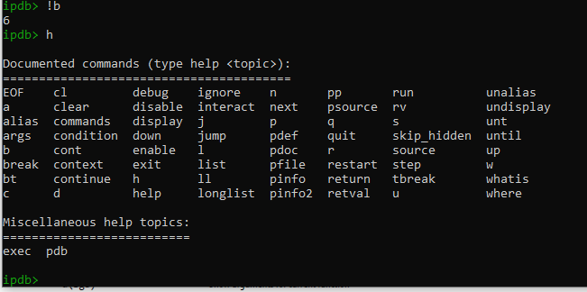
IPython Basics
Software Development Tools
Throws error: %run "C:\Users\ybathla\Desktop\Ipython\\testing_error.py”
Interactive Debugger:
Debug Mode: %debug

Slide 17
IPython Basics
IPython HTML Notebook
ipython notebook (Can be used but depreciated)
Or
jupyter notebook

Slide 18
IPython Basics
Advanced IPython Features
class Message:
def __init__(self, msg):
self.msg = msg
def __repr__(self):
return 'Message: %s' % self.msg
Type:
x = Message('I have a secret')

Slide 19
IPython Basics
Data visualization using Bokeh Package
pip install bokeh (Anaconda Terminal)
Scatter Plot
# import modules
from bokeh.plotting import figure, output_notebook, show
# output to notebook
output_notebook()
# create figure
p = figure(plot_width = 400, plot_height = 400)
# add a circle renderer with
# size, color and alpha
p.circle([1, 2, 3, 4, 5], [4, 7, 1, 6, 3],
size = 10, color = "navy", alpha = 0.5)
# show the results
show(p)

Slide 20
IPython Basics
Data visualization using Bokeh Package
Line Plot
# import modules
from bokeh.plotting import figure, output_notebook, show
# output to notebook
output_notebook()
# create figure
p = figure(plot_width = 400, plot_height = 400)
# add a line renderer
p.line([1, 2, 3, 4, 5], [3, 1, 2, 6, 5],
line_width = 2, color = "green")
# show the results
show(p)

Slide 21
IPython Basics
Data visualization using Bokeh Package
Bar Plot: : Use pandas.
Box Plot: Use pandas.
Histogram: Use pandas.
We will work later

Slide 22
matplotlib API Primer
import matplotlib.pyplot as plt
fig = plt.figure()
ax1 = fig.add_subplot(2, 2, 1)
ax2 = fig.add_subplot(2, 2, 2)
ax3 = fig.add_subplot(2, 2, 3)

Slide 23
matplotlib API Primer
import matplotlib.pyplot as plt
from numpy.random import randn
fig = plt.figure()
fig, axes = plt.subplots(2, 2, sharex=True, sharey=True)
for i in range(2):
for j in range(2):
axes[i, j].hist(randn(500), bins=50, color='k', alpha=0.5)
plt.subplots_adjust(wspace=0, hspace=0)

Slide 24
matplotlib API Basics
Figures and Subplots
accepts arrays of X and Y coordinates and optionally a string abbreviation indicating color and line style.
Any color on the spectrum can be used by specifying its RGB value (for example, '#CECE CE’).
Line plots can additionally have markers to highlight the actual data points.
For most kinds of plot decorations, there are two main ways to do things: using the procedural pyplot interface (which will be very familiar to MATLAB users) and the more object-oriented native matplotlib API.
Legends are another critical element for identifying plot elements.
In addition to the standard plot types, you may wish to draw your own plot annotations, which could consist of text, arrows, or other shapes.

Slide 25
Summary
Coding concepts of Interactive Visualization via IPython
Coding concepts of Viusalization and Data Processing via matplotlib API

