Slide 1

MindGrip AI
SO-101 Pick & Place · Binary Sort Lab
Curriculum & tooling overlay on Hugging Face LeRobot — assemble → calibrate → teleop → record → train ACT → deploy
Subhendu Datta Bhowmik · so101-lab · 2026

Slide 2
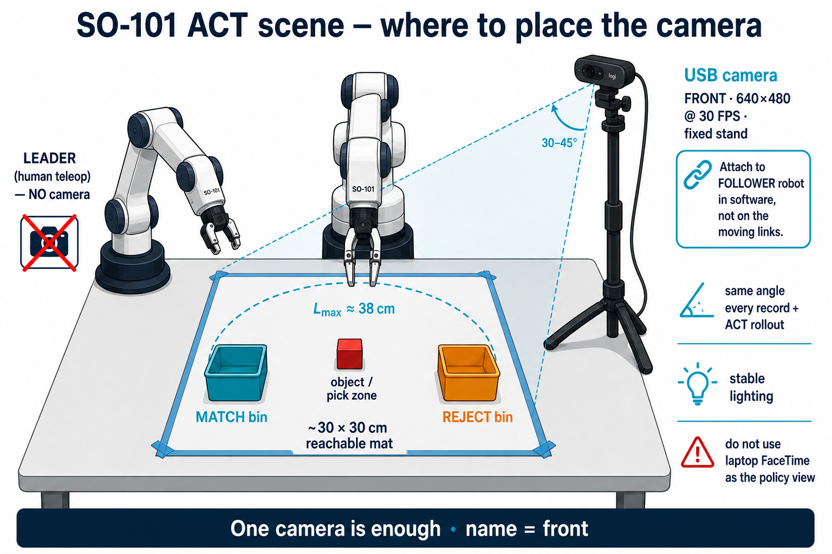
Problem & defined outcome
From docs · Project Description
• Teach an SO-101 dual-arm kit to sort objects from demonstration — not hand-coded paths
• Primary task: match-box objects → match-box bin; all other objects → reject bin
• Bridge teleop → dataset → ACT policy → real-robot evaluation
• Constraints: fragile 3D-printed parts, limited kit docs, need a vision + teleop pipeline
• Outcome: working binary sorter with reproducible LeLab / CLI workflow + dataset + checkpoint
MindGrip AI · so101-lab · © 2026 Subhendu Datta Bhowmik
2/10

Slide 3
Primary use case — binary sort
Same pipeline later extends to colour / shape
Match class
Reject class
Data plan
Policy
Match-box-like objects
→ match-box bin
All other objects
→ reject bin
~40–50 demos / class
~80–100 total episodes
ACT (Action Chunking
Transformer) — primary
MindGrip AI · so101-lab · © 2026 Subhendu Datta Bhowmik
3/10

Slide 4
End-to-end pipeline
MindGrip path on top of LeRobot
Assemble
→
Calibrate
→
Teleop
→
Record
→
Train ACT
→
Deploy
• Control host: laptop/desktop (8–16 GB) or Raspberry Pi for teleop, record, and rollout
• ACT training (Step 8) on cloud NVIDIA GPU / HF Jobs — not on the Air or Pi
• Prefer LeLab GUI after assembly; use ./so101_cli_menu.sh on Pi or for full control
MindGrip AI · so101-lab · © 2026 Subhendu Datta Bhowmik
4/10

Slide 5
Hardware — SO-101 dual arm
Leader (teleop) + follower (policy / camera)
• Leader: 5 V Feetech bus — human demonstration arm (id LeoArm)
• Follower: 12 V Feetech bus — executes teleop then ACT policy (id LeoArm)
• USB camera on follower only (OpenCV front · 640×480 @ 30 FPS)
• Fixed scene: ~30×30 cm mat, match + reject bins, consistent camera pose
• Calibrate both arms before teleop; save LeoArm.json under HF_LEROBOT_HOME
MindGrip AI · so101-lab · © 2026 Subhendu Datta Bhowmik
5/10

Slide 6
Software stack — so101-lab overlay
Vanilla LeRobot stays the core
Repo layout
Day-to-day tools
• lerobot/ — upstream core (sibling checkout)
• so101-lab/ — plugins, CLI, patches, docs only
• MuJoCo + keyboard teleop as optional plugins
• Optional UX patches (TTY keys, OBS cam, viz)
• LeLab — calibrate → teleop → record → train → deploy
• so101_cli_menu.sh — ports, cam, record, viz, train hooks
• Config: .so101_cli.env (menu C)
• Docs: docs-web SPA (roadmap, kinematics, CLI)
MindGrip AI · so101-lab · © 2026 Subhendu Datta Bhowmik
6/10

Slide 7
Roadmap — 9 steps
From zero hardware to autonomous sort
1
Install & host setup
2
Mechanical assembly
3
Motor mid-pose / IDs
4
Calibrate both arms
5
Teleop verify
6
Scene + camera
7
Record demos
8
Train ACT (cloud)
9
Rollout / evaluate
MindGrip AI · so101-lab · © 2026 Subhendu Datta Bhowmik
7/10

Slide 8
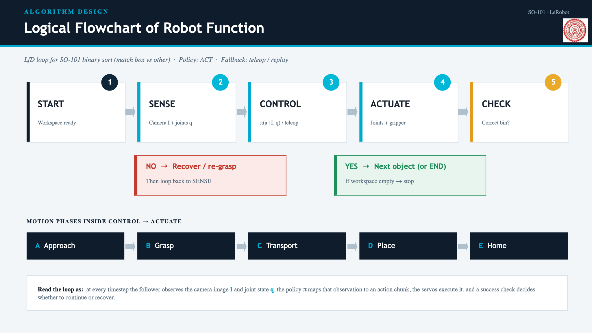
Data collection & ACT training
Steps 7–8
• Record with USB front camera + leader–follower teleop (CLI · 10 or LeLab)
• Each episode: joint state/action + images + timestamps + task string
• Visualize episodes (CLI · 11 / Rerun) and drop bad demos before train
• Train ACT on HF Jobs / cloud GPU — maps vision + state → action chunks
• Push dataset & checkpoint to Hugging Face Hub for reuse and eval
MindGrip AI · so101-lab · © 2026 Subhendu Datta Bhowmik
8/10

Slide 9
Deploy & success criteria
Step 9 · Sense → ACT → Actuate
• Roll out the trained policy on the follower with the same camera pose as recording
• Success: correct-bin placement for match vs reject classes on held-out scenes
• Deliverables: reproducible workflow, dataset, ACT checkpoint, and project docs
• Optional sim: MuJoCo viewer / leader→sim (CLI · 16–18) — not required for the sorter
• Control flow: camera + joints → ACT inference → follower motor commands
MindGrip AI · so101-lab · © 2026 Subhendu Datta Bhowmik
9/10

Slide 10
Resources & next steps
Start from the docs site
• Local docs: cd docs-web && npm run dev → http://localhost:8000/
• Key pages: Roadmap · Project · LeLab · CLI Menu · Policy Cheatsheet · Kinematics
• CLI: ./so101_cli_menu.sh · Configure with C · Record with 10 · Viz with 11
• LeRobot docs: https://huggingface.co/docs/lerobot · LeLab: /docs/lerobot/lelab
• Author: Subhendu Datta Bhowmik · https://subhdb.co.in
Finish the binary match-box sorter first — then reuse the same pipeline for colour / shape scenarios.
MindGrip AI · so101-lab · © 2026 Subhendu Datta Bhowmik
10/10

