Slide 1

Title Slide
Project Title: Smart Fertilizer & Pest Detection System
Team Name: [Saksham]
Hackathon: [Apratim Srajan Kumbh, 2025]
Members: [1. Aditya Chouksey
2. Atharv Barve
3. Darpan Naganpuriya
4. Subhi Tiwari
5. Yash Joshi]

Slide 2
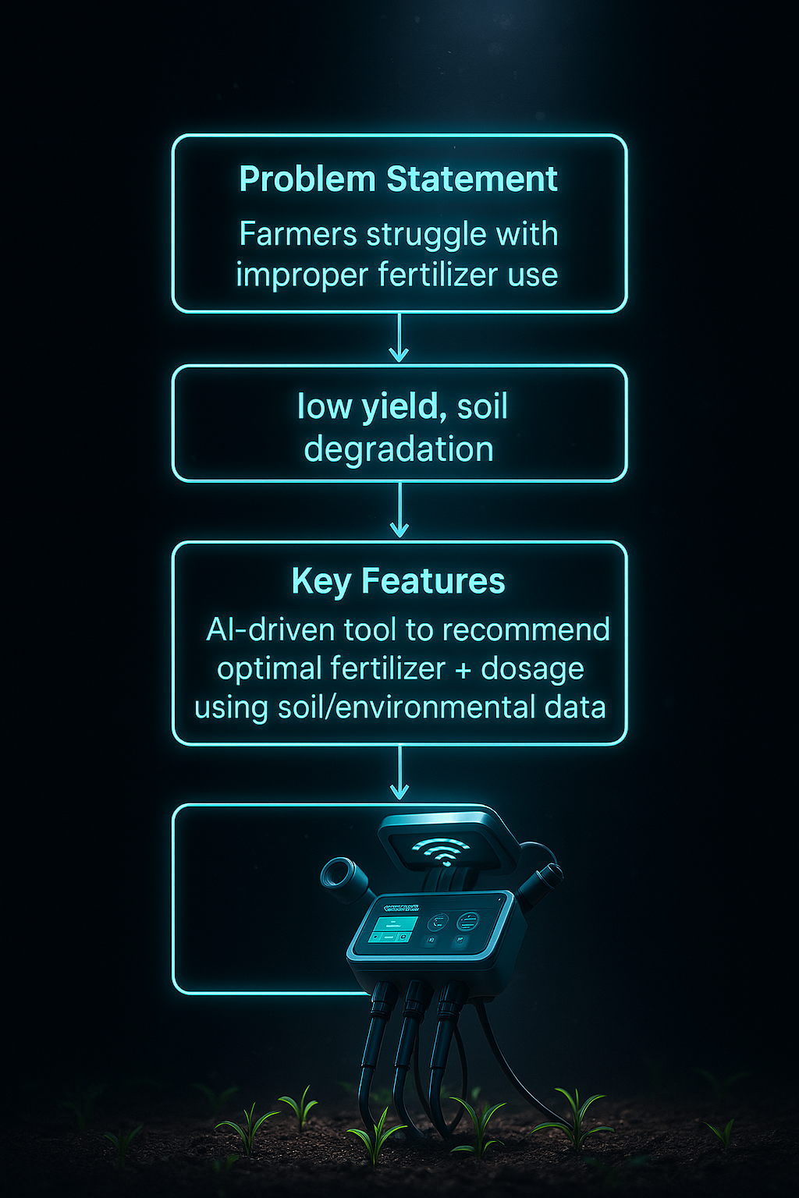

Slide 3
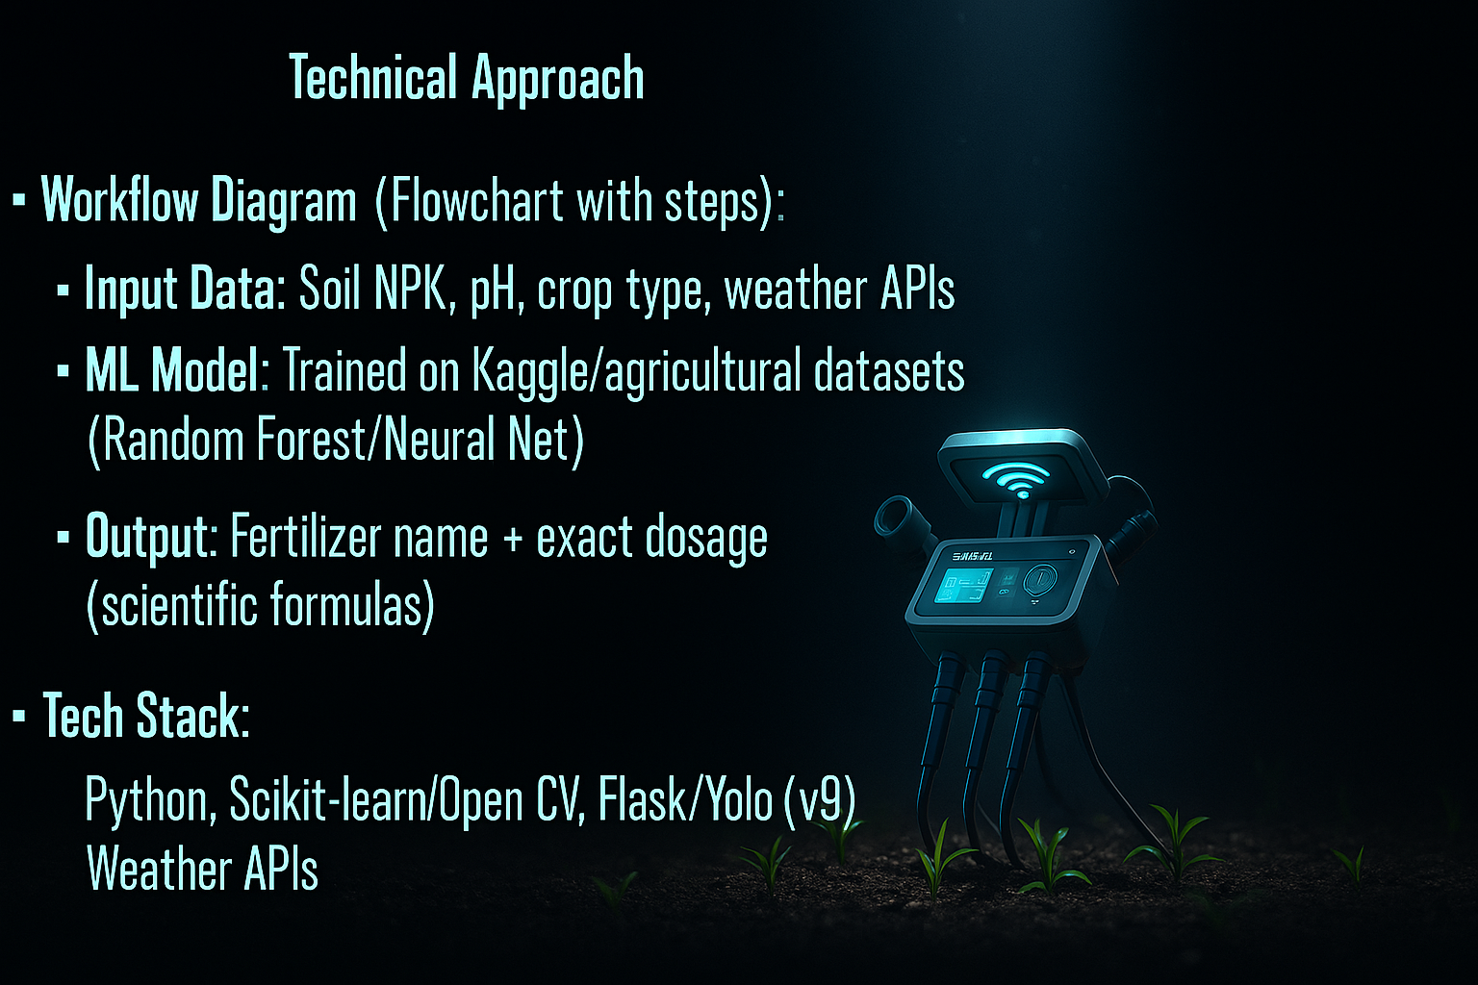

Slide 4

Feasibility & Viability
Feasibility:
  Uses existing datasets (Kaggle) and scalable APIs (weather data).
  Modular design for regional customization.
Viability:
  Low-cost: Farmers input data via mobile/web.
  ROI: Improves yield by 15-20% (based on research).

Slide 5
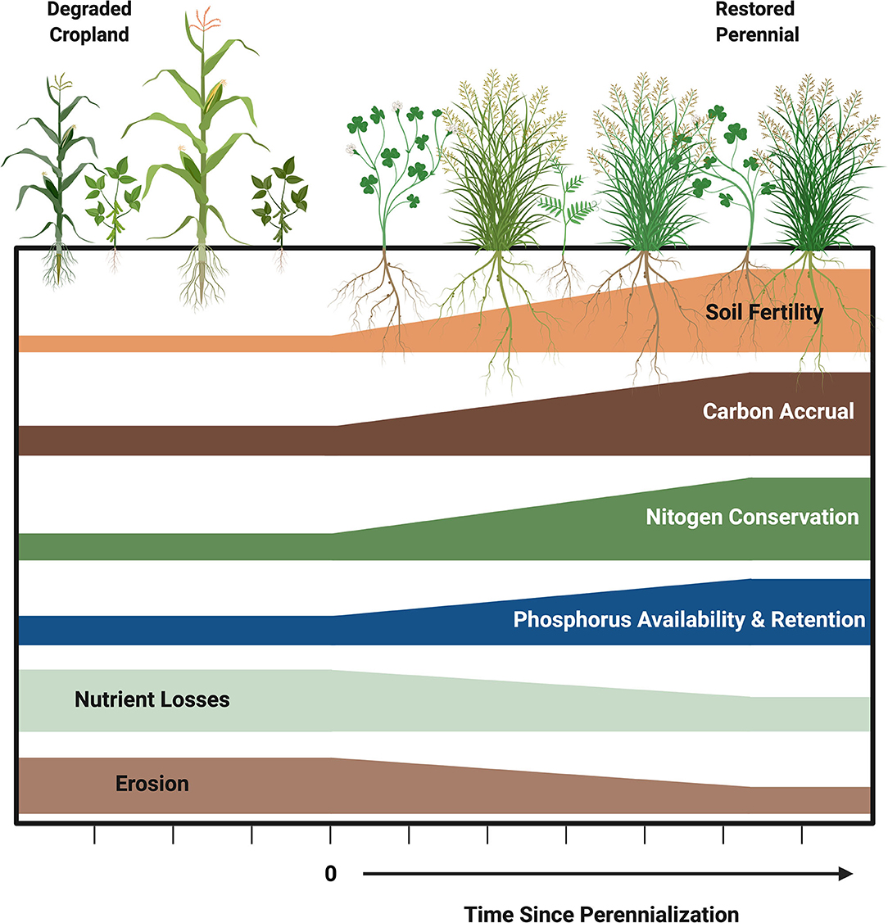
Impact & Benefits
Environmental: Reduces over-fertilization → prevents soil/water pollution.
Economic: Saves costs (+20% efficiency) for small farmers.
Social: Democratizes precision farming tech.
Stats:
  "60% Indian farms use excess urea" (reference FAO)

Slide 6
Research & References
Datasets: Kaggle soil NPK datasets,
Methods:
  Dosage formulas from "Fertilizer Recommendation Systems for Wheat Crops" (Journal of Agronomy, 2020).
Validation: Cross-checked with agricultural extension reports.

