Slide 1

Project Title: HYDROBLOOM
Branch / Year: CSE 3RD YEAR
Name 1/Enrollment number : SUBHI TIWARI / 0818CS231197
Name 2/Enrollment number : SHREYA LATHI / 0818CS231180
Name 3/Enrollment number : YATNESH PURANIK /0818CS231230
GUIDE - DR. RICHA GUPTA

Slide 2
PROBLEM STATEMENT
As urbanization increases and water resources decline, effective rooftop rainwater harvesting and artificial recharge planning becomes essential. However, several challenges hinder its adoption and optimization:
💧 Feasibility Confusion → Users lack instant tools to assess whether their rooftop is suitable for
rainwater harvesting.
📏 Inaccurate Capacity Estimation → Manual calculations lead to errors in storage sizing and system design.
⏱️ Time-Consuming Evaluation → Traditional assessment methods are slow and require technical expertise.
📉 Low Awareness & Adoption → Communities lack clear, data-driven insights to make informed water-conservation decisions.
🌍 Inefficient Groundwater Recharge → Absence of smart automation limits effective artificial recharge planning.

Slide 3
PROPOSED SOLUTION
🌧️ Smart Water Consultant App
A unified smart mobile & web platform that instantly evaluates Rooftop Rainwater Harvesting (RTRWH) and Artificial Recharge (AR) potential, enabling sustainable water management for homes and communities.
📲 Smart Access & Automation
  Seamless Input → Enter Location & Roof Size / Upload Rooftop Images
  AI-Powered Analysis → Computer Vision detects roof dimensions automatically
👥 Dual-Purpose Design
  For Users → Instant feasibility report, storage capacity, system sizing, clear action steps
  For Planners/Admins → Area-wise water potential mapping, adoption insights, planning support
✨ What Makes It Unique
✔ Converts complex technical guidelines into simple, actionable insights
✔ Location-specific recommendations with high accuracy
✔ Scalable, user-friendly UI/UX with regional language support

Slide 4
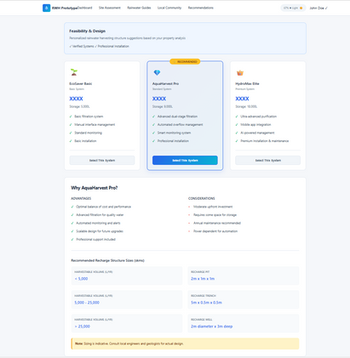
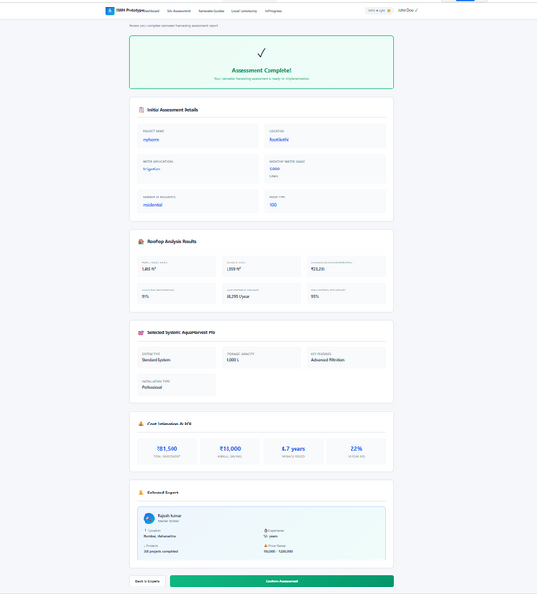
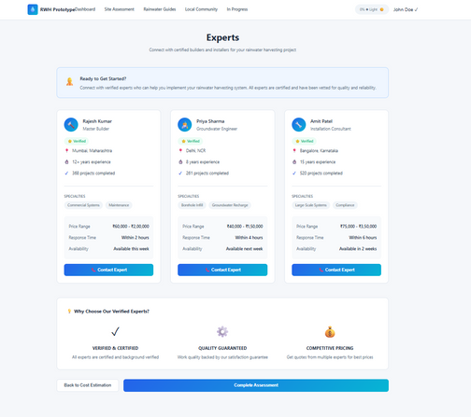
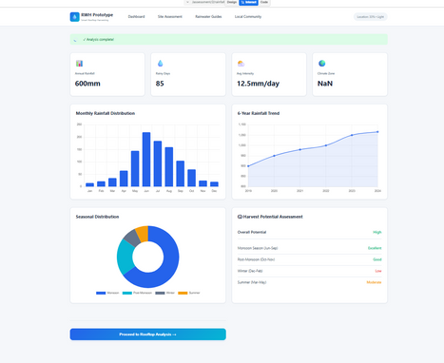
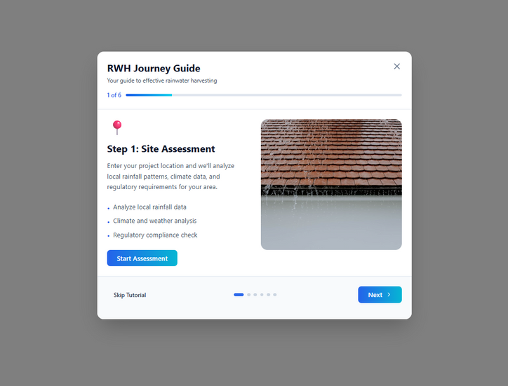
Prototype Demo Screenshots

Slide 5
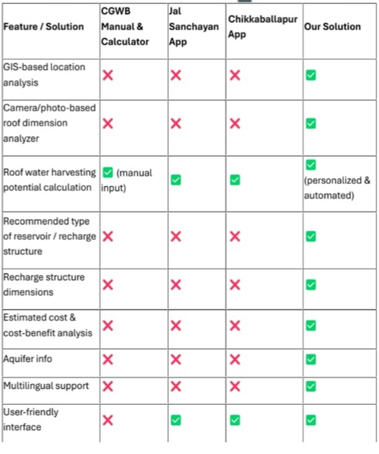
Existing Solution
1. CGWB Manual & Calculator → Rule-based, manual input driven, limited automation.
2. Jal Sanchalan Portal → Provides general guidance but lacks personalized, GIS-based evaluation.
📊 Analysis of Existing Solutions
Most current rooftop rainwater harvesting (RTRWH) assessment tools rely heavily on manual inputs, which reduces accuracy, efficiency, and user adoption.
⚠️ Key Limitations Identified
📐Manual Measurement Dependency → Users must physically measure roof dimensions and enter values, increasing chances of human error.
🌦️Generic Feasibility Estimates → Many tools ignore location-specific rainfall data and GIS-based mapping, resulting in unreliable or oversimplified results.
📄 Static & Complex Reports → Outputs are text-heavy, technical, and difficult for households to understand or implement.

Slide 6
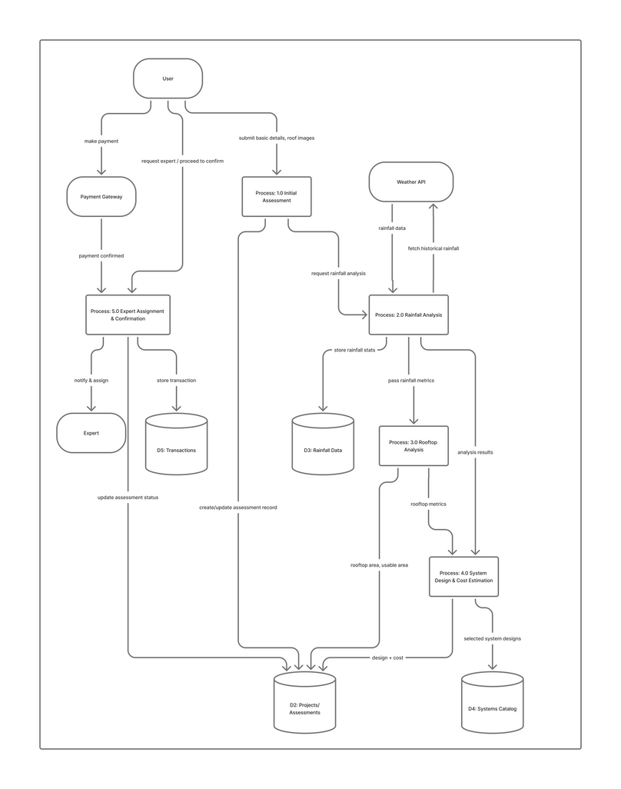
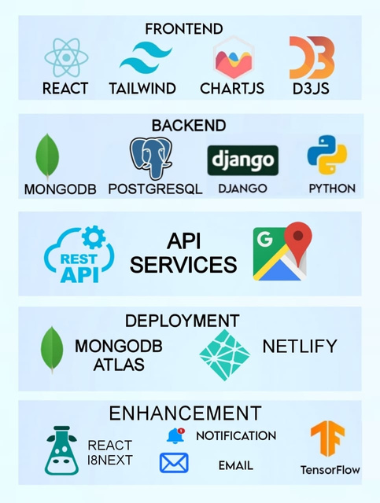
Technology

Slide 7
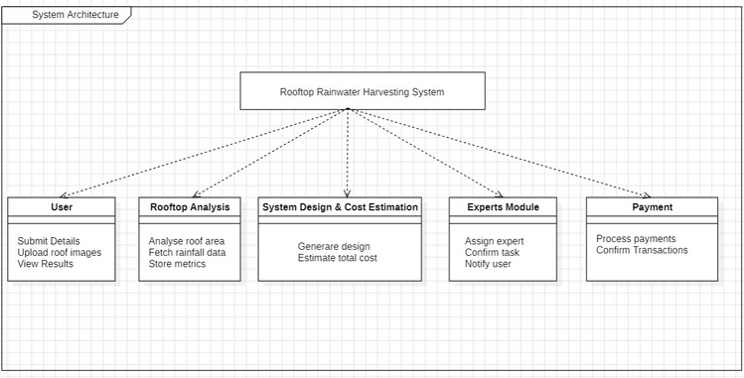
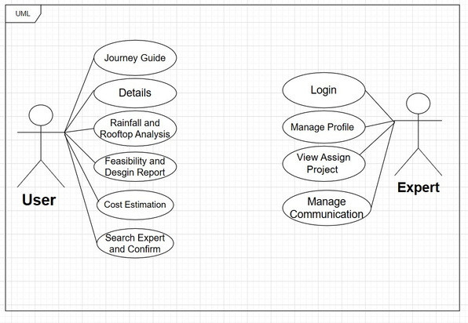

Slide 8
Functional Requirements
⚙️ Functional Requirements (What the App Must Do)
  📍 Location Input & Mapping – Users can enter their address or pin their location for site‑specific analysis.
  🏠 Roof Area Detection – Upload rooftop/open space photos; AI + Computer Vision auto‑detects dimensions.
  🌧️ Rainwater Potential Calculator – Algorithms estimate water harvesting capacity based on rainfall + roof size.
  📊 Feasibility Report Generation – Instant, personalized reports with system sizing, cost, and recharge potential.
  🌐 GIS Integration – Smart mapping overlays to visualize catchment areas and recharge zones.
  🔄 Multi‑Language Support – Regional language options for accessibility across diverse communities.
  📱 Cross‑Platform Access – Works seamlessly on both mobile and web applications.

Slide 9
Non-Functional Requirements
🚀 Non‑Functional Requirements (How the App Should Perform)
  ⚡ High Performance – Quick processing of images and data for real‑time results.
  🔒 Data Security – Secure handling of user location and photos with privacy protection.
  🎨 User‑Friendly UI/UX – Clean, intuitive design that simplifies technical concepts into easy steps.
  🌍 Scalability – Capable of supporting large user bases across different regions.
  🛠️ Reliability – Consistent accuracy in roof detection and water potential estimation.
  🔧 Maintainability – Easy updates and integration of new features without disrupting service.
  📶 Offline Support – Basic calculations available even without internet connectivity.

Slide 10
CONCLUSION
💧 Smart & Automated Evaluation → The proposed solution eliminates manual errors by leveraging AI, GIS, and automation for accurate rooftop rainwater harvesting assessment.
⚡ Instant & Location-Specific Insights → Real-time feasibility analysis based on rainfall data, roof geometry, and site conditions enables better decision-making.
📱 User-Friendly & Actionable → Clear, visual reports replace complex manuals, making water conservation accessible to households and communities.
🌍 Scalable & Inclusive Impact → Designed to scale across regions with multilingual support, benefiting both urban and rural users.
🚀 Towards Sustainable Water Management → By integrating smart technology with environmental responsibility, the system promotes efficient groundwater recharge and long-term water security

