Slide 1


Bank of Baroda Hackathon - 2022
Technology Partner
TEAM NAME : DREAM SEEKERS
TEAM MEMBERS :
Dr.S.Bhaggiaraj (Mentor)
(Assistant Professor(SI.Gr) Sri Ramakrishna Engineering College)
V.N. Subhikshaa Shree (Team Leader)
N. Sivaranjani
Date : 08/09/2022

Slide 2
Problem Statement?
Chatbot system is the smart application that acts as humans to solve real time problems and situations.
Most of them get benefitted using this handy software for online systems in recent days.
Knowing about the banking activities the chatbot withdraw , deposit and perform any other activities that a bank can perform which changes our lifestyle

Slide 3
User Segment & Pain Points
Humans are users of the virtual assistant which increases the performance of the bank which expands the consumer base.
To expand the abundance of bank the 24/7 service is provided by this virtual assistant. Queries can be answered anywhere and everywhere
This system helps the bank to grow their customers in a drastic way.

Slide 4
Pre-Requisite
Chatterbot is the python library which is used as the important part of artificial intelligence to facilitate human-machine interaction.
NLTK , spacy are some of the python libraries that communicate with humans with natural language.
Another popular examples of chatbot are google assistant and siri.

Slide 5
Azure tools or resources
Web app bot in azure portal used for virtual assistant
After choosing group of configurations the bot is built on the azure portal
Using visual studio code the azure access is set up
The new azure function app project created in visual studio code

Slide 6
Any Supporting Functional Documents
https://chatterbot.readthedocs.io/en/stable/
https://azure.microsoft.com/en-in/free/
https://docs.python.org/3/library/

Slide 7
Key Differentiators & Adoption Plan
Very simple to use in azure web chat bot service
Reduction in the cost of operation
This chatbot can recognize any natural language and the ambivalence is reduced
Constructing chats around the globe

Slide 8
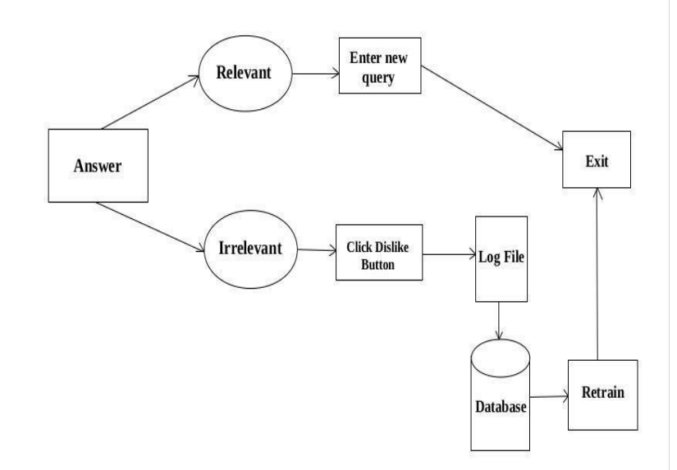
GitHub Repository Link & supporting diagrams, screenshots, if any

Slide 9
Thank You
Team members :
Dr. S. Bhaggiaraj (Mentor)
(Assistant Professor(SI.Gr),Sri Ramakrishna Engineering College)
V.N. Subhikshaa Shree (Team Leader)
N. Sivaranjani

