Slide 1
Supply Chain Analytics
Turning 180,519 orders into actionable insights
A data-driven review of sales, profitability, logistics, and late-delivery risk
Tools: Python · Jupyter · scikit-learn · Power BI
Data: DataCoSupplyChainDataset · tokenized_access_logs
2026

Slide 2
Agenda
What we will cover
• Phase 1 — Data Understanding & Preprocessing
• Phase 2 — Univariate (KPI) Analysis
• Phase 3 — Bivariate Analysis
• Phase 4 — Multivariate Analysis
• Phase 5 — Statistical Distributions & the Central Limit Theorem
• Phase 6 — Hypothesis Testing
• Phase 7 — Feature Engineering & Preprocessing
• Phase 8 — Machine Learning Modeling
• Power BI Dashboard Tour
• Recommendations & Next Steps
Supply Chain Analytics · Project Deck
Slide 2 / 28

Slide 3
PHASE 1
Data Understanding & Preprocessing
180,519 orders · 53 features · 4 columns with missing data · 0 duplicates
Slide 3 / 28

Slide 4
Dataset shape & feature types
180,519
53
44
9
Total orders
Total features
Business features
ID columns excluded
• 24 categorical features (transaction type, delivery status, region…)
• 14 integer features (IDs, days, quantity)
• 15 float features (sales, profit, discount, lat/long…)
• Two datasets merged — orders (180K) + clickstream (470K)
Six business dimensions:
• Customer
• Product
• Order
• Financial
• Logistics
• Geography
Speaker note: covers every dimension needed for end-to-end supply chain analysis.
Supply Chain Analytics · Project Deck
Slide 4 / 28

Slide 5
Data quality & cleaning
0
4 / 53
2
latin1
Duplicate rows
Cols with nulls
Cols dropped
Encoding
• Product Description — 100% missing (180,519 nulls) → dropped
• Order Zipcode — 86.24% missing (155,679 nulls) → dropped
• Customer Lname — 0.004% missing (8 rows) → filled with "Unknown"
• Customer Zipcode — 0.002% missing (3 rows) → filled with mode
• File decoded with latin1 (UTF-8 failed on special characters)
Cleaning philosophy
• Preserve every usable column.
• Drop only when >80% missing.
• Impute the long tail of near-empty columns with sensible defaults (mode / "Unknown").
• Never overwrite real nulls with synthetic zeros.
Supply Chain Analytics · Project Deck
Slide 5 / 28

Slide 6
PHASE 2
Univariate KPI Analysis
$36.78M total sales · 54.83% late risk · 2.13 items per order
Slide 6 / 28

Slide 7
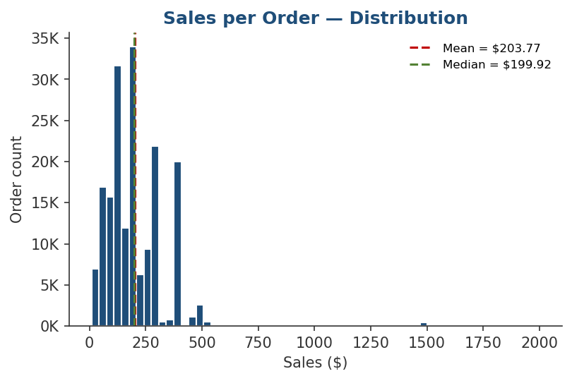
Sales distribution
Right-skewed, log-normal shape
• Total Sales ≈ $36.78M
• Mean sale = $203.77, Median = $199.92
• Mode = $129.99, Max = $1,999.99
• Skewness = 2.88, Kurtosis = 23.94
• Only 488 orders (0.27%) are statistical outliers above $569.91
Insight: a small number of high-value orders drive a disproportionate share of revenue.
Supply Chain Analytics · Project Deck
Slide 7 / 28

Slide 8
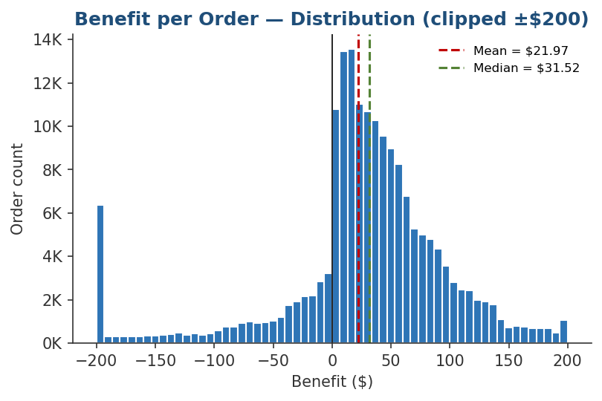
Benefit per order
A long loss tail drags the mean below the median
• Mean benefit = $21.97 / order
• Median benefit = $31.52 (mean < median → left-skewed)
• Worst loss = −$4,274.98
• 18,942 orders (10.49%) fall below −$79.70 — heavy loss tail
• These losses are concentrated in fraud and over-discounted orders
Insight: half of orders deliver $30+ profit, but ~10% of orders wipe out the margin.
Supply Chain Analytics · Project Deck
Slide 8 / 28

Slide 9
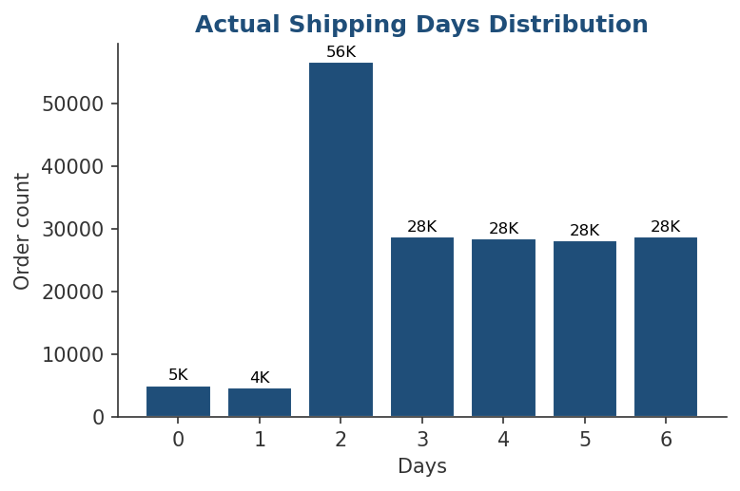
Shipping days & discount
• Shipping days (actual)
• Mean 3.50 · Median 3.0 · Mode 2
• Range 0–6 days · No outliers
• Tightly clustered → shipping time is well-controlled operationally
$20.66
$14.00
$500
4.18%
Avg discount
Median discount
Max discount
Outliers
Discounts vary widely — a clear lever for margin management.
Supply Chain Analytics · Project Deck
Slide 9 / 28

Slide 10
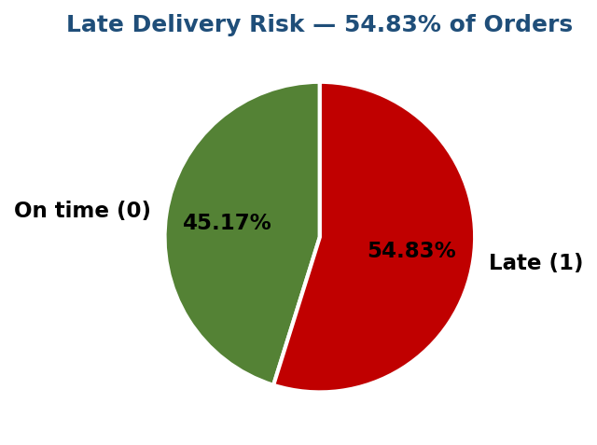
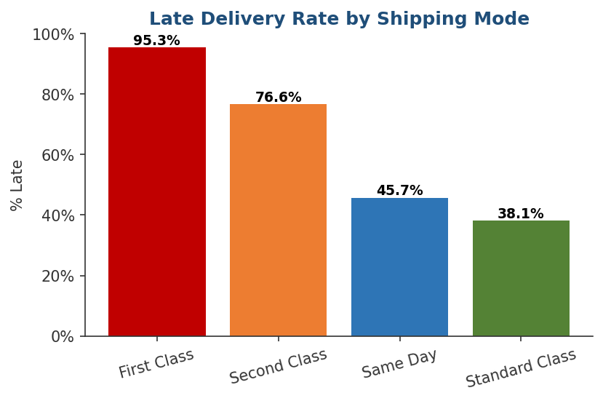
Late delivery risk
54.83% of orders are late — and shipping mode is the lever
• 98,977 / 180,519 orders are flagged late — a coin flip per order
• First Class (95.32%) is the worst offender · Standard Class (38.07%) is the most reliable
Supply Chain Analytics · Project Deck
Slide 10 / 28

Slide 11
PHASE 3
Bivariate Analysis
12 relationship pairs · profit drivers · logistics dependencies · customer mix
Slide 11 / 28

Slide 12
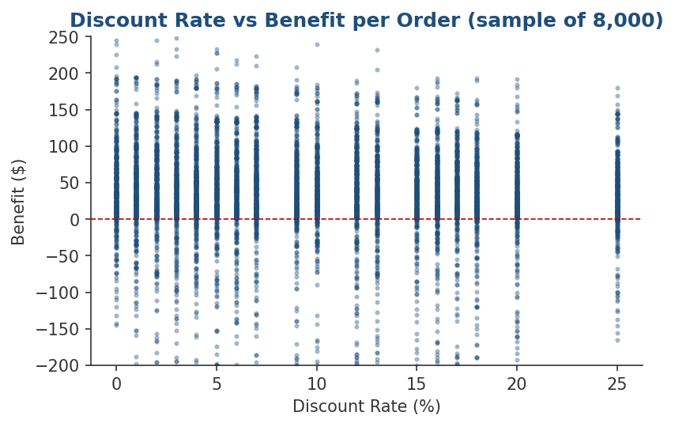
Profit drivers — sales & discount
• Sales ↔ Benefit: r = 0.1318 (weak)
• Mean profit by sales band: Low $8.32 · Medium $16.00 · High $24.83 · Very High $40.48
• Discount ↔ Benefit: r = 0.0648 (≈ zero)
• Mean profit by discount band: Low $17.40 · Medium $18.51 · High $21.86 · Very High $30.16
• Profit rises with discount because heavy-discount orders are also higher-ticket
Insight: Sales alone is a weak profit predictor; order composition matters more.
Supply Chain Analytics · Project Deck
Slide 12 / 28

Slide 13
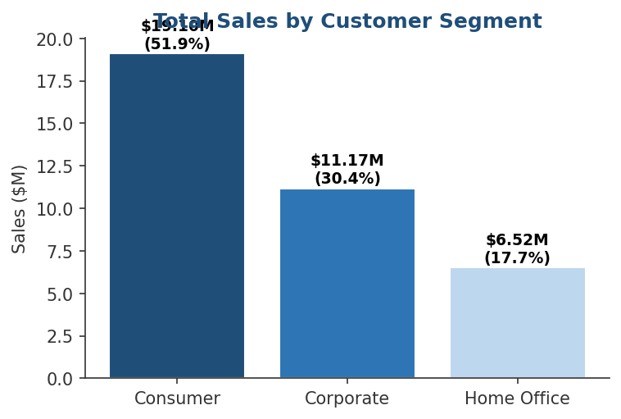
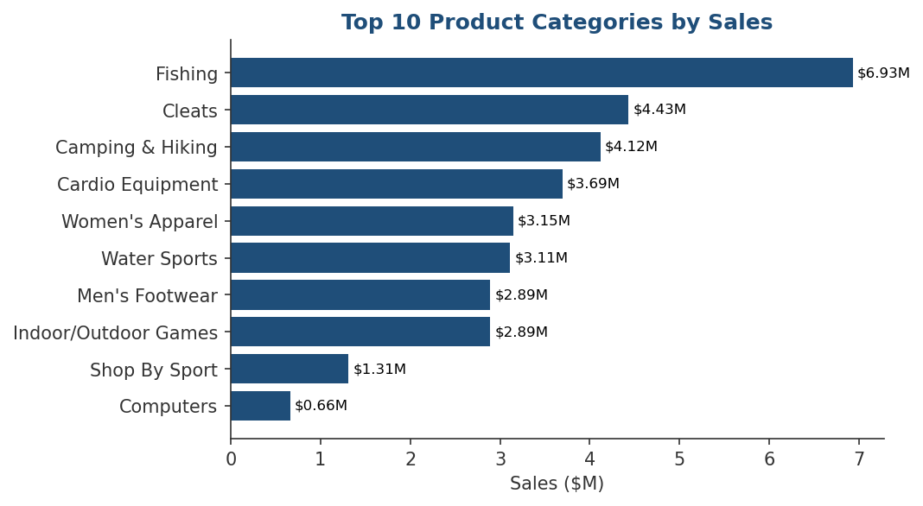
Customer & category mix
• Consumer 51.91% · Corporate 30.36% · Home Office 17.73% of sales
• Top 5 categories: Fishing $6.93M · Cleats $4.43M · Camping & Hiking $4.12M · Cardio $3.69M · Women's Apparel $3.15M
• Late-vs-on-time shipping days: 2.78 vs 4.09 — longer transit ⇒ higher late risk (r = 0.40)
Supply Chain Analytics · Project Deck
Slide 13 / 28

Slide 14
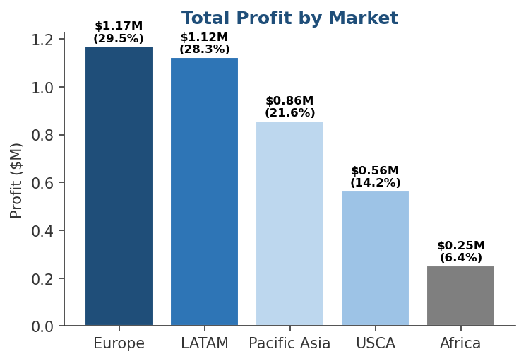
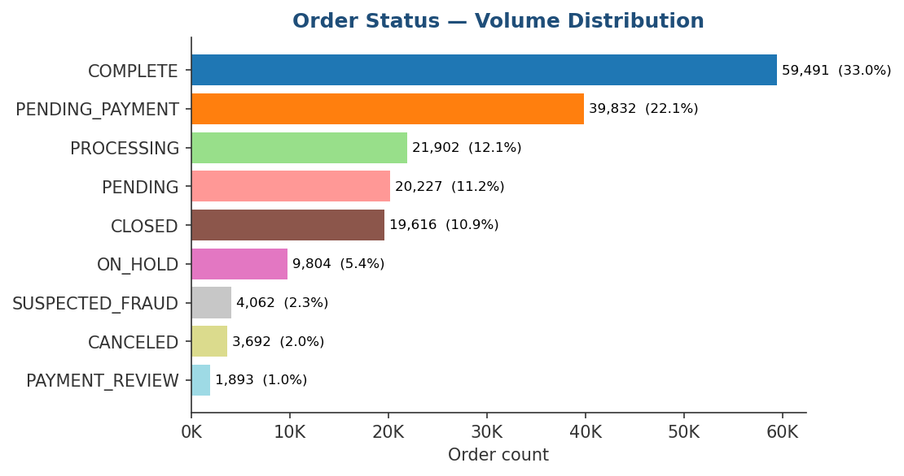
Markets, regions & order status
• Top markets by profit: Europe 29.48% · LATAM 28.32% · Pacific Asia 21.62% · USCA 14.23% · Africa 6.35%
• Top regions by sales: Western Europe $5.89M · Central America $5.67M · South America $2.96M
• SUSPECTED_FRAUD is only 2.15% of orders but worth monitoring — every % recovered drops straight to the bottom line
Supply Chain Analytics · Project Deck
Slide 14 / 28

Slide 15
PHASE 4
Multivariate Analysis
Discount is a double-edged sword · First Class fails almost everywhere
Slide 15 / 28

Slide 16
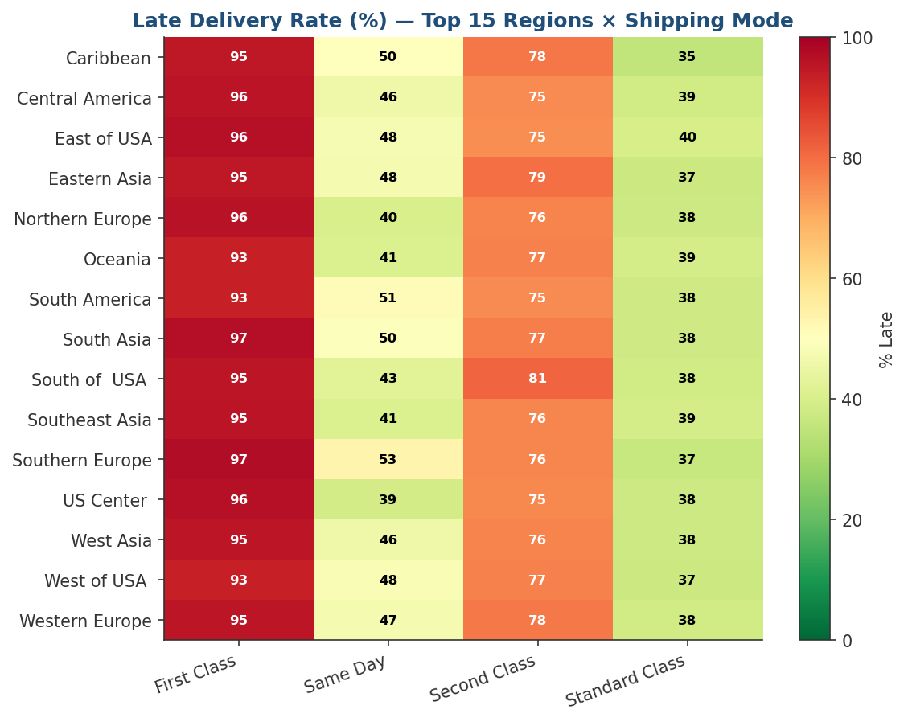
Multivariate findings
• First Class is late in 90%+ of regions
• Canada 92% · Caribbean 95% · Central Asia 100% · East Africa 99%
• Standard Class stays 28–42% late — most reliable everywhere
• Discount × Category × Profit:
• Helps: Electronics $9.74→$27.86, Cardio $24→$38
• Hurts: Men's Footwear $15.00→$11.27
Insight: discount is a double-edged sword — promotes electronics/cardio, destroys apparel/footwear margin.
Supply Chain Analytics · Project Deck
Slide 16 / 28

Slide 17
PHASE 5
Distributions & the Central Limit Theorem
Sales is log-normal · late orders ≈ Bernoulli(p=0.55) · CLT verified
Slide 17 / 28

Slide 18
Distribution findings
• Bernoulli — late delivery
• p = 0.5483 (q = 0.4517)
• P(≤2 late in batch of 10) ≈ 2.81%
• P(≥6 late in batch of 10) ≈ 50%
•
• Poisson — daily orders
• λ = 160.18 orders/day
• Variance = 1,207 → slight over-dispersion (clustered order days)
• Normal — shipping days
• μ = 3.50, σ = 1.62
• |z| > 3 outliers = 0
•
• Log-normal — sales
• Skewness 2.88 → log-transformed −0.71 → confirms long-tail
•
• Central Limit Theorem
• Sample means μ_x̄ ≈ $203.67 (true μ = $203.77)
• Sample skewness → 0.32 (≈ normal)
Supply Chain Analytics · Project Deck
Slide 18 / 28

Slide 19
PHASE 6
Hypothesis Testing
t-test · Chi-square · ANOVA — with effect sizes
Slide 19 / 28

Slide 20
Statistical evidence
• Two-sample t-test (Consumer vs Corporate profit)
• Means: $22.18 vs $21.95 · t = 0.4038 · p = 0.6864
• Fail to reject H0
• Cohen's d = 0.0022 → negligible effect
• → segments are statistically identical in profitability
•
• ANOVA — Sales across Markets
• F = 162.44 · p ≈ 4.66e-139 → reject H0
• η² = 0.0036 → statistically real, practically tiny
• Chi-square — Shipping Mode × Late Risk
• χ² = 37,716.04 · df = 3 · p ≈ 0
• → reject H0: strong dependency
• Cramér's V = 0.4571 → strong association
•
• Key takeaway
• Statistical significance ≠ business significance
• Always pair p-values with effect sizes (Cohen's d, η², Cramér's V) before acting
Supply Chain Analytics · Project Deck
Slide 20 / 28

Slide 21
PHASE 7
Feature Engineering & Preprocessing
10 ML features · 80/20 stratified split · 62 encoded columns
Slide 21 / 28

Slide 22
Features built & pipeline
10
62
144,415
36,104
ML features
Encoded columns
Train rows
Test rows
• Engineered features
• order_year, order_month, order_weekday, order_hour
• shipping_delay = actual − scheduled
• discount_band (Low / Medium / High / Very High)
• profit_band
• Leakage prevention
• Removed columns that reveal the target:
• Late_delivery_risk, Order Status
• Train/test split
• 80/20 stratified
• Preserves class balance
Original shape (180,519, 55) → ML dataset (180,519, 10) → encoded (180,519, 62).
Supply Chain Analytics · Project Deck
Slide 22 / 28

Slide 23
PHASE 8
Machine Learning Modeling
Late-delivery classifier · profit regressor · tuned Random Forest wins
Slide 23 / 28

Slide 24
Classification — Late Delivery Risk
0.70
0.84
0.55
0.66
Accuracy
Precision (late)
Recall (late)
F1 (late)
Best model: Tuned Random Forest · params: max_depth=15, n_estimators=50
Model
Accuracy
Precision
Recall
F1 (late)
Logistic Regression
0.6967
0.8502
0.5425
0.66
Decision Tree
0.6932
0.8293
0.5545
0.66
Random Forest (base)
0.6949
0.8230
0.5651
0.67
Random Forest (tuned)
0.7000
0.8400
0.5500
0.66
RF + SMOTE
0.7000
0.8500
0.5460
0.66
Insight: 55% recall on the late class means we catch roughly 1 in 2 late orders before they ship.
Supply Chain Analytics · Project Deck
Slide 24 / 28

Slide 25
Regression — Benefit per Order
$100.64
0.0148
8
100
Tuned RMSE
Tuned R²
max_depth
n_estimators
Model
RMSE
R²
Notes
Linear Regression
$100.25
0.0224
Baseline
Decision Tree
$106.63
−0.1061
Over-fits
Random Forest (base)
$101.62
−0.0046
Slight over-fit
Random Forest (tuned)
$100.64
0.0148
Best overall
Insight: profit is dominated by noise + outliers; predictive signal in current features is weak.
Discount and order composition matter more than anything captured here.
Supply Chain Analytics · Project Deck
Slide 25 / 28

Slide 26
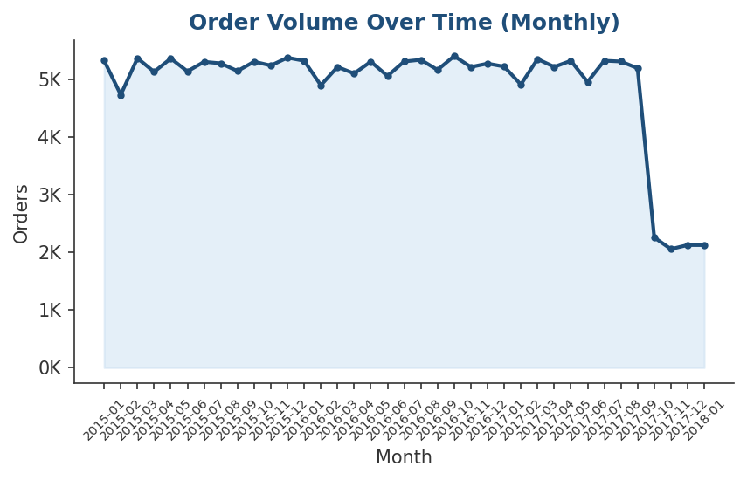
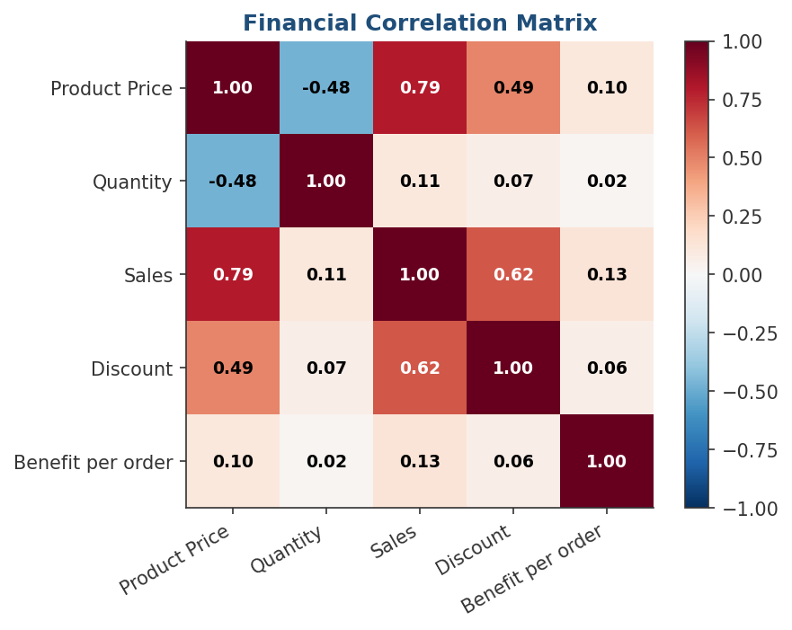
Power BI dashboard — page tour
• Page 1 — Overview
• KPI tiles: Total Sales $36.78M · Total Profit $3.97M · Orders 180,519 · Late % 54.83%
• Page 2 — Profitability
• Sales vs Profit by Category · Discount vs Profit · Top 5 categories
• Page 3 — Logistics
• Late delivery heatmap (Region × Shipping Mode) · Avg shipping days by mode
• Page 4 — Customers
• Segment contribution · Top regions & countries
• Page 5 — ML Output
• Confusion matrix · Classification report · Feature importance
Supply Chain Analytics · Project Deck
Slide 26 / 28

Slide 27
Recommendations
1. Cap discount rate
Cap at the 75th-percentile ($29.99). Protects margin in Men's Footwear, Women's Apparel and Cleats where heavy discounts erode profit.
2. Re-route First/Second Class
In regions with >90% late rate (Canada, Caribbean, Central Asia, East Africa, East of USA, Eastern Asia, Eastern Europe, North Africa), switch to Standard Class where appropriate.
3. Deploy the late-delivery classifier
Catches 55% of late orders before they ship — embed the tuned Random Forest into the order-routing workflow.
4. Focus growth investment
Europe (29.48% of profit) + LATAM (28.32%); Fishing, Cleats and Camping categories lead the top line.
5. Re-train quarterly
Refresh models as new orders arrive; expand the feature set with carrier and inventory data to lift recall.
Supply Chain Analytics · Project Deck
Slide 27 / 28

Slide 28
Next steps & Q&A
Add real-time carrier & weather feeds → lift recall
Build a fraud-specific classifier on SUSPECTED_FRAUD subset
Move Power BI dashboard to a scheduled daily refresh
Track KPI movement: Late % · Avg Profit/Order · Discount %
Thank you.
Slide 28 / 28

