Slide 1

NBA DATA ANALYSIS
Team 11

Slide 2
Objective:
To extract relevant data on player performance, team performance and overall game outcomes
Benefits:
Detection of skills.
Gives better insight of players and game performance.
Helps in managing resources.

Slide 3
Overall Process
Start
Data Collection
Data Transformation
Data Validation
Data Cleaning
Preparing Dashboard in Power Bi
Data Analysis
Export as CSV
Data Insertion in DB

Slide 4
Analysis
Top 20 player performance based on the score
Top 20 score by city
Top 10 winning team cities with team coach
Top 10 Schools by top players
Home Vs Away by season
Score by Team & Position
A win matrix of Home Team Vs Away Team
All outputs in Powerbi

Slide 5
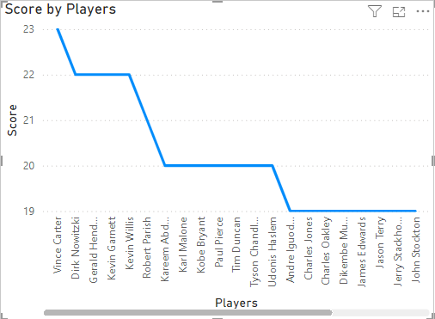
Top 20 player performance based on the score
Findings: The chart shows a steady decline in scores from Vince Carter (23) to John Stockton (19), indicating a downward trend in player performance.

Slide 6
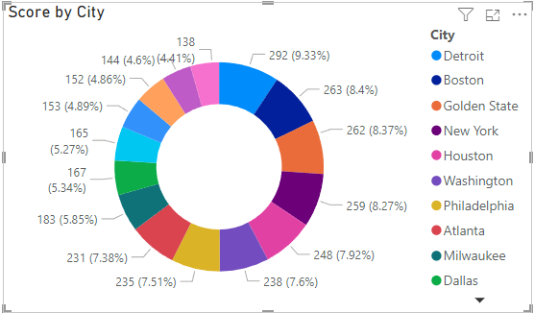
Top 20 Score by city
Findings: The donut chart shows score distribution by city. Detroit has the highest at 9.33%, followed by Boston and Golden State. Most other cities contribute between 7% and 8%. Milwaukee and Dallas have the lowest, around 5% or less.

Slide 7
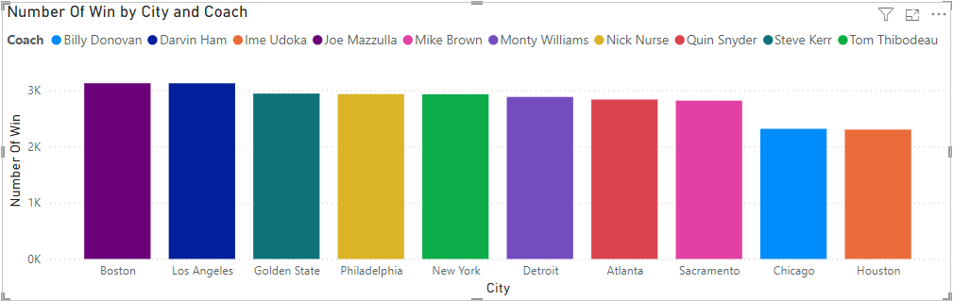
Top 10 winning team cities with team coach
Findings: The bar chart shows the number of wins by city and coach. Boston and Los Angeles have the most wins, followed by Golden State and Philadelphia. New York, Detroit, and Atlanta are in the middle, while Sacramento, Chicago, and Houston have the fewest.

Slide 8
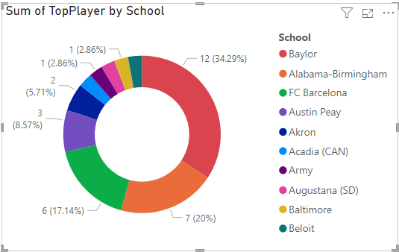
Top 10 Schools by top players
Findings: The donut chart shows top players by school. Baylor leads with 34.29%, followed by Alabama-Birmingham (20%) and FC Barcelona (17.14%). The rest have fewer players, each contributing less than 10%.

Slide 9
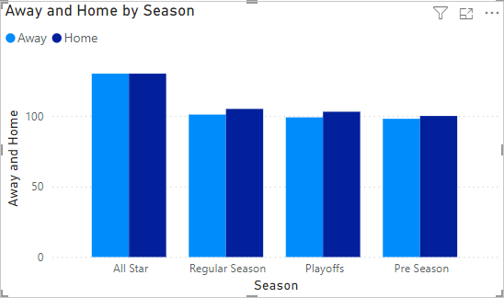
Home Vs Away by season
Findings: The chart shows minimal differences between Away and Home games across all seasons (All Star, Regular, Playoffs, Pre Season), with Away games slightly higher in the All Star and Regular seasons. Overall, the distribution is balanced.

Slide 10
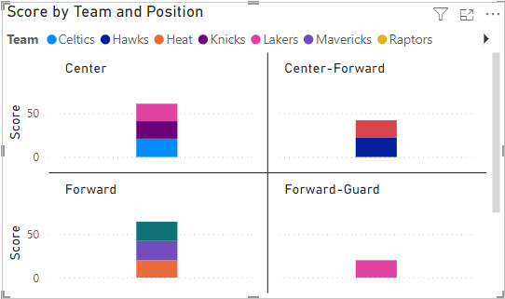
Score by Team & Position
Findings: The chart shows team scores by position. The Center and Forward positions have the highest scores, with major contributions from the Lakers, Celtics, and Mavericks. The Center-Forward and Forward-Guard positions have lower scores, with notable input from the Heat and Lakers respectively.

Slide 11
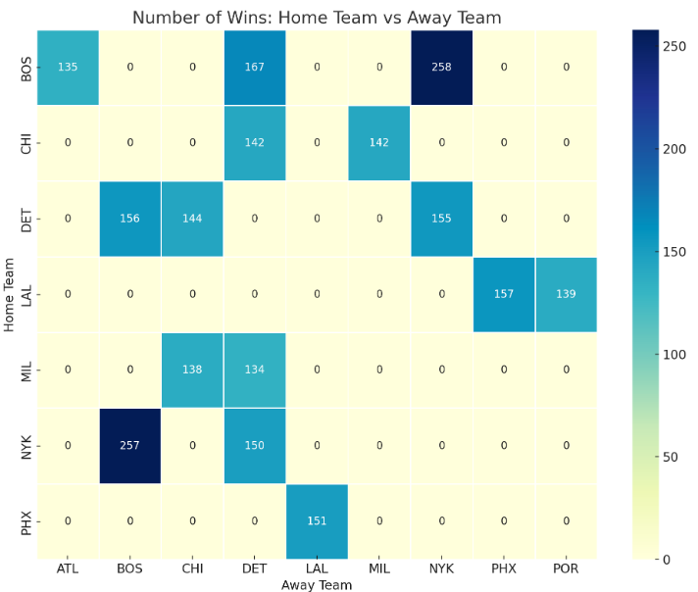
A win matrix of Top 10 Home Team Vs Away Team
Key Insights: High Wins: Boston (BOS) has the highest number of wins against New York (NYK) with 258 victories.
Notable Performances:
New York (NYK) has 257 wins against Boston (BOS).
Los Angeles (LAL) has strong performances with significant wins against Phoenix (PHX) (151) and Milwaukee (MIL) (138).
Detroit (DET) has evenly matched wins against both Milwaukee (MIL) and Chicago (CHI), with 156 and 144 wins, respectively.
Zeros: Some matchups have zero wins recorded, indicating that no games were won by the home team in those cases.

Slide 12
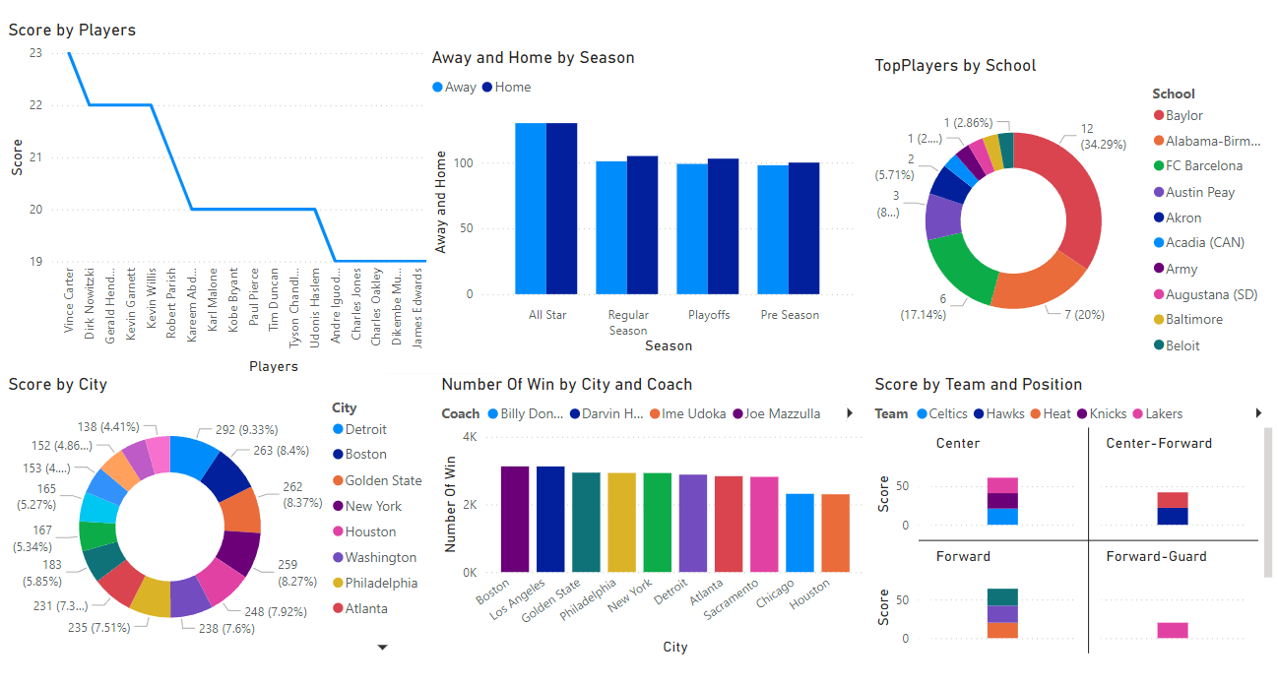
All outputs in Powerbi

Slide 13
Thank you

