Slide 1
House Inn
Themes

Slide 2
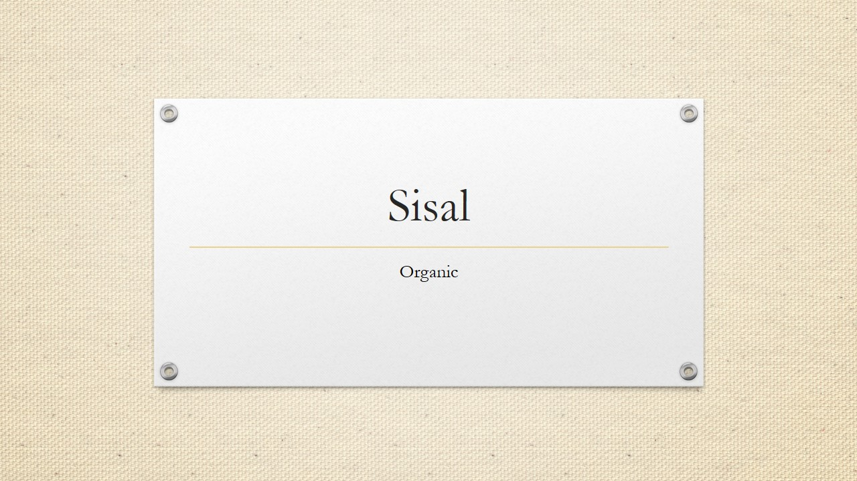
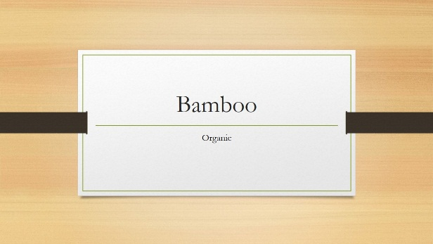
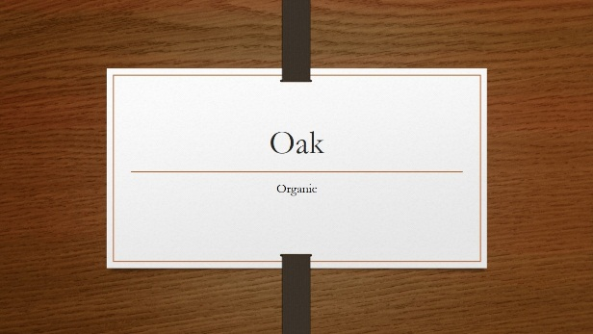
Home page theme
Logo with name
Find home ,register your home now
Login in
Some photos
Search bar for location

Slide 3
Login page
It should not be complicated
It should have gmail and pass option
Nothing more
Bot to send gmail and otp
Now you are logged in

Slide 4
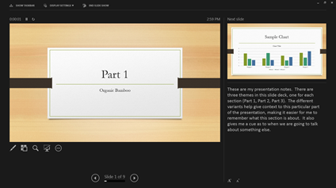
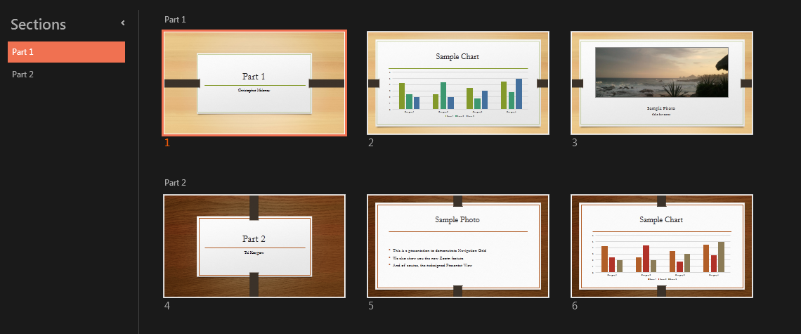
If you are a student searching for home then your are going to click on find home
You click on search home
New page pops
Some recommendation
You add your location
Places appear
Filter will be on same page

Slide 5
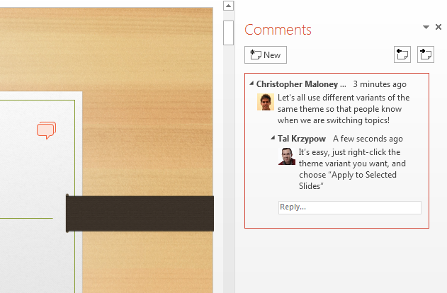
You click on some specifc home
Details of home ‘
Theme should be just like amazon detail page
Options to contact the dealer
And one page for messaging the dealer
Done from the consumers side

Slide 6
You click on register your home now
Page pops up for adding location
Add photo
Add price
Now you have to connect this page other pages for recommendations ,searches etc
Done from producers side

Slide 7
You click on register your home now
Home pg
Login pg
Click on search home
.Search bar pg with recommendation
.Homes
.details of house
.contact with dealer
You register you home page
.page to upload photos details
.

