Slide 1


EduLead ERP
SUSTAINABLE OUTREACH AND UNIVERSAL LEADERSHIP LIMITED
(SOUL)
23-Nov-2022

Slide 2
Content
1 | Introduction Of SOUL Limited
2 | Our ERP Product - EduLead
3 | How EduLead Will Help WSC
4 | Engagement Model
5 | Project Timeline
6 | Governance Model
7 | Standards and Procedures
8 | Escalation Matrix
9 | Case Study
10 | Demo
11 | Question & Answer

Slide 3









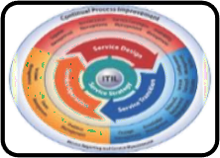


Introduction Of SOUL Limited
SOUL Limited (sister concern of KIIT), advises its client on Strategy for Business transformation, focused on sustainability through delivery process realignment, skill development, smart negotiation, contracting and digitization to achieve operational efficiency and capital productivity.
Our Insights:
Smart campus solutions using IoT and AI
Skilled human resources for operation and maintenance of solar appliances
Deployment of Enterprise Applications for governance of University
Sustainable engagement in core strategy, operational and technical development
Design and deployment of education aids
IT infrastructures support to organizations
as per ITIL standards
Sustainable Healthcare, Modernizing Agriculture, Skill development in
manufacturing, Disability Cluster
Robotics-Aiding institutions with humanoids
for contactless services
© Copyright SOUL LIMITED

Slide 4
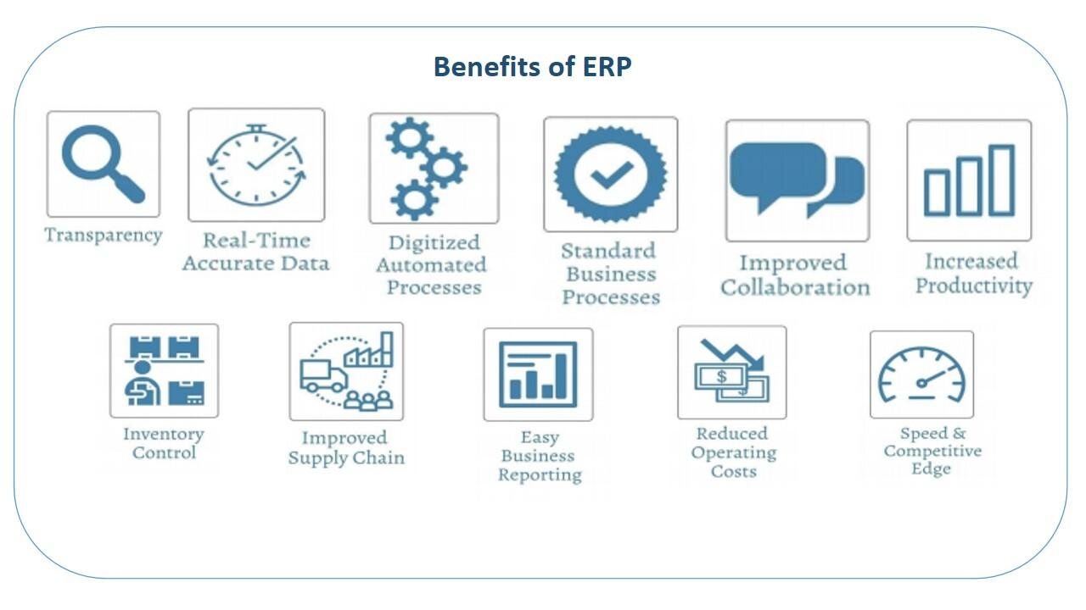
Our ERP Product -EduLead
EduLead ERP is a cloud based solution specifically designed for Educational Institutions.
It provides solution to manage operation of an Educational Institute such as Student Life Cycle Management, Human resource management, Finance and accounting, payroll management, Materials management and Inventory management etc
© Copyright SOUL LIMITED

Slide 5
How EduLead Will Help WSC
SOUL proposes to implement EduLead ERP for WSC’s Campus Management Application System. The designed system shall be a web based application providing solution for efficient internal functioning of WSC along with on line delivery of services to each Stakeholder.
WSC Scope Of Work
Finance and Accounting System | Infrastructure Management
Academic System | Procurement & Inventory Management
Students Management Modules | Training and Placement
Human Resources Management System | Application Integration
© Copyright SOUL LIMITED

Slide 6
Engagement Model
Project team and the development activities will be based at SOUL, Bhubaneswar premises.
In case of assistance by WSC, team member(s) will be deputed to WSC premises
Following are the roles defined for the development of ERP application :
Account Manager
Functional Consultant * n
Technical Architect
Project Manager
Team Lead * n
Development Team * n
Test Specialist * n
System Administrator
n denotes person involved for a particular role
© Copyright SOUL LIMITED

Slide 7
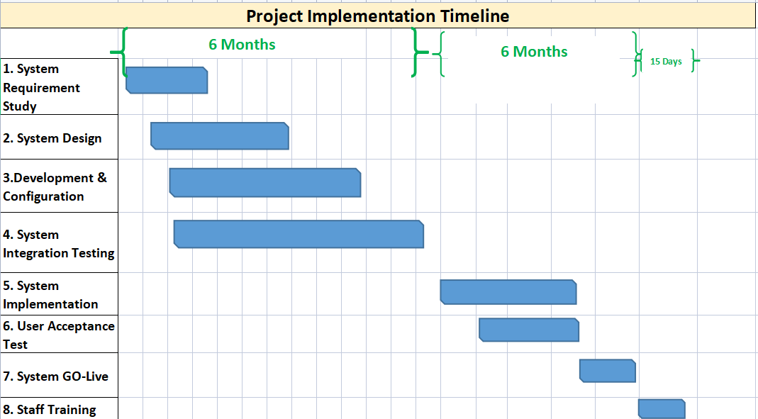
Project Timeline
© Copyright SOUL LIMITED

Slide 8
Governance Model
Governance
Bodies
Steering Committee
Overall project governance , direction & management oversight
Escalation point as needed
Governance
Checkpoints
Project Management Committee
Performance & management of project
Ensure on time delivery of the system
Address the issues & risks raised by the Working Committee
Working Committee
Development & delivery of the requirements
Addresses tactical and operational issues
Periodic governance checkpoints
Meeting | Frequency | Governance Bodies | Purpose
Working level meeting | Weekly | Working Committee | Review progress against key milestones with Project team, leads and SOUL project manager Discuss concern areas or operational issues
Project Status Update Meeting | Bi-Weekly | Project Management Committee Working Committee | Bi-weekly performance review Discuss outstanding and new issues Forecast of activities
Steering Committee Meeting | Monthly | Steering Committee Project Management Committee Working Committee | Project performance review Upcoming milestones and plans Issues requiring intervention
© Copyright SOUL LIMITED

Slide 9
Standards and Procedures
Project Change Control Procedure
Project Change Control Procedure process :
Requirement request taken after the sign off will be taken as a Change Request (CR) and incur additional cost
SOUL will evaluate and document the CR in terms of change in scope , cost, schedule, impact, benefits and other terms and conditions
Deliverable Acceptance Procedure
Deliverable Acceptance Procedure process :
Post deliverable release, WSC stakeholder will either accept or request further changes to it. If SOUL, does not receive any response, the deliverable is deemed accepted
All deliverable will pass through necessary quality checks and peer reviews before handing over to WSC
Escalation Procedure
The following escalation procedure will be followed :
The requirement will be shared by WSC on an agreed timeline
WSC will share the point of contact with SOUL for any clarification with respect to the requirement
The procedure will work in accordance to the Escalation Matrix (next slide)
© Copyright SOUL LIMITED

Slide 10
Escalation Matrix
Role | Triggers WHEN?
Stakeholders | Define Functional needs
Account Manager | Sufficient resource allocation & keep customers updated on regular basis
Project Manager | Delay in Project Execution Missing requirement on Change Request (CR) Risk mitigation Prioritizing of a feature
Project Lead | Prioritizing of a feature Quick & Effective conflicts Frequent communication (internal, customer) and provides updates on goal progress
Disclaimer : This is subject to change based on discussion with client
© Copyright SOUL LIMITED

Slide 11
Case Study
Two of our clients where we successfully deployed ERP system to keep and manage data for SLCM, are :
KISS -The largest residential school facility for tribal children in the world
KIIT Polytechnic
Prior ERP Implementation :
Our clients maintained their data using web-based applications and spreadsheets, which were not effectively connected
to one another. As a result, it was difficult to maintain voluminous data.
Post ERP Implementation :
View all of their students' records in one location that are connected to one another. As a result, altering a record in one place changes it everywhere.
Perform transactions like Approve students, Create Program Enrollment, Exam declaration, Attendance, Course Scheduling, Fees payment, Paper setting, result declaration from ERP platform
Users are notified at each stage of the transaction
Other modules such as Training & Placement, Human Resource Management, Procurement & Inventory were also implemented for KISS and KIIT Polytechnic
© Copyright SOUL LIMITED

Slide 12
Demo
© Copyright SOUL LIMITED

Slide 13
Question and Answer
© Copyright SOUL LIMITED

Slide 14
Thank you！

