Slide 1
Basics of Unix / Linux | #1

Slide 2
Introduction to Unix
Origin: Unix was developed in the late 1960s at AT&T Bell Labs by Ken Thompson, Dennis Ritchie, and others.
Purpose: It was designed as a multi-user, multitasking operating system, primarily for servers and developers.
Popularity: Unix and its derivatives (Linux, macOS) are widely used in servers, supercomputers, and embedded systems.

Slide 3
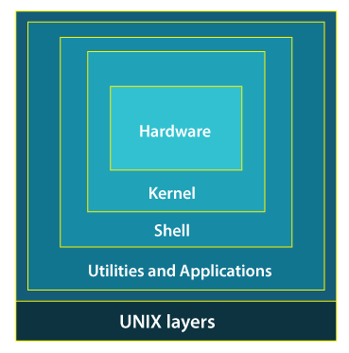
Unix Architecture
Kernel: The core of Unix, managing hardware, processes, and memory.
Shell: Acts as a bridge between the user and the kernel, interpreting commands.
File System: A hierarchical structure storing data and configuration files.
Utilities: Pre-installed commands and programs for managing the system.

Slide 4
Features of Unix
Multi-user: Multiple users can log in and use the system simultaneously.
Multitasking: Supports running multiple processes at the same time.
Security: File permissions and encryption protect user data.
Portability: Runs on different hardware with minimal modifications.
Pipelining: Allows chaining commands using | (pipes) to enhance efficiency.

Slide 5
Unix File System
Unix follows a hierarchical file structure, starting from / (root).
Key directories in Unix:
Navigation Commands:
cd /etc # Move to /etc directory
pwd # Print current directory
ls -l /home # List files in /home
Directory | Purpose
/bin | Essential binaries (ls, cp, mv, rm, etc.)
/home | User home directories
/etc | Configuration files
/var | Log files, mail queue
/tmp | Temporary files
/usr | User programs and libraries

Slide 6
Unix File Types
Unix supports multiple file types, categorized as follows:
File Type | Description | Example
Regular File (-) | Normal text or binary files | .txt, .c, .sh
Directory (d) | Folders storing other files | /home, /etc
Symbolic Link (l) | Shortcut to another file | ln -s file1 link1
Character Device (c) | Interfaces for devices (keyboards, terminals) | /dev/tty1
Block Device (b) | Disk drives, USBs | /dev/sda
FIFO (p) | Named pipe for inter-process communication | mkfifo mypipe

Slide 7
User Management in Unix (Introduction to Users)
Unix is a multi-user system, meaning multiple people can use it simultaneously.
User-related Commands:
whoami # Displays current username
who # Shows logged-in users
id # Shows user ID (UID) and group ID (GID)
Types of Users:
Root User (root) → Superuser with full control.
Regular Users → Limited privileges for safety.
System Users → Used for running system services (e.g., Apache).

Slide 8
Access Control in Unix (Permissions Overview)
Every file and directory has owner, group, and others permissions.
Changing Permissions:
chmod 755 myscript.sh # rwxr-xr-x (Owner: all, Group: read & execute, Others: read & execute)
chmod u+x script.sh # Add execute permission for the owner
Permission types:
Symbol | Meaning | Example (-rwxr-xr--)
r | Read | Can view file contents
w | Write | Can modify file contents
x | Execute | Can run file as a program

Slide 9
Identifying Users in Unix (whoami, who, id)
Checking current user:
whoami # Prints your username
Checking user ID and group ID:
id # Shows UID, GID, and groups
Checking all logged-in users:
who # Lists all users logged into the system

Slide 10
Introduction to Shells
Bourne Shell (sh) – The original Unix shell.
Bash (bash) – An improved version of Bourne Shell with added features.
Korn Shell (ksh) – Enhanced for scripting and performance.
C Shell (csh) – Syntax similar to C programming.
Restricted Shell (rbash) – Limits user actions for security reasons.
A shell is a command-line interpreter that interacts with the Unix OS. Popular Unix shells include:

Slide 11
Basic Shell Commands
Common Unix commands for file and system management:
File & Directory Operations:
ls # List files
cd /home # Change directory
pwd # Print current directory
mkdir newdir # Create a directory
rm file.txt # Remove a file
Viewing Files:
cat file.txt # Display file content
head -n 5 file.txt # Show first 5 lines
tail -n 5 file.txt # Show last 5 lines
Process Management:
ps # Show running processes
kill PID # Terminate a process with a specific Process ID

Slide 12
Graphical Shell
A graphical shell provides a GUI (Graphical User Interface) to interact with the operating system instead of using only the command line. It includes:
Graphical Desktops (GNOME, KDE, XFCE)
Window Managers (X11, Wayland)
GUI Tools (File managers, System settings)
Examples of Graphical Shells
GNOME Shell: Default in Ubuntu, Fedora.
KDE Plasma Shell: Feature-rich, used in KDE-based distros.
XFCE & LXDE: Lightweight for older hardware.

Slide 13
Process Management in Unix
What is a Process?
A process is a running instance of a program.
Types of Processes:
Foreground Process: Runs in the terminal, blocking input.
Background Process: Runs in the background (use &).
Zombie Process: Completed but not removed from the process table.
Orphan Process: Parent terminated before the child.

Slide 14
Process Monitoring:
ps aux # View active processes
top # Display real-time CPU/memory usage
htop # Interactive process viewer
Process Control:
kill -9 PID # Forcefully kill a process jobs

Slide 15
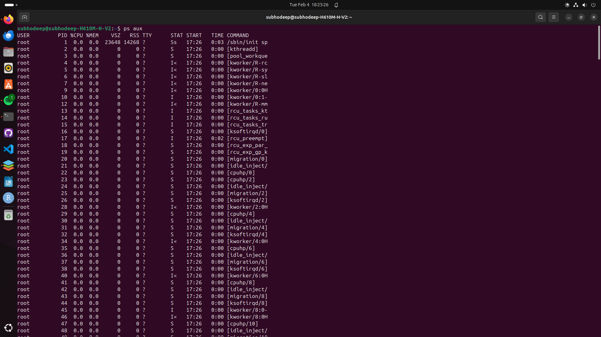
ps aux output

Slide 16
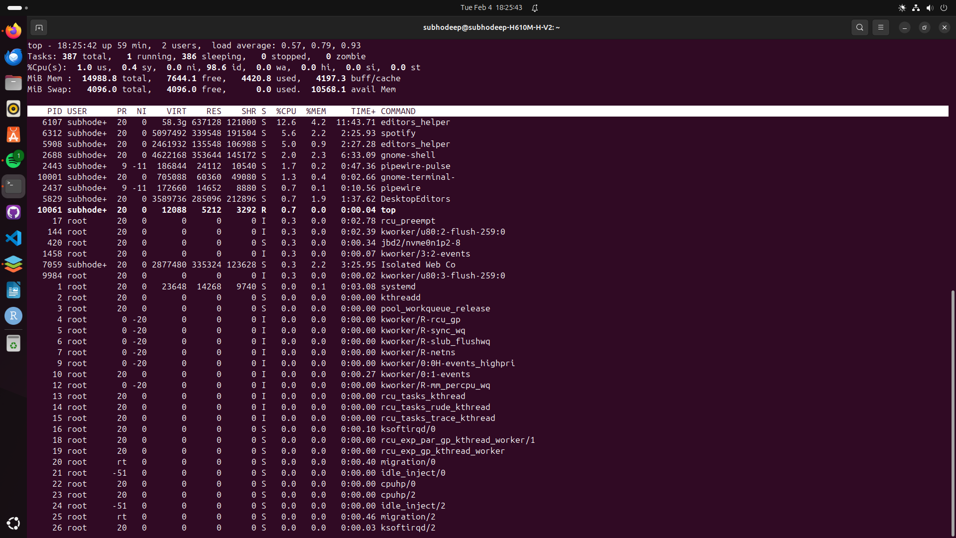
top output

