Slide 1
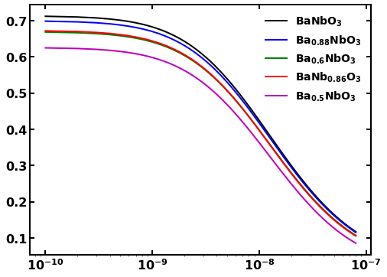
Hamaker constant of Ba_{1-x}Nb_{1-y}O₃
Gapped metals
Insulator
Hamaker constant (eV)
Distance (m)

