Slide 1
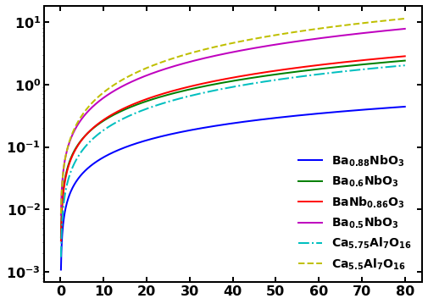
Surface variance v/s distance
Δd (nm)
d_{S} (nm)

