Slide 1
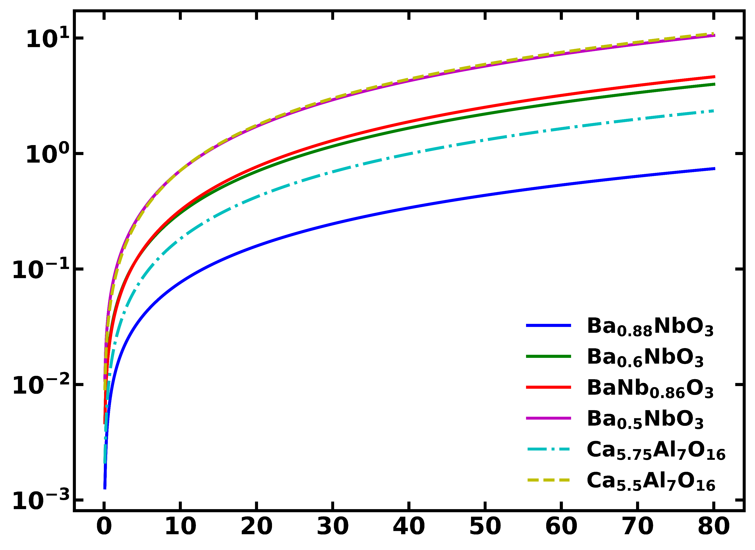

Surface variance v/s distance
$$Δd (nm)$$
d_{s} (nm)

