Slide 1
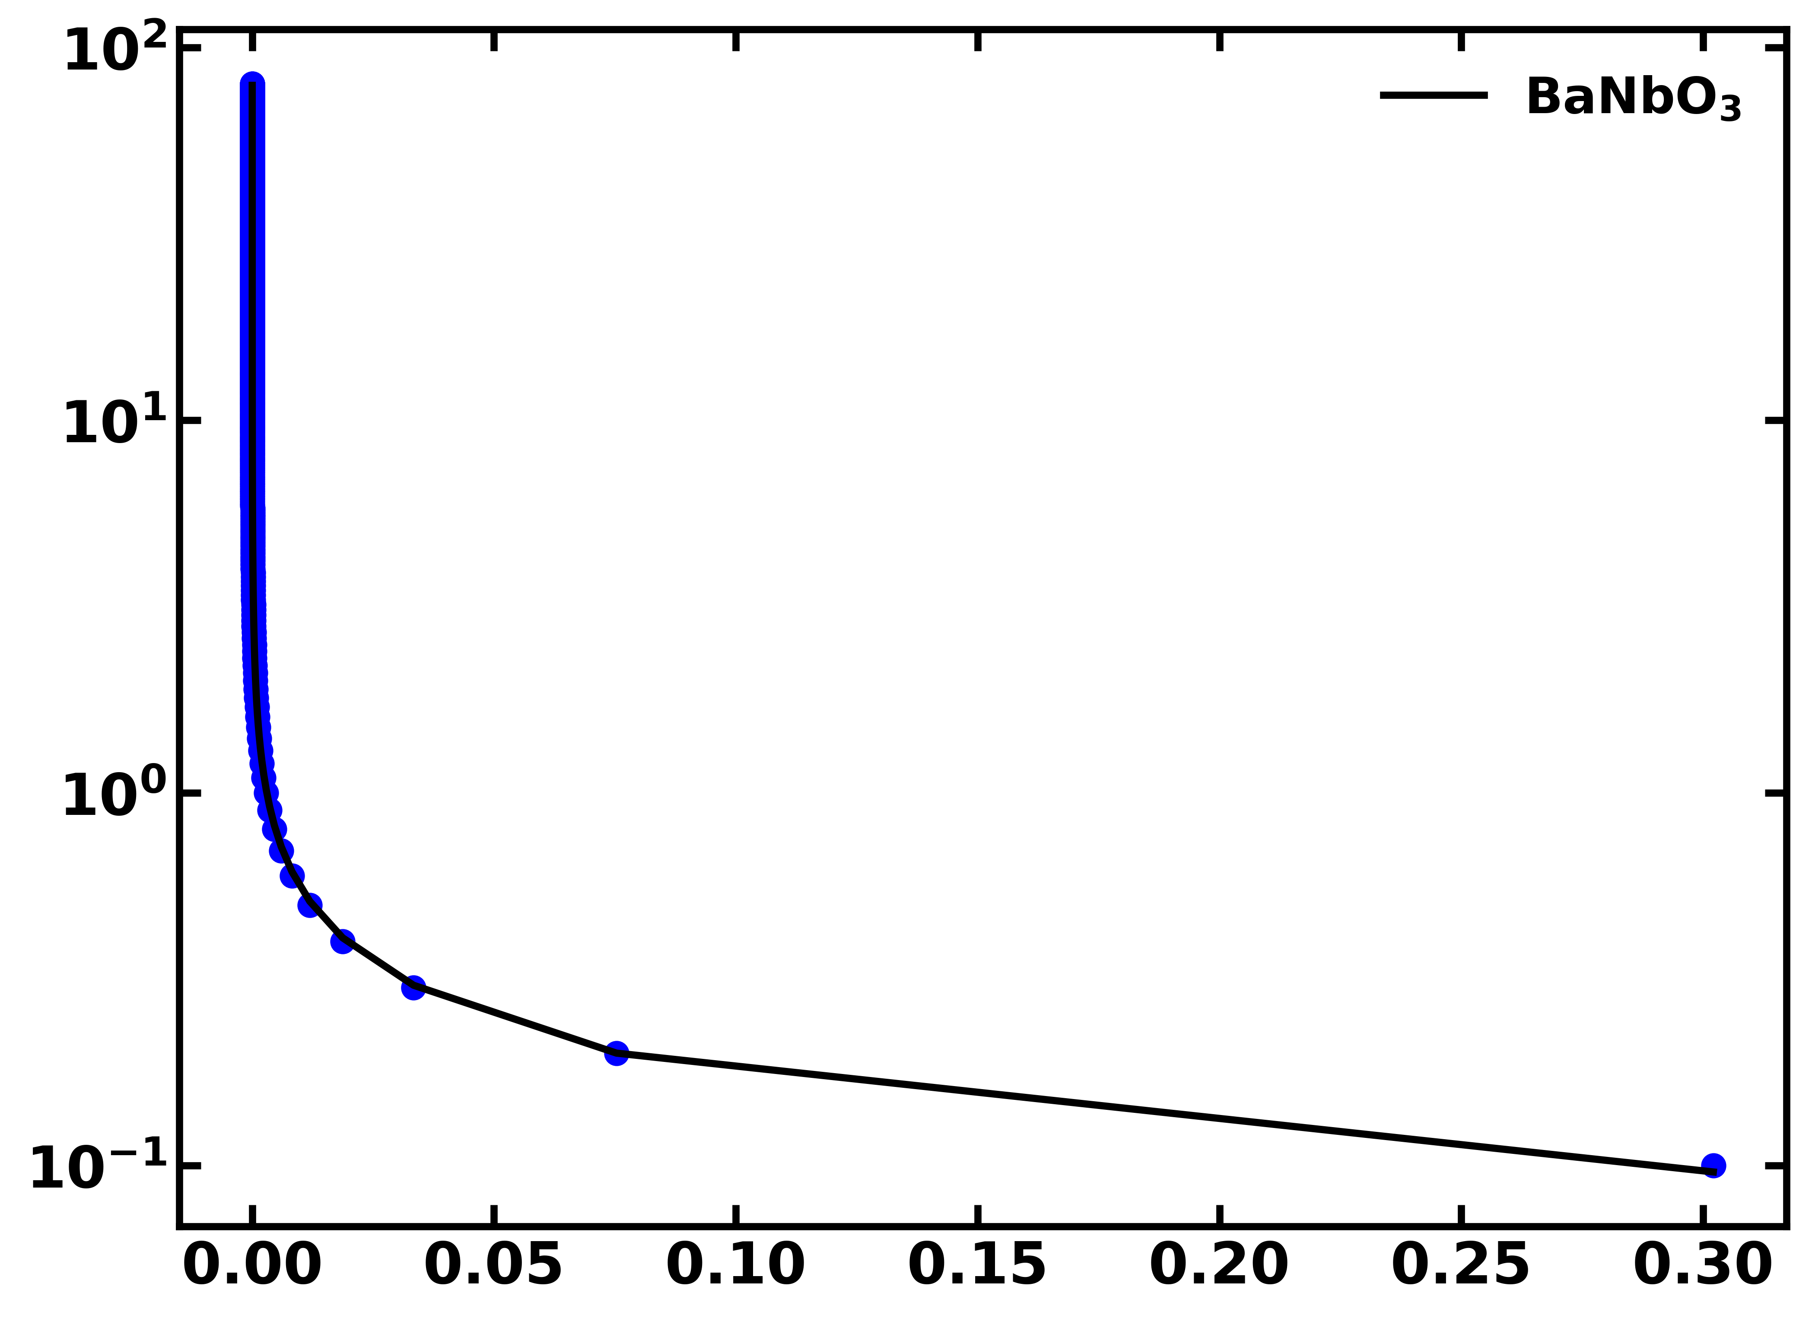
Fitting curve for distance v/s Casimir-Lifshitz force of BaNbO₃
Distance (nm)
f(d)/[2 π R] (J/m²)

