Slide 1
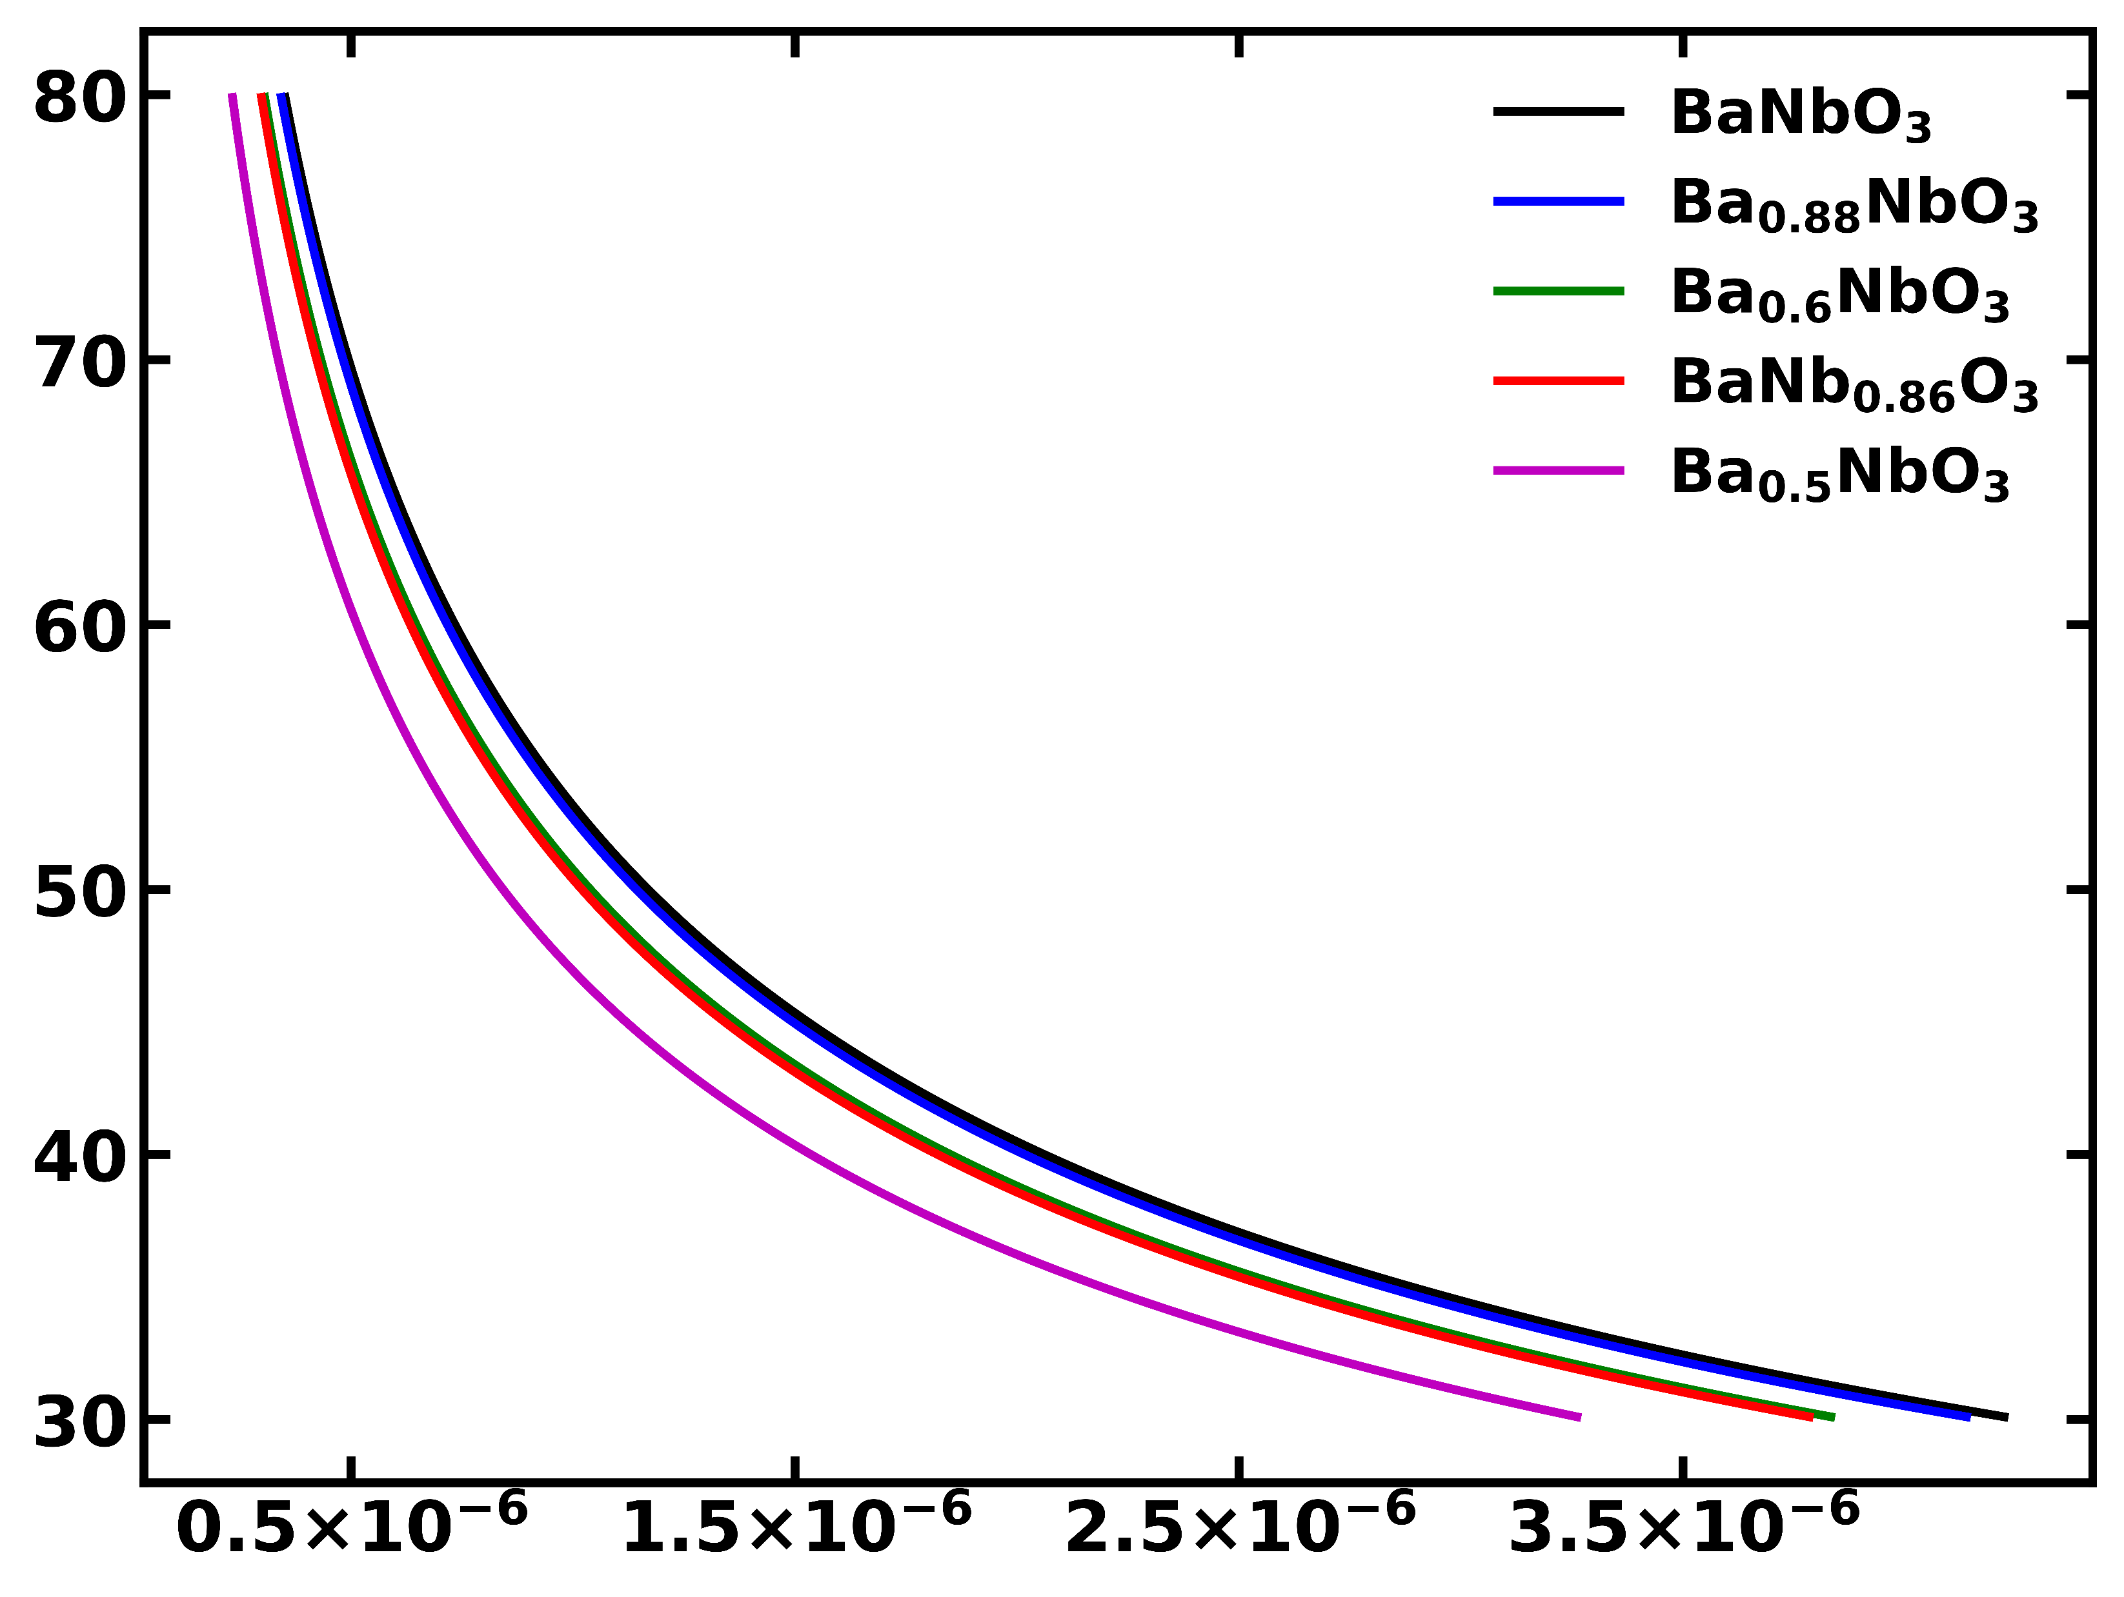
Distance v/s Casimir-Lifshitz force of
Ba_{1-x}Nb_{1-y}O₃
Gapped metals
Insulator
Distance (nm)
f(d)/[2 π R] (J/m²)

