Slide 1
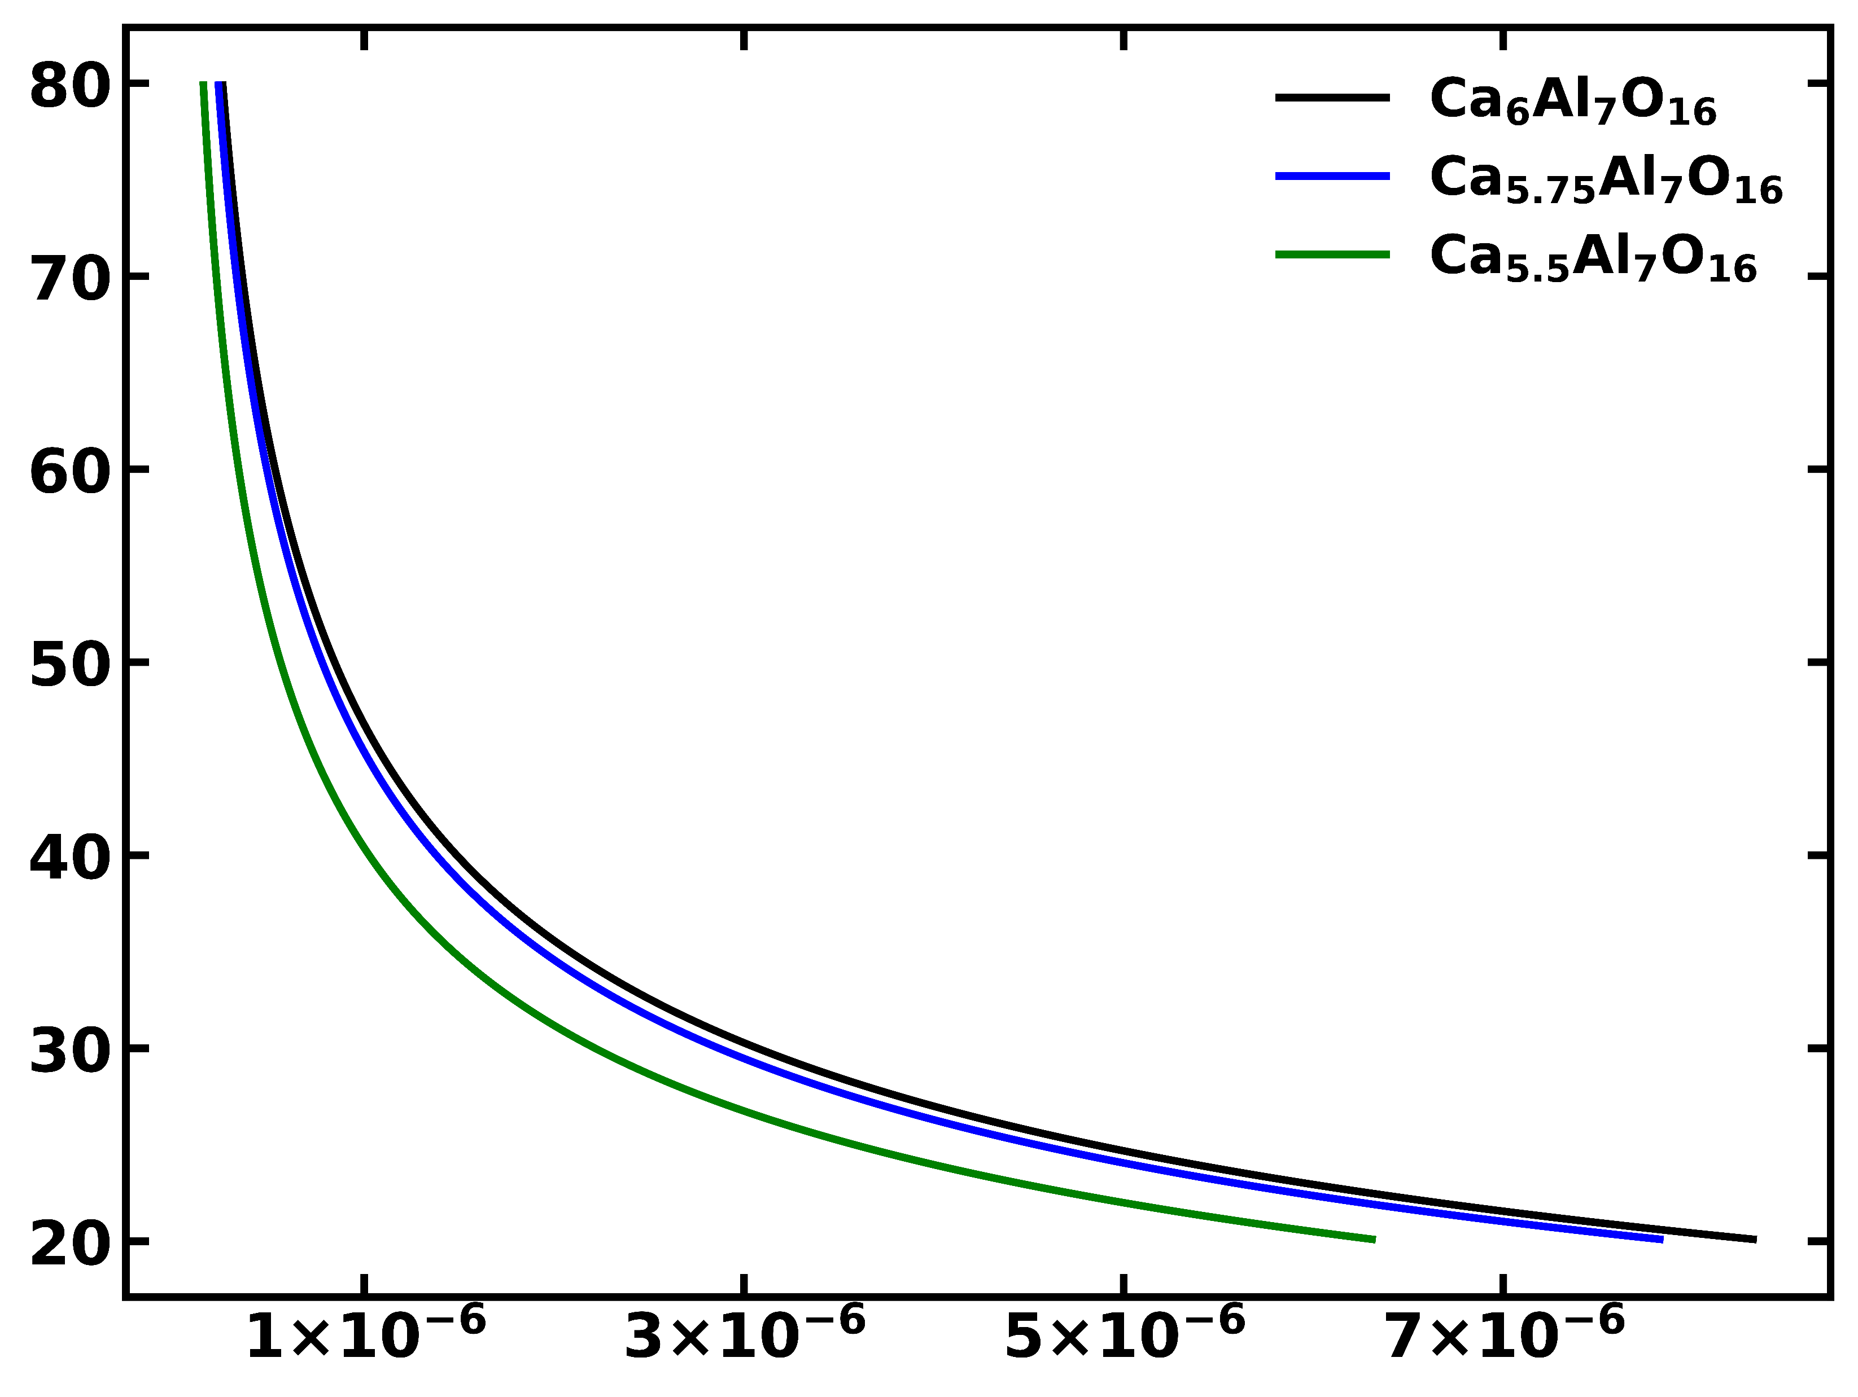
Distance v/s Casimir-Lifshitz force of
Ca_{6-x}Al₇O₁₆
Gapped metals
Insulator
Distance (nm)
f(d)/[2 π R] (J/m²)

