Slide 1

EDA of English Premier League
1993-2018

Slide 2
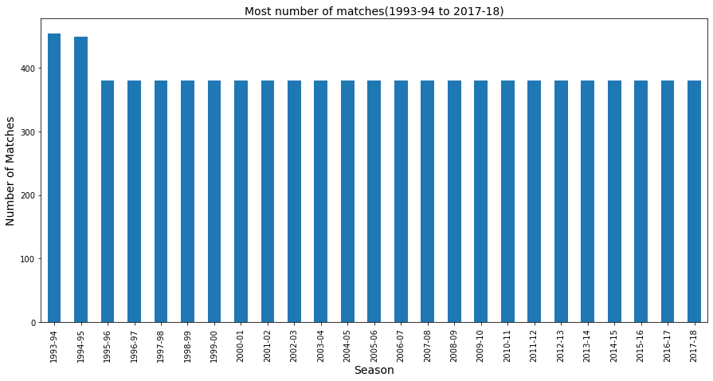
In which season most number of games was played between 1993 to 2018?
Most number of matches was played in the season 1993-94.
From 1995-96 season onwards in each season total 380 games were played.

Slide 3
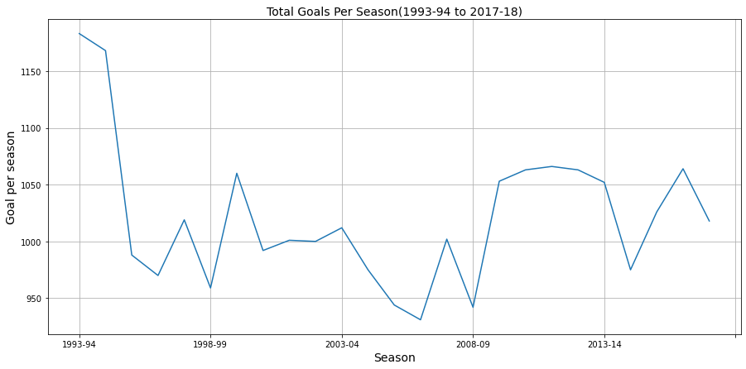
What is the total number of goals scored between 1993-94 to 2017-18 per season?
1993-94 season was the highest scoring season and 2006-07 season was the lowest scoring season among all the 25 seasons.

Slide 4
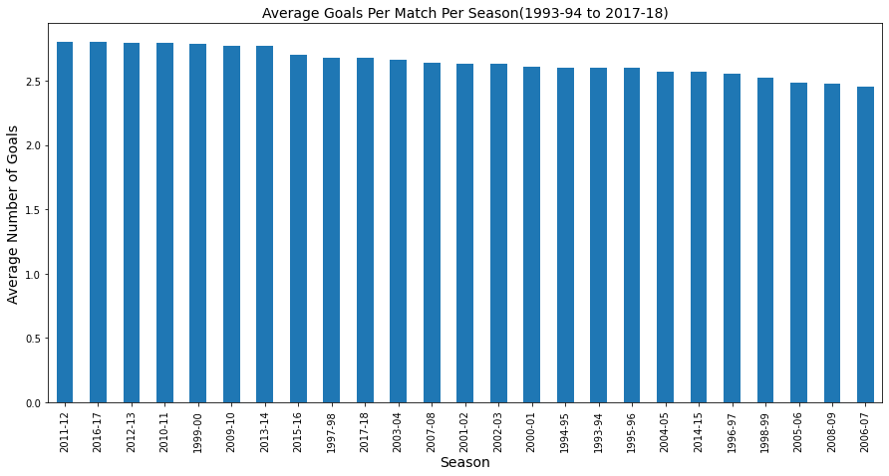
What is the average number of goals scored per match in all the seasons?
2011-12 season has the highest average number of goals per match.
2006-07 season has the lowest average number of goals per match.
The average goal has been around 2.45 to 2.80 per match between 1993 to 2018.

Slide 5
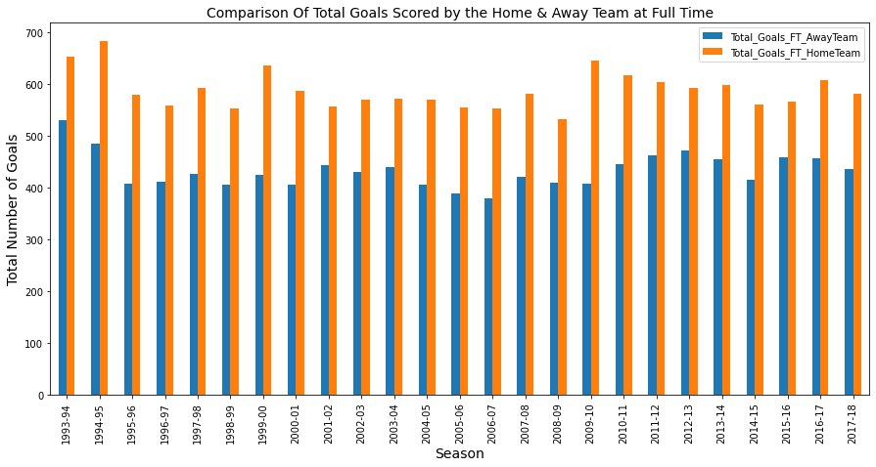
In which season the home team scored more goals then the away team at full time or vice versa?
In every season between 1993 to 2018, the total number of goals scored by Home Teams in more than the Away Teams.
It reflects the added advantage of playing a home game.

Slide 6
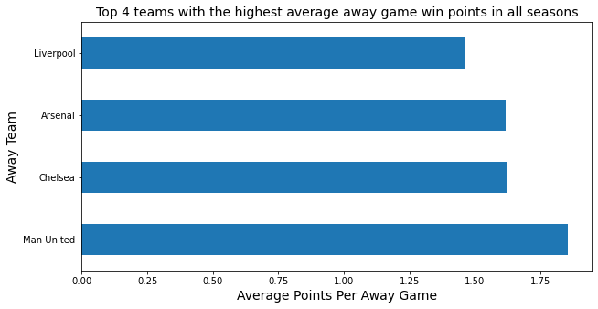
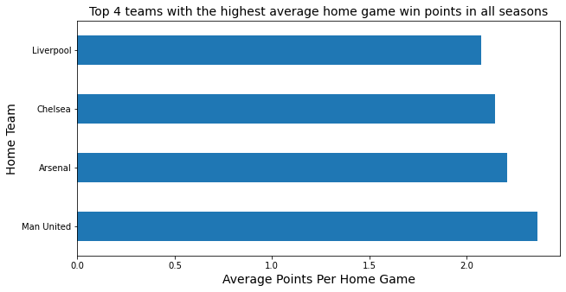
Which are the top 4 teams whose average point earned in all the away & home games per season are the highest?
Manchester United have the highest number of average goals scored all the 25 seasons in all the away games.
Manchester United, Arsenal, Chelsea & Liverpool have scored at least 1 goals on an average in all the home games for 25 seasons.

Slide 7
What is the average point required to finish within the top 4 in EPL and qualify for the Champions League?
To finish in top 4 of EPL and to qualify in Champions League, a team in an average has to gain 77 points or more.
What is the average point required to stay above the bottom 3 and not get relegated from the EPL?
As per the analysis, a team has to gather more than 34 points to avoid relegation in the league.

Slide 8
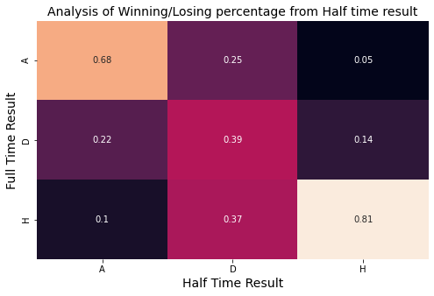
What is the percentage of winning or losing or ending a game in a draw from the half time result?
81% times the home team wins the game if it leads at half time.
68% times the away team wins the game if it leads at half time.

Slide 9
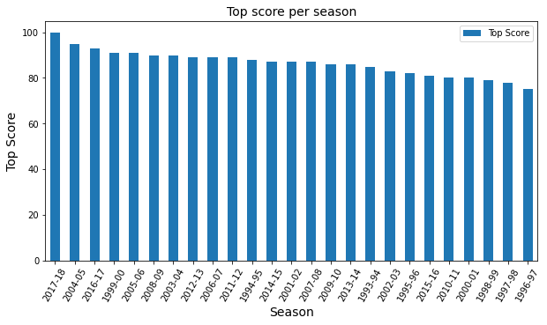
Which season has the top score?

Slide 10
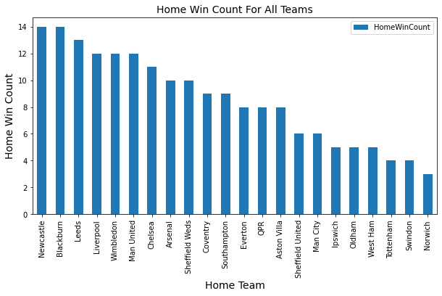
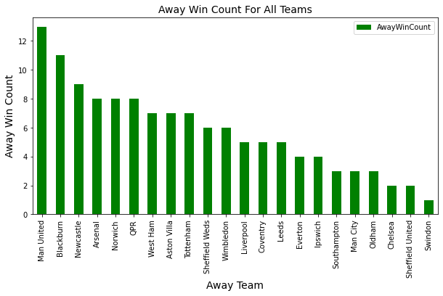
How many home and away games are won by a team in a particular season?
Newcastle United has the most number of home wins and Manchester United has the most number of away wins.

Slide 11
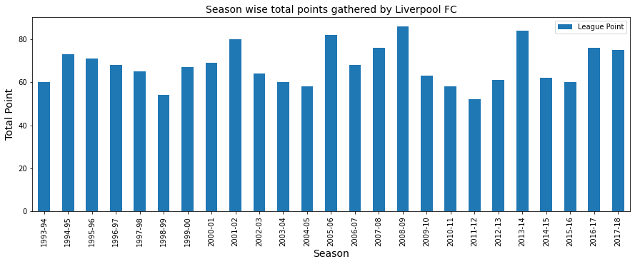
Which season was the most successful season for a particular team between 1993 to 2018?

