Slide 1
High cloud Airline Analysis
Group -2

Slide 2
Agenda
1.Introduction
2.Objective
3.KPI’S
4.Dashboard
5.Conclusion

Slide 3
Introduction:
The High cloud Airline project utilizes key performance indicators(KPIs) to enhance Airline management and risk management. By Analyzing Carrier wise based on transported passengers vs available seats and load factor vs year, quarter and month, load factor on weekdays vs weekend and top 10 routes based on the passenger preference and the top routes based on the distance.

Slide 4
Business Objective:-
The Business objective of the High Cloud Airline project is to optimize lending and risk management by analyzing KPIs like carrier name basis based on transported passengers vs available seats and year ,quarter and month basis based on the transported passengers vs available seats.

Slide 5
KPI’S:-
1.Year ,quarter and month wise load factor.
2.Load factor wise carrier name basis
3.Top 10 carriers
4.Top routes based on Number of flights.
5.weekends vs weekdays.
6.Number of flights based on distance group.

Slide 6
KPI 1:Year ,quarter and month wise load factor
From the bar chart as we can see the year wise load factor and month wise load factor , In the Year wise load factor 2008 and 2012 has the same percentage and 2011 has the highest percentage.
In the month wise load factor Feburary has the lowest load factor 7.45% and June has the highest load factor 8.96%.

Slide 7
KPI 2:load factor vs carrier name basis
From the chart we can see that the load factor wise 10 top carriers ,the first carrier is the South west Airlines has 24.09% and the second carrier is the delta airline has 19.02% and the last carrier Air Tran airways corporation has only 4.05%.

Slide 8
KPI 3:Top 10 Carrier Names
The Top 10 carrier names based on the passenger preference is the Delta Air line carrier based on the passenger preference And the last one is the United Parcel service based on the passeneger preference.

Slide 9
KPI 4:Top routes based on number of Flights:
The Top routes based on the number of flights which have been the more number of passengers travelling through the route.
From the Donout chart Chicago state has been the first and have more number of flights compared to the other states.

Slide 10
KPI5:Weekdays vs weekends
Weekday and weekend as we see from the pie chart of the weekday vs weekends the load factor was more in the weekdays as compared to the weekend days.
From the pie chart as we can observe that most of the people where travelling on the weekdays as compared to the weekends.

Slide 11
KPI 6:Number of flights based on distance group

Slide 12
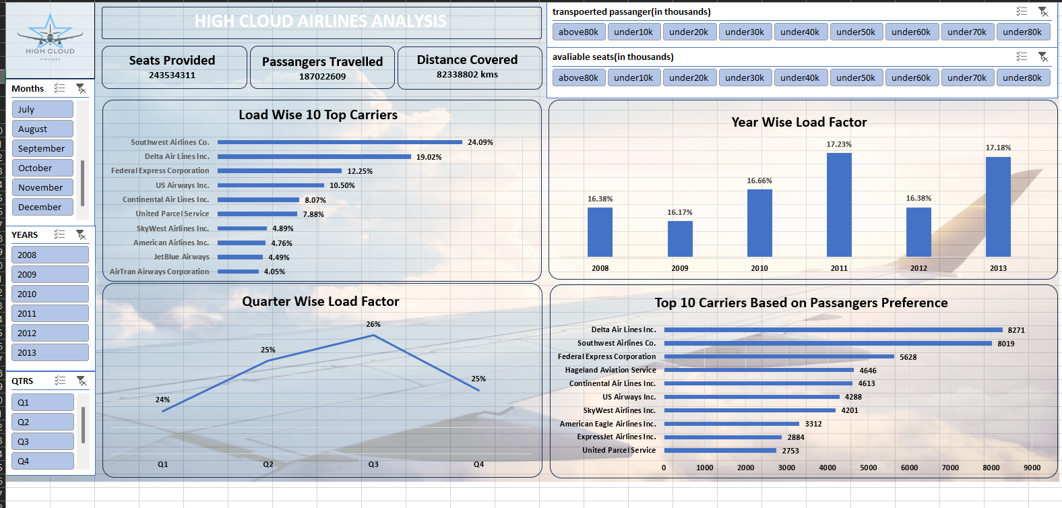
Excel dashboard:-

Slide 13
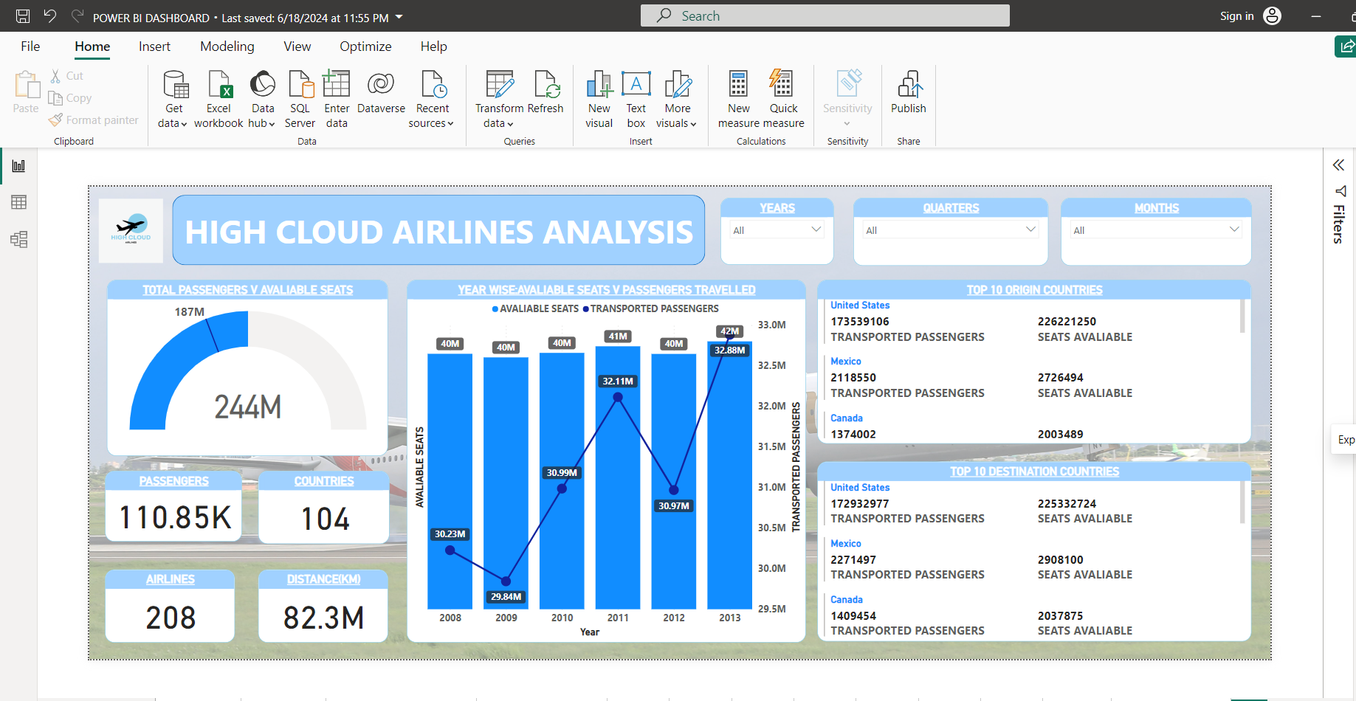
Power bi dashboard:-

Slide 14
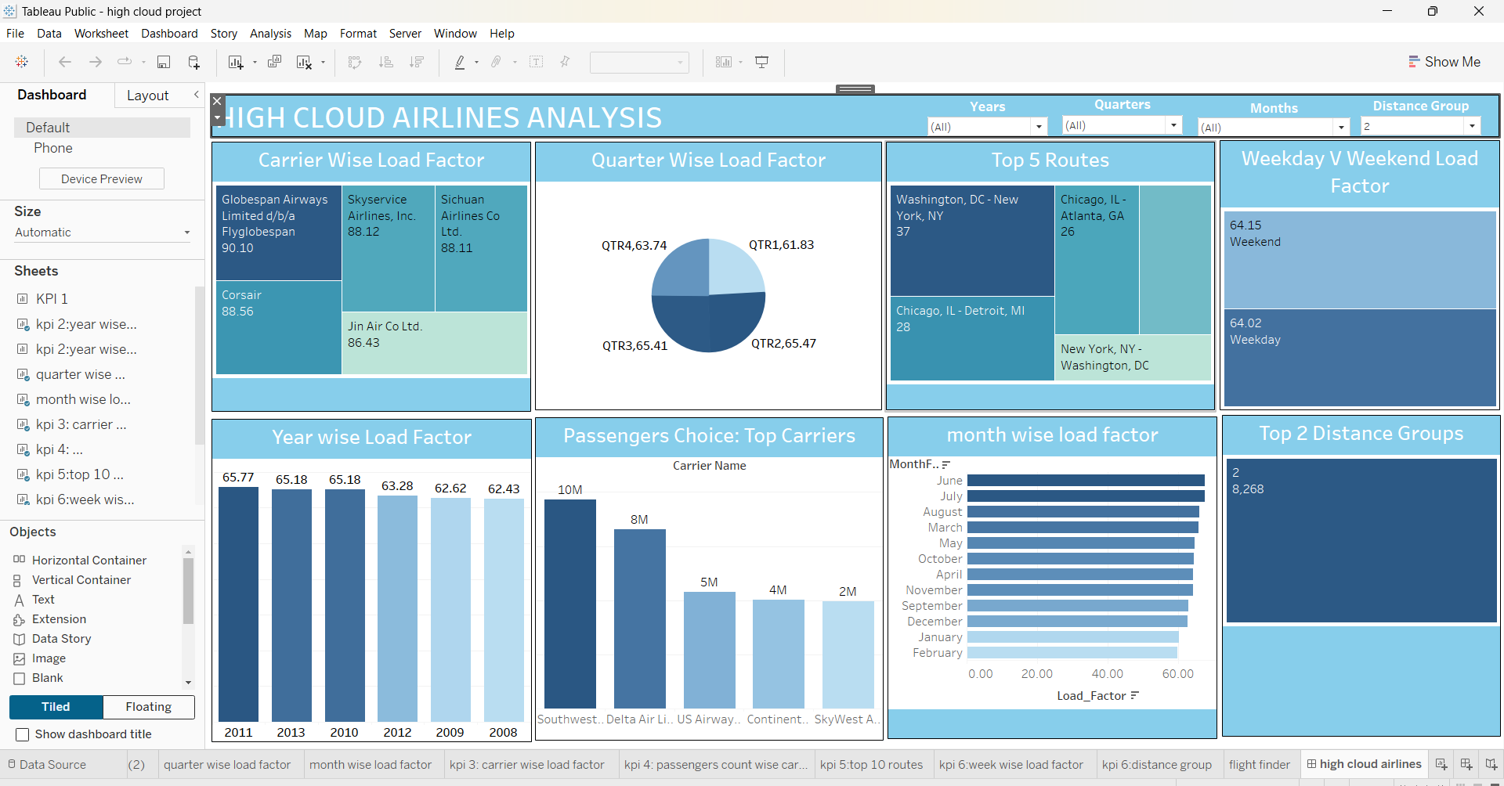
Tableau dashboard:-

Slide 15
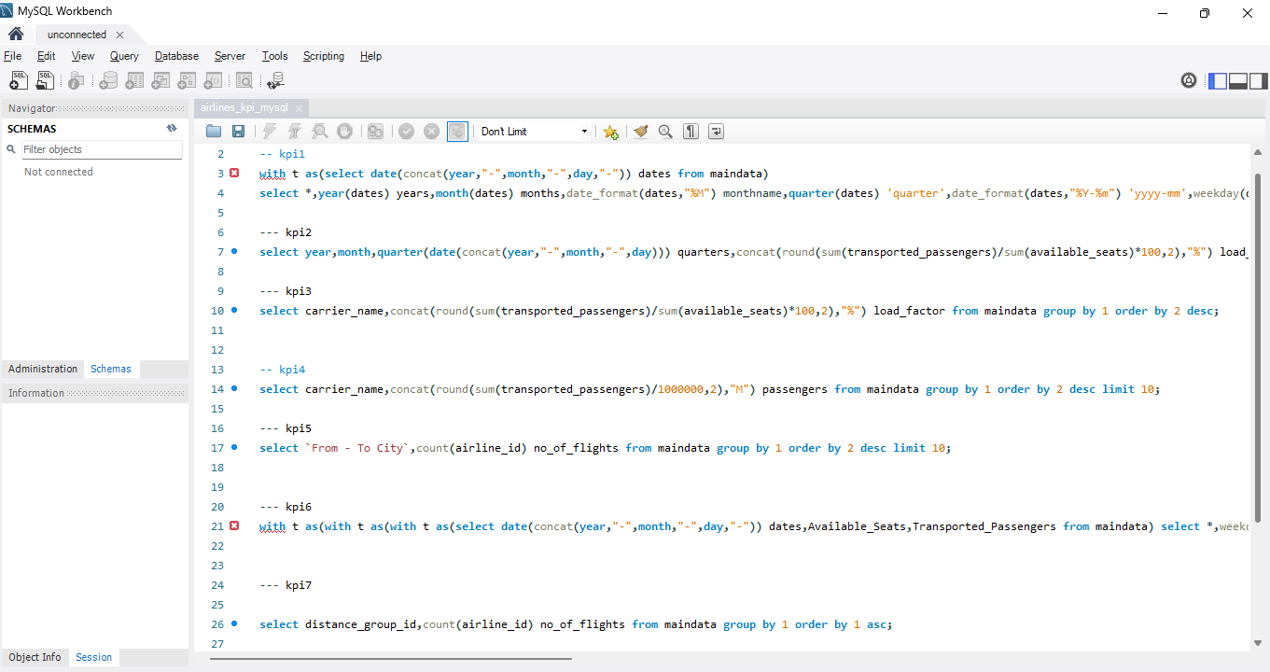
SQL KPI’S

Slide 16
THANK YOU

