Slide 1

Airbnb Advertisement Strategy
Power BI dashboard insights report
Data period: 5 May 2014 – 23 Apr 2015
Notes:
This report summarizes the four-page Power BI dashboard for Airbnb's advertisement strategy, covering 5 May 2014 to 23 April 2015.

Slide 2



Executive summary
Strong demand, but conversion leaks on iPhone and before the first message.
7,756
630
984
$245.11K
31.58%
Total visits
Unique visitors
Total bookings
Total revenue
Conversion rate
Audience
Conversion
Revenue
25–35 is the core age; ages 22–35 spend most; 56% of users are women.
iPhone converts at 21% vs Desktop's 47%; 59% of searches never reach a message.
Returning users bring 84.95% of revenue; the average booking is $249.10.
Notes:
Headline KPIs: 7,756 total visits, 630 unique visitors, 984 total bookings, $245.11K revenue and a 31.58% conversion rate (bookings divided by searches: 984 / 3,116). Average spend per booking is $249.10.

Slide 3
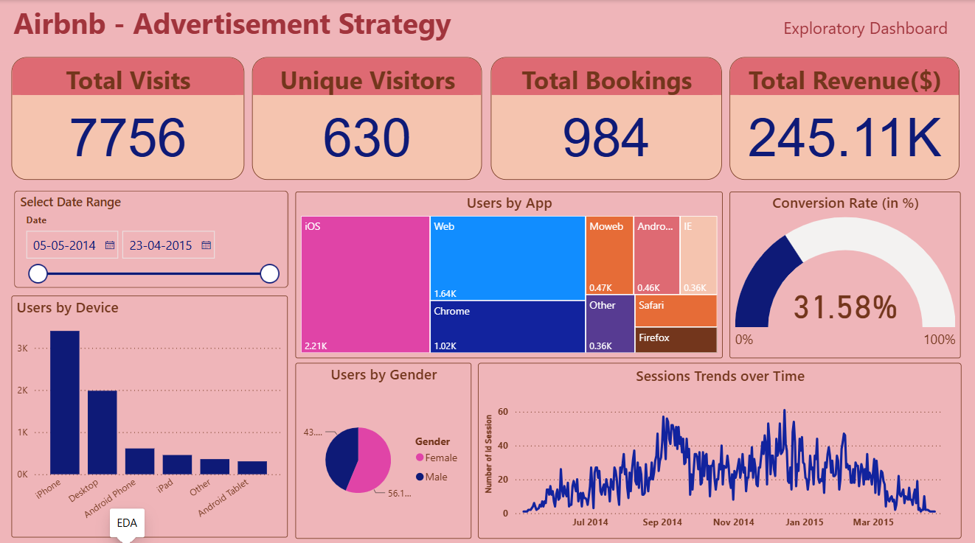
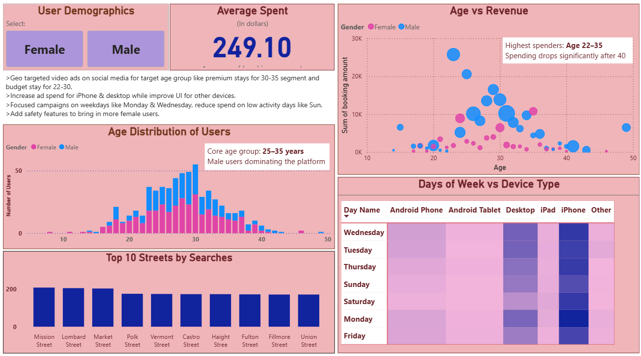
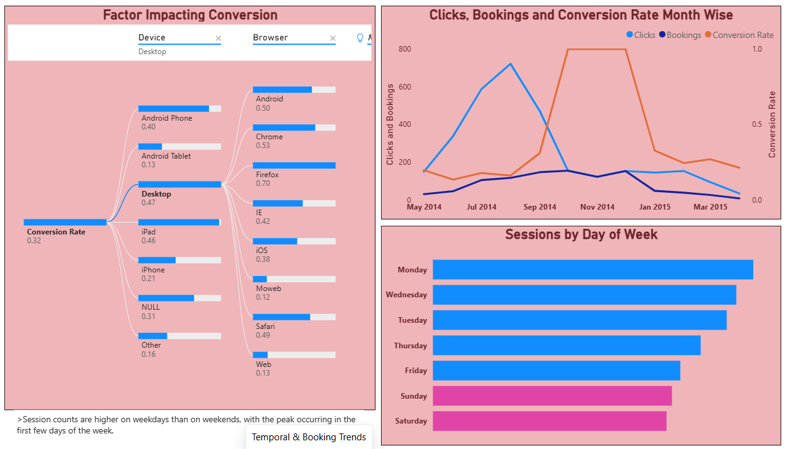
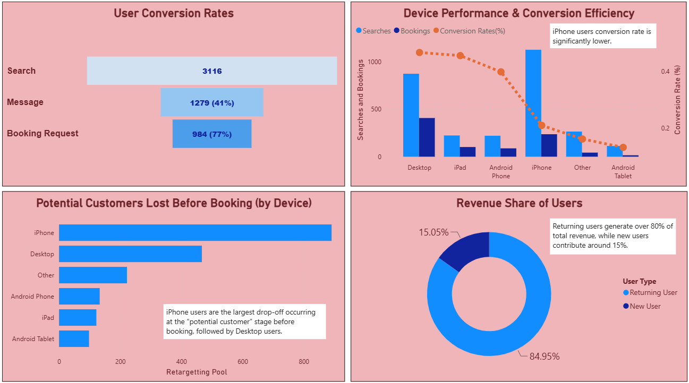
What the dashboard covers
Four report pages take us from raw traffic to revenue and ad strategy.
EDA
User Demographics
KPIs, devices, apps, trends
Age, gender and spend
Temporal & Booking Trends
Performance & Revenue Insights
Monthly and weekday trends
Funnel, devices, revenue
Notes:
The four dashboard pages: EDA (KPIs, devices, apps, session trend), User Demographics (age, gender, spend, streets), Temporal & Booking Trends (monthly and weekday patterns, conversion drivers), and Performance & Revenue Insights (funnel, device performance, revenue by user type).

Slide 4
Where traffic comes from
iPhone and iOS dominate; Desktop and Web follow.
Device values are approximate, read from the dashboard chart. App chart shows labelled segments only.
Notes:
From the EDA page. iPhone is the biggest device with roughly 3.4K users, then Desktop at about 2.0K. By app, iOS leads with 2.21K users, then Web 1.64K and Chrome 1.02K. Safari and Firefox segments are unlabelled in the dashboard so they are not shown.

Slide 5
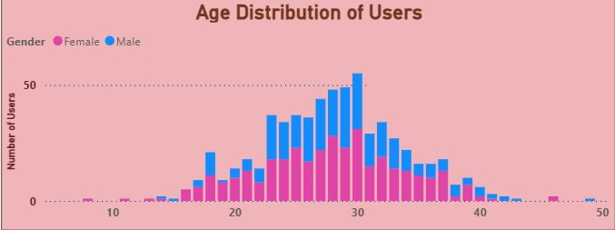
Who the users are
Women are 56% of users, and the core age group is 25–35.
25–35
≈30
core age group
age with the most users
Notes:
From the User Demographics and EDA pages. The gender pie shows 56.1% female and about 44% male. The age histogram peaks around 30, with the core group between 25 and 35. Note: the dashboard's own caption says male users dominate, but the gender pie shows women are the larger share of users; men stand out on spend (next slide).

Slide 6
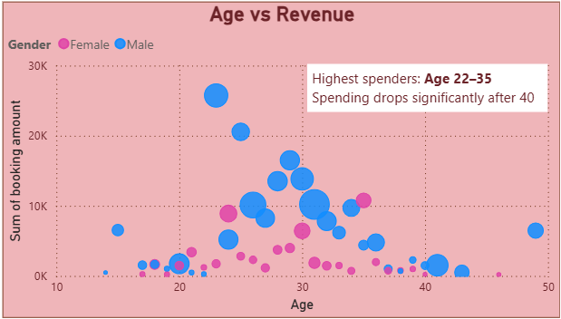
Who spends the most
Ages 22–35 spend the most, and the biggest spenders are mostly male.
$249.10
average spent per booking
22–35
highest-spending ages
40+
spending drops significantly
Notes:
From the Age vs Revenue scatter. Highest spenders are 22-35 and spending falls significantly after 40. The largest booking totals (up to roughly $26K for a single age) are male users, while female users cluster at lower totals. Average spent is $249.10.

Slide 7
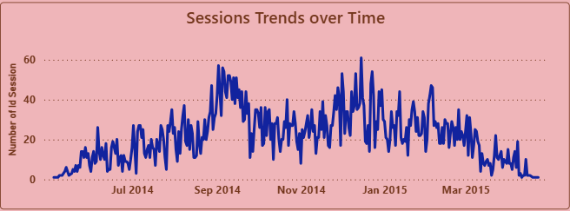
When users engage
Monday is the busiest day; weekends run about a quarter lower.
Seasonality
Daily sessions climb from July 2014, peak near 60 around Sep and Dec–Jan, then fade into spring 2015.
Index approximated from bar lengths in the dashboard chart.
Notes:
Sessions by day of week (Temporal & Booking Trends page): Monday is highest, then Wednesday and Tuesday; Saturday and Sunday are lowest. Bars are indexed to Monday = 100 from the chart's relative bar lengths, so treat values as approximate. The sessions trend from the EDA page shows growth from July 2014, peaks near 60 daily sessions around September and December/January, and a decline into March-April 2015.

Slide 8
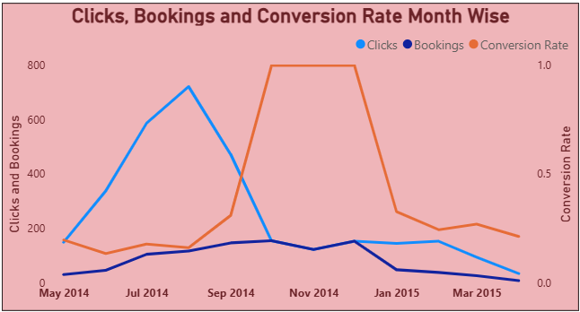
Monthly click-to-booking trend
Clicks peaked in Aug 2014; conversion hit ~100% in Oct–Dec.
Aug 2014: clicks peak near 720 while bookings keep climbing.
Oct–Dec 2014: conversion reaches ~100% as clicks fall to booking levels.
2015: clicks and bookings both fade; conversion settles near 0.2.
Notes:
From the Clicks, Bookings and Conversion Rate month-wise chart. Clicks peak at roughly 720 around August 2014. Between October and December 2014 clicks drop to about the same level as bookings, so the conversion rate reaches roughly 100%. In 2015 both fall and conversion settles around 0.2. Values are read from the chart and approximate.

Slide 9
The booking funnel
Most searches stop before a message; 31.58% convert end to end.
Search
3,116
59%
of searches never reach a message
Message
1,279 (41%)
77%
Booking request
98
of messages become booking requests
Notes:
User Conversion Rates funnel: 3,116 searches, 1,279 messages (41% of searches) and 984 booking requests (77% of messages). Overall conversion is 984 / 3,116 = 31.58%. The biggest leak is between search and message.

Slide 10
What drives conversion
Desktop converts 2.2x better than iPhone (47% vs 21%).
Overall conversion is 32%. Source: Factor Impacting Conversion decomposition tree.
Notes:
From the decomposition tree: overall conversion 0.32. By device: Desktop 0.47, iPad 0.46, Android Phone 0.40, iPhone 0.21, Other 0.16, Android Tablet 0.13 (NULL devices 0.31 not shown). Drilling into Desktop by browser/app: Firefox 0.70, Chrome 0.53, Android 0.50, Safari 0.49, IE 0.42, iOS 0.38, Web 0.13, Moweb 0.12. Web and Moweb are the weak spots.

Slide 11

Lost potential customers
iPhone loses the most potential customers, then Desktop.
iPhone’s lost pool is nearly twice Desktop’s.
A ready-made retargeting audience.
iPhone drives the most searches, yet converts at only 21%.
Retargeting pool values are approximate, read from the dashboard chart.
Notes:
From 'Potential Customers Lost Before Booking (by Device)': the retargeting pool is about 885 for iPhone and 465 for Desktop, then Other (~220), Android Phone (~130), iPad (~120) and Android Tablet (~100). From Device Performance: iPhone has the highest search volume (about 1.1K) but the conversion rate is only 21%.

Slide 12
Who drives revenue
Returning users generate 84.95% of total revenue.
$245.11K
total revenue from 984 bookings
$249.10
average spent per booking
Retention and re-engagement are the highest-value levers for ad spend.
Notes:
Revenue share donut: returning users 84.95%, new users 15.05%. Total revenue $245.11K over 984 bookings, which matches the $249.10 average spent per booking.

Slide 13
Recommendations
Four actions, each backed by the dashboard’s numbers.
1
Age-targeted video ads
2
Fix the iPhone funnel
Geo-targeted social video: premium stays for 30–35 and budget stays for 22–30, the top-spending ages.
Keep spending on iPhone and Desktop, but fix iPhone booking (21% vs 47%) and improve other devices’ UI.
3
Weekday timing
4
Build trust
Focus on Monday and Wednesday; cut Saturday and Sunday spend (weekends run ~25% below Monday).
Add safety features: women are 56% of users, and 59% of searches never reach a message.
Notes:
Recommendations extend the dashboard's own suggestions with the supporting numbers: age-targeted geo video ads, scaling iPhone/Desktop spend while fixing the iPhone booking flow, a Monday/Wednesday weekday focus, and safety/trust features (women are 56% of users and 59% of searches never reach a message).

Slide 14
Dashboard page 1 of 4
Original Power BI page: EDA
Notes:
Original Power BI dashboard page: EDA.

Slide 15
Dashboard page 2 of 4
Original Power BI page: User Demographics
Notes:
Original Power BI dashboard page: User Demographics.

Slide 16
Dashboard page 3 of 4
Original Power BI page: Temporal & Booking Trends
Notes:
Original Power BI dashboard page: Temporal & Booking Trends.

Slide 17
Dashboard page 4 of 4
Original Power BI page: Performance & Revenue Insights
Notes:
Original Power BI dashboard page: Performance & Revenue Insights.

