Slide 1
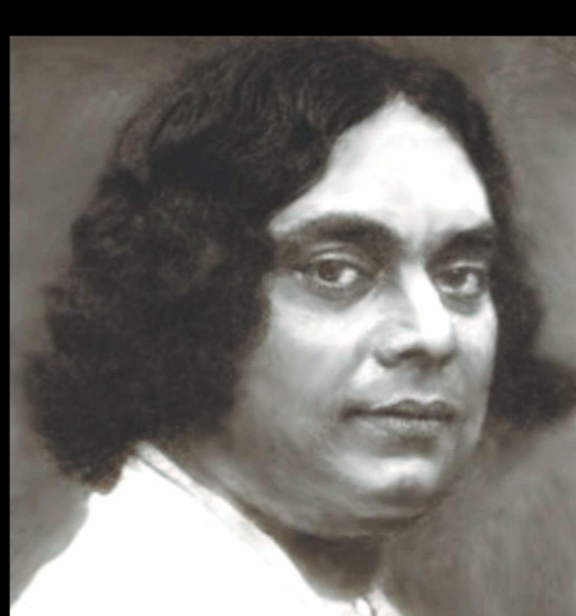
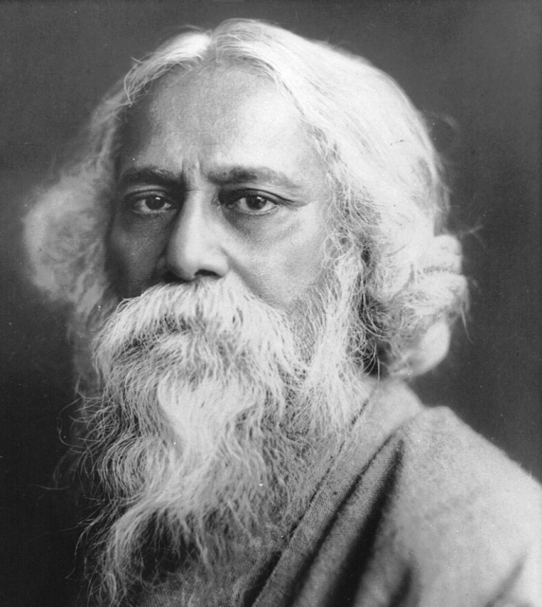
Gloucester Puja And Cultural Association
Presents
Rabindra Nazrul Sandhya
18th May 2024 (Saturday)

