Slide 1
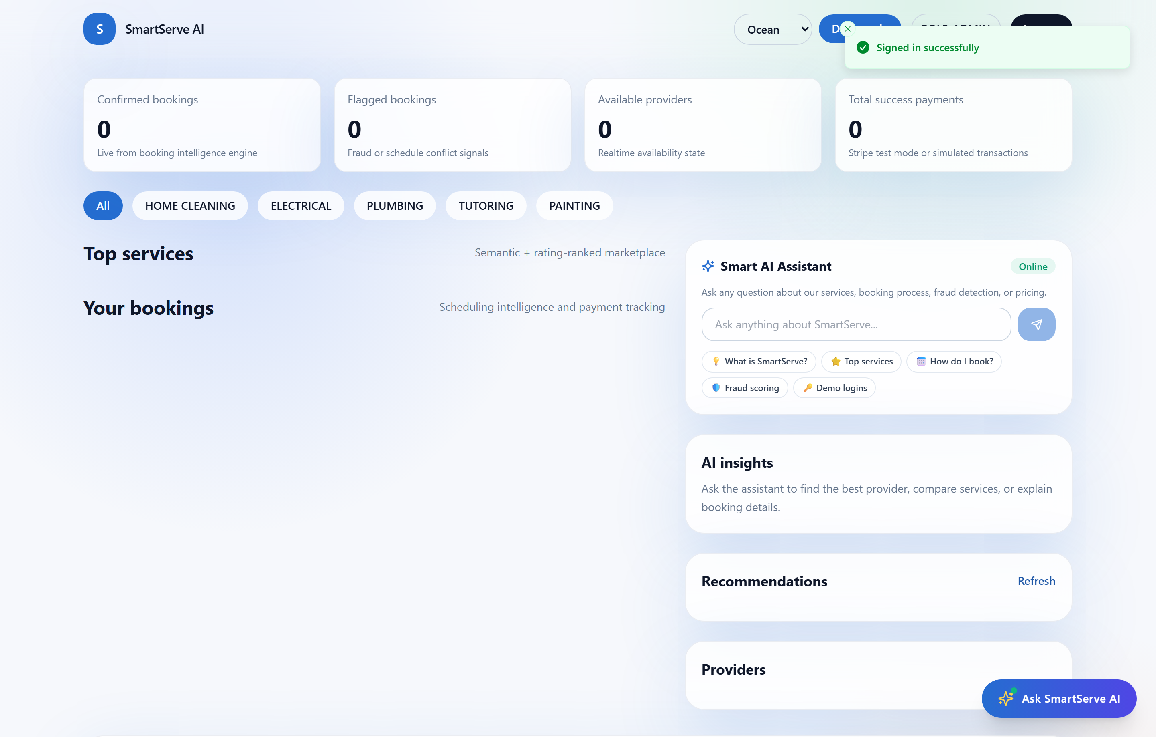
MCA IBST MINI PROJECT • BATCH 2025–2027
SmartServe AI
Intelligent Cloud-Native Local Service Marketplace with Multi-Vector Fraud Detection & AI Concierge
PRESENTER DETAILS & AFFILIATION
Candidate Name: Prasuk Goyal
Registration No: 2505286042
Academic Degree: Master of Computer Applications (MCA)
Institution: Srusti Academy of Management & Technology (Autonomous)
Affiliated To: Biju Patnaik University of Technology (BPUT), Odisha
Repository: github.com/subhrajitsamal910-happy/SmartServe

Slide 2
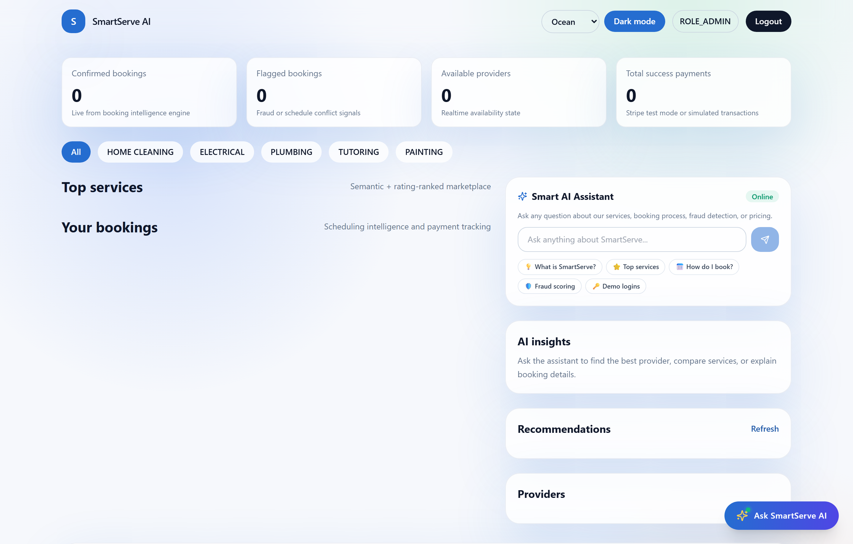
EXECUTIVE SUMMARY & SYSTEM SCOPE
Problem Statement, Proposed Solution & Core Features
THE PROBLEM IN LOCAL SERVICE DISCOVERY
• High Booking Friction: Manual scheduling causes frequent double-booking conflicts.
• Lack of Trust: Unverified local providers and opaque pricing structures.
• Booking Spam & Fraud: Platforms lack automated risk scoring to block bot attacks.
THE SMARTSERVE AI SOLUTION
• Automated Conflict Checking: Rejects overlapping provider slots in real-time.
• AI Fraud Risk Engine: Dynamic 0-100 heuristic scoring flags suspicious velocity.
• 6-Signal Personalization: Hybrid collaborative & popularity recommendation engine.
Real-Time Booking
Conflict-free
Fraud Guard
Risk Score >= 70
AI Concierge
NLP Assistant
Admin Telemetry
Live Analytics

Slide 3
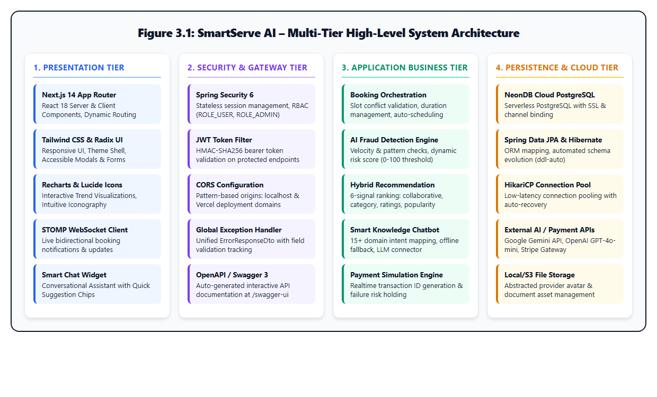
TECHNICAL BLUEPRINT & ARCHITECTURE
Technology Stack & Multi-Tier Architecture
1. PRESENTATION TIER (FRONTEND)
• Next.js 14 App Router, React 18, TypeScript
• Tailwind CSS for responsive dark/light UI
• Lucide Icons, Radix UI Modals, STOMP WebSocket
2. SECURITY & GATEWAY TIER
• Spring Security 6 with stateless JWT Bearer filter
• Role-Based Access Control (CUSTOMER, PROVIDER, ADMIN)
• SpringDoc OpenAPI 3.0 / Swagger UI at /swagger-ui
3. BUSINESS & AI ENGINES TIER
• Java 17 & Spring Boot 3.5 Core Services
• Multi-Vector Fraud Scorer (Velocity + Patterns + Slot Risk)
• 6-Signal Hybrid Personalized Recommendation Engine
4. PERSISTENCE & CLOUD TIER
• NeonDB Cloud PostgreSQL (Serverless, SSL Channel)
• Spring Data JPA & Hibernate ORM, HikariCP Pool
• 8 Normalized Relational Tables with Foreign Keys & Indexes

Slide 4
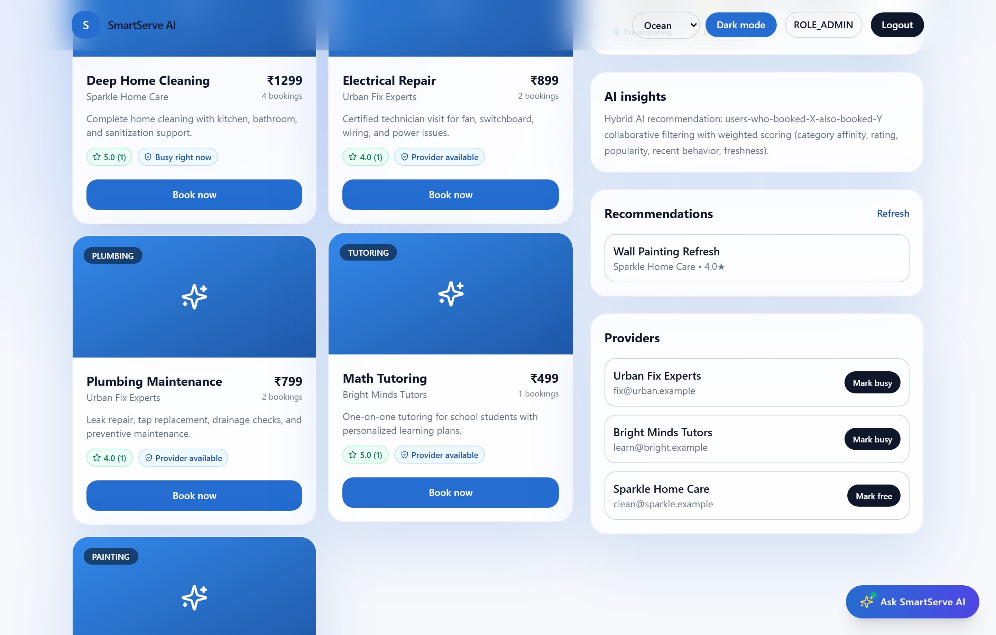
DEVELOPMENT LIFECYCLE & QUALITY ASSURANCE
Engineering Process, Prompts & 100% Test Verification
5-STAGE ENGINEERING WORKFLOW
1. Inception & PRD: Requirements gathering, user stories, role boundaries.
2. DB Schema & Security: 8-table 3NF schema, Spring Security JWT Bearer filter.
3. AI Intelligence Engines: Rule-based fraud detector & hybrid multi-signal ranking.
4. Next.js 14 Frontend: Component hierarchy, booking modal & AI chatbot concierge.
5. Automated Testing: 45 automated test scripts with 100% pass rate.
SAMPLE ANTIGRAVITY PROMPTS (PROMPT-DRIVEN BUILD)
• AI Fraud Scoring Prompt:
"Implement a heuristic booking fraud engine in Spring Boot evaluating velocity, off-hour slots, and previous flags with a 70-point threshold."
• Interactive Chatbot Prompt:
"Build a floating Next.js AI assistant widget with suggestion chips, intent matching, and real-time service recommendation fallback."
100% AUTOMATED TEST SUITE EXECUTION RESULTS
✓ 45 Total Test Cases Executed | ✓ 45 Passed (100% Pass Rate)
• Auth & Security Suite (7/7) • Service Catalog Suite (8/8)
• Booking Workflow Suite (8/8) • AI Fraud Engine Suite (8/8)
• AI Recommender Suite (7/7) • Admin Analytics Suite (7/7)

Slide 5

PROJECT CONCLUSION & REPOSITORY ACCESS
Conclusion, GitHub Repository & Acknowledgement
KEY PROJECT CONTRIBUTIONS & IMPACT
• Production-Ready Cloud Architecture: Full-stack integration of Java Spring Boot 3.5, Next.js 14, and serverless NeonDB PostgreSQL.
• Multi-Vector Fraud Defense: Proactive detection mechanism safeguarding against booking spam, off-hour abuse, and velocity spikes.
• Personalized Recommendations: 6-signal scoring formula ranking services based on collaborative affinity, popularity, and ratings.
• Empirical Quality Assurance: Validated by 45 automated end-to-end tests with 100% pass rate.
FUTURE ENHANCEMENTS ROADMAP
• Mobile Application: Cross-platform mobile client in React Native or Flutter.
• Production Payment Gateway: Integration with live Stripe / Razorpay webhooks.
• Deep Learning Recommender: Embedding-based neural collaborative filtering.
SCAN OR ACCESS CODEBASE
github.com/subhrajitsamal910-happy/SmartServe
THANK YOU!
Questions, Feedback & Discussion Welcome
Prasuk Goyal | MCA Batch 2025–2027

