Slide 1
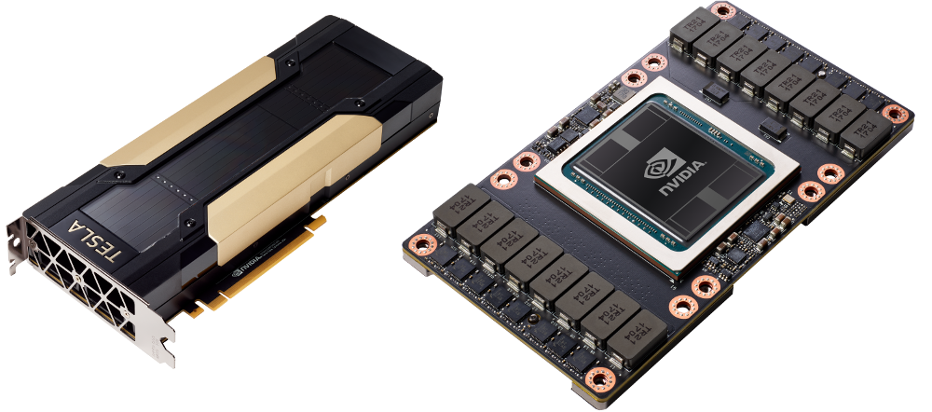
Introduction to GPU Architecture
Hamdy Sultan
Notes:
Hello everyone. In today's video, we'll be diving deep into the differences between CPUs and GPUs..

Slide 2


Motivation:
It is very important Video
The basic knowledge of the GPU Architectures.
Before programming any HW you need to understand it first.
Notes:
This video is very important because By its conclusion, you'll have the essential knowledge to understand GPU hardware architectures, with a particular focus on NVIDIA's designs.
Okay. Let’s start with the first question in this video, "Can't we simply write a code and run it on a GPU to get the optimal performance?" Surprisingly, the answer is no. A good understanding of every segment within the GPU is required to maximize its performance. To put it into perspective, imagine a doctor performing surgery. Without comprehensive knowledge of the human anatomy, the surgery could go wrong. Similarly, to unlock the GPU's full potential, one must be well-versed with its hardware, and this is the main purpose of this course.

Slide 3
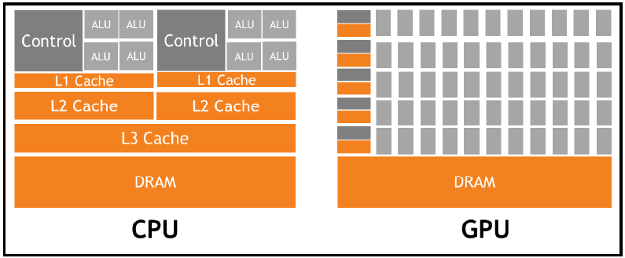
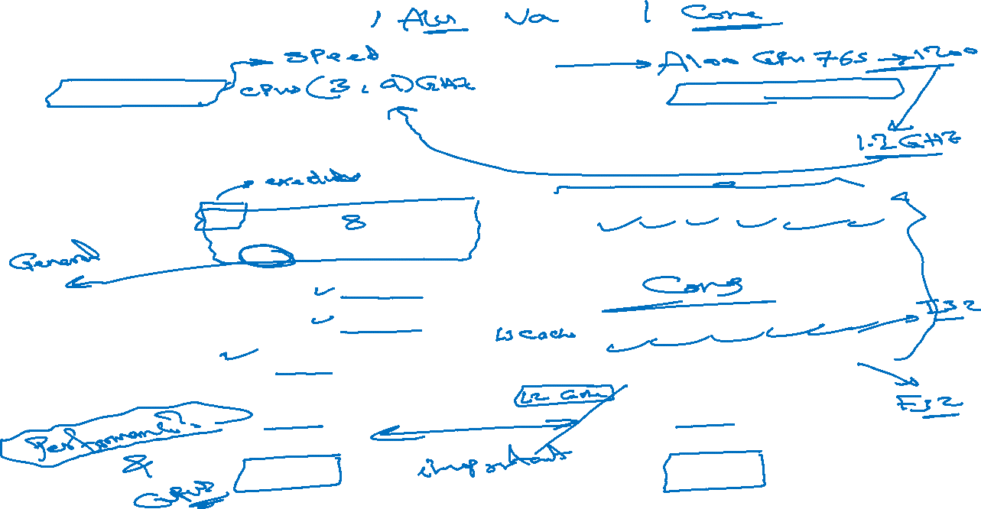
GPU Vs CPU
CPU
Powerful ALU.
Large Cache memory per ALU
Good for sequential applications
GPU
Thousands of small ALUs. (Or cores)
Small caches per core.
Good for parallelized applications.
Notes:
Now, onto the core topic: comparing CPUs and GPUs. Look at these two images: The first image represents the CPU while the second one represents the GPU. From the images, both CPUs and GPUs seem to contain similar components or units. For instance, both have DRAM or global memory. Moreover, they both have different cache memory levels. As shown here, the CPU contains three cache levels (L1, L2 and L3). On the other side, the GPU is equipped with two cache levels performing similar functions as those in the CPU. Next, we have the ALU unit which stands for Arithmetic and Logic Unit. This unit is responsible for executing instructions of any application. In the CPU, we have a limited number of ALU units, whereas the GPU houses hundreds or perhaps thousands of similar units called cores. Given these similarities, one might wonder about their differences and the reason that most systems require both CPUs and GPUs.
---
To address this, let's examine the ALU. In a one-to-one comparison, the ALUs in CPUs are markedly more powerful and complex than the cores in GPUs. Let’s take an example to explain the term powerful in this case. When referring to a "powerful" ALU, we're speaking of attributes such as speed. For example, modern CPUs can operate at frequencies reaching 3 or 4 gigahertz. On other hand, a 2020-released GPU, the A100 GPU from the Nvidia company, has core frequencies ranging from 765 to 1200 megahertz. 1200 megahertz means 1.2 gigahertz, which is roughly a quarter of the average CPU speed.
-------------
--Moreover, ALU units in the CPUs are designed for general-purpose tasks and often focus on executing a single thread quickly. It performs arithmetic operations (like addition, subtraction and maybe multiplication) and logic (AND, OR, NOT) operations. On the other hand, GPU Cores are more specialized, often designed to perform specific types of tasks very efficiently. For example, each core can execute one operation like floating-point operations. While other cores execute other operations such as integer operations.
Additionally, GPU Cores are designed for parallelism. They are optimized to process many threads simultaneously, making them ideal for tasks like rendering graphics where the same operation is applied to many data elements in parallel.
So, for the GPU cores, we can say that they can handle a specific set of tasks extremely efficiently due to their parallel processing nature. But the CPUs might have fewer ALUs but are more complex than the GPU cores and they are good in general tasks.
----
Understanding these distinctions is vital, but a further query arises: how do these differences impact application performance? After all, the primary aim of this course is optimizing application performance, using GPUs and parallel programming, right.
----
Considering this, let's examine the effect of core count differences on the applications performance.

Slide 4
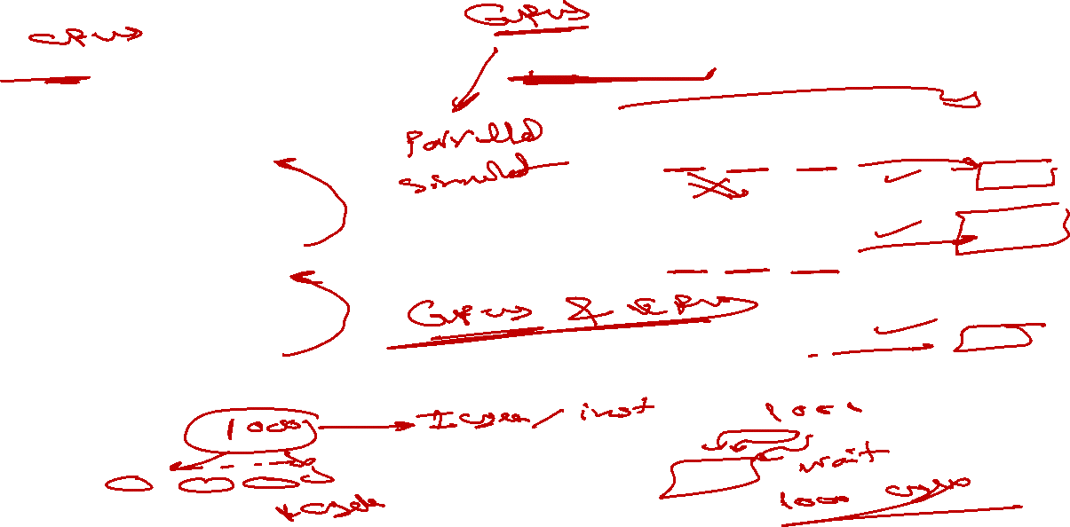
GPU hardware in general
Case 1
Dependent instructions
Case 2
independent instructions
Add R1 , R2 , R3
Mul R4 , R1 , R5
Div R6 , R4 , R7
Add R1 , R2 , R3
Mul R4 , R5 , R6
Div R7 , R8 , R9
Notes:
Here, we are going to study two scenarios. In the first, we assume most of the application instructions are dependent, meaning each instruction relies on its predecessor. To clarify this, let's draft some instructions for this scenario.
--
We start with three separate instructions, each performing a distinct operation. Here, in this instruction, we add two values, then we multiply them in the second instruction, and finally, we use this instruction to divide them. Specifically, our initial instruction takes the values from registers r2 and r3, adds them together, and stores the result in r1. Next, we multiply the value in r1 with r5, storing the outcome in r4. Now, a crucial point to note here is the interdependency of these instructions. If you observe the second instruction, it uses r1 – the same register that was involved in the preceding addition. This means before we can carry out the multiplication, the addition needs to be complete. Thus, the second instruction depends on the result of the first. Similarly, our division operation waits for the result of the multiplication operation because it involves r4, where the multiplication result is stored. This method of processing is termed “sequential execution” which means that the instructions follow one another in a series.
---
So, in this example, we need 3 steps to execute these 3 instructions. Now, you might wonder: Why not utilize multiple cores for these instructions to execute them in parallel in one step? Well, even with three separate cores handling the add, multiply, and divide operations, they wouldn't operate simultaneously. The second would still await the first, and the third would wait for the second. Thus, in scenarios like this, a single core, like those found in CPUs, is ideal especially if we have thousands of dependent instructions.
----
This might lead to another question: If CPUs are optimal for such processes, when would we need the GPUs? The answer lies in the nature of the operations or the instructions. While the scenario we discussed is best suited for CPUs, GPUs shine brightest in situations where instructions within an application are non-dependent or independent. To clarify this point, let’s dive into another example.
---
delving deeper using our previous examples of the add, multiply, and divide instructions. This time, however, there's a twist: each instruction is independent of the others. For instance, while we add values from registers r2 and r3 and store the result in r1, our multiplication doesn't depend on this outcome. Instead, it multiplies values from r5 with r6 and saves the result in r4.
----
With such independence between instructions, if we have multiple cores available, we can assign each instruction to a separate core and execute them simultaneously. This can happen on a large scale, with thousands of instructions running concurrently across numerous cores. Imagine that we have 1000 instructions with each requiring just 1 cycle for execution. In this independent scenario, all instructions would be executed in parallel at once on 1000 cores, finishing collectively in just one cycle. However, in a dependent situation, it would take 1000 cycles because each instruction must wait for its predecessor to finish.
---
From our discussion, we can deduce that CPUs are specifically designed for operations that are sequential or reliant on previous instructions. On the other hand, when dealing with tasks filled with numerous independent instructions, GPUs take the lead due to their capability to run multiple instructions simultaneously across various cores. It's vital فايتال وليس فيتال to grasp this differentiation because there's a myth that GPUs consistently are better than CPUs in all circumstances, but that's not the absolute truth.
---

Slide 5
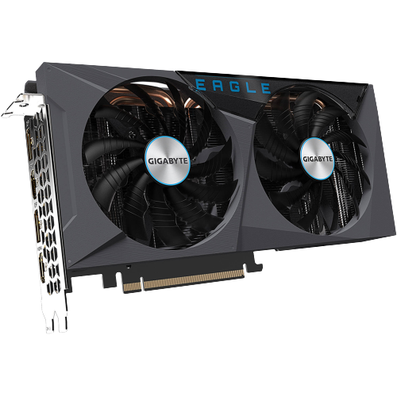
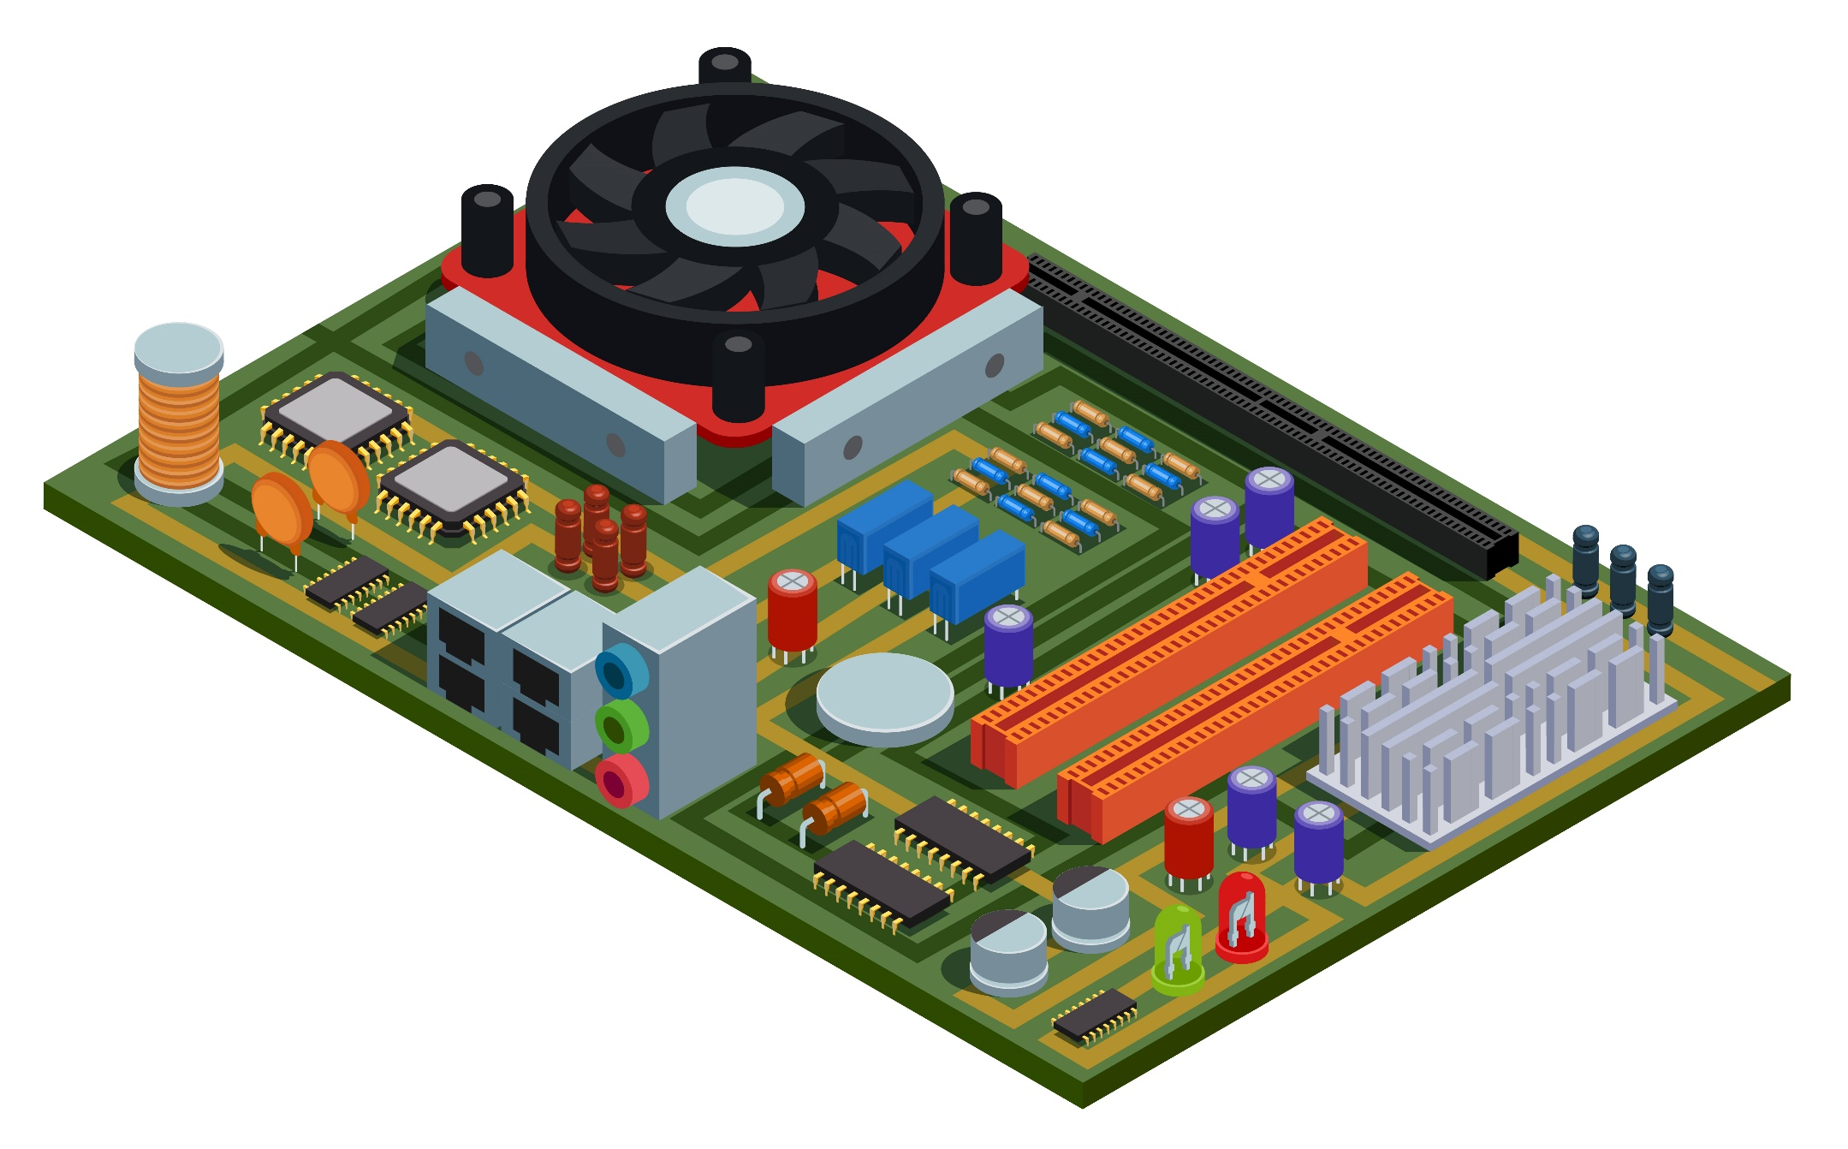
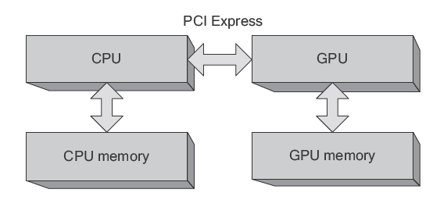
GPU hardware in general
image: Freepik.com
bhphotovideo.com
The CUDA Handbook_ A Comprehensive Guide to GPU Programming
Notes:
Moving on, let's explore how CPUs and GPUs coexist in most systems. let's start with this picture here which represents a general motherboard that exists in most of our computers.
Here, you can observe a fan dedicated to keeping the CPU cool and protecting it from overheating. This CPU interfaces with various components through some types of connections. For example, here, we have the DRAM socket, the power interface, and notably, the PCI interfaces. The PCI interface is very essential, as it allows connection to several cards, including GPUs, network cards, and sound cards. By slotting a GPU into this interface, it establishes a direct link via the motherboard's pathways to the CPU.
---
This setup here is commonly depicted in most literature, showing the connection between the CPU and GPU.
As shown, you'll observe the CPU, which is connected to the GPU through the PCI interface. Alongside with the CPU, there's the CPU global memory, or DRAM. Similarly, the GPU has its dedicated memory as shown here.
Referring back to the previous image, the CPU’s global memory or its RAM is po(z)sitioned here, in this socket, directly connected to the CPU through certain pathways or a bus.
For the GPU, it is equipped with its own DRAM or global memory. Which can be found on the electronic board inside this box.
----
Here I want to mention that while many of you might find this very simple, my aim is to explain can clarify every part, starting from the basics.

Slide 6
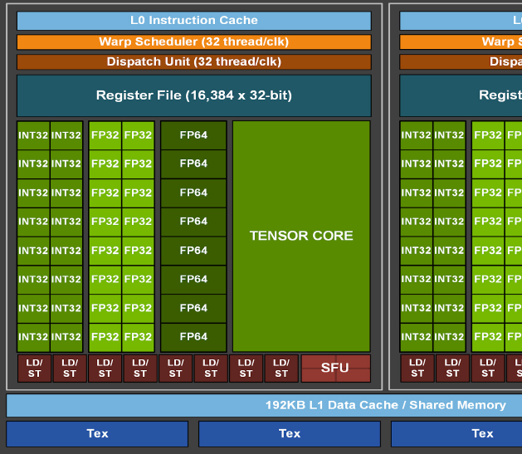
GPU hardware in general
Core
Core
Core
Core
Core
Core
SM
SM
SM
Core
Core
Core
Core
Core
Core
L2 Cache Memory
Core
Core
Core
Core
Core
Core
Scheduler and dispatcher
Core
Core
Core
Core
Core
Core
SM
SM
SM
Core
Core
Core
Core
Core
Core
Shared memory / L1 Cache Memory
Device Global Memory
Registers
Scheduler and dispatcher
Notes:
Shifting focus, let's delve into the key components that exist in GPUs, particularly focusing on NVIDIA GPUs.
The green box shown here represents the GPU card. Within the GPU, there's a crucial unit named the streaming multiprocessor which is often abbreviated as SM .
The term SM will frequently appear in this course, making it essential to grasp its significance from this lecture. Alongside the SM, various فيروس وليس فاريسmemory levels can be found in the GPUs, such as the L2 cache memory and the global memory. Additionally, elements like the scheduler and dispatcher are present and we will delve deeper into these components in upcoming videos.
Diving further into the SM, it houses an array of memory types like shared memory and the L1 cache memory. Additionally, it incorporates registers and, as mentioned earlier, its own scheduler and dispatcher. Both the scheduler and dispatcher, as well as the different memory types, can be found not just within the GPU framework but also within each SM.
As we advance in our discussions, we'll explain the differences between these units. But for now, this serves as a basic overview of GPU architecture.
Delving deeper into the SM, it's equipped with a variety of cores designed for specific tasks. Some of these cores might be dedicated to executing floating-point operations, while others execute integer operations. Also, here, in this part, there are units designed for executing specific functions, such as sine, cosine, tan, and log calculations.
---
Now, let’s look at a real GPU example from Nvidia. And also look at one of its SMs. Consider the A100 GPU which is released in 2020. What we're looking at here represents just a single SM, not the entire GPU. Within this SM, there's the L1 cache memory. It's essential to note that while the L1 cache level is situated within the SM, the L2 cache memory is a part of the broader GPU and not specifically within the SM. Additionally, as we mentioned, the SM houses a scheduler unit, a dispatcher unit, and several registers.
In terms of execution or functional units, the SM is quite diverse. We find tensor cores specifically designed for matrix multiplication operations, floating point cores dedicated to handling floating point operations, and integer cores. There are also special function units tailored for particular tasks as we discussed a few seconds ago. And when it comes to memory interactions, the SM features load and store units, which are responsible for reading from and writing values to the memory.
This detailed image provides a snapshot of only a quarter of one SM as found in the whitepaper or the datasheet of the GPU Ampere architecture. In upcoming videos, we'll delve deeper into what whitepapers are, where they can be accessed, and other related nuances
This particular image provides a detailed look at the specifications of Nvidia's A100 GPU. Within the A100, there are approximately 108 SMs. Each SM contains 64 single precision units or cores. This means that the entire GPU houses around 7000 single precision cores which is a very high count. However, remember, this is only accounts for single precision operations. The GPU also holds another 7000 units designated for integer operations, as well as additional special functional units and tensor cores. The sheer computational power of these cores with its high count is why the A100 GPU is a central component in numerous high-performance supercomputers globally.
-----
For example, Meta recently announced their ambitious project to construct the world's most powerful supercomputer. If you refer to the official Meta website's article, it becomes evident that their supercomputing architecture heavily relies on the A100 systems. In the realm of recent developments, there's speculation that they might integrate the newly unveiled H100 GPU which is lunched in 2022. This is two years following the release of the A100 GPU or the Ampere architecture. Comparing to the A100 GPU, the H100 boasts further advancements and enhancements.
--------
To highlight the significance of Nvidia GPUs, especially the A100 GPU, let's delve into the top 500 supercomputers worldwide. You can find this list on the "Top 500" website, which provides detailed information about the world's leading supercomputers . as we see here is the top500 website , --- stop here for 5 seconds --- .
Let's navigate to the list and specifically search for the presence of the A100.
(read this more slowly) As observed in this picture, the A100 GPU exists in 3 of the top 0 supercomputers. Specifically, it's integrated into the fourth-ranked supercomputer, known as the Leonardo supercomputer, as well as the supercomputers ranked at numbers 7 and 8.
Thank you for delving into the world of GPUs with us. Remember, technology is ever-evolving. Stay curious, and I'll see you in the next video!

Slide 7

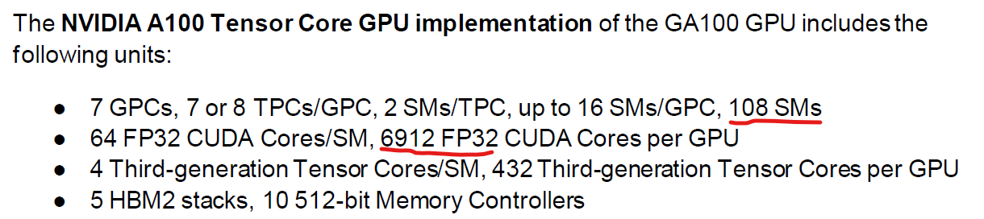
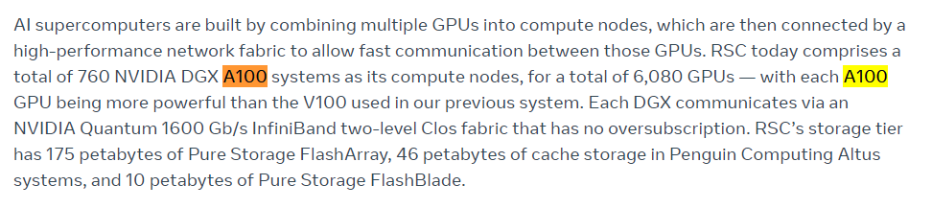
GPU hardware in general
Notes:
Shifting focus, let's delve into the key components that exist in GPUs, particularly focusing on NVIDIA GPUs.
The green box shown here represents the GPU card. Within the GPU, there's a crucial unit named the streaming multiprocessor which is often abbreviated as SM .
The term SM will frequently appear in this course, making it essential to grasp its significance from this lecture. Alongside the SM, various فيروس وليس فاريسmemory levels can be found in the GPUs, such as the L2 cache memory and the global memory. Additionally, elements like the scheduler and dispatcher are present and we will delve deeper into these components in upcoming videos.
Diving further into the SM, it houses an array of memory types like shared memory and the L1 cache memory. Additionally, it incorporates registers and, as mentioned earlier, its own scheduler and dispatcher. Both the scheduler and dispatcher, as well as the different memory types, can be found not just within the GPU framework but also within each SM.
As we advance in our discussions, we'll explain the differences between these units. But for now, this serves as a basic overview of GPU architecture.
Delving deeper into the SM, it's equipped with a variety of cores designed for specific tasks. Some of these cores might be dedicated to executing floating-point operations, while others execute integer operations. Also, here, in this part, there are units designed for executing specific functions, such as sine, cosine, tan, and log calculations.
---
Now, let’s look at a real GPU example from Nvidia. And also look at one of its SMs. Consider the A100 GPU which is released in 2020. What we're looking at here represents just a single SM, not the entire GPU. Within this SM, there's the L1 cache memory. It's essential to note that while the L1 cache level is situated within the SM, the L2 cache memory is a part of the broader GPU and not specifically within the SM. Additionally, as we mentioned, the SM houses a scheduler unit, a dispatcher unit, and several registers.
In terms of execution or functional units, the SM is quite diverse. We find tensor cores specifically designed for matrix multiplication operations, floating point cores dedicated to handling floating point operations, and integer cores. There are also special function units tailored for particular tasks as we discussed a few seconds ago. And when it comes to memory interactions, the SM features load and store units, which are responsible for reading from and writing values to the memory.
This detailed image provides a snapshot of only a quarter of one SM as found in the whitepaper or the datasheet of the GPU Ampere architecture. In upcoming videos, we'll delve deeper into what whitepapers are, where they can be accessed, and other related nuances
This particular image provides a detailed look at the specifications of Nvidia's A100 GPU. Within the A100, there are approximately 108 SMs. Each SM contains 64 single precision units or cores. This means that the entire GPU houses around 7000 single precision cores which is a very high count. However, remember, this is only accounts for single precision operations. The GPU also holds another 7000 units designated for integer operations, as well as additional special functional units and tensor cores. The sheer computational power of these cores with its high count is why the A100 GPU is a central component in numerous high-performance supercomputers globally.
-----
For example, Meta recently announced their ambitious project to construct the world's most powerful supercomputer. If you refer to the official Meta website's article, it becomes evident that their supercomputing architecture heavily relies on the A100 systems. In the realm of recent developments, there's speculation that they might integrate the newly unveiled H100 GPU which is lunched in 2022. This is two years following the release of the A100 GPU or the Ampere architecture. Comparing to the A100 GPU, the H100 boasts further advancements and enhancements.
--------
To highlight the significance of Nvidia GPUs, especially the A100 GPU, let's delve into the top 500 supercomputers worldwide. You can find this list on the "Top 500" website, which provides detailed information about the world's leading supercomputers . as we see here is the top500 website , --- stop here for 5 seconds --- .
Let's navigate to the list and specifically search for the presence of the A100.
(read this more slowly) As observed in this picture, the A100 GPU exists in 3 of the top 0 supercomputers. Specifically, it's integrated into the fourth-ranked supercomputer, known as the Leonardo supercomputer, as well as the supercomputers ranked at numbers 7 and 8.
Thank you for delving into the world of GPUs with us. Remember, technology is ever-evolving. Stay curious, and I'll see you in the next video!

Slide 8
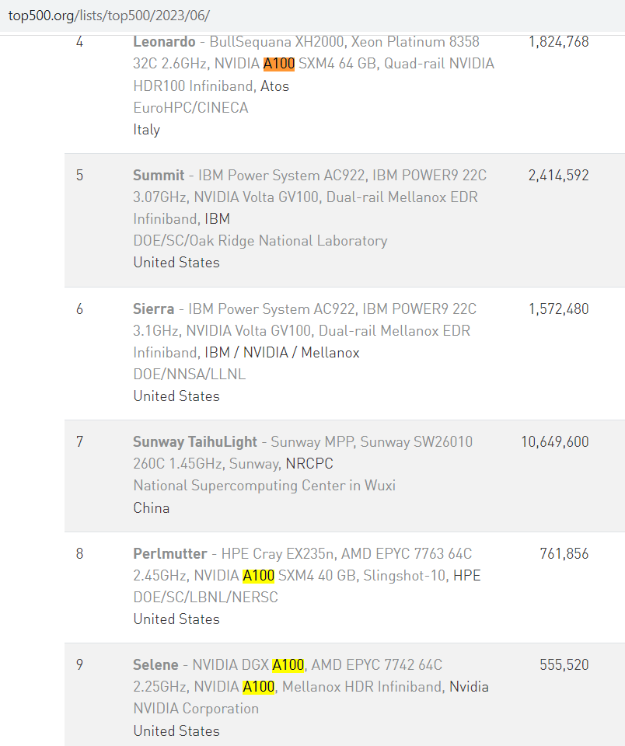
GPU hardware
Notes:
To highlight the significance of Nvidia GPUs, especially the A100 GPU, let's delve into the top 500 supercomputers worldwide. You can find this list on the "Top500" website, which provides detailed information about the world's leading supercomputers . as we see here, the A100 GPU is prominently featured in several supercomputers. Specifically, it's integrated into the fourth-ranked supercomputer, known as the Leonardo supercomputer, as well as the supercomputers ranked at numbers 8 and 9.
Okay.

Slide 9
GPU Vs CPU
Thanks
Notes:
Thank you for delving into the world of GPUs with us and I'll see you in the next video!

Slide 10
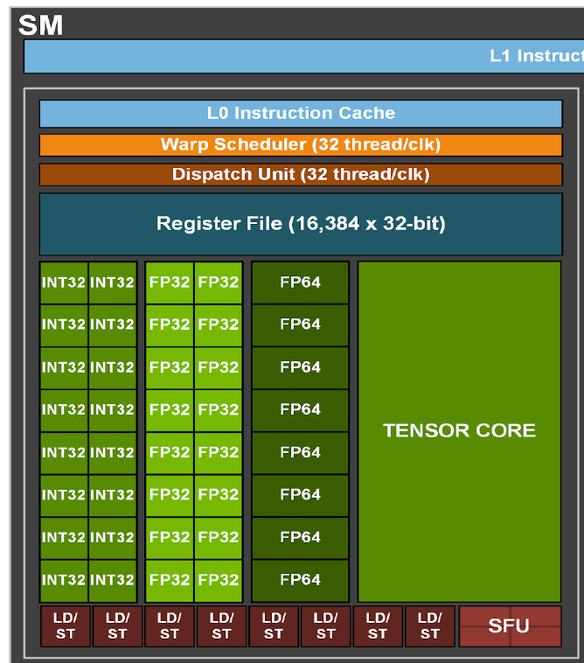
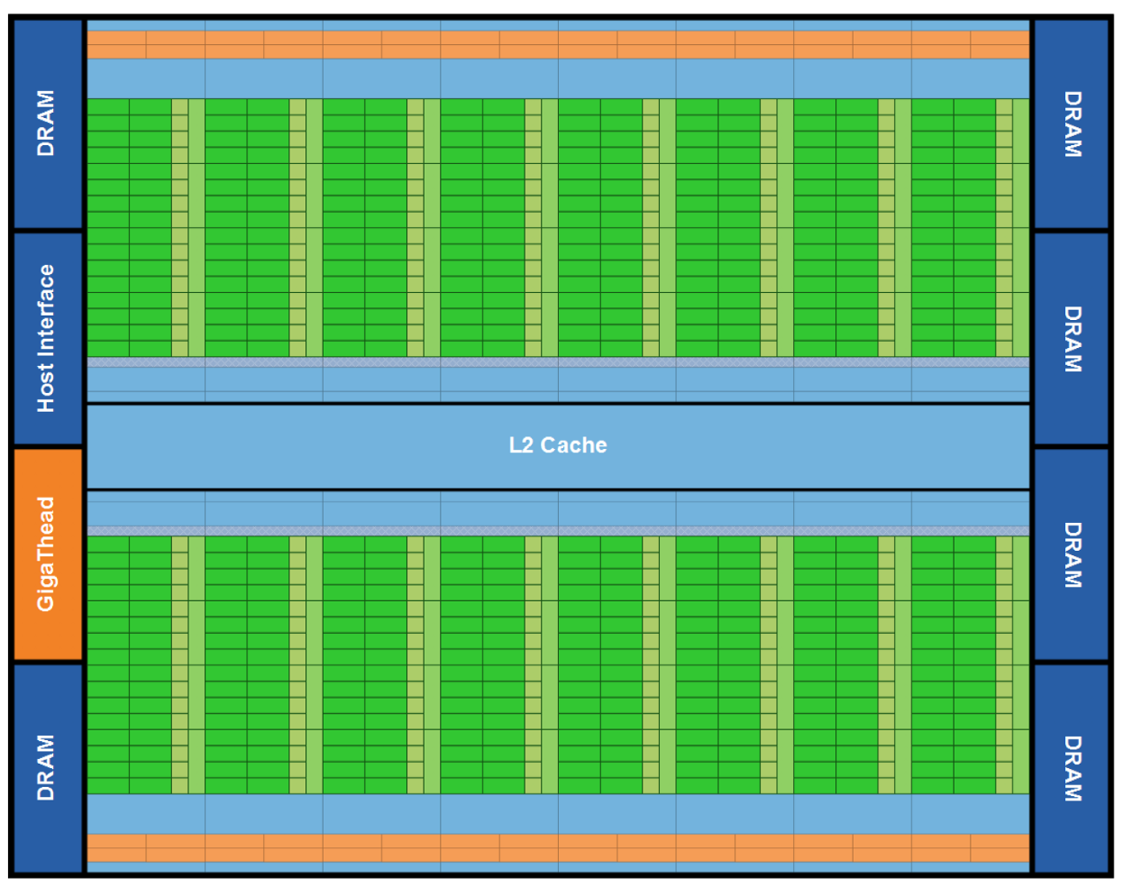

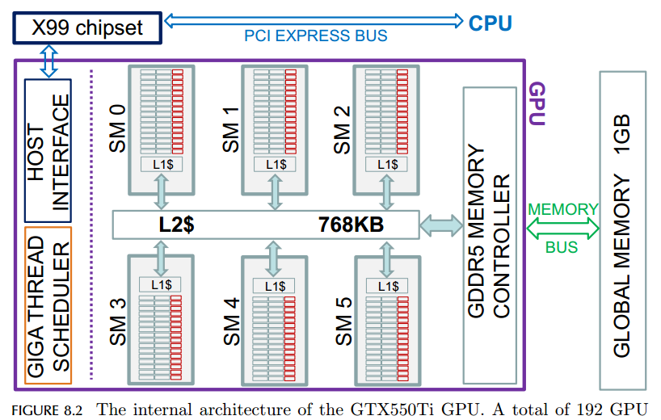
GPU hardware in general
Host interface
PCI.
Streaming multiprocessor (SM)
Consists of many cores (in basic).
Cores
Integer, floating and special
Giga-thread scheduler
Used to assign blocks to SM.
Different types of Memory
Global M, L2 cache, L1 cache. registers.
image: Freepik.com
bhphotovideo.com

Slide 11
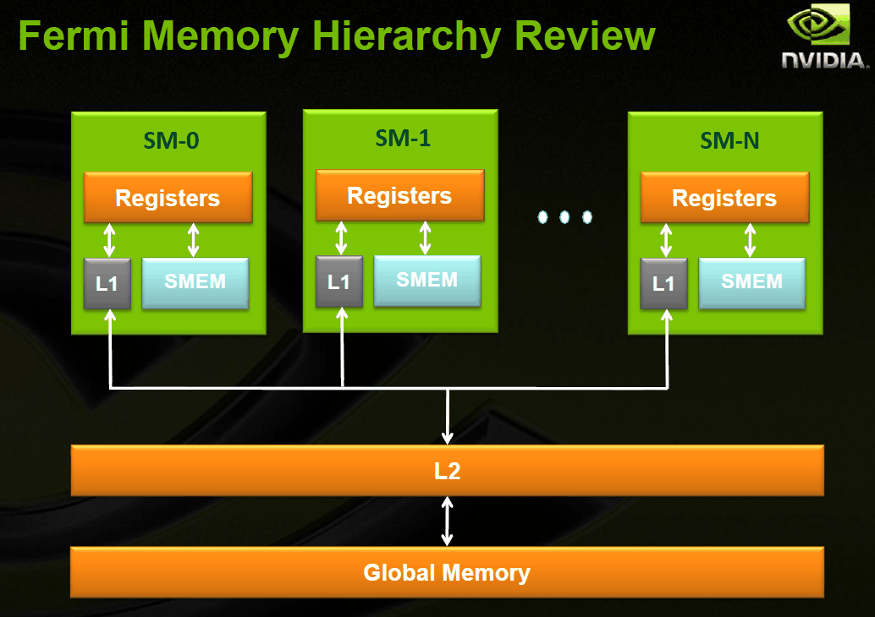
GPU memory hierarchy
Global memory
Accessible by all threads and the CPU –
L2 cache
Accessible by all threads
L1 cache
Accessible by all threads inside the block
(Hardware Cache)
Shared memory
Accessible by all threads inside the block
Programmable (Software cache)
Allows for threads to communicate and share data between one another
registers
Per thread (lifetime is the thread lifetime)
Src:http://xiongz-hft.blogspot.com/2011/11/nvidia-gpu-fermi-memory-hierarchy.html

