Slide 1
GlucoTwin
A Digital Twin that warns of glucose excursions 2 hours ahead
by fusing EHR and wearable / CGM data (Type 2 Diabetes)
Happiest Health · Reimagining and Reforming Healthcare in India Summit 2026 · Digital Twin Challenge
Team: Digital Twiner · College: Birla Institute of Technology, Mesra
Notes:
Introduce team and the one-sentence pitch: a virtual patient that sees a glucose spike coming two hours before it happens.

Slide 2
Why diabetes needs a twin, not a snapshot
Millions
Minutes
5 min
of people live with diabetes in India
of doctor time every few months, per patient
how often glucose, heart rate and sleep data change on a wearable
Today's care reacts after the spike. A Digital Twin keeps a living virtual replica of each patient, updated by wearables and joined with the health record, so the care team can act before an adverse event.
GlucoTwin · trained on synthetic data, checked on CGMacros · research prototype
2
Notes:
Source for the diabetes figure: ICMR-INDIAB, Anjana RM et al., Lancet Diabetes & Endocrinology 2023 (about 101 million people). The exact figure and citation are in the README.

Slide 3
Use case: forecast, explain, test a fix
Condition
Type 2 Diabetes
Adverse event
Glucose above 180 mg/dL at any time in the next 2 hours (currently at or below 160)
User
Diabetologist or care team looking at a virtual patient console
Output
Probability + expected peak + risk level + 'why' + what-if simulation
GlucoTwin · trained on synthetic data, checked on CGMacros · research prototype
3

Slide 4
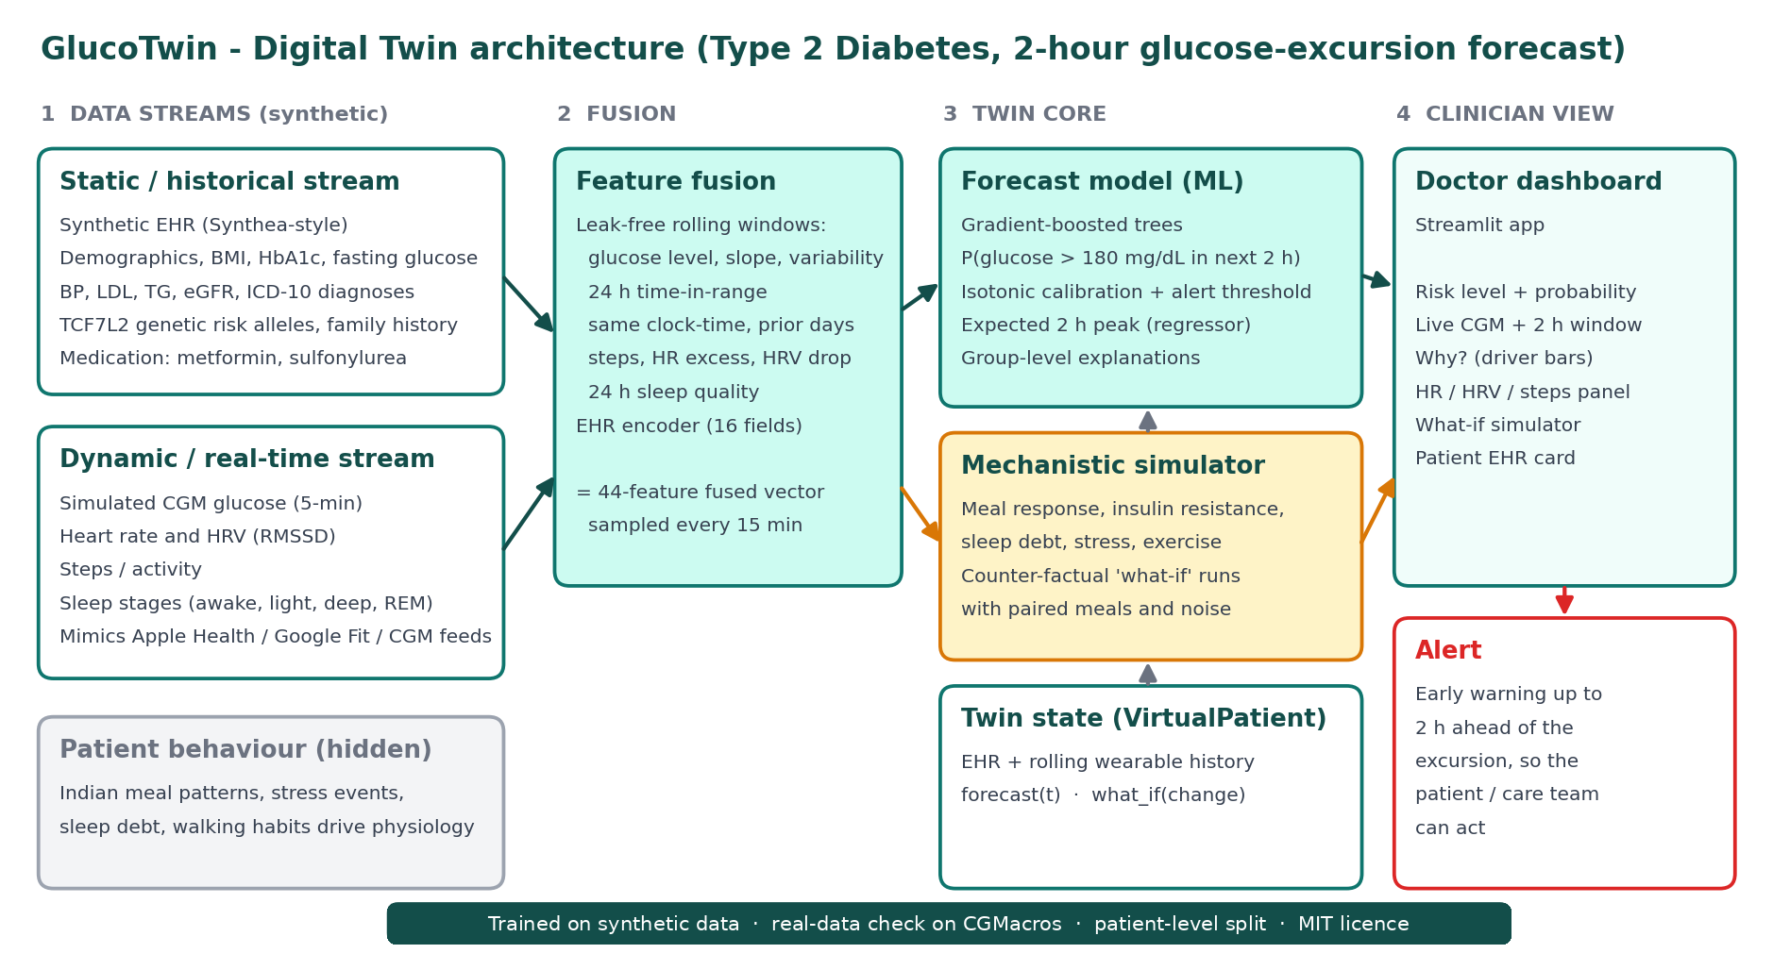
Architecture
GlucoTwin · trained on synthetic data, checked on CGMacros · research prototype
4

Slide 5
Two data streams, simulated for training
Static / historical (EHR)
Dynamic / real-time (wearables)
Age, sex, BMI, HbA1c, fasting glucose
BP, LDL, triglycerides, eGFR
ICD-10 diagnoses, medications
TCF7L2 genetic risk alleles, family history
CGM glucose every 5 minutes
Heart rate and HRV (RMSSD)
Steps and activity
Sleep stages (awake, light, deep, REM)
150 virtual patients × 14 days × 5-minute resolution. Indian meal patterns, sleep debt, stress and walking habits drive the physiology. Training uses no real patient data. The real open dataset CGMacros (de-identified, PhysioNet) is used only for validation and is not redistributed.
GlucoTwin · trained on synthetic data, checked on CGMacros · research prototype
5
Notes:
Both streams used for training are synthetic. Real data enters only in the validation slide.

Slide 6
The twin is a hybrid: data-driven + mechanistic
1
2
3
Forecast (ML)
What-if (simulator)
Explain (drivers)
Gradient-boosted trees on 44 fused, leak-free features. Calibrated probability, expected 2 h peak, alert threshold tuned for about 80% sensitivity.
Meal response, insulin resistance, sleep debt, stress and exercise. Re-runs the same meals and noise with one change. Insulin resistance is estimated from the patient's first 5 days of CGM (tested in simulation only).
Each forecast shows which input group pushes risk up or down: glucose trend, meal-time habit, sleep, clinical profile, stress, movement.
GlucoTwin · trained on synthetic data, checked on CGMacros · research prototype
6

Slide 7
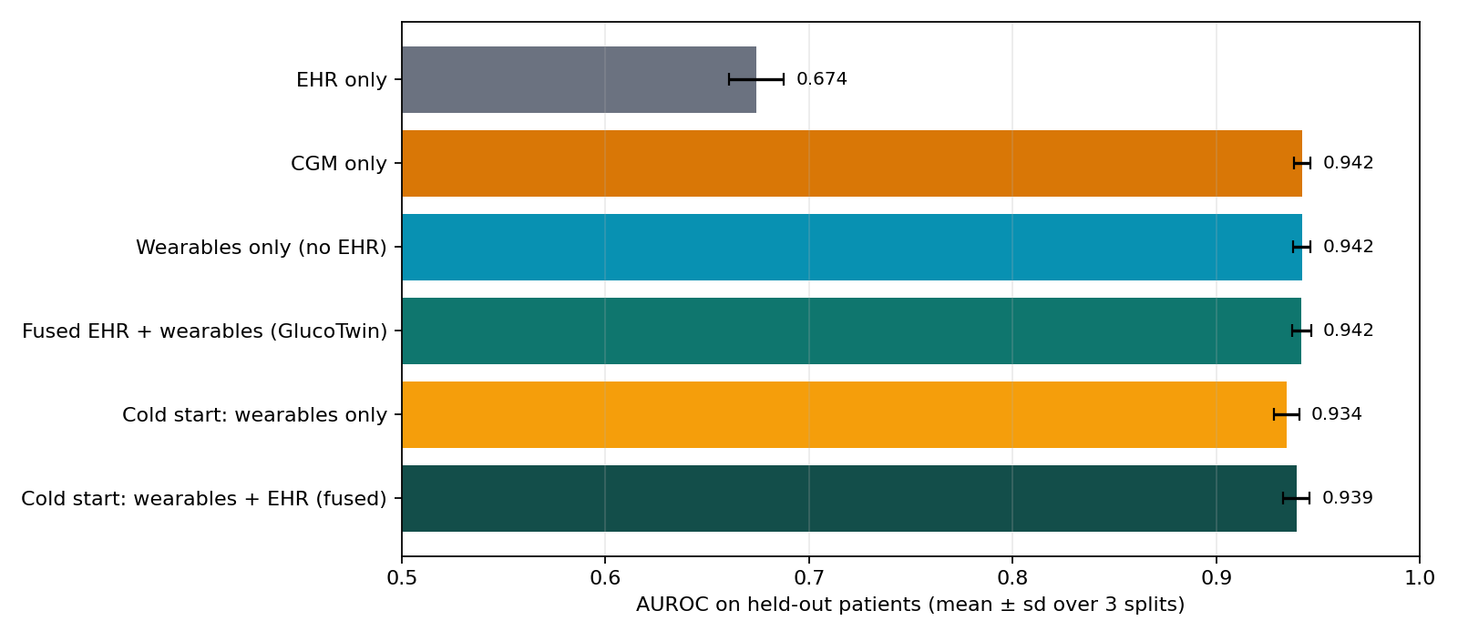
Results on held-out synthetic patients
0.942
AUROC, fused model (3 patient-level splits)
98%
pre-warned (primary split), at ~6 alerts per patient-day
EHR alone: 0.67. Logistic regression on glucose + trend: 0.61. Prevalence about 17%.
Labels come from our simulator, so this measures pipeline learning, not clinical accuracy.
GlucoTwin · trained on synthetic data, checked on CGMacros · research prototype
7
Notes:
Fused AUROC 0.942 +/- 0.005, AUPRC 0.770 +/- 0.024 (3 patient-level splits, mean +/- sd, from metrics.json). Primary split (23 test patients, prevalence 19.3%): 87.5% sensitivity, 87.8% specificity, 63.2% precision, peak MAE about 11.5 mg/dL, 510 of 521 episodes pre-warned at 5.8 alerts per patient-day. Labels come from our own simulator.

Slide 8
Honest reading of the results
1
Glucose history leads
Recent CGM and meal-time habit carry most of the signal (importance 0.17 and 0.12 AUROC). EHR alone cannot time a spike (AUROC 0.67).
2
Fusion helps only at cold start, not with history
With CGM history: AUPRC 0.771 (CGM), 0.769 (wearables), 0.770 (fused), so no gain. Cold start: 0.739 to 0.762, within one sd (3 splits). On real data, adding EHR fields gave no gain (AUROC 0.827 vs 0.817).
3
HRV, sleep and steps add little to the forecast
Importance only about 0.001 to 0.006 AUROC in simulation, even though they drive the simulated physiology. They mainly add explanatory context for the clinician.
GlucoTwin · trained on synthetic data, checked on CGMacros · research prototype
8
Notes:
We report this as measured. The fusion benefit is not reproduced on real data.

Slide 9
Real-data check: CGMacros, 45 adults
Setting | AUROC (95% CI) | AUPRC
A. Synthetic-trained, tested on real | 0.826 (0.795–0.853) | 0.422
B. Real-trained, participant-grouped CV | 0.827 (0.795–0.852) | 0.454
B + 7 shared EHR fields | 0.817 (0.783–0.842) | 0.446
A, T2D only (n=14) | 0.835 (0.811–0.856) | 0.554
B, T2D only (n=14) | 0.820 (0.799–0.835) | 0.577
0.94 → ~0.83
AUROC, synthetic patients vs real participants (sim-to-real gap)
No gain
15 healthy, 16 prediabetes, 14 T2D; about 10 days each; Dexcom G6 Pro; 25,306 forecast times; event prevalence 12.1%. CGM and time-of-day features only. CI resamples whole participants.
from EHR fusion on real data (45 participants, 7 shared EHR fields)
One US site, mostly mild T2D, no HRV/sleep/steps in this dataset: not clinical evidence. Libre readings gave a higher AUROC (about 0.89 to 0.90, prevalence 5.4%, values possibly interpolated); Dexcom was chosen in advance as primary.
GlucoTwin · trained on synthetic data, checked on CGMacros · research prototype
9
Notes:
Real data: CGMacros v1.0.0 (PhysioNet), open access, not stored in the repo. A = trained on synthetic only, tested on real. B = trained and tested on real with participant-grouped CV. Numbers exactly as measured. Dataset licence/citation to be added from the PhysioNet page.

Slide 10
Alert burden: episodes warned vs alerts per day
~50%
of episodes warned at 2 alerts per patient-day (real participants)
97.9%
warned at the original ~5.8 alerts per day (synthetic only)
Proposed two-tier design: a continuous risk bar on the dashboard, push alerts only at a low alert budget. Thresholds were picked on the same predictions they are reported on, so figures are illustrative; the operating point should be set with clinicians.
GlucoTwin · trained on synthetic data, checked on CGMacros · research prototype
10
Notes:
60-minute cool-down between alerts. Real: cross-validated out-of-fold predictions. Illustrative because thresholds are chosen on the same predictions they are reported on.

Slide 11
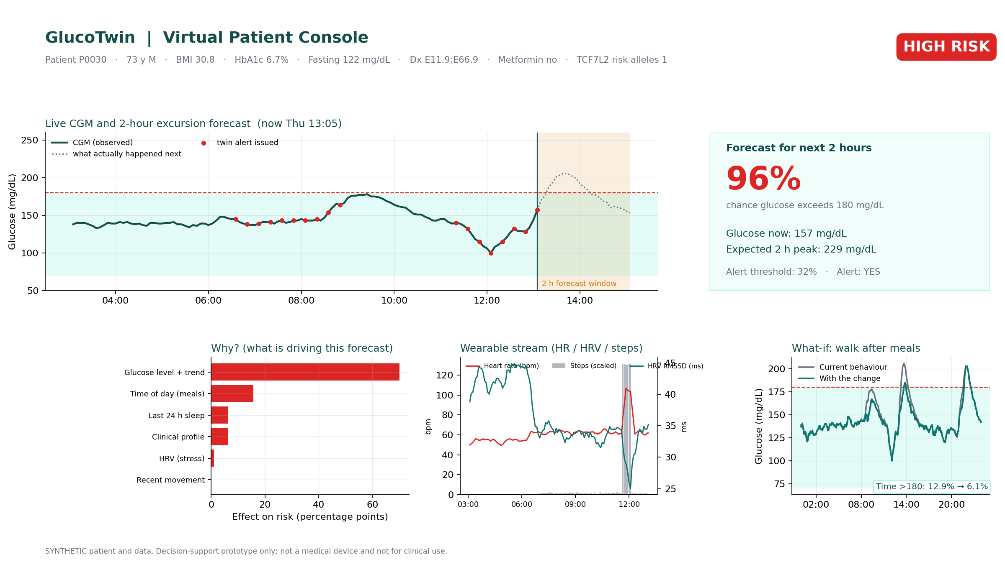
Conceptual UI: the doctor's console
GlucoTwin · trained on synthetic data, checked on CGMacros · research prototype
11

Slide 12
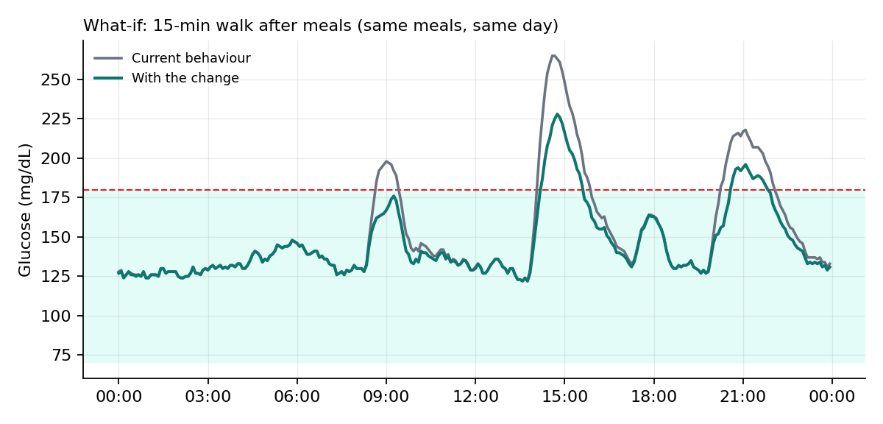
What-if: walk 15 minutes after meals
12.9% → 6.1%
time above 180 mg/dL (demo patient P0030, true insulin resistance)
231 → 205
mean daily peak, mg/dL
Same meals, same noise, one change. Effect size reflects simulator assumptions, not clinical evidence. With insulin resistance estimated from CGM the benefit is smaller (next slide).
GlucoTwin · trained on synthetic data, checked on CGMacros · research prototype
12

Slide 13
Twin calibration: estimating insulin resistance
r = 0.88
estimated vs true IR, 150 synthetic patients (first 5 days of CGM)
0.094
IR error (MAE) vs 0.164 for the cohort-mean baseline; true IR sd 0.196
In all 5 patients checked, the walk benefit was underestimated with estimated IR (small example). P0003's estimate hit the grid edge (0.30).
Optimistic: the same simulator generates and fits the data. Walk habit, resting HR, meal timings and noise seed are still true values. Not tested on real patients.
GlucoTwin · trained on synthetic data, checked on CGMacros · research prototype
13
Notes:
calibrate_ir searches IR 0.30 to 1.60 (step 0.05) using different meal/noise seeds and matches summary statistics only (mean, SD, % time above 180, mean daily peak). Benefit = reduction in time above 180 mg/dL, percentage points, 15-minute walk after main meals.

Slide 14
Limitations and responsible use
Trained on synthetic data. Real check: 45 adults, one US site, mostly mild T2D; not clinical evidence
Sim-to-real gap: AUROC 0.94 on synthetic, about 0.83 on real. EHR fusion gain not seen on real data
Results depend on the CGM sensor (Dexcom 0.83 primary; Libre about 0.89 to 0.90, possibly interpolated)
Twin calibration estimates only insulin resistance and was tested in simulation only (optimistic); other parameters are true values
Fixed 180 mg/dL threshold; alert-fatigue risk; operating points not chosen on separate data
What-if results are simulations, not prescriptions. Research prototype, not a medical device, no regulatory clearance
GlucoTwin · trained on synthetic data, checked on CGMacros · research prototype
14

Slide 15
Next steps
Validate on larger real datasets (e.g. ShanghaiT2DM) and anonymised clinical records, with ethics approval
Estimate more twin parameters from each patient's own data (walk habit, meal timing), and test on real patients
Clinician-tuned alert policy: two-tier design, with the alert budget set by diabetologists
Add uncertainty intervals and re-test sensor dependence (Dexcom vs Libre)
Thank you · github.com/subhrank09/DigitalTwiner_BITMESRA
GlucoTwin · trained on synthetic data, checked on CGMacros · research prototype
15

