Slide 1










ACCIDENT ALERT SYSTEM
AMI Application
BY SUBHRANSU SOURAV PRIYADARSHAN (5302091)

Slide 2

Problem Statement
In the modern world the rate of accidents is increasing day by day. Most of the accident deaths are caused due to ignorance and lack of sufficient remedial measures and timely action. All these facts point to an efficient accident monitoring and vehicle tracking system.
Here an accelerometer sensor senses the change in acceleration caused by the shake or tilt. The detection of accident is done by the microcontroller after checking the output of accelerometer. When the accident is detected, the location is decoded from the output of a GPS module and this data will be push as notification to emergency authorities. By implementing this system, we are hoping to have better control over road accidents by the fast communication between the victim and the control center.

Slide 3
HOW IT WORKS
1
2
3
4
Event
GPS and Accelerometer
The crucial task
Final Action
The application comes into play in case of any
mishappening (or potential mishappening)
GPS sends the location when the output of
accelerometer value is above the threshold value
The location of the driver is sent to the
nearest hospital and to the emergency contacts of the individual
Concerned authorities take the required action

Slide 4
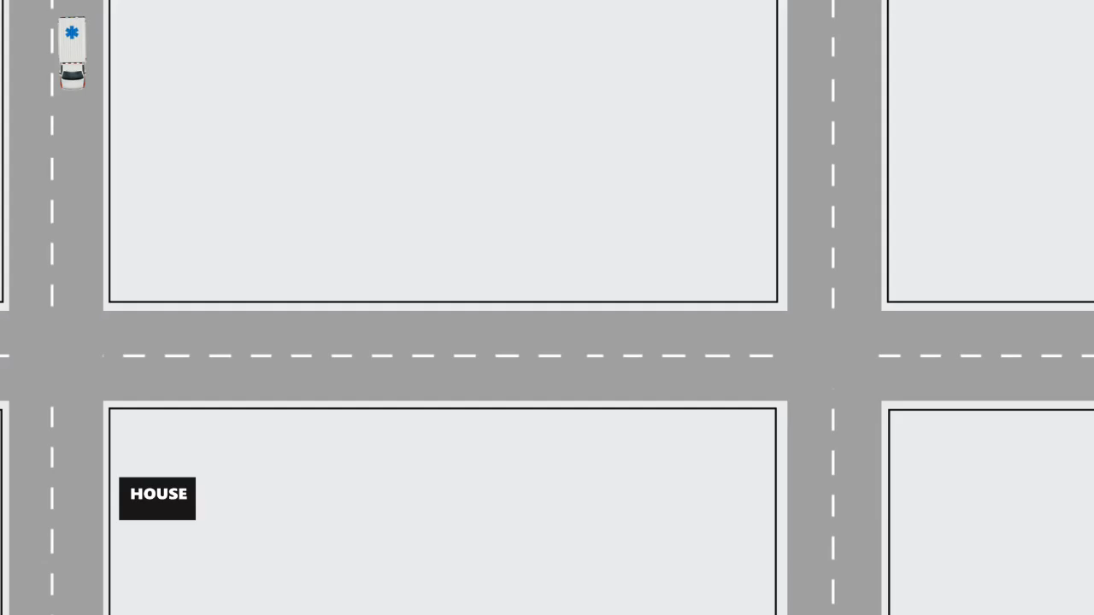
Simulation

Slide 5
Work Flow | Accident Alert System
Start
Accepts value from Accelerometer & GPS Sensor
Send data to Firebase using Wi-Fi
Yes
Has Accident Occurred?
No
Send the current location to App + Push Notification
Send the current location of vehicle
Stop

Slide 6
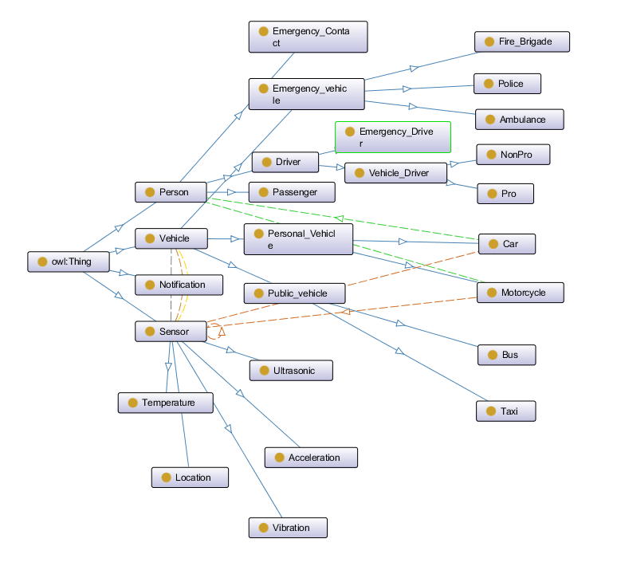
ONTOLOGY

Slide 7
Thank You

