Slide 1
Recent Works on Congestion Control Mechanism
2020

Slide 2
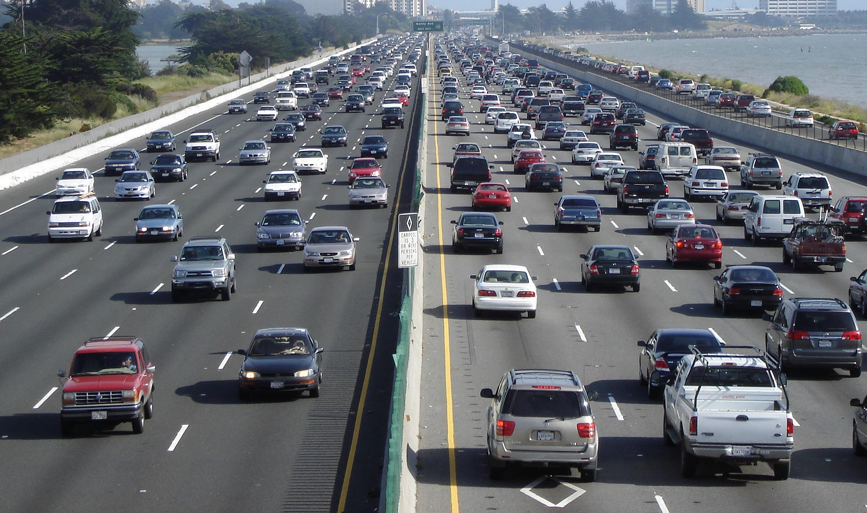
Congestion
a situation in which there is too much traffic and movement is difficult

Slide 3
Congestion Control (CC)
a situation in which there is too much traffic and movement is difficult
Avoid or manage such situation

Slide 4
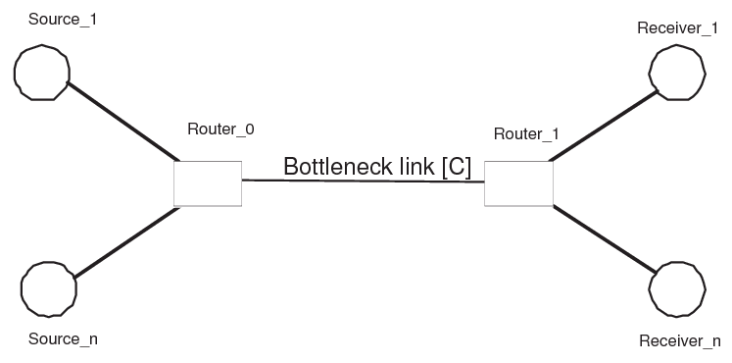
Points of Interest
CCA runs here
External triggering point

Slide 5
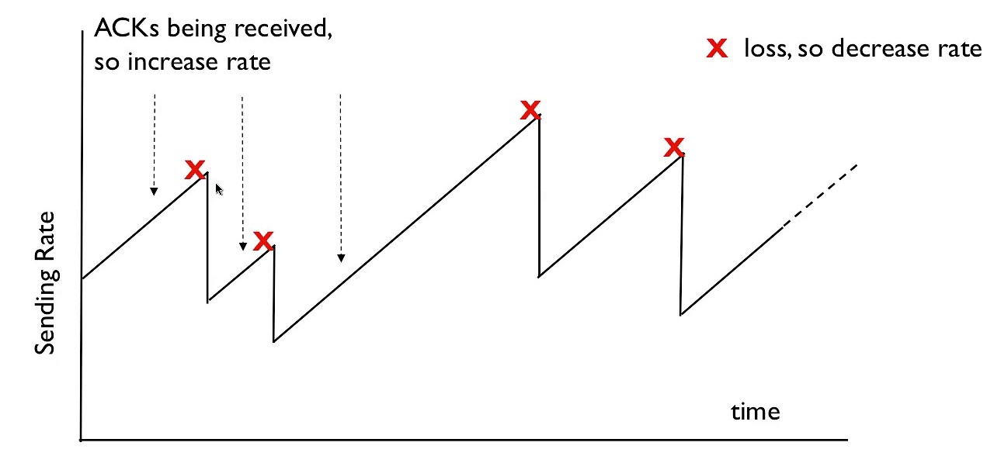
End-to-end Congestion Control (Congestion Control Algorithms)
Loss based
STCP, HSTCP, CUBIC, New RENO
Delay based
Vegas, LoLa
Delay & loss based
Illinois, Veno, Westwood+
Model based
BBR

Slide 6
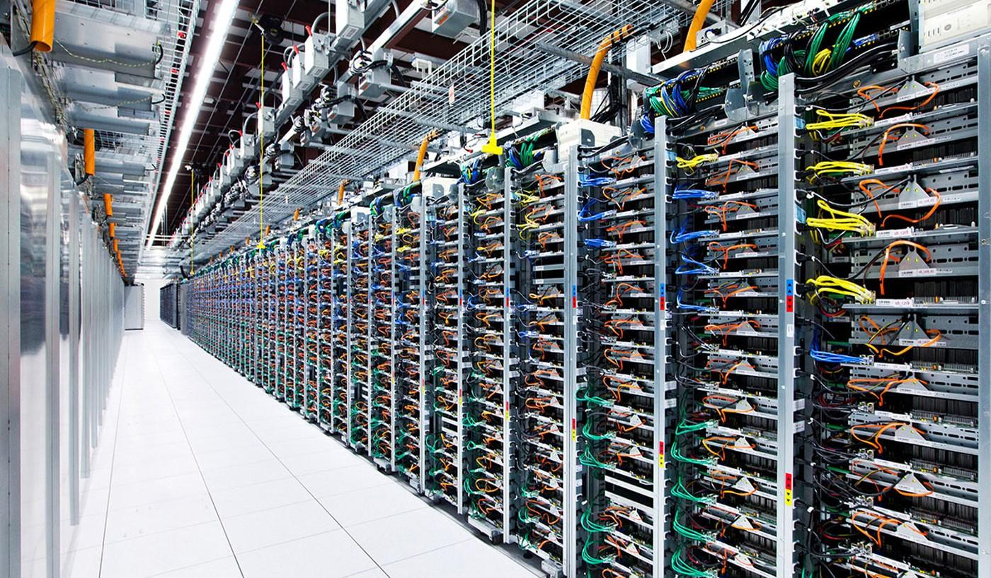
Recent end-to-end CCA
Data Center Network
Swift
MultiPath-TCP
D-LIA, mpCUBIC
Learning Based
NEAT-TCP, Eagle

Slide 7
Mid Point CC
Controls E2E CCA from network sides
P4air, Future of Congestion Control, Annulus

Slide 8
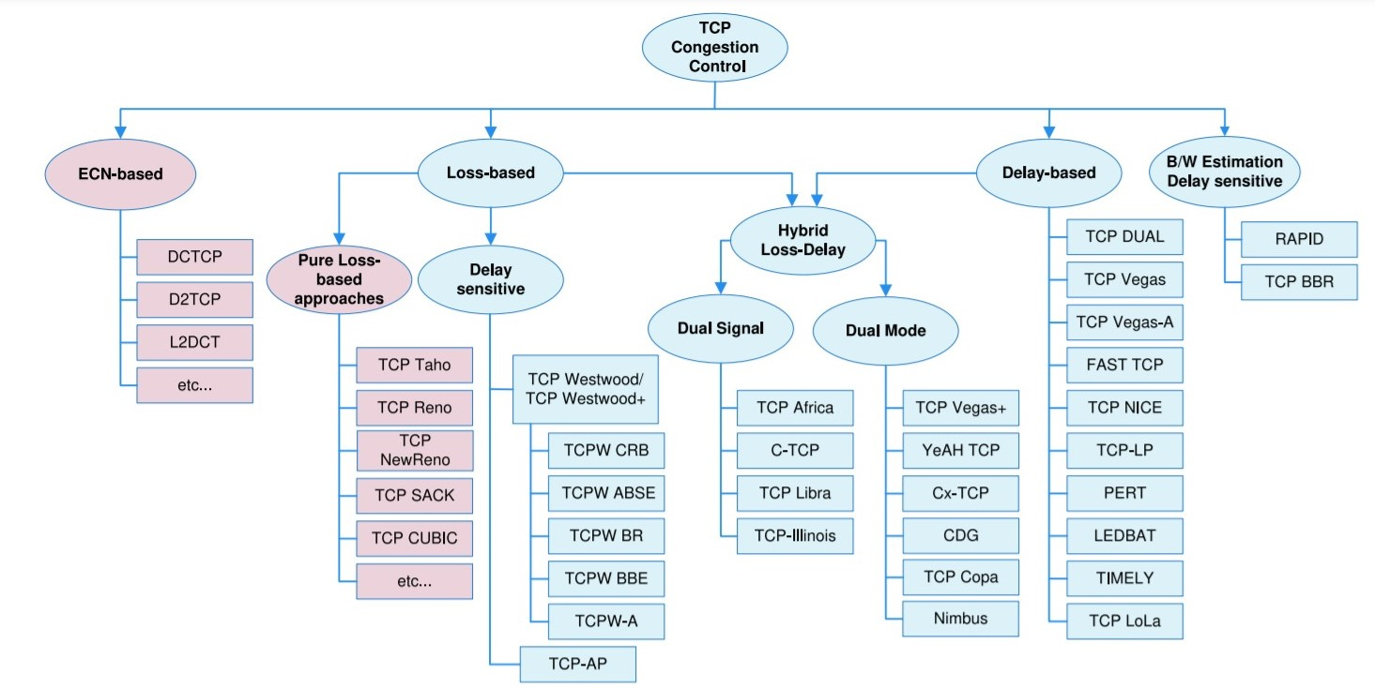
A Taxonomy of TCP Congestion Control Strategies
Source: A Survey of Delay-Based and Hybrid TCP Congestion Control Algorithms, IEEE Communications Surveys & Tutorials, 2019

Slide 9
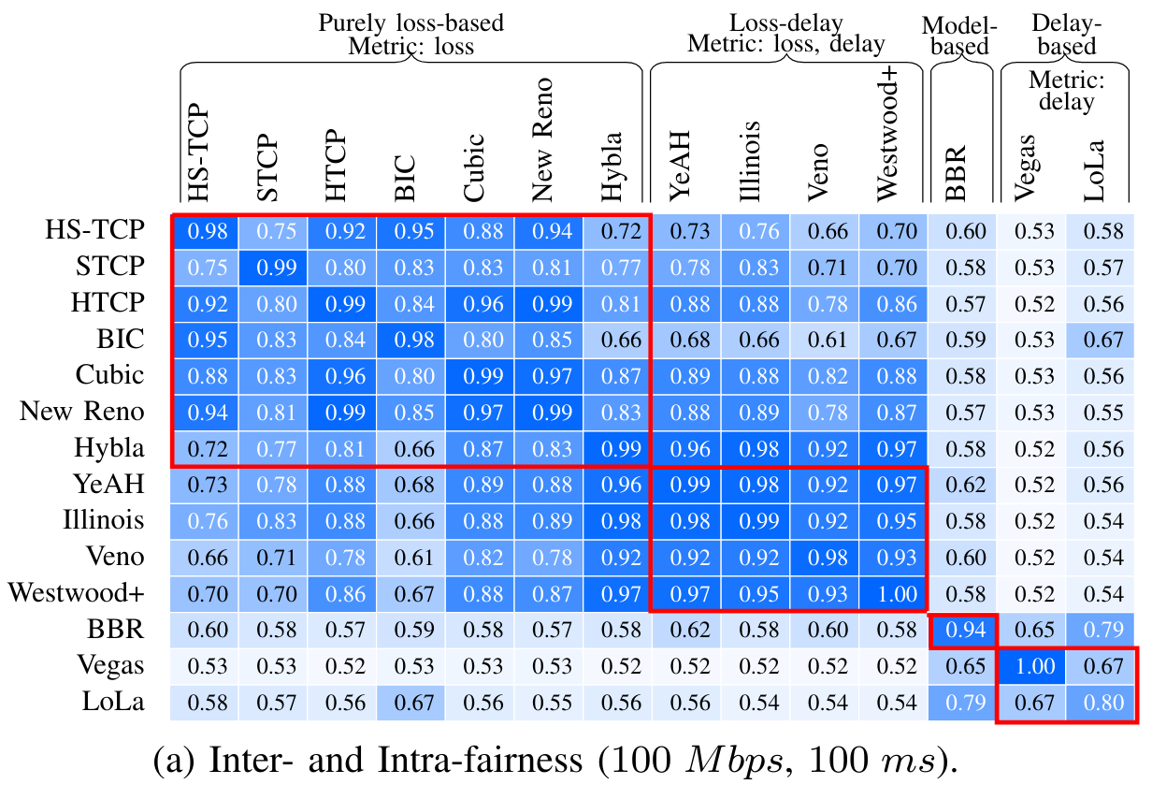
P4air
ICNP 2020
Problem
Fairness among different CCAs
RTT, aggressiveness causes unfairness among CCAs
Idea
Detect and tweak CCAs parameter from data-plane
Solution
A P4 application at bottleneck
Fingerprint and categorise flows
Queue according to categories
Apply policy on queues to enforce fairness
Notes:
Congestion control algorithms are usually developed in isolation without thoroughly investigating their co-existence and interactions with other protocols and/or congestion control algorithms. As a result, flows using different algorithms and/or having different Round-Trip Times may overpower each other, resulting in unfair resource distribution, with a subset of the flows usually claiming most of the capacity.
This paper proposes, P4air which run entirely in the data-plane to enforce fairness between all flows present on a switch.

Slide 10
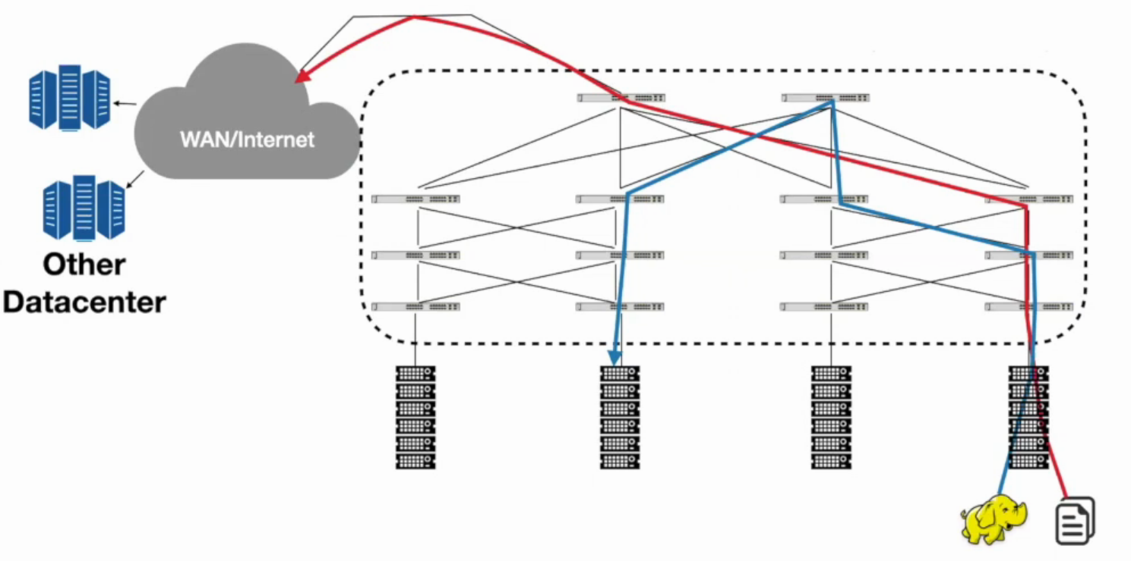
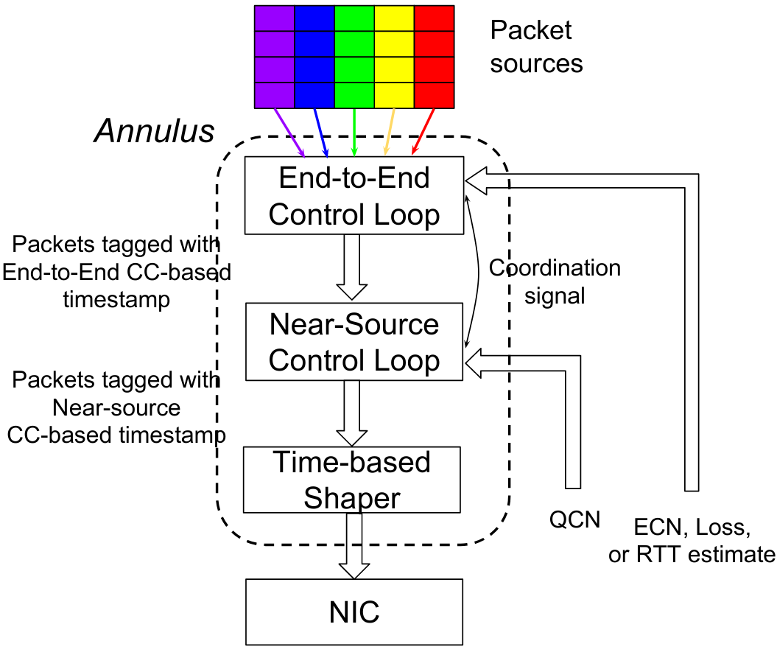

Annulus
SIGCOMM 2020
Notes:
QCN: Quantized congestion notification
https://www.definethecloud.net/whats-the-deal-with-quantized-congestion-notification-qcn/
Distributed datacenter: Connected via WAN
Traffic volume: DCN: WAN → 5:1
Tail latency of DCN traffic affected by WAN traffic due to shared bottleneck
Affects flow completion delay (FCT)
DCN traffic: Short queue build ups → Reacts faster and reduces CW size
WAN traffic: DCN bursty traffic → Under utilization of WAN bandwidth
Annulus: Design Contribution
Goals:
“One-size-fits-all” algorithm
Homogenous bottleneck (unshared) remains unaffected
Low switch overhead and no modification: User space implementation
Control loop:
Near source: A. QCN based congestion signalling B. Rate control
End-to-end: Window based congestion control
Needs synchronization between two control loops

Slide 11
Future of Congestion Control
HotNets 2020
Congestion control in public Internet
A dilemma regarding fairness
General Assumption: Used CC algos are TCP Friendly
If True → Limits the flexible architecture
If False → Significant inequities in the bandwidth received by different flows
Is per-flow TCP friendliness overrated?
Fairness should have a basis in the economic flow
Economic flow: Customer → ISP → Next-Hop ISP → … → Destination ISP → Receiver
Flows are not economic actors: Larger entities contract for service from providers
Contributions: Recursive congestion shares
Congestion in local ISP ∝ congestion-share between local ISP & Customer
Congestion in Next-hop ISP ∝ congestion-share between local ISP & next-hop ISP
Notes:
Contributions:
A new paradigm for network centric CCA
Recursive congestion shares (RCS)
hierarchical Congestion share calculation
Implementation challenges for RCS
Minimize packet drop within transit domains
Packet scheduling at egress points
Propagation of hierarchical Congestion share information
Criticism
RCS violates network neutrality and relying too heavily on economics
“the bandwidth a customer’s traffic receives today already depends on the set of economic agreements along the path.”

Slide 12
Other Works
Zhang, Ticao, et al. "Machine learning for end-to-end congestion control." IEEE Communications Magazine 58.6 (2020): 52-57.
Mishra, Ayush, et al. "The Great Internet TCP Congestion Control Census." Proceedings of the ACM on Measurement and Analysis of Computing Systems 3.3 (2019): 1-24.
Goyal, Prateesh, et al. "ABC: A Simple Explicit Congestion Controller for Wireless Networks." 17th USENIX Symposium on Networked Systems Design and Implementation (NSDI 20). 2020.

Slide 13
Conclusions
Motivating Factors for Future Congestion Control
Recent changes affecting Congestion control
Machine Learning: Incorporate adaptivity in congestion control
SDN, Programmable networks: Network centric approach than Host centric approach for better manageability
Traffic pattern: Rise in video traffic
Data center and Content providers: Most of the traffic does not leave the AS domains
Simplified design philosophy
Avoid complicated solutions
Avoid general purpose scenarios and use-cases

Slide 14
Thanks

Slide 15
Objectives
Look at some of the recent works on congestion control mechanisms
Try to understand why sudden surge in this area?
What can we do to join this movement?

Slide 16
Congestion Control Basics
Congestion Definition
Objective of CCA
Types of existing Congestion Control based on governing entity

Slide 17
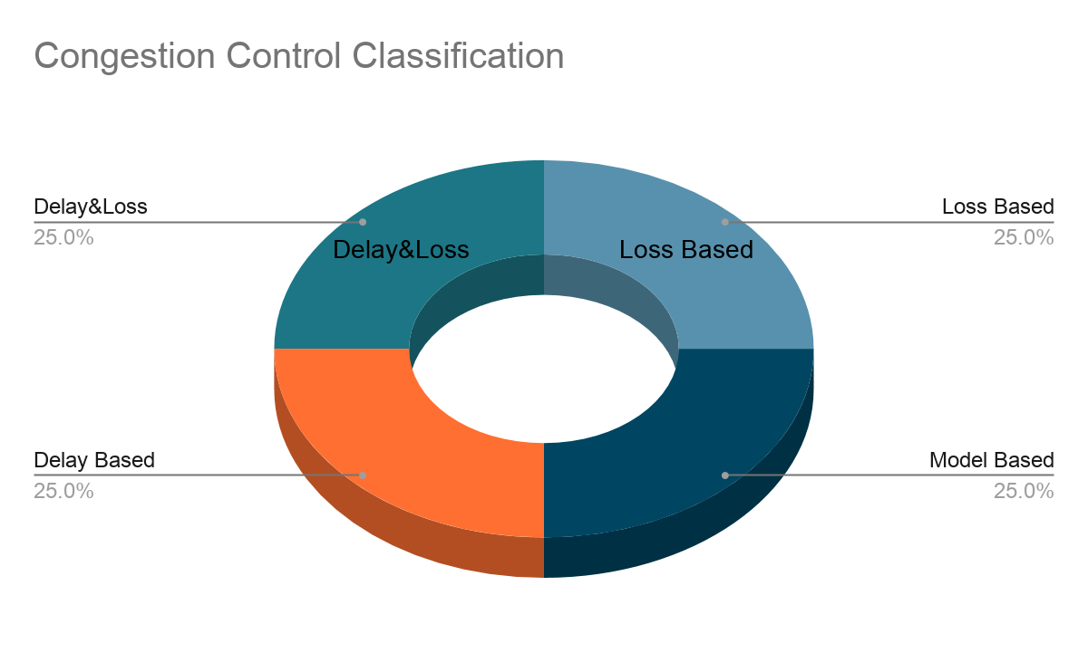
P4air
Design methodology of Congestion control algorithms
Does not consider fairness with other existing approaches
Question: How to ensure fairness among existing congestion control Algos?
Resource reservation/ Active Queue Management (AQM)
Types of Congestion control algos
4 categories based on design choices
P4air:
A P4 application
Running in the bottleneck switches
Objective: enforce fairness between all flows on a switch
Fingerprinting: Classify flows into 4 classes
Queue reservations based on the class
STCP, HSTCP, CUBIC, New RENO
Illinois, Veno, Westwood+
Vegas, LoLa
BBR
Turkovic, Belma, et al. "P4air: Increasing Fairness among Competing Congestion Control Algorithms." 2020 IEEE 28th International Conference on Network Protocols (ICNP). IEEE, 2020.
Notes:
Congestion control algorithms are usually developed in isolation without thoroughly investigating their co-existence and interactions with other protocols and/or congestion control algorithms. As a result, flows using different algorithms and/or having different Round-Trip Times may overpower each other, resulting in unfair resource distribution, with a subset of the flows usually claiming most of the capacity.
This paper proposes, P4air which run entirely in the data-plane to enforce fairness between all flows present on a switch.

Slide 18
Datacenter Congestion Control
Editorial Paper: Non-peer reviewed
Many existing congestion control algorithms on data center network
How to detect/signal congestion?
How a host adapt before, during and after congestion?
How to schedule packets in a switch?
Question: Do we really need recent research on data center congestion control algorithms for the common case?
Two aspects of DCN- congestion control
Packet scheduling: FIFO, Fair Queuing, Shortest-Job-First (SJF), Shortest-Remaining-Time-First (SRPT)
Congestion signalling and Rate setting: Dup-ACK, ECN, time-out
Mushtaq, Aisha, et al. "Datacenter congestion control: Identifying what is essential and making it practical." ACM SIGCOMM Computer Communication Review 49.3 (2019): 32-38.

Slide 19
Datacenter Congestion Control ...
Editorial Paper: Non-peer reviewed
Observations: From experimentations
Used Flow completion time to measure the effect
Multiple workload traffic: Facebook dataset, Web search work load, Uniform distribution etc.
Any reasonable rate setting scheme performs best under SRPT
Challenge: “no current switches are capable of supporting SRPT at line rate”;
Contribution: Approximate & Deployable SRPT (ADS)
Switch firmware level (OpenFlow/P4 supported also)
No hardware modification
No application modification
Commodity switch architecture
Design Issues
WHY?
arbitrarily fine granularity
pick the oldest packet from the flow
Flow length counter Priority mapping using VLAN ID | Traffic measurement Per switch measurement
Mushtaq, Aisha, et al. "Datacenter congestion control: Identifying what is essential and making it practical." ACM SIGCOMM Computer Communication Review 49.3 (2019): 32-38.
Notes:
SRPT: Shortest Remaining Processing Time
Challenge:
In true SRPT, the switch must transmit the oldest packet from the flow with the fewest remaining bytes. Assuming that the remaining-bytes information is contained in each packet, the switch must both (i) do priority scheduling at arbitrarily fine granularity, and (ii) pick the oldest packet from the flow whose packet is at the head of the queue (to prevent starvation of old packets). Commodity switches cannot support either of these necessary behaviors.
Estimation of Flow Lengths: SRPT requires information about flow lengths in order to determine priority. However, this information does not exist in typical transport protocols. For this purpose, the switch firmware can be updated to implement a packet counter per flow.
Computation of priority mappings: Somehow, a mapping must be made from a large priority space (i.e., the space of all possible flow sizes) to a small number of queues. For this purpose 802.1q VLAN Tags can be used.
Traffic measurement: No matter the exact details of how the priority mappings are computed, doing so requires some sort of measurement of the flow size distribution. Control plane can enquire about the counter.
Measurement/update frequency: If the computation is expensive or centralized, this may limit the update frequency.
Per-switch or network-wide thresholds: Is the priority mapping applied globally, or per-switch?

Slide 20
Comment on Datacenter Congestion Control
Editorial Paper: Non-peer reviewed
This paper “dispute the authors’ claim that SRPT is the crucial factor in achieving good FCT performance in datacenter networks.”
Claims in the previous paper:
“SRPT is the crucial factor in achieving good performance”
Researchers should "look no further than ADS"’
What are the issues in these claims?
Optimal flow completion time (FCT) can be achieved if poisson process → Not true always]
SRPT works well if independent distributions → Each session has multiple flows one after another.
Conclusion:
“A more thorough evaluation is clearly necessary using an accurate datacenter workload model.”
Roberts, James. "Comment on" Datacenter Congestion Control: Identifying what is essential and making it practical" by Aisha Mushtaq, et al, CCR, July 2019." ACM SIGCOMM Computer Communication Review 50.2 (2020): 64-64.

Slide 21
Future of Congestion Control
Congestion control in public Internet
A dilemma regarding fairness
General Assumption: Used CC algos are TCP Friendly
If True → Limits the flexible architecture
If False → Significant inequities in the bandwidth received by different flows
Is per-flow TCP friendliness overrated?
Fairness should have a basis in the economic flow
Economic flow: Customer → ISP → Next-Hop ISP → … → Destination ISP → Receiver
Flows are not economic actors: Larger entities contract for service from providers
Contributions: Recursive congestion shares
Congestion in local ISP ∝ congestion-share between local ISP & Customer
Congestion in Next-hop ISP ∝ congestion-share between local ISP & next-hop ISP
Brown, Lloyd, et al. "On the Future of Congestion Control for the Public Internet." Proceedings of the 19th ACM Workshop on Hot Topics in Networks. 2020.

Slide 22
Future of Congestion Control ...
The average AS path length is fairly stable ≅ 4-5.
For GCE
62% → 2 AS
29% → 3 AS
9% → >3 AS
Therefore, Use of local congestion share is sufficient.
Contributions:
A new paradigm for network centric CCA
Recursive congestion shares (RCS)
hierarchical Congestion share calculation
Implementation challenges for RCS
Minimize packet drop within transit domains
Packet scheduling at egress points
Propagation of hierarchical Congestion share information
Criticism
RCS violates network neutrality and relying too heavily on economics
“the bandwidth a customer’s traffic receives today already depends on the set of economic agreements along the path.”
Brown, Lloyd, et al. "On the Future of Congestion Control for the Public Internet." Proceedings of the 19th ACM Workshop on Hot Topics in Networks. 2020.
Notes:
GCE: Google compute engines

Slide 23
Annulus
Distributed datacenter: Connected via WAN
Traffic volume: DCN: WAN → 5:1
Tail latency of DCN traffic affected by WAN traffic due to shared bottleneck
Affects flow completion delay (FCT)
DCN traffic: Short queue build ups → Reacts faster and reduces CW size
WAN traffic: DCN bursty traffic → Under utilization of WAN bandwidth
Annulus: Design Contribution
Goals:
“One-size-fits-all” algorithm
Homogenous bottleneck (unshared) remains unaffected
Low switch overhead and no modification: User space implementation
Control loop:
Near source: A. QCN based congestion signalling B. Rate control
End-to-end: Window based congestion control
Needs synchronization between two control loops
Window-Based: Control in flight pkts. Good for end-to-end path.
Rate-Based: Control sender rate. Works well in partial path information.
Saeed, Ahmed, et al. "Annulus: A Dual Congestion Control Loop for Datacenter and WAN Traffic Aggregates." Proceedings of the Annual conference of the ACM Special Interest Group on Data Communication on the applications, technologies, architectures, and protocols for computer communication. 2020.
Notes:
QCN: Quantized congestion notification
https://www.definethecloud.net/whats-the-deal-with-quantized-congestion-notification-qcn/

Slide 24
Other Works
Zhang, Ticao, et al. "Machine learning for end-to-end congestion control." IEEE Communications Magazine 58.6 (2020): 52-57.
Mishra, Ayush, et al. "The Great Internet TCP Congestion Control Census." Proceedings of the ACM on Measurement and Analysis of Computing Systems 3.3 (2019): 1-24.
Goyal, Prateesh, et al. "ABC: A Simple Explicit Congestion Controller for Wireless Networks." 17th {USENIX} Symposium on Networked Systems Design and Implementation ({NSDI} 20). 2020.

Slide 25
Conclusions
Motivating Factors for Future Congestion Control
Recent changes affecting Congestion control
Machine Learning: Incorporate adaptivity in congestion control
SDN, Programmable networks: Network centric approach than Host centric approach for better manageability
Traffic pattern: Rise in video traffic
Data center and Content providers: Most of the traffic does not leave the AS domains
Simplified design philosophy
Avoid complicated solutions
Avoid general purpose scenarios and use-cases

