Slide 1
Self Adjusting Networking
Subhrendu Chattopadhyay

Slide 2
Outline
Motivations
Background: ProjecToR
Self-adjusting Network: AdjustNet
New Directions / Thoughts/ DIscussions

Slide 3
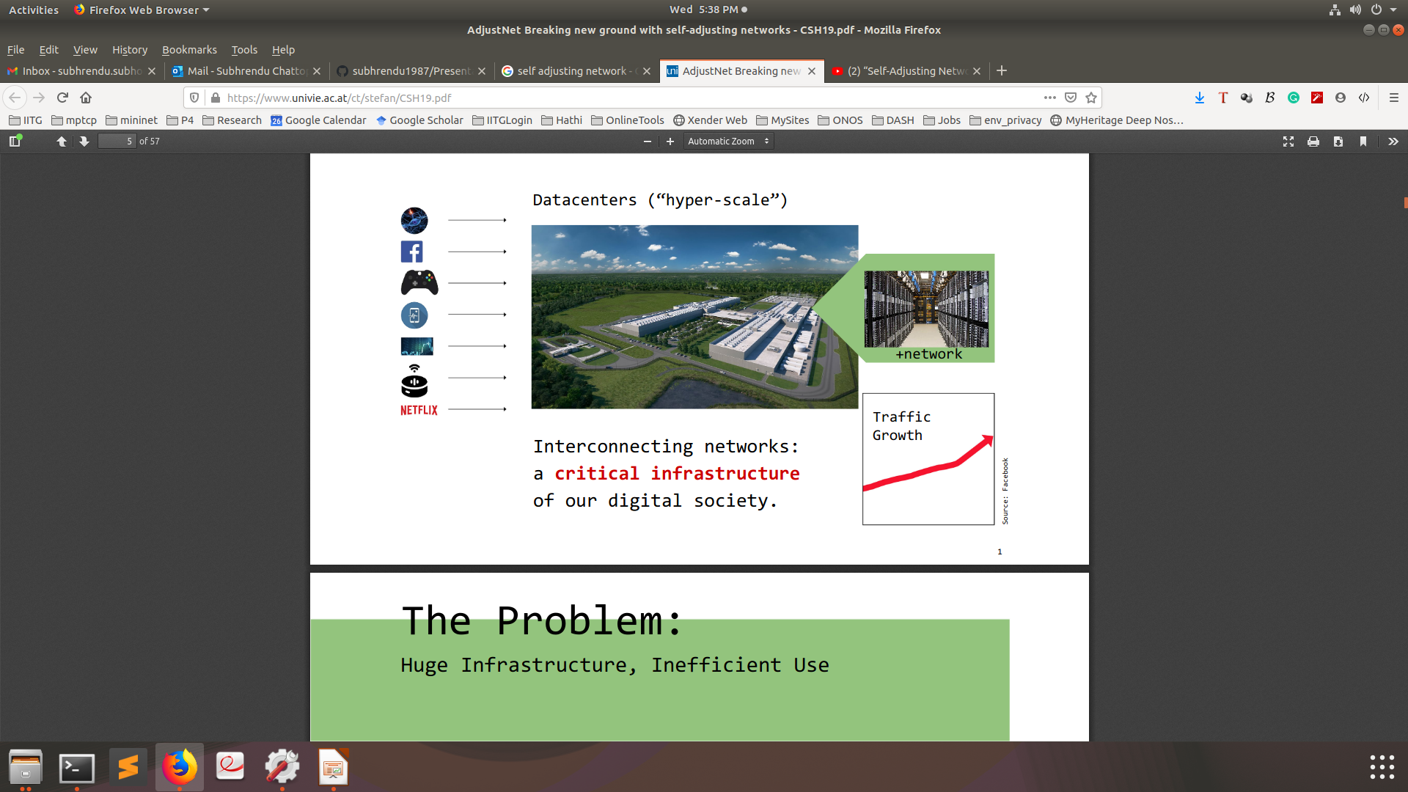
Trend: Data-centric Applications
Impact of data center
Traffic growth
Critical resoures for Alibaba
Interconnecting networks: a critical infrastructure
of our digital society.
Notes:
A lot of networked applications rely on cloud and data center for operations. Like Social networks, gaming, etc. So the traffic inside datacenter is growing a lot.

Slide 4
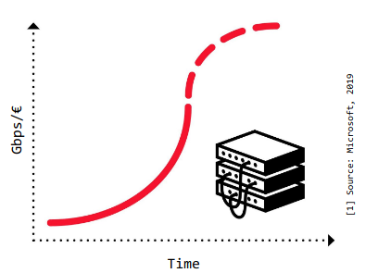
The Problem: Huge Infrastructure & Inefficient Use
Network equipment reaching capacity limits
Transistor density rates stalling
“End of Moore‘s Law in networking” [1]
Hence: more equipment, larger networks
Resource intensive and: inefficient
Annoying for companies,opportunityfor researchers

Slide 5
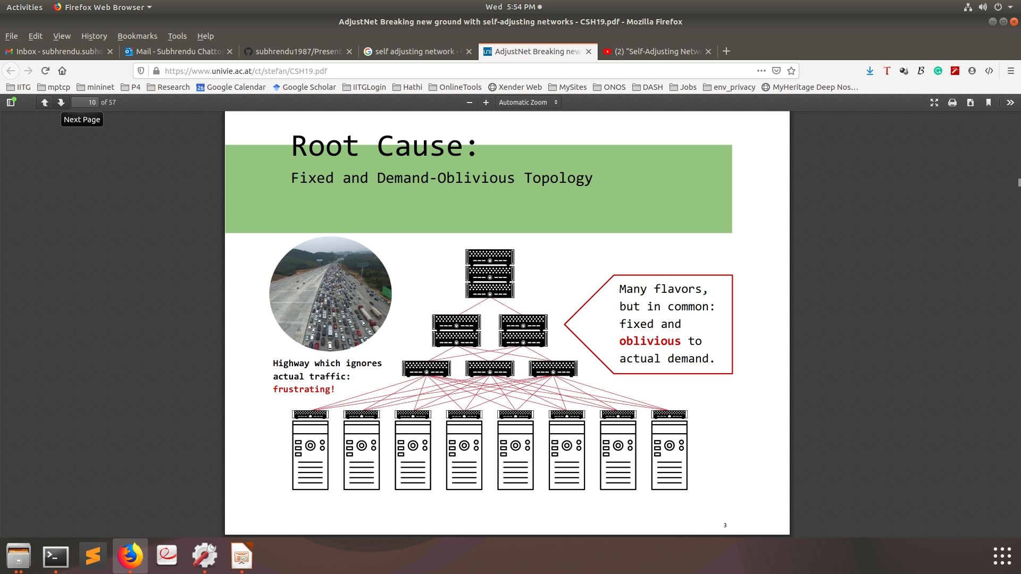
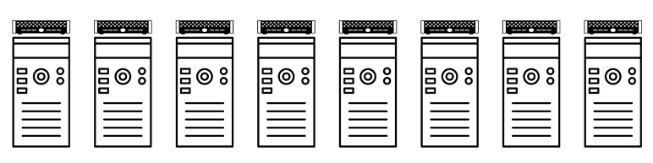
Root Cause: Fixed & Demand Oblivious Topology
How to interconnect?
Demand Oblivious Topology
Frustrating
Demand Oblivious Topology

Slide 6
Vision: Flexible & Demand Aware Topology
#14, #17

Slide 7
Motivation: Find Structure in Demand
#18

Slide 8
How to Achieve it? Enabler Technology
Novel Reconfigurable Optical Switches
#20

Slide 9
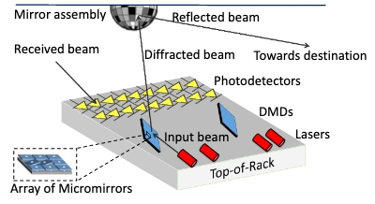
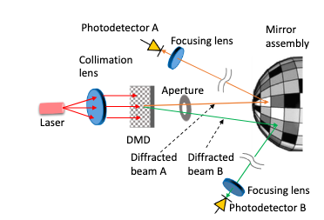
ProjecToR
Reconfigurable Top of Rack Optical Switch
Disco Ball Arrangement

Slide 10
ProjecToR: Scheduling Of Links
given a set of po-tential opportunistic links and current traffic bundles, find aset of active opportunistic links such that each laser is con-nected to at most one photodetector and vice versa. In otherwords, the set of active edges should form amatchingbe-tween lasers and photodetectors.
At first blush, our problem appears as the standard switchscheduling problem: given the current state of the queues,match input-output ports. An important distinction, how-ever, is that our problem is two-tiered. While the traffic ma-trix is between ToRs, matching occurs between lasers andphotodetectors, and there are multiples of those per ToR.
Because of this distinction, we cannot use existing match-ing approaches [29, 30] out of the box.Simply stated,the presence of two-tiers complicates the computationalstructure of the problem.
For instance, an instantaneousthroughput maximizing matching for the single-tier case canbe found using efficient maximum weight matching algo-rithms [15], but for the the two-tier case, we currently do notknow whether the problem is polynomial time solvable orNP-Hard. (As we will go on to show, latency minimiza-tion is solvable in polynomial time).

Slide 11

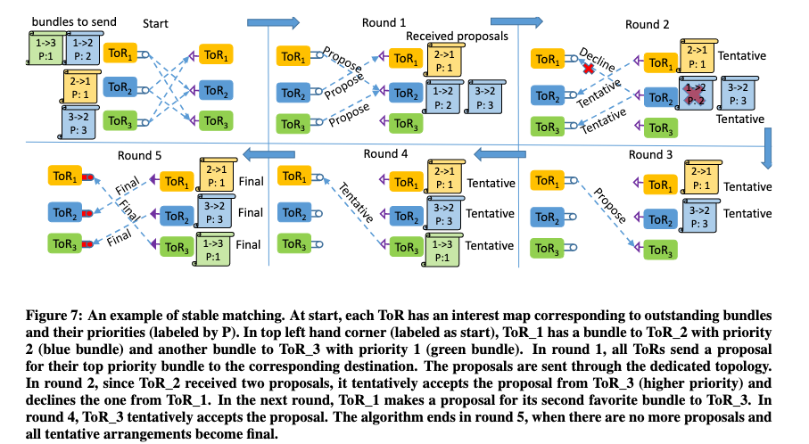
ProjecToR: ILP Formulation
For each Bundle j
Bi-partite matching problem
Discrete time
Sources vs Destination

Slide 12
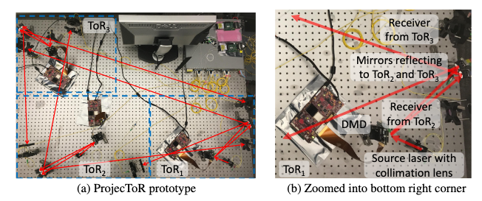
ProjecToR: Test Bed
“We built a three-ToR prototype of ProjecToR using threeTexas Instruments DLP Discovery 4100 kits with 0.7 XGAChipset [2]. Each ToR is equipped with one transmitter andone DMD.”

Slide 13
Key Findings: Experimental Results
Wastage of Light time during switching: 12µs

Slide 14
AdjustNet: Big Picture
#23

