Slide 1

Aloe: An Elastic Auto-Scaled and Self-stabilized Orchestration Framework for IoT Applications
Subhrendu Chattopadhyay¹, Soumyajit Chatterjee² Sukumar Nandi¹
Sandip Chakraborty²
Presenter:
Subhrendu Chattopadhyay
¹IIT Guwahati, ²IIT Kharagpur
Notes:
Thank you Prof. Pau, for the introduction. Hello everyone. Myself Subhrendu and my friend Somyajit here. The work we are about to present, came out of a collaborative project between IIT Guwahati and IIT Kharagpur. The title of the talk is Aloe : An elastic Auto-scaled and self-stabilized Orchestration Framework for IoT Applications. As the title suggests, in this paper we tried to explore the management issues for the IoT platforms

Slide 2
Aloe: An Elastic Architecture
IoT devices has inbuilt resources (Like CPU, Memory etc.)
Thousands of IoT devices form an IoT ecosystem
Can we form a resource Pool?
Notes:
At the beginning of this work, we wanted to look at the current challenges in IoT paradigm. And we found the following issue. Lets consider that, the nodes in the pictures are the IoT devices. Each of them has some inbuilt resources (CPU,RAM, Sensors etc.).
<clk>
As the IoT devices are connected, they form an eco-system.
<clk>
In this scenario, the first question we ask is, can we combine the computational capabilities of those thousands IoT devices to form a resource Pool?

Slide 3
Aloe: An Elastic Architecture
IoT devices has inbuilt resources (Like CPU, Memory etc.)
Thousands of IoT devices form an IoT ecosystem
Can we form a resource Pool?
Advantages of the resource pool
Reduces “capex”.
Provides faster response.
Keep data inside network. (Provides security)
In-Network processing
Use residual resources of the networking components
Notes:
Deployment of such a pool creates a mini cloud inside the network. This mini-cloud minimizes cloud expenses because almost every IoT apps require cloud access. Due to processing in the local neighborhood, the mini-cloud can provide better QoS to the delay sensitive applications. Additionally the data does not leave the eco-system. Therefore, data security is maintained to some extent.
<clk>
The already existing solution for such eco-system is often termed as in-network processing platform. It uses residual resources of the networking components.

Slide 4
Aloe and In-Network Processing
How to manage the in-network processing infrastructure?
Design Objectives:
﻿Auto-scalable
﻿Fault tolerance
Partition tolerance
﻿Plug-and-play
OpenFlow Switches
Notes:
Our work focuses on how to manage such an infrastructure. Specifically our paper is on the management of network operations of the infrastructure. Management functionalities are dependent on the nature and objective of the platform. So, lets look at the design goals for such platform.
<clk>
Large scale system like this requires auto-scalability. i.e. addition and deletion of nodes should be handled automatically.
<clk>
On the other hand failure rates of IoT nodes are generally high. Therefore, the system should support a fault-tolerant and partition tolerance architecture to ensure liveness.
<clk>
Ease of deployment and incremental deployment is a good feature for any large scale systems. This can be handled if the devices can operate in a plug and play fashion.

Slide 5
Aloe and In-Network Processing
How to manage the in-network processing infrastructure?
Design Objectives:
﻿Auto-scalable
﻿Fault tolerance
Partition tolerance
﻿Plug-and-play
﻿Short-lived flows
﻿﻿Micro-service architecture
Rapid deployment
OpenFlow Switches
Notes:
In an IoT platform, the percentage of short-lived flows are high. The network management must reduce the flow-setup delay because short flows are more affected by the flow-setup delay than it’s large counterpart.
<clk>
Each devices are resource constrained devices; so use of micro service architecture helps deployment of the services.
<clk>
Finally like all new aged network management techniques, the platform should be agile to support rapid deployment of applications without incurring additional overhead for in-network processing.
The figure contains a sample in-network processing architecture. Here each node represents IoT device. They also have multiple interfaces. So they can forward data between each other.

Slide 6
Aloe and In-Network Processing
SDN Based System
﻿Auto-scalable
﻿Fault tolerance
Partition tolerance
﻿Plug-and-play
﻿Short-lived flows
﻿Rapid deployment
﻿Micro-service architecture
OpenFlow Supported Controllers
Notes:
One way to design a network mgmt plane is to use SDN. SDN uses controller driven architecture. SDN can enable rapid deployment, does not support the rest of the features. Therefore, traditional SDN is not a suitable solution.

Slide 7
Aloe and In-Network Processing
SDN Based System
Distributed SDN
Notes:
The next choice for network management is use of Distributed SDN. D-SDN deploys multiple SDN controllers to increase scalability.

Slide 8
Aloe and In-Network Processing
SDN Based
Distributed SDN
SCL
Switch Agent
Switch Agent
Switch Agent
Switch Agent
Switch Agent
Switch Agent
Switch Agent
Switch Agent
Notes:
One of the popular implementation of distributed SDN is SCL. SCL uses replicated controller instances. An additional switch agent module is added to each switch for maintaining the consistency.

Slide 9
Aloe and In-Network Processing
SDN Based System
Distributed SDN
SCL
Auto-scalable
﻿Fault tolerance
Plug-and-play
Short-lived flows
﻿Rapid deployment
Micro-service architecture
Policy Coordinator
Switch Agent
Switch Agent
Switch Agent
Switch Agent
Switch Agent
Switch Agent
Switch Agent
Switch Agent
Notes:
To maintain the high level policy consistency between the controller instances, a policy coordinator layer is attached to the system. SCL increases fault-tolerance. However, it also adds overhead for managing consistency. This overhead acts as a bottleneck and reduces the scalability. Also, SCL does not provide sufficient gurantee to ensure short-flow QoS.

Slide 10
Aloe and In-Network Processing
SDN Based System
Distributed SDN
SCL
BLAC
BLAC SCHEDULER
Notes:
<clk>
Another recent implementation of d-SDN is BLAC. BLAC introduces a scheduling layer. The scheduling layer chooses a suitable controller for each flow from a pool of controller based on the load of the controller.

Slide 11
Aloe and In-Network Processing
SDN Based System
Distributed SDN
SCL
BLAC
Auto-scalable
﻿Fault tolerance
Plug-and-play
Short-lived flows
﻿Rapid deployment
Micro-service architecture
BLAC SCHEDULER
Notes:
<clk><clk>
BLAC scheduling layer introduces auto-scalability. It can also solve the controller failure problem. But BLAC is neither suitable for IoT short-flows nor link/partition tolerant. BLAC can perform well in case of out-of band operation, but not suitable for in-band control plane. And we know that, other than datacenter networks, most of the network can have out of band controlling for practical purposes. On the other hand, IoT devices has fewer interfaces, so it heavily depends on in-band controlling which BLAC fails to satisfy.

Slide 12
Aloe and In-Network Processing
SDN Based System
Distributed SDN
Aloe
Notes:
<clk><clk>
Based on the limitations of the d-SDN planes, we developed ALOE as an orchestration framework for the network management for in-network processing platforms. Here is how Aloe differs from rest of the d-SDN. ALOE supports the single image/production grade controllers to form distributed SDN.

Slide 13
Aloe and In-Network Processing
SDN Based System
Distributed SDN
Aloe
Notes:
The controller applications are containerized using docker. This helps us to deploy the control plane as a service. On the other hand, servicification helps auto-scaling. The controller services are deployed in the in-network processing platform itself.
<clk>
This is how ALOE works. First the controller applications are sub divided into small micro controller services.

Slide 14
Aloe and In-Network Processing
SDN Based System
Distributed SDN
Aloe
Notes:
These micro-controller services are executed in the in-network processing framework to manage itself. The animation shows how the micro-controller services are deployed in the actual infrastructure.

Slide 15
Aloe and In-Network Processing
SDN Based System
Distributed SDN
Aloe
Auto-scalable
﻿Fault tolerance
Plug-and-play
Short-lived flows
﻿Rapid deployment
Micro-service architecture
Super Network Controller
Notes:
To manage the high level consistent policies we use a Super network controller.
The major advantages of Aloe includes auto-scalability. We’ll discuss in a short while. To ensure the fault-tolerance, we rely on a distributed self-stabilizing algorithm for placement of the micro-controller services. Use of docker makes it plug and play compatible. Once the device is attached to system, it is configured automatically by the super controller. Docker also helps in dynamic deployment of controllers by use of container migration. Our controller placement policy deploys the controller applications near the switches. So, the short flows can receive quick attention. Finally, it is compatible to micro-service architecture.

Slide 16
Aloe: Implementation
How Aloe exploits In-network processing architecture?
Software SDN switch
Control plane as µ service and support for plug and play
Lightweight service migration
Aloe fast flow installation
Notes:
How aloe exploits in-network processing?
We are using OVS to implement software switch over commodity IoT device.
Since Aloe uses micro service architecture, it becomes plug and play.
We propose a lightweight REST based micro service migration mechanism. It helps Aloe to achieve, fault tolerance by ensuring weak consistency of the system in case of failure.
Aloe improves performance of short lived IoT flows via fast flow installation by placing micro-controller services near the switches.

Slide 17
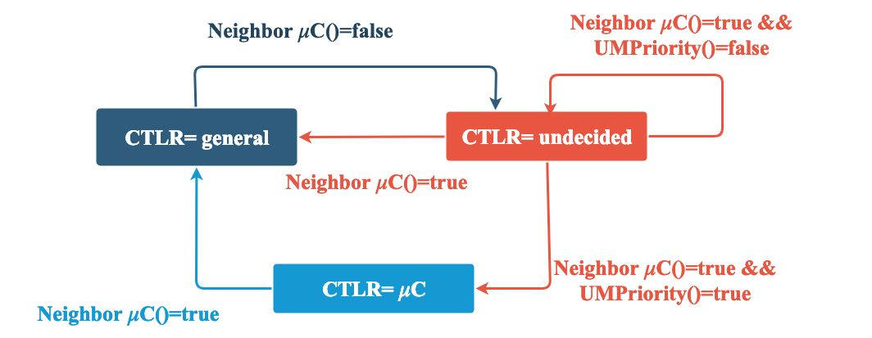
Aloe: Implementation
Aloe self-stabilizing µC placement module
Maximal Independent set Algorithm
Linear time convergence
Self-stabilizing
Notes:
During implementation we have developed 5 different modules targeted for specific operations. E.g. Topology management, State discovery, micro-service manager, policy updation and micro-controller placement.
Here we explain only the micro-controller placement module. Its task is to ensure fault-tolerance deployment of controller applications. The core of the module is dependent on a self-stabilizing Maximal independent set algorithm. (Details of the algorithm are in paper). As it is self-stabilizing, it ensures fault-tolerance. The algorithm is also linear time convergent. Lets look at some example on how the algorithm works.

Slide 18
Aloe and In-Network Processing
Aloe self-stabilizing µC placement module
New node insertion
Super Network Controller
Notes:
Say a new node is added to the platform. Once the adjacent nodes of the platform detects the insertion event, the Self stabilizing –maximal independent set algorithm is invoked. Thus the micro-controller positions are re-adjusted to suit two criteria. 1) place micro controller near the switch. 2) Keep the number of controller instance to a limit.

Slide 19
Aloe and In-Network Processing
Aloe self-stabilizing µC placement module
New node insertion
Node/Link Failure
Super Network Controller
Notes:
<clk>
When a node is failed, Self Stabilization maximal independent set again re-adjusts the micro-controller positions.

Slide 20
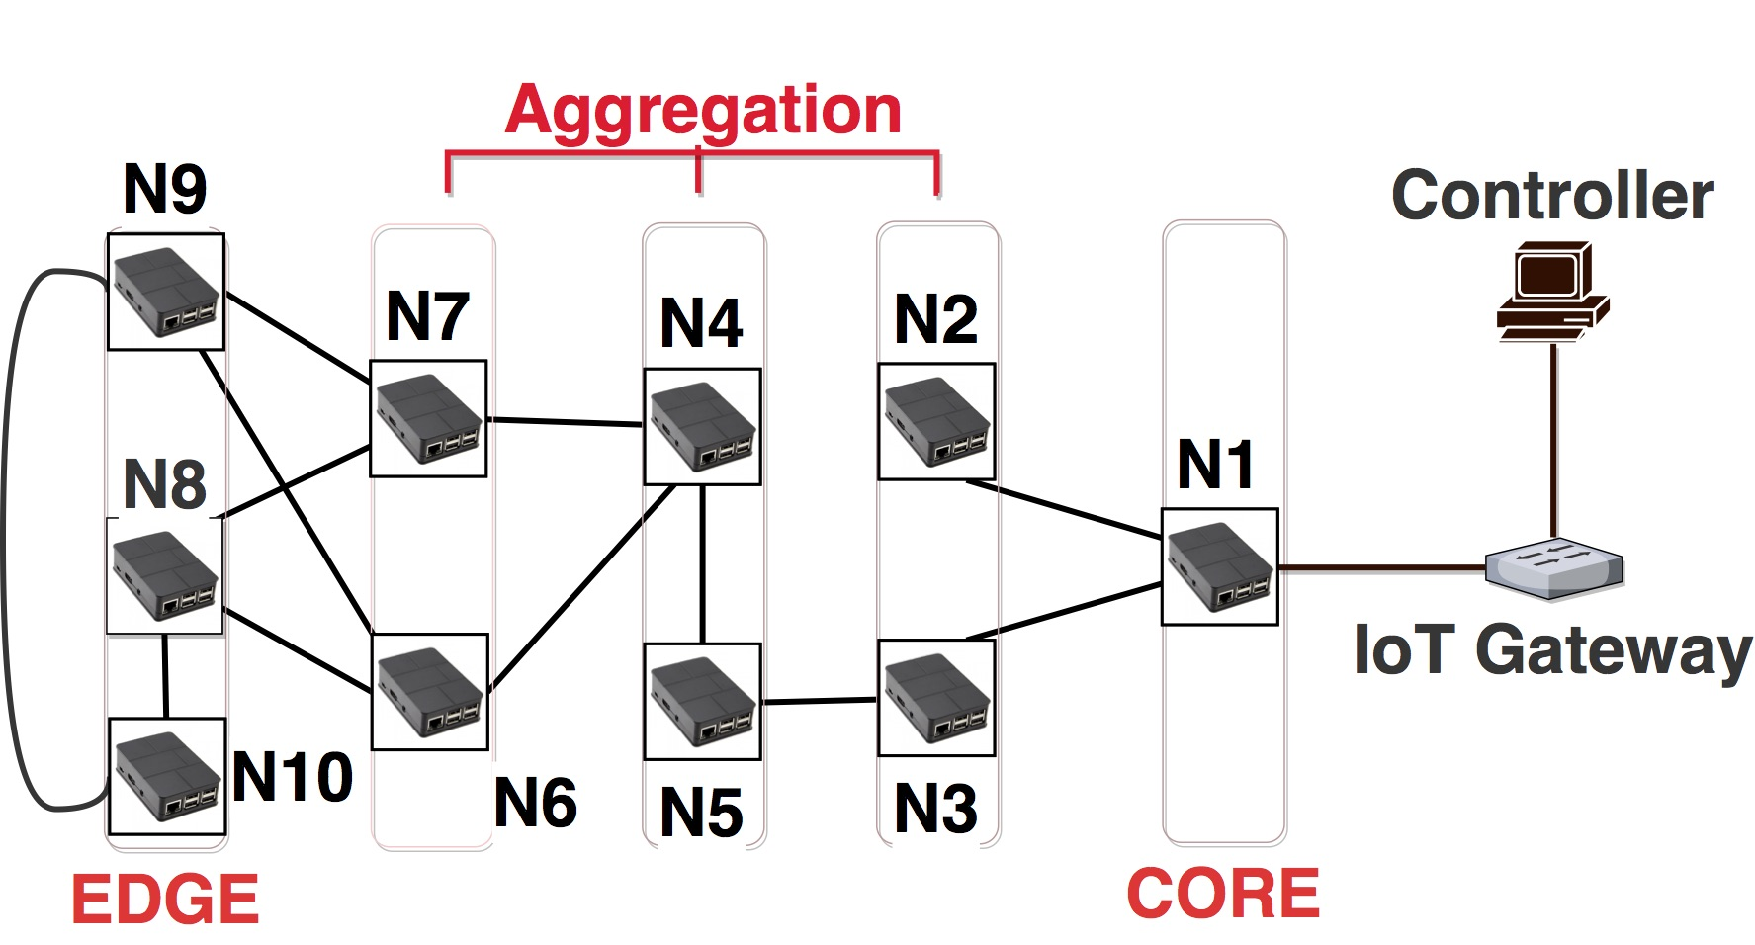
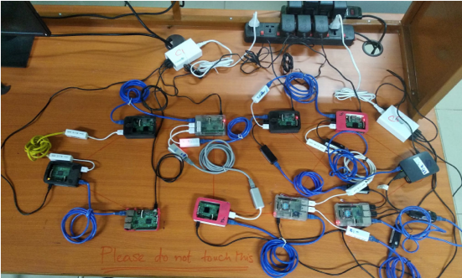
Aloe: Experimental Observations
Experimental Setup
In-house Testbed
(10 Nodes)
Amazon AWS Rocket Fuel topology
(70 Nodes)
Migration protocol
lightweight REST based
weak consistency preserving
µC Application (Results in the paper)
Zero SDN (less CPU and RAM)
RYU
ODL
Notes:
Lets look into the performance of the proposed orchestration framework. For experiments, we use 2 different setup. 1-in-house testbed using Raspberry-Pi, 2-AWS instances for large scale deployment.
In the right hand side, there is a neat schematic diagram of the testbed, but lets see how it looks like in reality. <clk>
We have developed a REST based micro-controller migration protocol for maintaining weak consistency. Based on rigorous experimental comparisons between RYU, Zero-SDN and OpenDayLight we found that zero-SDN performs the best.

Slide 21
Aloe: Experimental Observations
Experimental Setup
In-house Testbed
(10 Nodes)
Amazon AWS Rocket Fuel topology
(70 Nodes)
Migration protocol
lightweight REST based
weak consistency preserving
µC Application
Zero SDN (Requires less CPU and RAM)
RYU
ODL
IoT Applications
Distributed database (Cassendra)
HTTP (Python SimpleHTTP)
Distributed file system (GlusterFS)
Other Parameters
Chaos- Monkey Fault injection model
Notes:
To test the performance of Aloe, we have chosen 3 types of Applications.
Short query based Cassendra distributed database, Long flow based HTTP file transfer, another distributed file system application named GlusterFS; which generates long flows between short hops.
All results are performed under netflix’s chaos –monkey fault injection models and compared with BLAC framework.

Slide 22
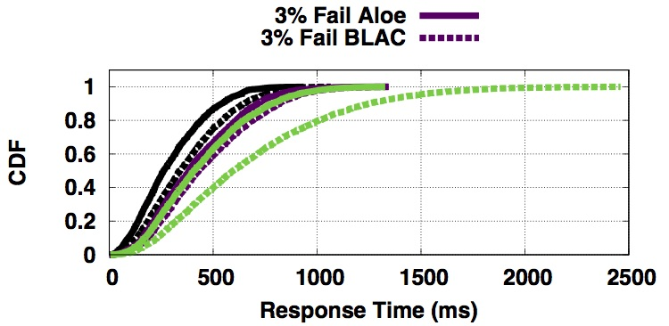
Aloe: Experimental Observations
Selected Results:
Aloe can provide better Response time for HTTP and Cassendra
Cassendra
Notes:
We observe that Aloe provides a significant improvement in the query response time.

Slide 23
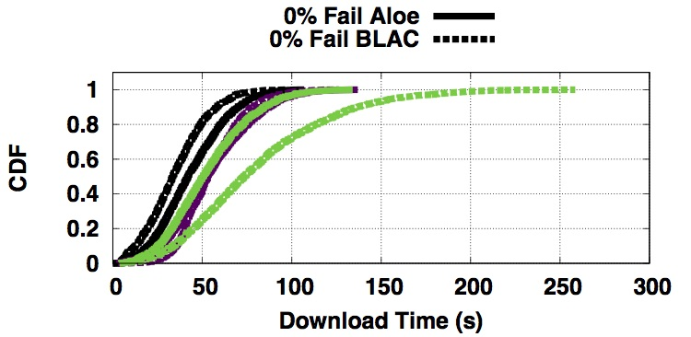
Aloe: Experimental Observations
Selected Results:
Aloe can provide better Response time for HTTP and Cassendra
HTTP
Notes:
For HTTP long flows, the overhead of Aloe is higher than BLAC when there is no failure. However, Aloe out performs in the presence of link outage.

Slide 24
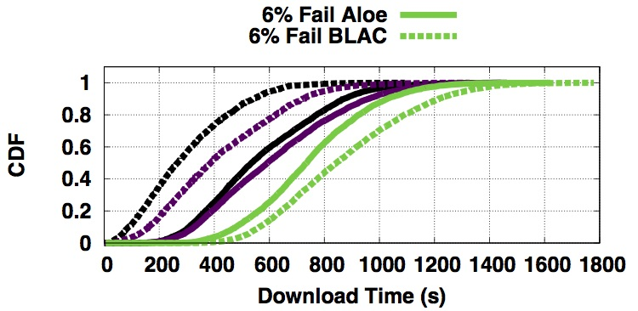
Aloe: Experimental Observations
Selected Results:
Aloe can provide better Response time for HTTP and Cassendra
GlusterFS response time is improved if the amount of failure increases (Why?)
GlusterFS
Notes:
Gluster flows are short-distant flows, usually within one-hop. The flow-setup delay is almost negligible for a one-hop flow. Therefore the µC deployment overhead of Aloe is more when the number of failures are less.

Slide 25
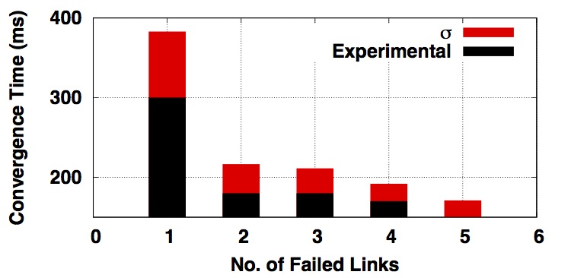
Aloe: Experimental Observations
Selected Results:
Aloe convergence after failure
As the amount of failure increases, convergence time reduces due to ripple effect of the µC placement module
Notes:
During the experimentation, we found an interesting observation. We found that, when the number of failure increases, the convergence time improves. But this is counter intuitive.
This is happening due to the ripple effect. During the question and answer session I can explain the ripple effect if necessary.

Slide 26
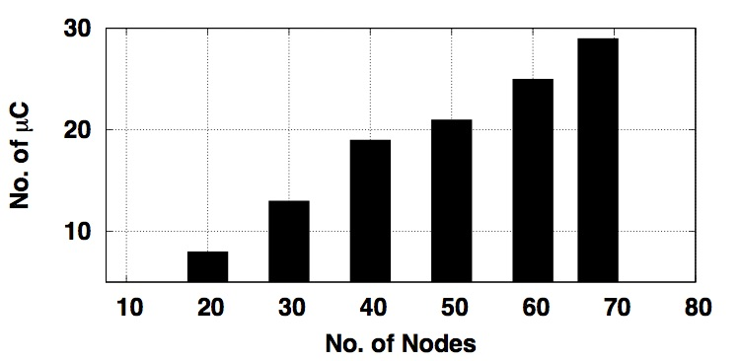
Aloe: Experimental Observations
Selected Results:
Effect of Scaling: µC Placed in the network
Notes:
As the no of nodes in the system increases, the no. of micro-controller instances are also scaling automatically.

Slide 27
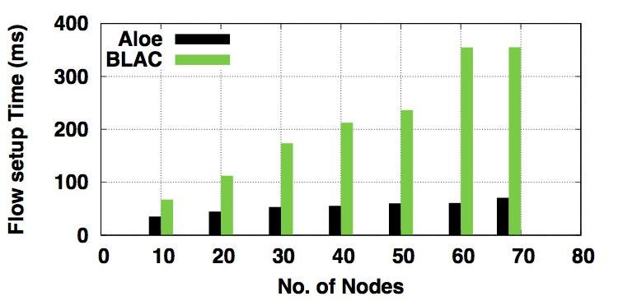
Aloe: Experimental Observations
Selected Results:
Effect of Scaling: Flow setup delay reduces significantly
Notes:
The flow-setup delay is reduced significantly.

Slide 28
Conclusion
﻿We present Aloe, an orchestration framework, for IoT in-network processing
Aloe uses docker container
Aloe is elastic auto-scaling
It minimizes the flow setup time
The performance of Aloe has been tested
thoroughly using two real testbeds
Aloe provides significant improvement I terms of response time
Notes:
We present Aloe, an orchestration framework, for IoT in-network processing infrastructures. Aloe
uses docker container to support lightweight migration capable in-band controllers. This design choice helps Aloe to provide elastic auto-scaling while keeping flow setup time under control. Aloe provides controller as a service to exploit in-network processing infrastructure and supports fault and partition tolerance. The performance of Aloe has been tested thoroughly using two real testbeds and compared with a very recent orchestration framework (BLAC). The results indicate a significant improvement in response times.

Slide 29
Thank You
Questions?

