Slide 1
Team : Infynite Loop
STG Makeathon – March,2009
Bhubaneswar

Slide 2
Problem Statement
Problem #3
Visitor Management System

Slide 3
Objective
To develop a Secure, Friction Less, Feature Rich and User Friendly visitor management system.

Slide 4
Salient Features of our solution
Face recognition
  Find a visitor by their face
  Verify a visitor’s identity by clicking their photo
Paperless Operation
  Mobile application developed for security guards for easy paperless operation
  Gate pass and visitor requests sent electronically

Slide 5
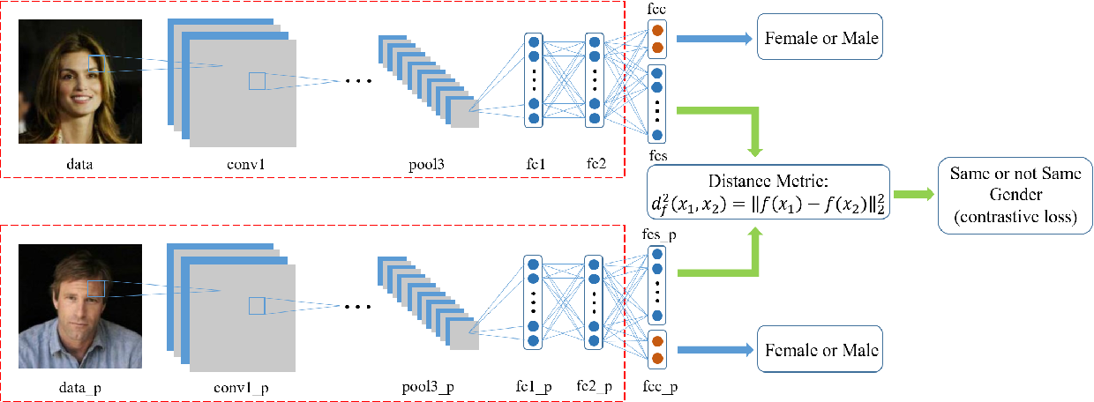
Face Recognization Model
One-shot Learning
Using trained VGGNET model to convert images to vectors
OpenCV is used to detect and crop faces from images

Slide 6
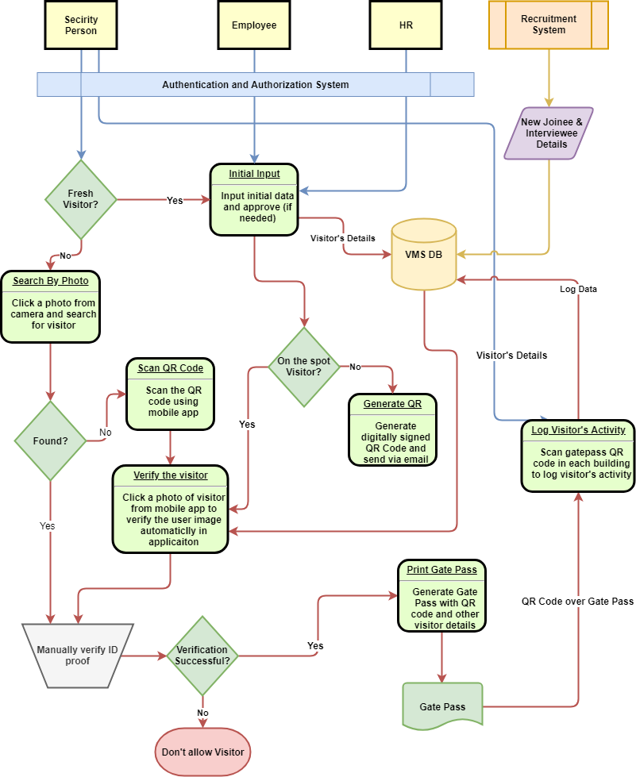
Work Flow Diagram

Slide 7
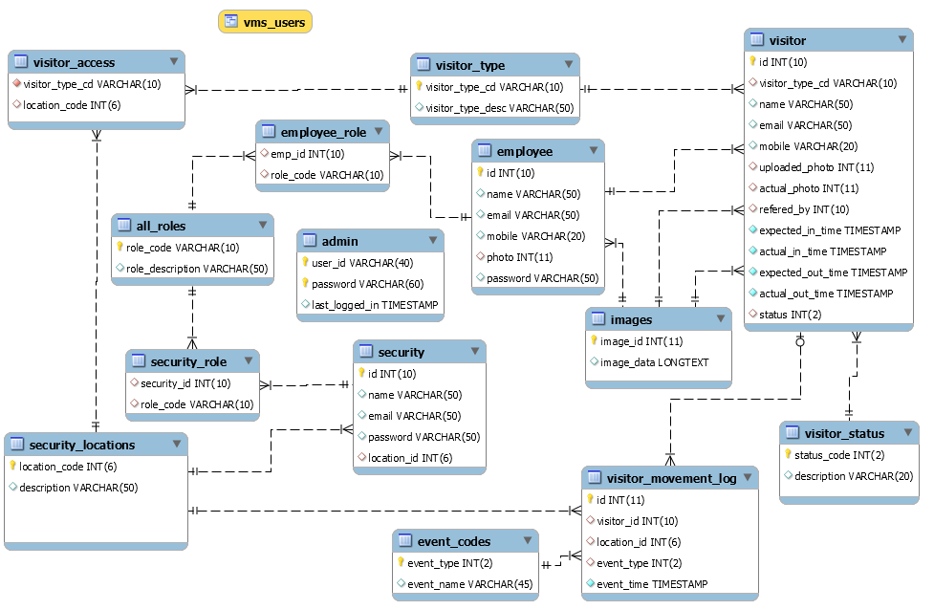
Database Model

Slide 8
Demo

Slide 9
Thanks

