Slide 1
Team : Infynite Loop
STG Makeathon – March,2019
Bhubaneswar

Slide 2
Problem Statement
Problem #3
Visitor Management System

Slide 3
Objective
To develop a Secure, Friction Less, Feature Rich and User Friendly visitor management system.

Slide 4
Salient Features of our solution
Face recognition
Find a visitor by their face
Verify a visitor’s identity by clicking their photo
Kiosk application at key locations to identify a vistor by face
Paperless Operation
Mobile application developed for security guards for easy paperless operation
Gate pass and visitor requests sent electronically
Overstaying alerts send via Text Message automatically

Slide 5












High Level Design
Mobile App
ML Services
Data Base
Web APP
Web Services
Desktop APP

Slide 6
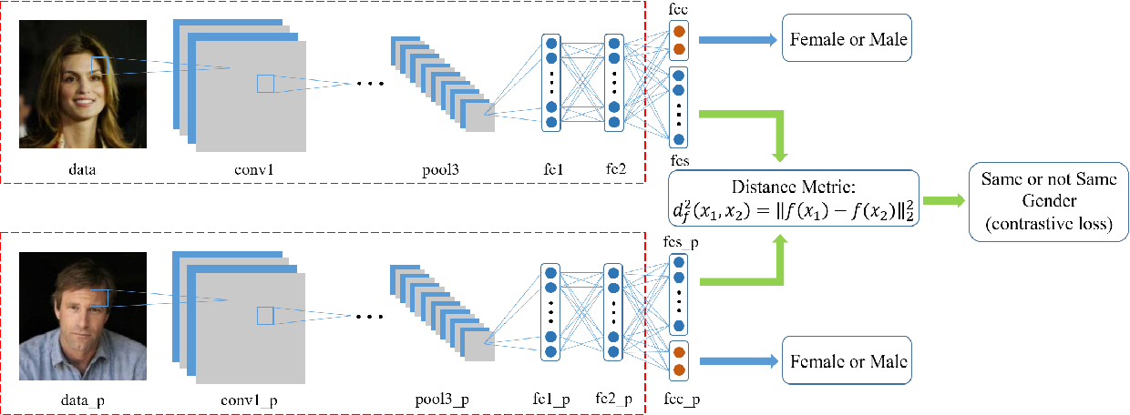
Face Recognization Model
One-shot Learning
Using trained VGGNET model to convert images to vectors
OpenCV is used to detect and crop faces from images

Slide 7
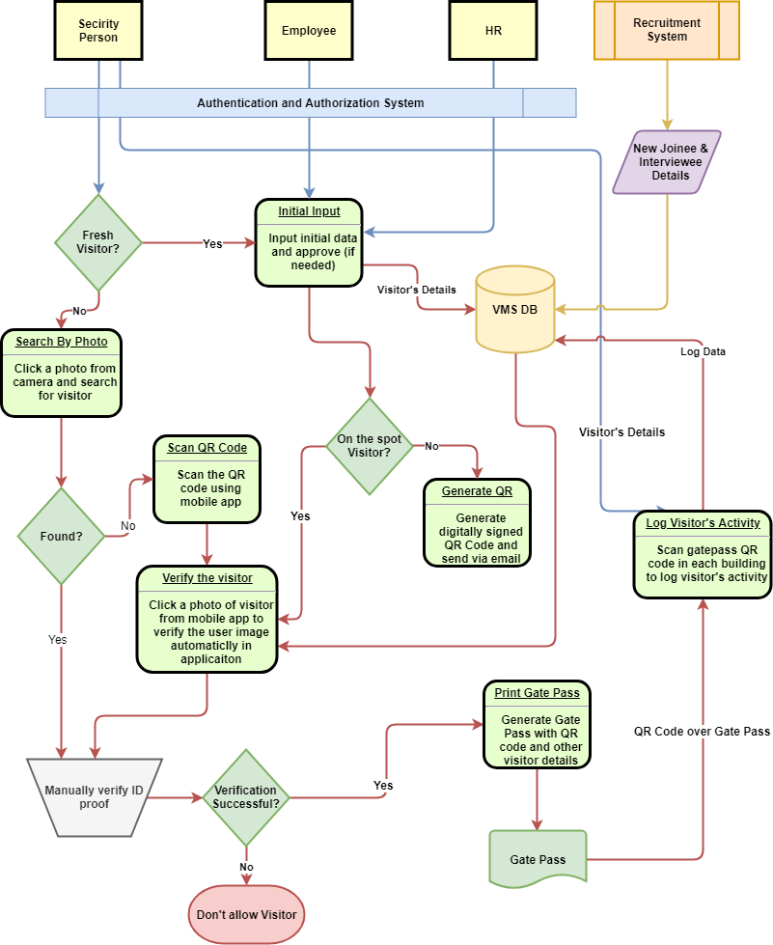
Work Flow Diagram

Slide 8
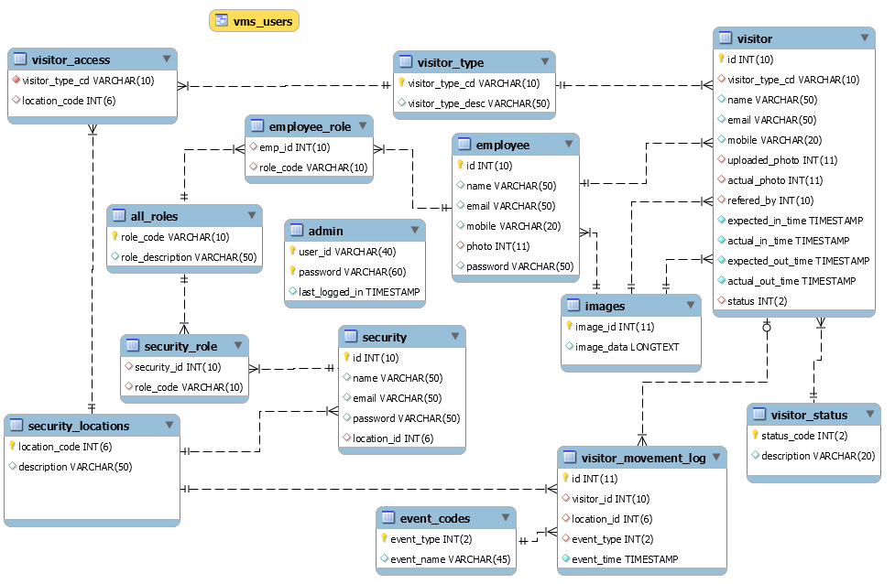
Database Model

Slide 9
Demo

Slide 10
Thanks

