Slide 1

Walkthrough by
Shaswata Saha
shaswata.ssaha@gmail.com

Slide 2

Topic
Academic Life Tools
Focus on developing tools and software to help students and educators navigate academic life more effectively. This could include study aids, educational apps, or tools to help manage coursework and schedules.

Slide 3
About the project
I have developed an app named ACNS Learning which provides the facilities of navigating academic lives more easily. I have also attached some demo videos and course work section of the website so that the website looks legitimate to the users.
Moreover the website will be updated to contain some of the very valuable course which would provide educational contents to the students, teachers as well as adults. This platform will also help manage time effectively of the students. In further updates, the website will contain a time monitoring feature and a break habit feature. Moreover it will also have a fitness care session for which the users will be given a break of 30 minutes after each 2hrs course as well as 1hr of project work.
This website is aimed to be a competitor of other learning platforms like LinkedIn and IBM Learn. To attract users the user would be provided a custom made certificate of completion and a badge score for every course he finishes. These scores can provide him a discount in any paid course he wants to purchase.

Slide 4
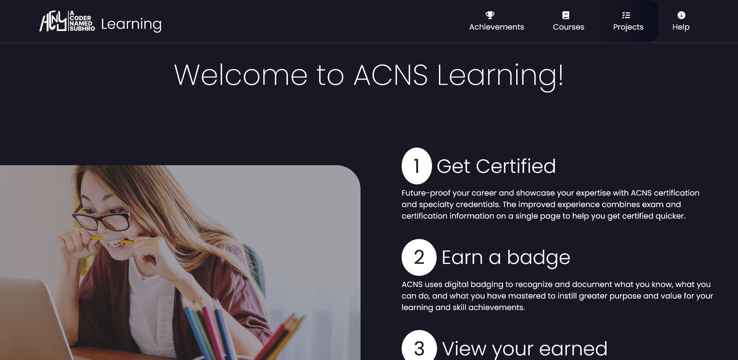
ACNS- Learning
This website has been created taking in mind the needs for every individual with a good UI and a ever guiding process. Here is the link →

Slide 6
Topic

