Slide 1





TECH
THREADS
NEXT STEP TOWARDS DIGITAL FABRICATION

Slide 2
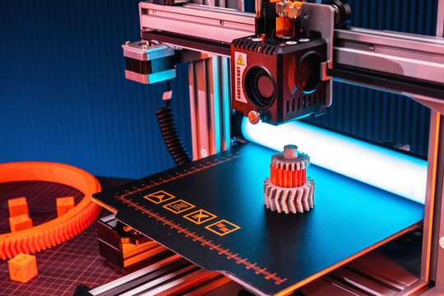
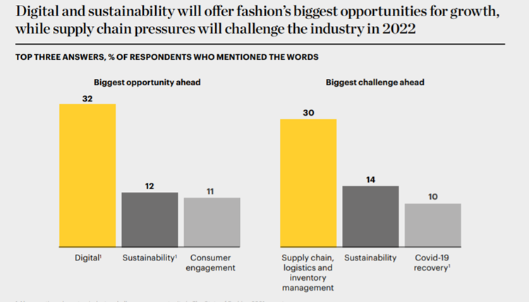
What exactly is 3D Printing?
As we all know, today’s apparel industry is not sustainable. Each stage of it’s value chain is harmful to both people and planet.
In fact, fashion is world’s second-most pollution industry.
3-D printing technology is considered as one of the most emerging and significant technology of the upcoming revolution in the fashion industry.
One can use 3D printing technology in fashion to design accessories, build prototypes and manufacturing tools , boost towards sustainability efforts and expand customization options.

Slide 3
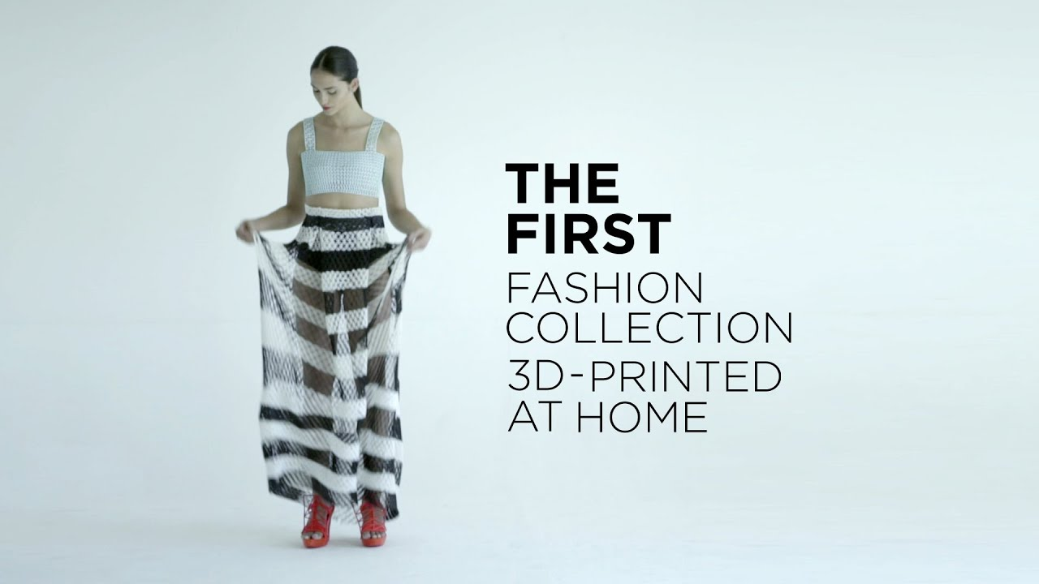
3D printing technology is considered as one of the most emerging and significant technology of the forth industrial revolution in the fashion industry.
One can use 3D printing technology in fashion to design accessories build prototypes and manufacturing tools, boost towards sustainability efforts and expand customization options.
Moreover, it can reduce labour costs and increase efficiency in production of better and sustainable fabrics to the population.
Therefore we can harness this new technology to our fullest and can gain benefits out of this.

Slide 4
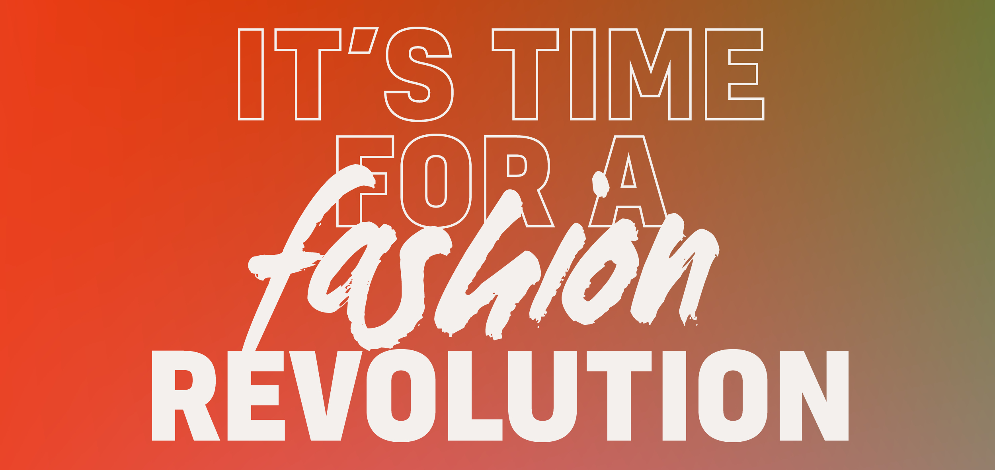
OUR GOALS AND VISIONS
What we aspire to do?
We are revolutionizing the fashion industry by making clothes that are not only unique but also highly creative. These clothes have great opportunities for personalization/customization and the material used to prepare these clothes are quite affordable, sustainable and eco-friendly.
How we should do it?
Using the above mentioned efficient fabrication system we can make better products as the 3D printing technology allows us to do so.

Slide 5
Why we do it?
To keep up with the technical drive and to solve a lot of problems our textile industry is facing these years like labour and lack of technical efficiency, we decided to solve this problem our way like this.

Slide 6
FINANCE & ACCOUNTING
LOREM300

Slide 7
SALES & MARKETING
LOREM300

Slide 8
WHY US?
LOREM300

Slide 9
FUTURE VISIONS
LOREM300

