Slide 1

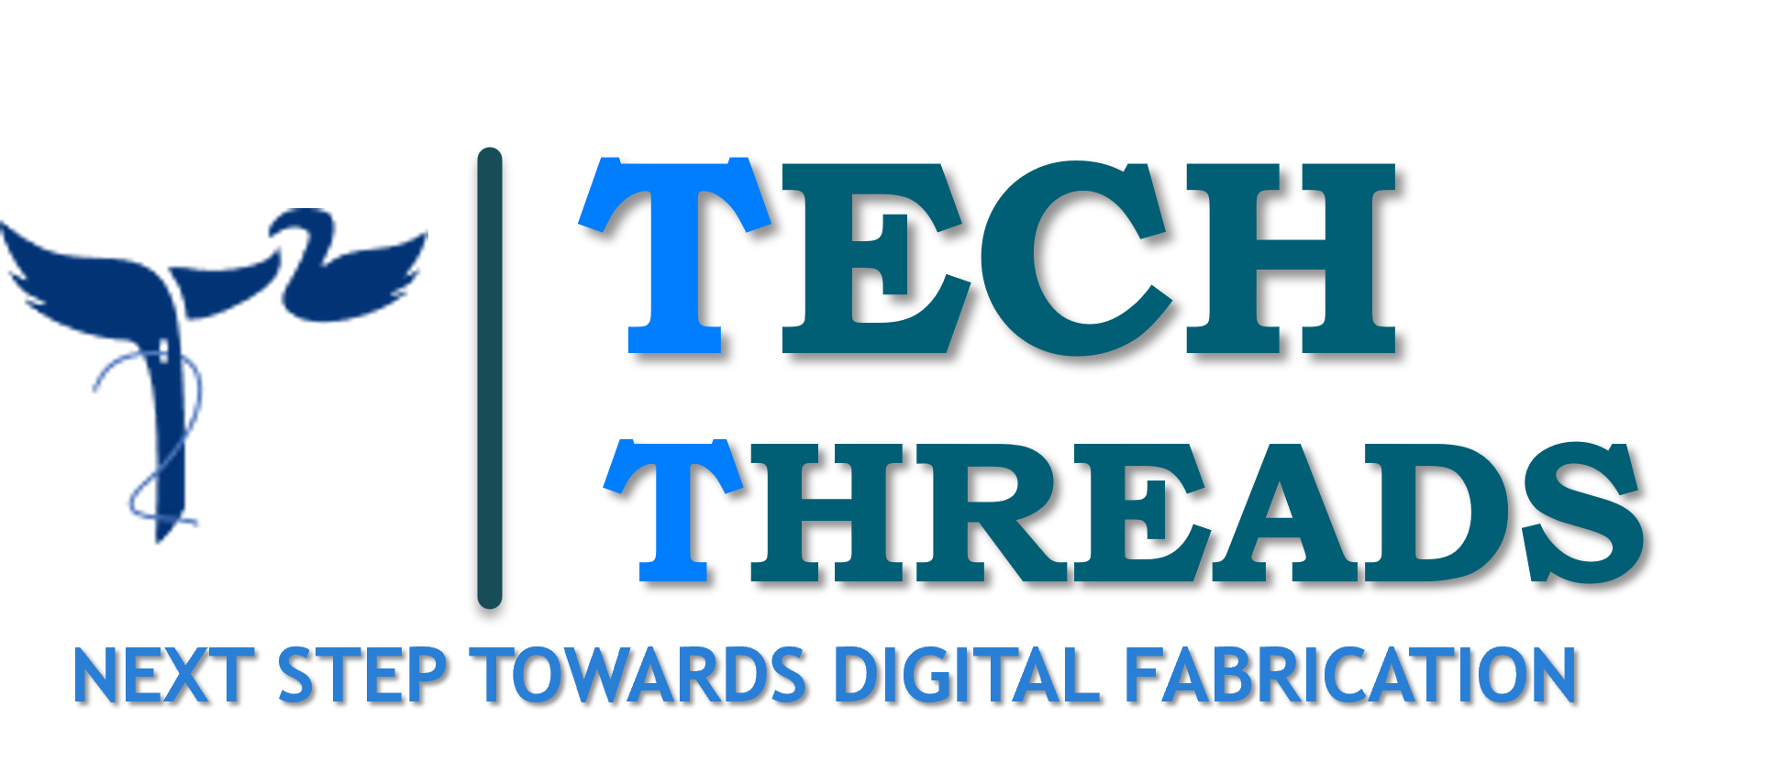




TECH
THREADS
NEXT STEP TOWARDS DIGITAL FABRICATION

Slide 2
PROBLEMS IN TODAY’S TEXTILE INDUSTRY
As we all know, today’s apparel industry is not sustainable. Each stage of it’s value chain is harmful to both people and planet.
In fact, fashion is world’s second-most pollution industry.

Slide 3
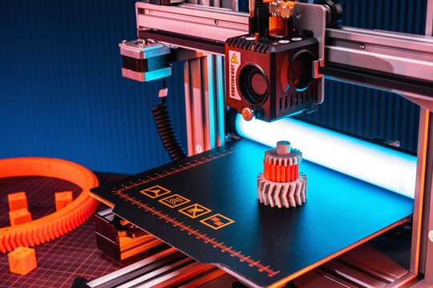
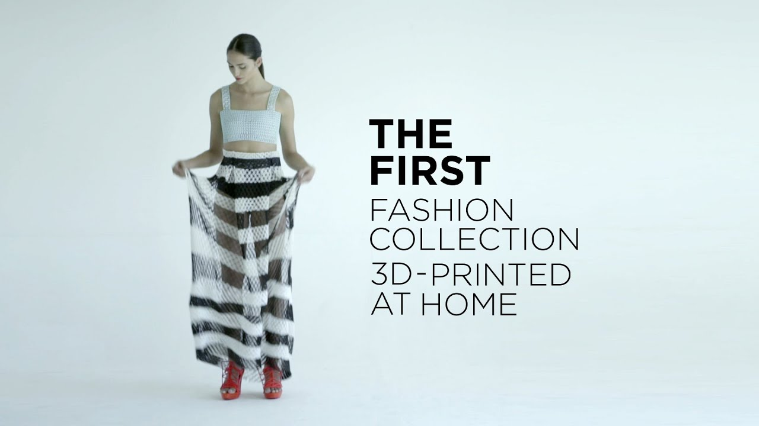
WHAT EXACTLY IS 3D PRINTING?
3-D printing technology is considered as one of the most emerging and significant technology of the upcoming revolution in the fashion industry.
One can use 3D printing technology in fashion to design accessories, build prototypes and manufacturing tools , boost towards sustainability efforts and expand customization options.
Moreover, it can reduce labour costs and increase efficiency in production of better and sustainable fabrics to the population.

Slide 4
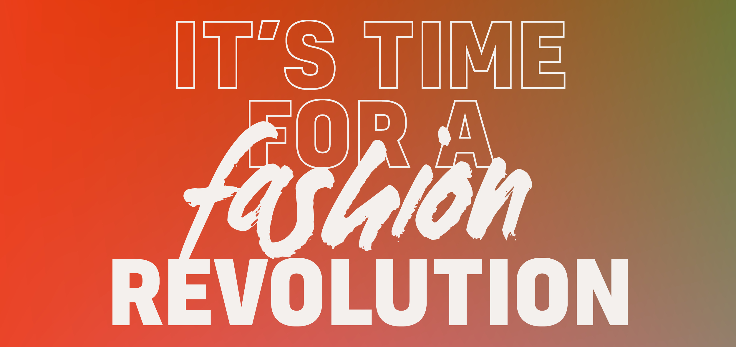
OUR GOALS AND VISIONS
What we aspire to do?
We are revolutionizing the fashion industry by making clothes that are not only unique but also highly creative. These clothes have great opportunities for personalization/customization and the material used to prepare these clothes are quite affordable, sustainable and eco-friendly.
How we should do it?
Using the above mentioned efficient fabrication system we can make better products as the 3D printing technology allows us to do so.

Slide 5
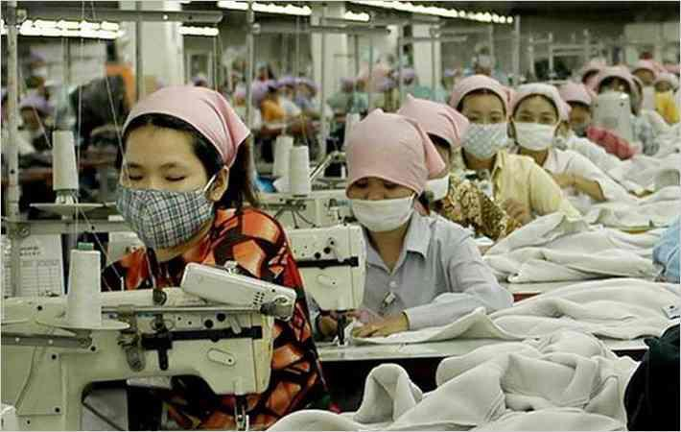
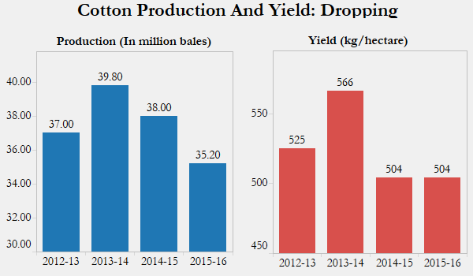
Continued…
Why we do it?
To keep up with the technical drive and to solve a lot of problems our textile industry is facing these years like labour and lack of technical efficiency, we decided to solve this problem our way like this.

Slide 6

HOW DOES OUR SYSTEM WORK?
Showcasing Digital designs or prototypes
Old products will be used as filaments and would then be converted to clothes.
Customers choose their designs
Our Website
Start manufacturing their chosen designs
After usage collecting the used product by giving the customer digital credits which they might use to buy new clothes or make a new cloth out of their old ones
Taking digital measurements of the customer
Delivery to the customer

Slide 7
OUR FINANCIAL STRATEGY
Expenditure
3D printers
Manufacturing costs
Employees
Maintenance
Delivery variable
Operational costs
Marketing
Filaments
Revenue
Selling the clothes
Subscriptions for exclusive designs
Using recycled filaments
Cash In
Cash Out
Net Profit
Our supply chain is responsive, which prevents over production and consumes less storage.
It is as responsive as required, as efficient as possible.

Slide 8

OUR MARKETING STRATEGY
Target Audience:
16 – 28 years
Primary
Film Industry
Fashion Shoes
Influencers
Audience (Middle & Upper-middle class)

Slide 9
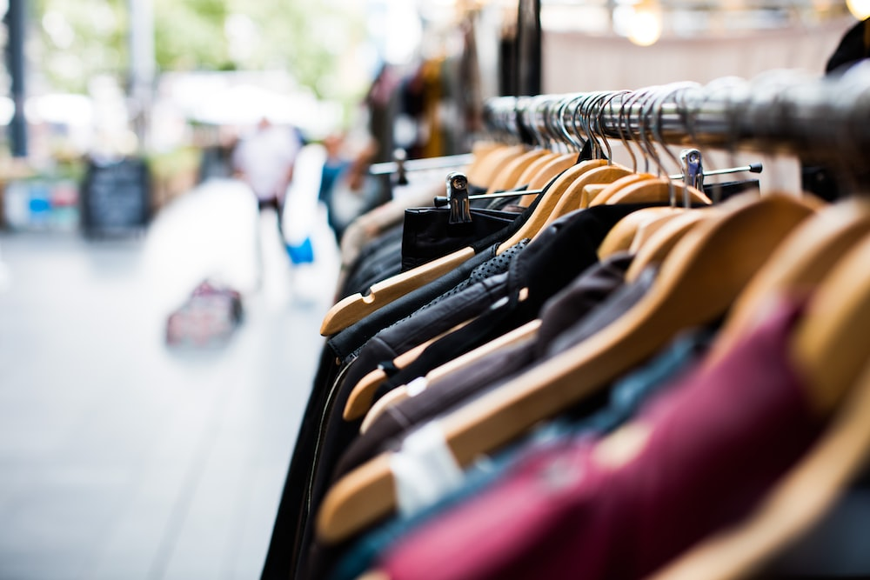
Continued…
Strategy for marketing:
Exclusive previews
Showcasing as a sustainable and durable product through memes
Google and Facebook ads
Social Media posts
Virtual events
Introductory offers
Building a premium brank look
Giving credits to customer when we will collect the sold clothes, which they can use to buy new ones
Doing a social media event where we will take designs and choose top 3 and send the clothes with their design back to them

Slide 10
EMPLOYMENT SCOPES
Technical Positions
Software Engineers
Textile Engineers, etc.
Designer Positions
Fashion Designers
Textile Designers, etc.
Other Positions
There will be a big team of delivery & supervising crew.
Sales Positions
Sales Associates
Merchandizers, etc.
Development Positions
Product Developers
Technical Developers, etc.

Slide 11
WHY US?
Pre – T^2 | Post – T^2
Wastage of clothes/products due to market risks or change in trends | Prevent over production
Design → Produce → Sell | Design → Sell → Produce
A lot of shipping fees invested | Sending designs by digital files to our company’s other branches. So, no shipping fee
Microfibres dumped into water bodies causing water pollution. | Mostly recyclable. No microfibres dumped into water bodies
Huge textile waster after the cutting process | No textile/fabric waster after cutting process

Slide 12
Continued…
Pre – T^2 | Post – T^2
Not vegan, animal cruelty | Vegan, no animals are harmed in the making process
Huge portion of land needed for production (i.e., cotton, jute etc.) | No land needed for production of raw material
Not individually involved | Supporting individuality by customization / personalization.
Does not support work from home, i.e., have to meet customers physically | Supports work from home, i.e., does not have to meet customers physically

Slide 13
OUR FIRST STEP
Consult with qualified professionals
Above-average understanding of market
Identify community competitors and their business
Familiarize with current cloth costs
Start the production of the ordered designs

Slide 14
OUR FUTURE PLANS
Introducing AI in our business
Making clothes more affordable and comfortable
Investing in research & development
Globalized market
Creating accessories, bags etc rather than just clothes.

Slide 15
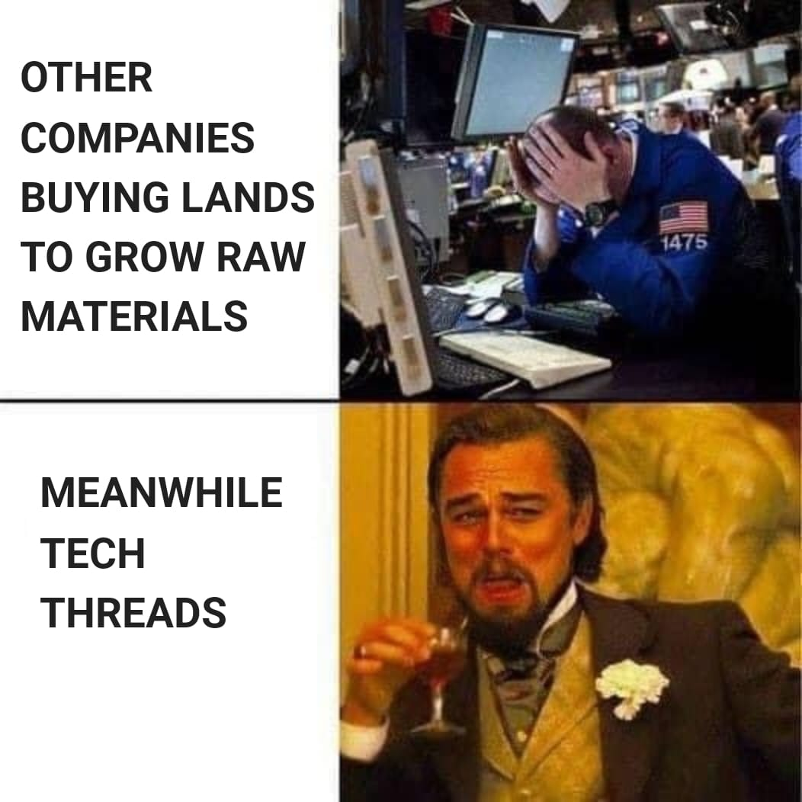
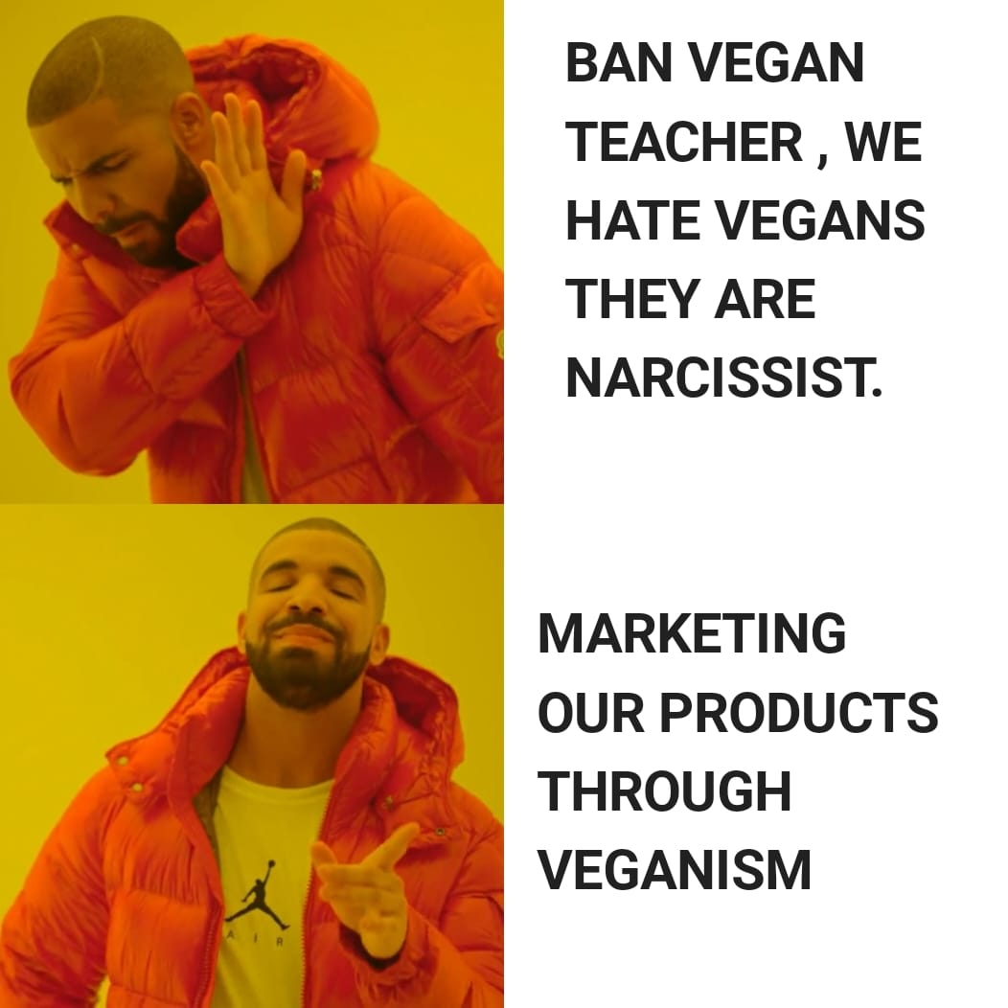
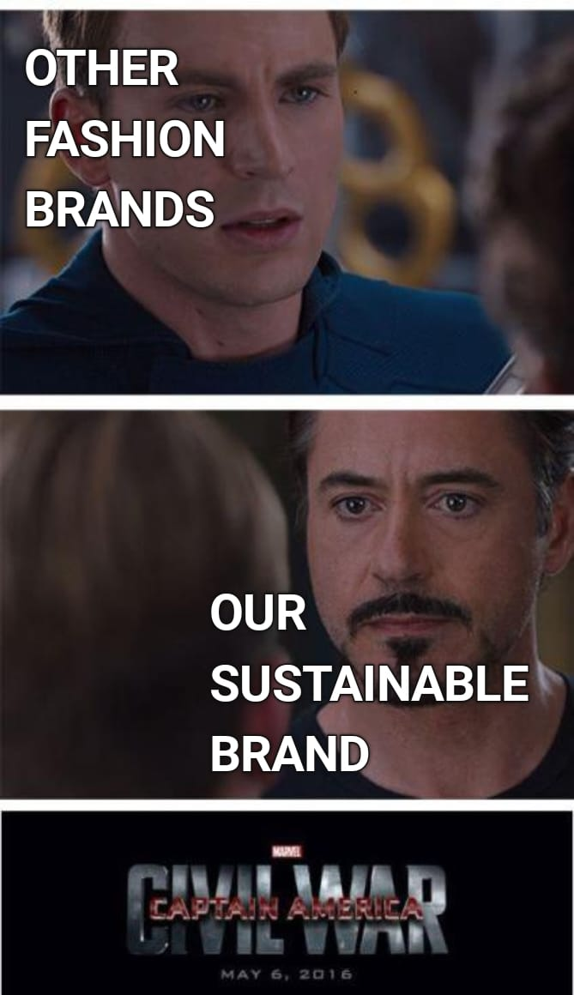
OUR UNIQUE WAY OF MARKETING

Slide 16
CONCLUSION
Creating unique sustainable clothes while taking care of our mother nature.
Less water pollution, no animal cruelty, no wastage, huge amount of lands being conserved while making profile.
Creating employment scopes.

