Slide 1


Walkthrough
By
Shaswata Saha
shaswata.ssaha@gmail.com

Slide 2
ABOUT THE HACKATHON
MBOA CODE is a hackathon which aims at bringing together University and High school students of all ages (novices to advanced) who are problem identifiers/solvers from all over Cameroon to converge and show their skills to investors and the world at large while standing multiple chances to go home with prizes that range from cash prizes, gadgets, sponsor awards, popularity awards and opportunities to foster their careers while having fun.

Slide 3
PROBLEM STATEMENT
MBOA CODE participants will have 24 to 48 hours to build and submit working prototypes of applications useful in the the field of agriculture.

Slide 4
TECHNOLOGIES USED
Laravel
PHPMyAdmin
HTML
CSS
JavaScript
Git
Bash
Linux
Ubuntu
ChatGPT
Youtube
MySQL

Slide 5
Implementing Laravel
Install Laravel: First, you need to install Laravel on your system. Laravel requires PHP and Composer to be installed. If you don't have them already, you can download and install PHP from the official website (https://www.php.net/downloads.php) and Composer from (https://getcomposer.org/download/).
Once you have PHP and Composer installed, open your command-line interface and run the following command to install Laravel globally:
laravel new project-name

Slide 6
Research
Africa faces various challenges in the agricultural sector. Some of the key problems affecting agriculture in Africa include:
Limited access to modern agricultural inputs: Many farmers in Africa lack access to quality seeds, fertilizers, pesticides, and other modern agricultural inputs. This limits their productivity and hampers their ability to adopt improved farming techniques.
Poor infrastructure: Inadequate rural infrastructure, including roads, transportation systems, and storage facilities, makes it difficult for farmers to access markets and transport their produce. It results in post-harvest losses and reduces the profitability of farming.
Climate change and weather variability: African countries are vulnerable to climate change, which leads to unpredictable weather patterns, including droughts, floods, and erratic rainfall. These factors negatively impact agricultural production, leading to crop failure, reduced yields, and livestock losses.
Land degradation: Soil erosion, deforestation, overgrazing, and improper land management practices contribute to land degradation in many parts of Africa. It reduces soil fertility, decreases agricultural productivity, and exacerbates food insecurity.

Slide 7
Research
5.Lack of access to credit and financial services: Smallholder farmers often struggle to access credit and financial services to invest in their farms, purchase inputs, or expand their operations. Limited access to finance restricts their ability to improve productivity and adopt modern farming technologies.
6.Limited market access: Many farmers in Africa face challenges in accessing local and international markets. Poor market infrastructure, high transportation costs, and limited market information hinder their ability to sell their produce at fair prices and engage in profitable agricultural trade. Inadequate agricultural extension services: Limited access to agricultural extension services, such as training, technical advice, and information on best practices, hampers farmers' ability to adopt modern farming techniques and improve productivity.
7.Pests and diseases: Crop pests, diseases, and livestock ailments pose significant challenges to African farmers. Inadequate pest control measures, limited access to veterinary services, and lack of disease-resistant varieties contribute to crop and livestock losses.
8.Inadequate policy support: In some cases, inadequate policy support and weak institutional frameworks hinder agricultural development. Limited investment in agricultural research, extension services, and infrastructure development can slow down progress in the sector.

Slide 8
Solution
While a website alone cannot solve all the agricultural problems in Africa, it can contribute to addressing some of the challenges and providing valuable information and resources to farmers. Here are some ways a website can help:
Information dissemination: Create a website that serves as a knowledge hub for agriculture in Africa. Provide comprehensive information on modern farming techniques, best practices, pest and disease management, climate-smart agriculture, and sustainable farming methods. Make this information easily accessible and available in local languages.
Market access and e-commerce: Develop an online platform where farmers can showcase their produce and connect with potential buyers, including local markets, retailers, and exporters. This platform can facilitate direct sales, reduce middlemen, and enable farmers to access fair prices for their products.
Access to agricultural inputs: Collaborate with agribusinesses and suppliers to create an online marketplace where farmers can purchase quality seeds, fertilizers, pesticides, and other agricultural inputs. Provide information on product availability, pricing, and delivery options.

Slide 9
Solution
4.Weather information and climate services: Integrate weather forecasting services into the website, providing real-time weather updates, climate information, and early warning systems for extreme weather events. This helps farmers plan their activities, adapt to changing weather patterns, and mitigate risks.
5.Online training and extension services: Offer online training courses, video tutorials, and webinars on various agricultural topics, targeting smallholder farmers. Provide access to agricultural extension services through the website, enabling farmers to seek expert advice and guidance remotely.
6.Farmer networking and community building: Create a platform where farmers can connect, share experiences, and learn from each other. Include discussion forums, online communities, and social networking features to facilitate knowledge exchange and collaboration.

Slide 10
Solution
7.Access to financial services: Partner with financial institutions or microfinance organizations to provide access to financial services, such as microloans, insurance, and savings accounts tailored to the needs of farmers. Enable farmers to apply for loans, manage their finances, and access financial literacy resources through the website.
8.Policy advocacy and information: Use the website as a platform to raise awareness about agricultural policies, advocate for necessary reforms, and provide information on government programs and initiatives supporting agriculture. Engage with policymakers, researchers, and stakeholders to promote evidence-based decision-making and agricultural development.

Slide 11

LOGO OF THE WEBSITE
Click image to open in Figma

Slide 12
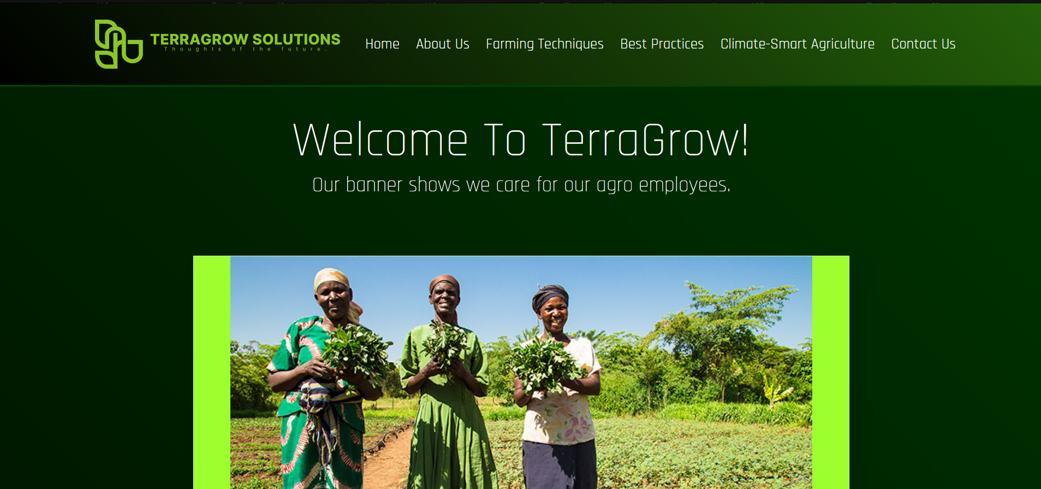
WEBSITE DETAILS

Slide 13
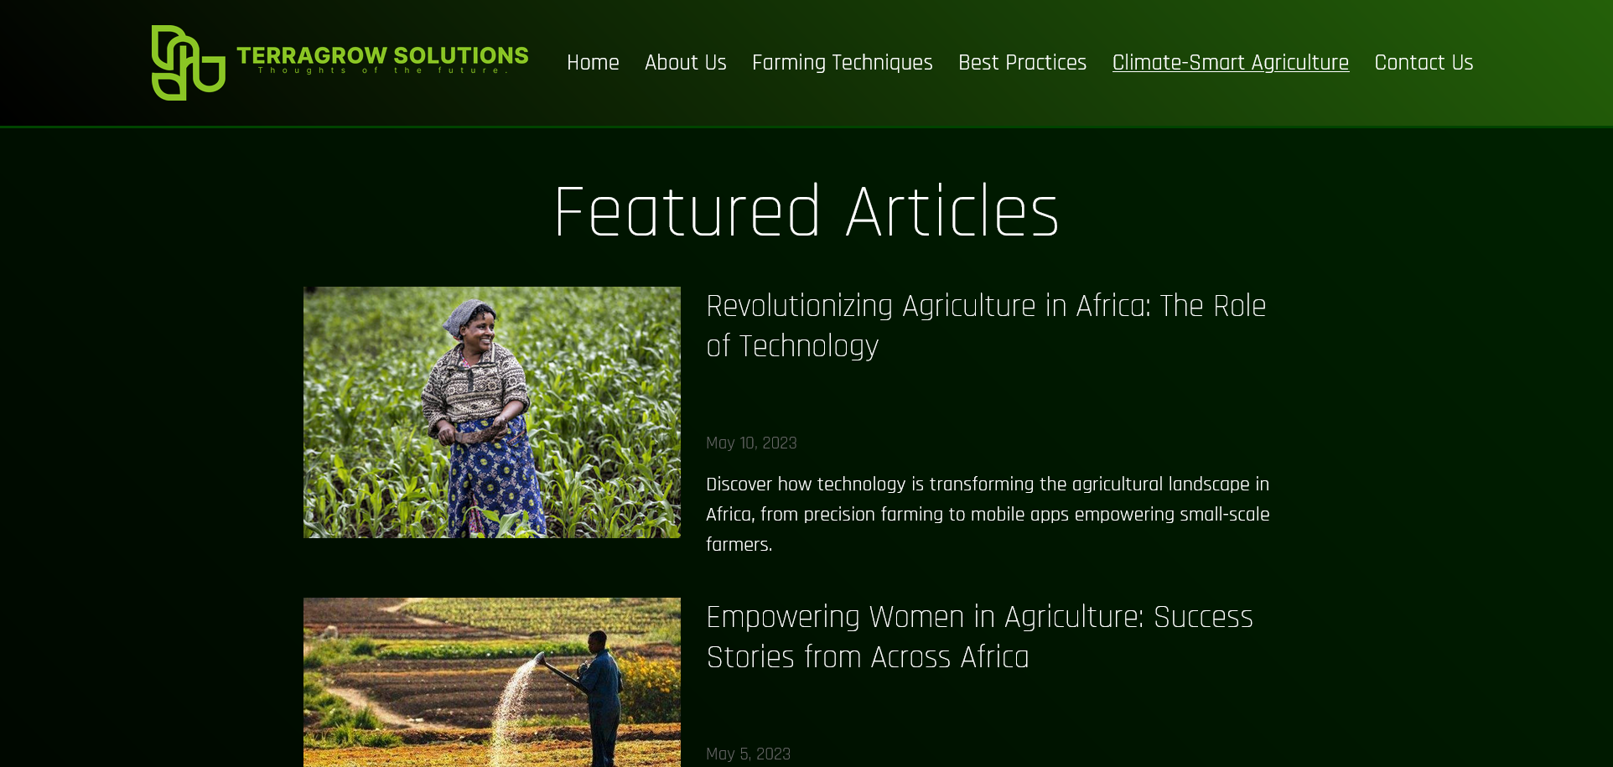
WEBSITE DETAILS

