Slide 1



Slide 2
Contest Task:
Design a visually appealing and user-friendly homepage for https://www.foundit.in that will attract potential job seekers and showcase job opportunities to them.
Submission Formats: -
Figma (link), Sketch(link), PDF, .psd, .png, .jpeg, adobe XD(link) - Upload your files with a maximum size of 5 MB.
Evaluation Criteria:
To create an effective landing page with clear messaging of benefits, a simple layout for easy navigation, and visual design that aligns with the brand and creates credibility. You will be judged on the basis of a few of these criteria's like creativity & originality, user experience & functionality, visual design and aesthetics.

Slide 3
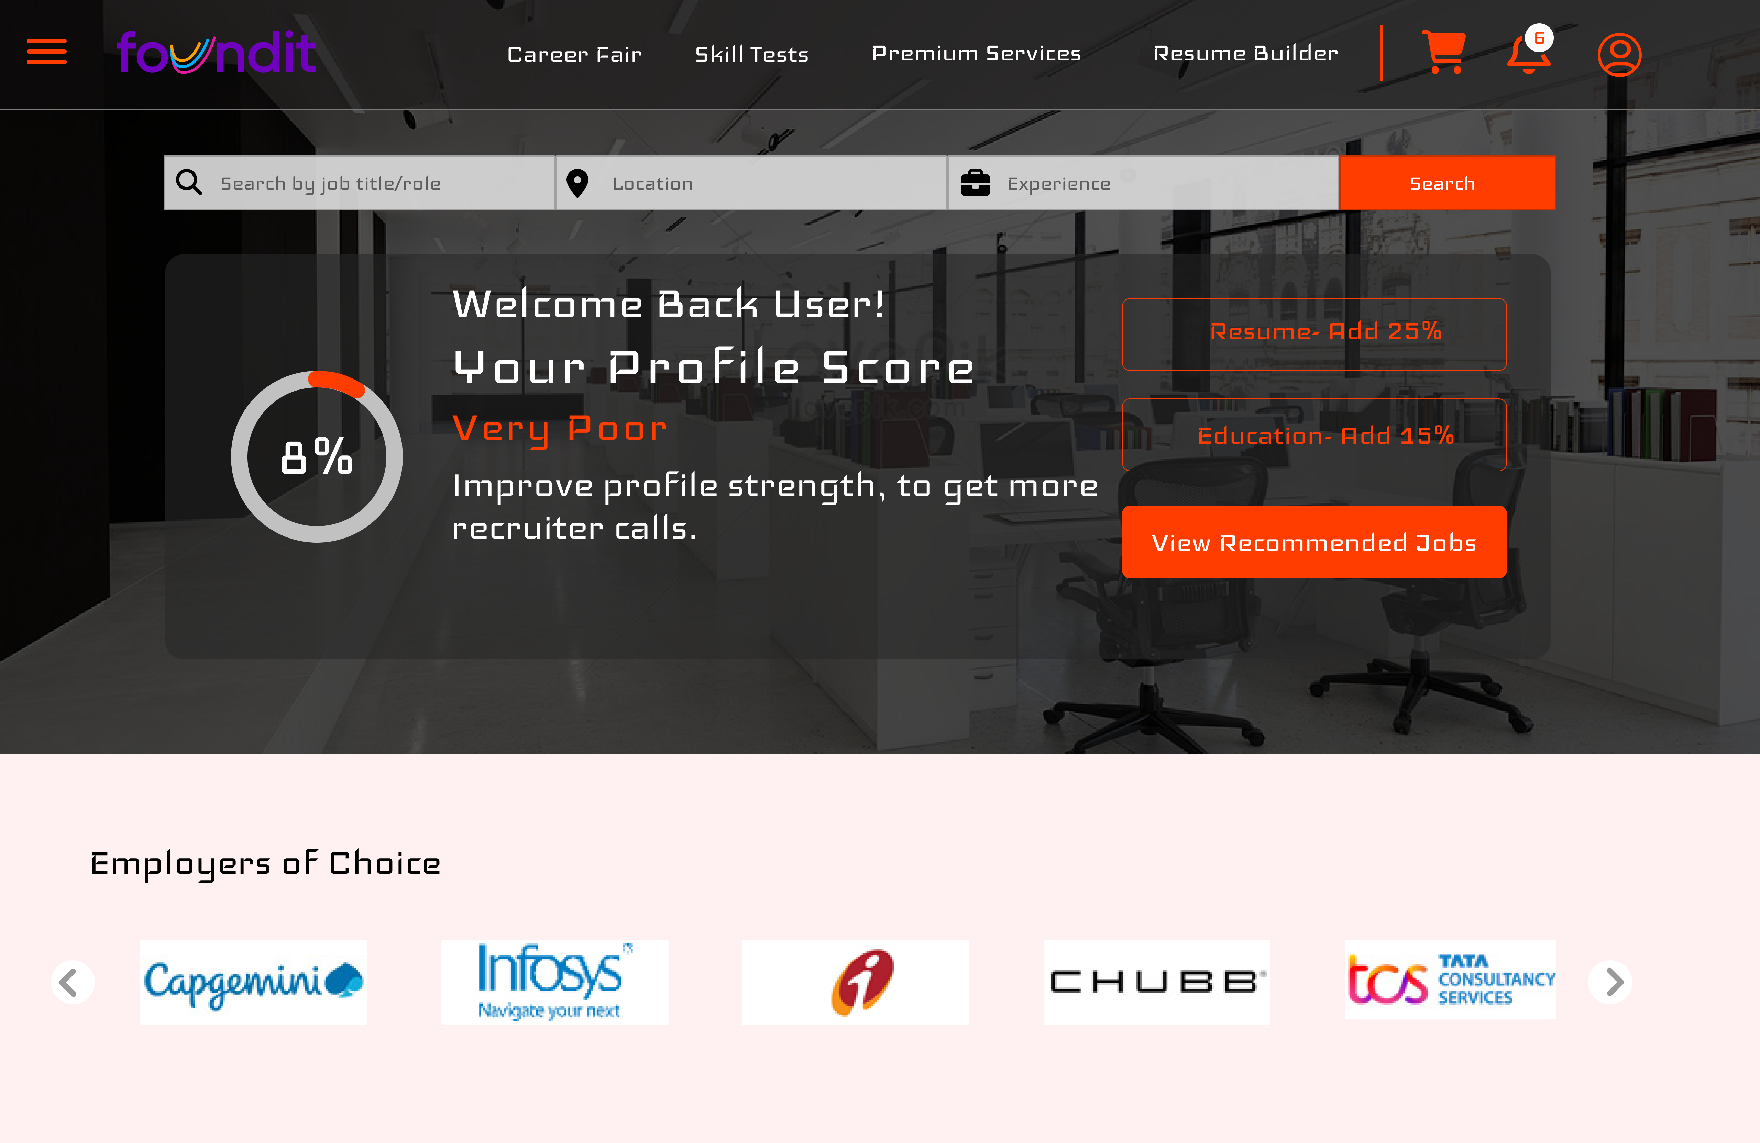
THE WEBSITE IN DESKTOP MODE

Slide 4
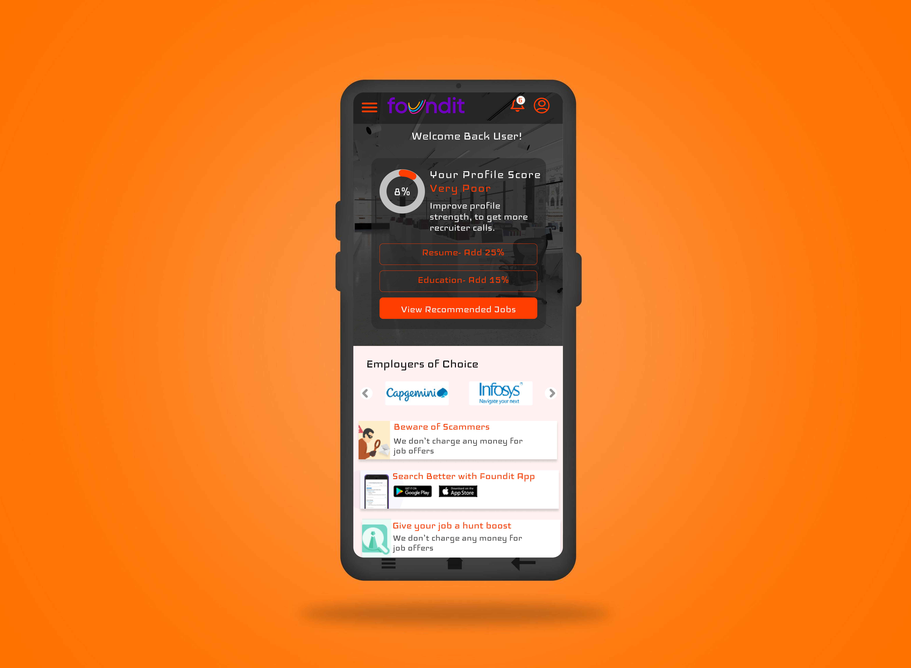
THE WEBSITE IN Mobile MODE

Slide 5

SHASWATA SAHA UI/UX DEVELOPER STUDENT AT UNIVERSITY OF CALCUTTA +91 9674177512 Email: shaswata.ssaha@gmail.com Blog: https://acodernamedsubhro.web.app/
Linkedin: https://www.linkedin.com/in/shaswata-saha-74b209251/

