Slide 1
Network Traffic Monitoring for an Iaas in Cloud
Cosmic_Dust
Lakshmi Srinivas, Ashwin Kini, Subhadarshi Samal

Slide 2
Group project Description
List of Tasks:
  Task 1 : Cloud Environment Setup.
  Task 2: Setting of TaaS (Traffic Monitoring System)
  Task 3: Network Traffic Acquisition (Monitoring)
  Task 4: Network Traffic Classification and Analysis
  Task 5: Documentation

Slide 3
Project Description (cont.)
Task Name | Person Responsible | Work (%) | Progress
Cloud Environment setup | Ashwin, Lakshmi, Subh | 10 | Complete
Setting of TaaS | Ashwin, Lakshmi | 25 | Complete
Network Traffic Monitoring | Lakshmi, Subh | 25 | Complete
Network Traffic Acquisition, Classification and Analysis | Subh, Ashwin | 25 | Complete
Documentation | Ashwin, Lakshmi, Subh | 15 | Complete

Slide 4
Technical Details
Software and Hardware used:
Hardware OS: Ubuntu 16.04 LTS
Cloud Setup Requirements : Devstack for OpenStack , Neutron API, Tap as a Service (TaaS) API
Host VMs OS : Ubuntu 14.04 LTS (Linux)
Languages & Tools: Python, wireshark, tcpdump

Slide 5
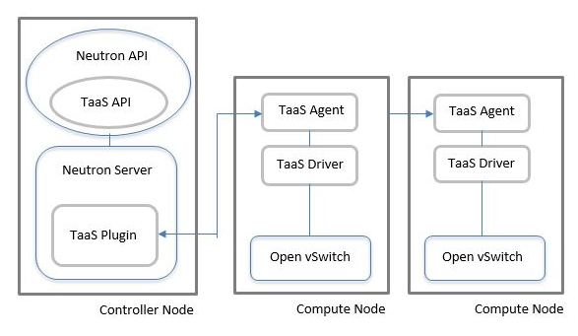
Technical Details
Taas Setup
Compute Nodes: These are target instances whose traffic needs to be sniffed.
Controller node: Instance that has monitoring application.

Slide 6
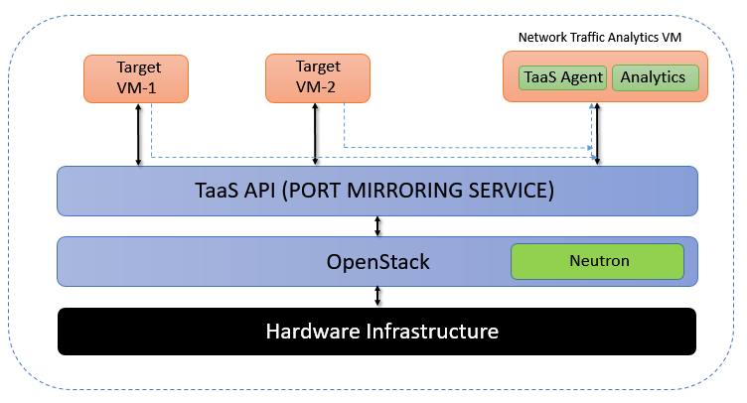
Taas
Taas introduces the functionality of port mirroring in OpenStack Neutron provisioned networks. This feature allows tenants and administrators to mirror network traffic (ingress/egress) from VM connected neutron ports to any other port

Slide 7
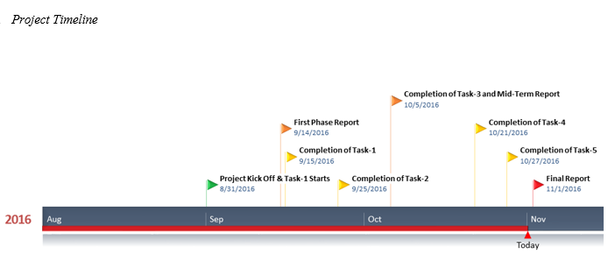
Technical Details
Roadmaps of your project (Milestones):

Slide 8
Technical Details
- Using OpenStack for building private cloud
Using TaaS for port mirroring.
Building the traffic analyzing and classification using Taas.
Taas does port mirroring to replicate traffic from target nodes to analyzing node .

Slide 9
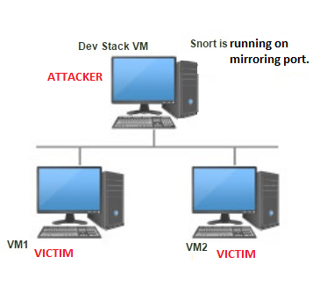
System Model

Slide 10
Risks and Benefits
Novel aspects of this project:
Leveraging TaaS ( a new plugin) for the project.
Risks/challenges:
Openstack installation and resource allocation
Integration of TaaS and network monitoring application will be a demanding task. TaaS is a new feature added to the Openstack functionalities. We are building on top of TaaS which might be challenging.
Potential applications & benefits:
This can be integrated with IDS.
It can also be used simply as network monitoring tool.

Slide 11
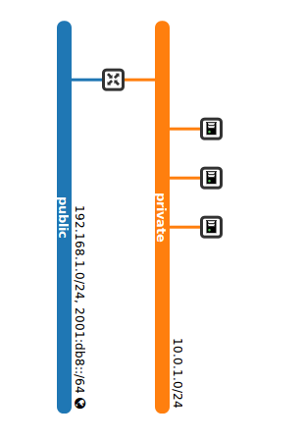
Tasks Accomplished by Now
Task 1: Cloud Environment Setup on ThothLab

Slide 12
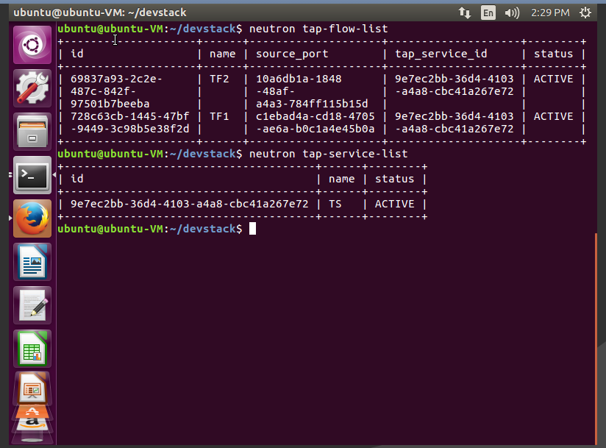
Tasks Accomplished by Now
Task 2: Setup of Taas

Slide 13
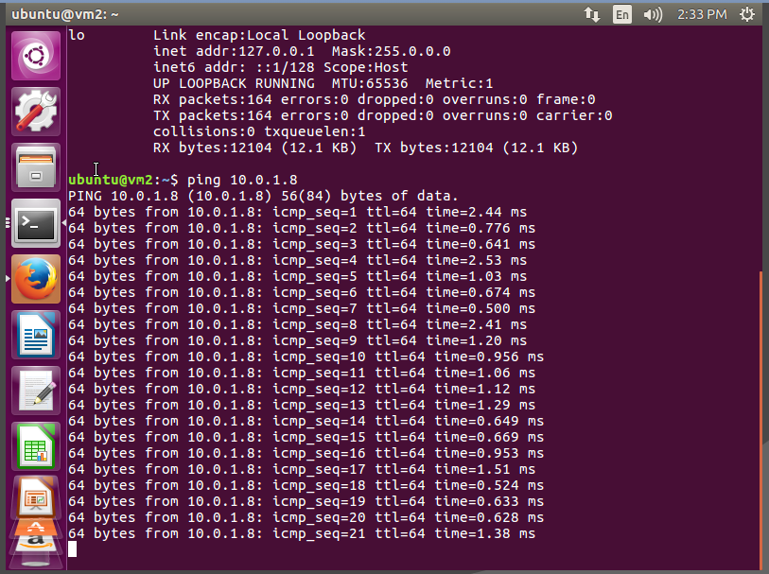
Tasks Accomplished by Now
Task 3: Traffic Monitoring:
- Ping from Target VM1 to Target VM2

Slide 14
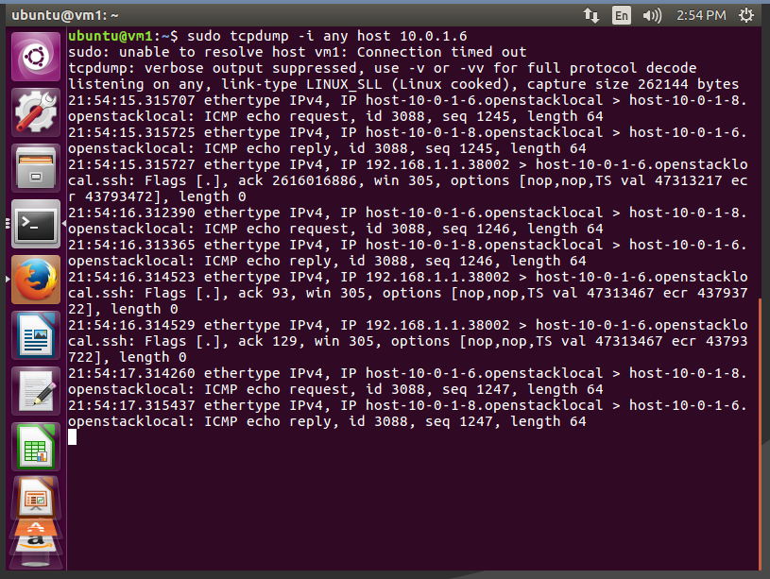
Tasks Accomplished by Now
- Successful port mirroring on TaaS Agent

Slide 15
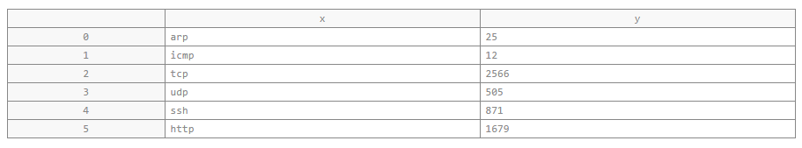
Tasks Accomplished by Now
Task 4 – Traffic Classification
Output of traffic classifier

Slide 16
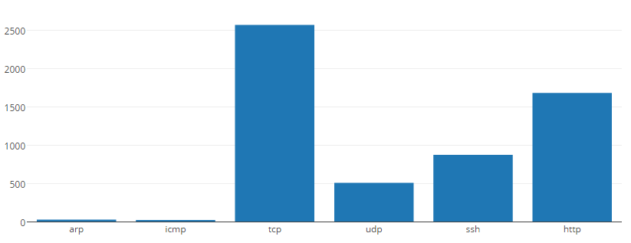
Tasks Accomplished by Now
Plotting of the graph:

Slide 17
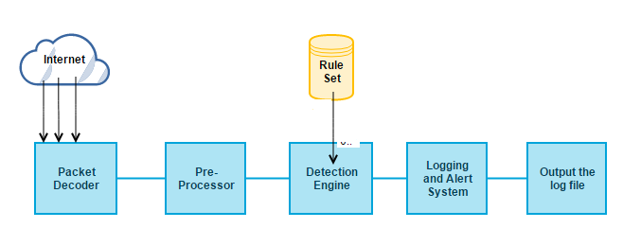
Tasks Accomplished by Now
Task 4 - Traffic Analysis (Integration of Intrusion Detection System):
Snort work flow

Slide 18
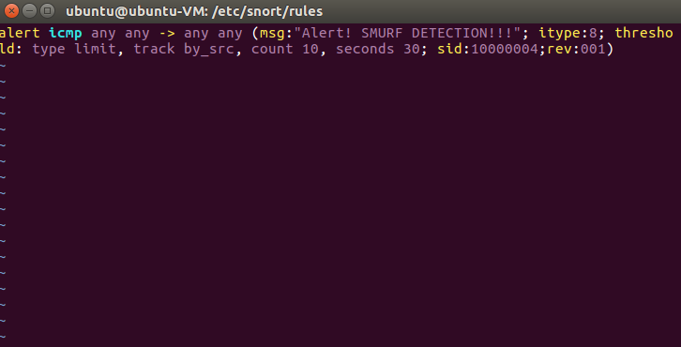
Tasks Accomplished by Now
Snort Rule – for Smurf detection

Slide 19
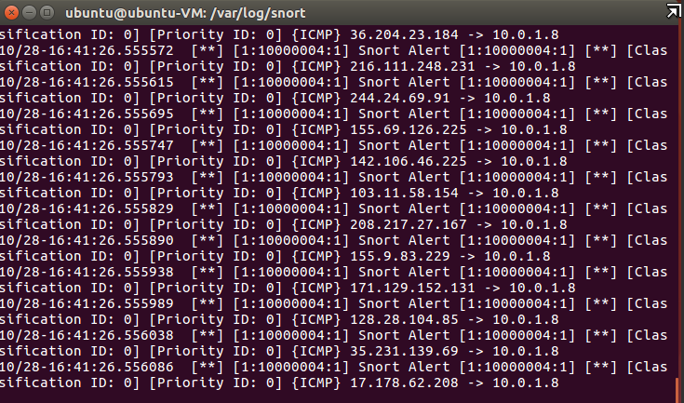
Tasks Accomplished by Now
Attack log captured in Snort

Slide 20
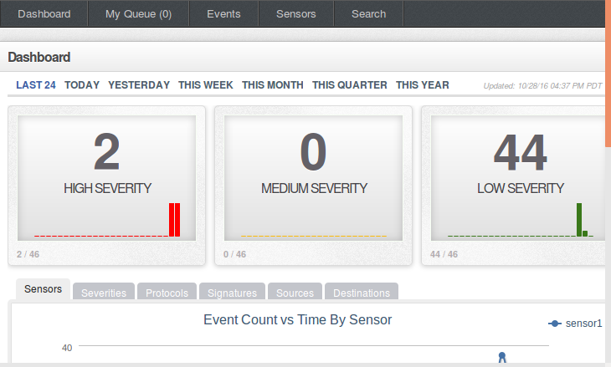
Tasks Accomplished by Now
Severity analysis on Snorby GUI

Slide 21
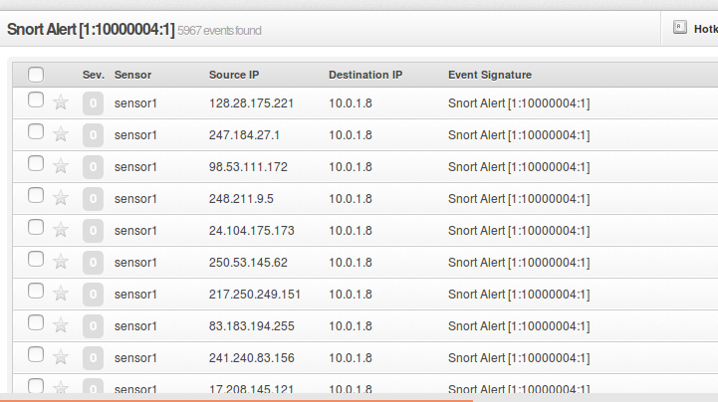
Tasks Accomplished by Now
Traffic Detection in Snorby sensor

Slide 22
Conclusion
The Network Traffic Monitoring system helps cloud administrators’ to capture traffic and perform analysis. This feature can be integrated into Openstack.
To monitor the traffic going to and from all the Openstack instances we use TaaS which does port mirroring on the Monitoring VM.
We also implement a network traffic analyzer and classifier to categorize data and use this for detecting malicious traffic and prevent attacks.
Future work can include integrating it with other systems for a more robust and secure system model.

Slide 23
Demo https://www.youtube.com/watch?v=0K6tusUQaUU&feature=youtu.be

