Slide 1
DIGITAL VAULT FOR EMPLOYEE DOCUMENTS
BHARATI VIDYAPEETH’S COLLEGE OF ENGINEERING FOR WOMEN, PUNE
VANSHIKA SHAH
SUBHU TRIVEDI
SHUBHANGI GUND
KHUSHABU KHINVASARA
SHWETA CHINDHE

Slide 2
INDEX
IDEA UNDERSTANDING
ARCHITECTURE
TECHNOLOGY STACK
DEMO
BENEFITS
PRODUCTION READINESS
CHALLENGES

Slide 3
IDEA UNDERSTANDING
Digital Vault for Employee Documents aimed at transforming employee and HR experience related to upload and update of documents
Objective of the application is to store the employee documents digitally

Slide 4
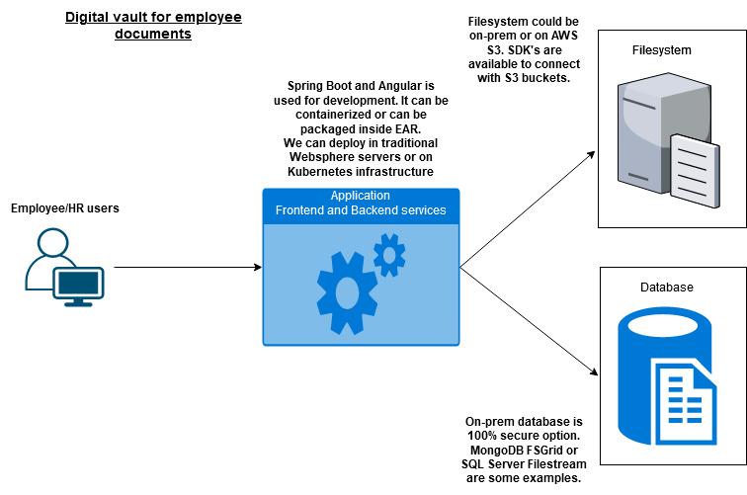
ARCHITECTURE

Slide 5
TECHNOLOGY STACK
ANGULAR 10
BOOTSTRAP
SPRING BOOT
MYSQL DATABASE

Slide 6
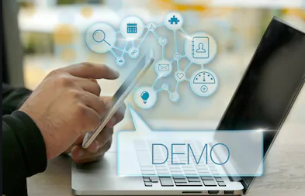
DEMO

Slide 7
BENEFITS
Easily scalable
User-friendly
Easily accessible
Saves lot of time
HR can fetch the report

Slide 8
PRODUCTION READINESS
Basic structure is in working condition but need to work on covering full requirements
Email notification to share user credentials needs to be implemented
SSO login should be integrated for employees and HR
Security assessment needs to be done
File storage decision should be finalized
Bootstrap is used but exact Principal theme to be used

Slide 9
EXPERIENCES, LEARNINGS & CHALLENGES
Time limitations
Unaware about Technology
Integration of frontend and backend
Network Issues
Team members working from different location

Slide 10

THANK YOU
Questions & Answers

