Slide 1
DIGITAL VAULT FOR EMPLOYEE DOCUMENTS
BHARATI VIDYAPEETH’S COLLEGE OF ENGINEERING FOR WOMEN, PUNE
TEAM MEMBERS :
VANSHIKA SHAH
SUBHU TRIVEDI
SHUBHANGI GUND
KHUSHABU KHINVASARA
SHWETA CHINDHE

Slide 2
INDEX
IDEA UNDERSTANDING
ARCHITECTURE
TECHNOLOGY STACK
DEMO
BENEFITS
IMPROVEMENTS
CHALLENGES

Slide 3
IDEA UNDERSTANDING
Digital Vault for Employee Documents aimed at transforming employee and HR experience related to upload and update of documents
Objective of the application is to store the employee documents digitally

Slide 4
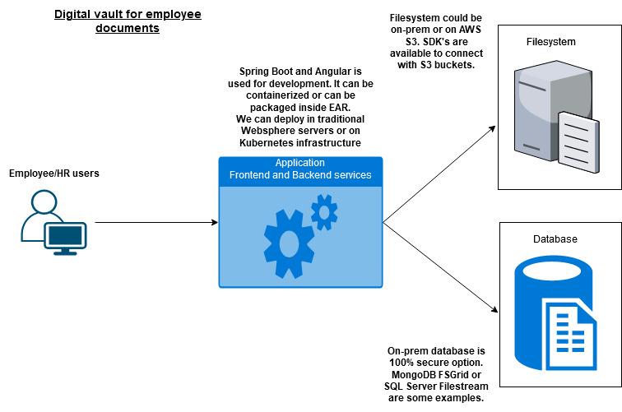
ARCHITECTURE

Slide 5
TECHNOLOGY STACK
ANGULAR 10
BOOTSTRAP
SPRING BOOT
MYSQL DATABASE

Slide 6
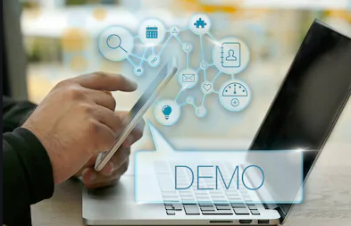
DEMO

Slide 7
BENEFITS
Easily scalable
User-friendly
Easily accessible
Customizable

Slide 8
IMPROVEMENTS
Email notification regarding login credentials
Use of other databases to store the file(Ex. MongoDB FSgrid, SQL server file-stream etc.)
Explore the option of AWS to store the files
Containerize the application

Slide 9
CHALLENGES
Time limitations
Unaware about Technology
Integration of frontend and backend
Network Issues
Team members working from different location

Slide 10

THANK YOU

