Slide 1
Filters
Tableau provides the ability to filter individual views or even entire data sources on dimensions, measures, or sets
This filtering capability can serve a variety of purposes, including minimizing the size of the data for efficiency purposes, cleaning up underlying data, removing irrelevant dimension members, and setting measure or date ranges for what you want to analyze.

Slide 2
Types of filters
Dimension Filter
Measure Filter
Macro Filter

Slide 3
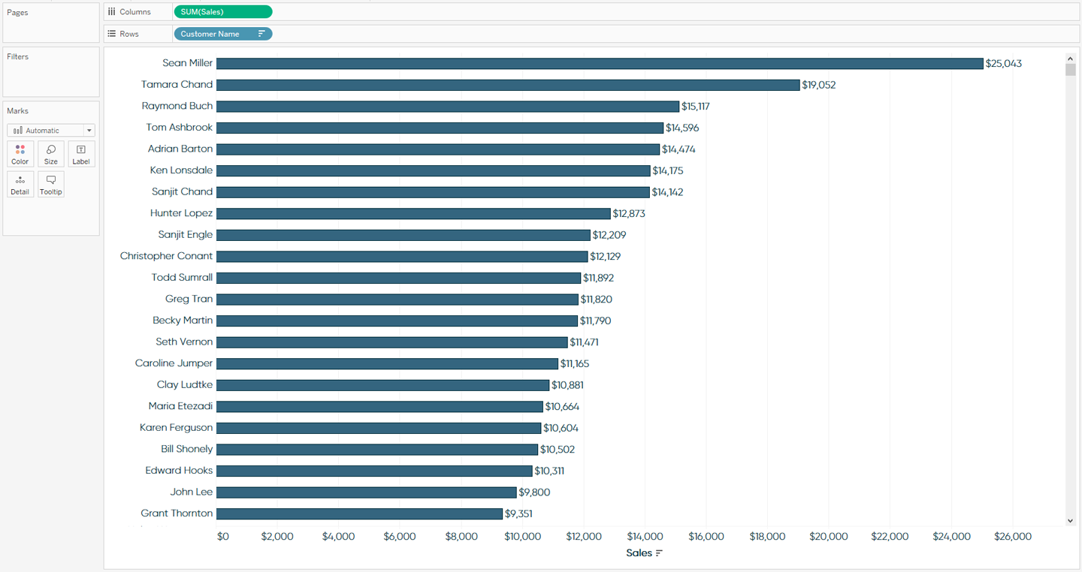
Dimension Filter

Slide 4
The first, and most basic way to filter out marks on a view, is to select the marks, and then choose to keep or exclude them.
Let’s say that our boss has an extreme aversion to names that start with the letter “C”, so we want to make sure we remove those customers from the report.
To do so, you can go through the list of customers, and use multiselect (Ctrl-Click on a PC) to highlight them.

Slide 5
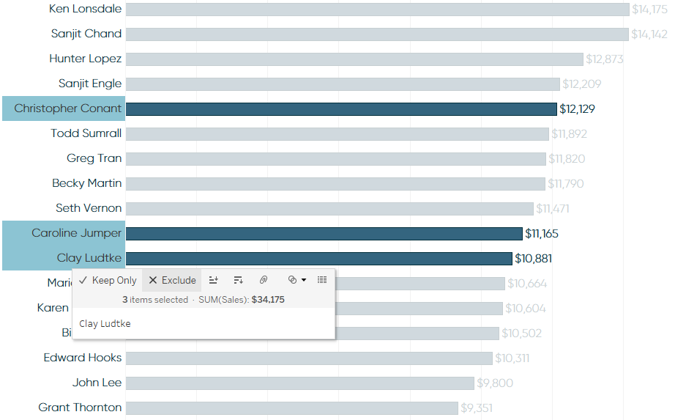
After selecting the names that you want to filter, hover over one of the dimension members (in this case, customer names), and click Exclude:

Slide 6
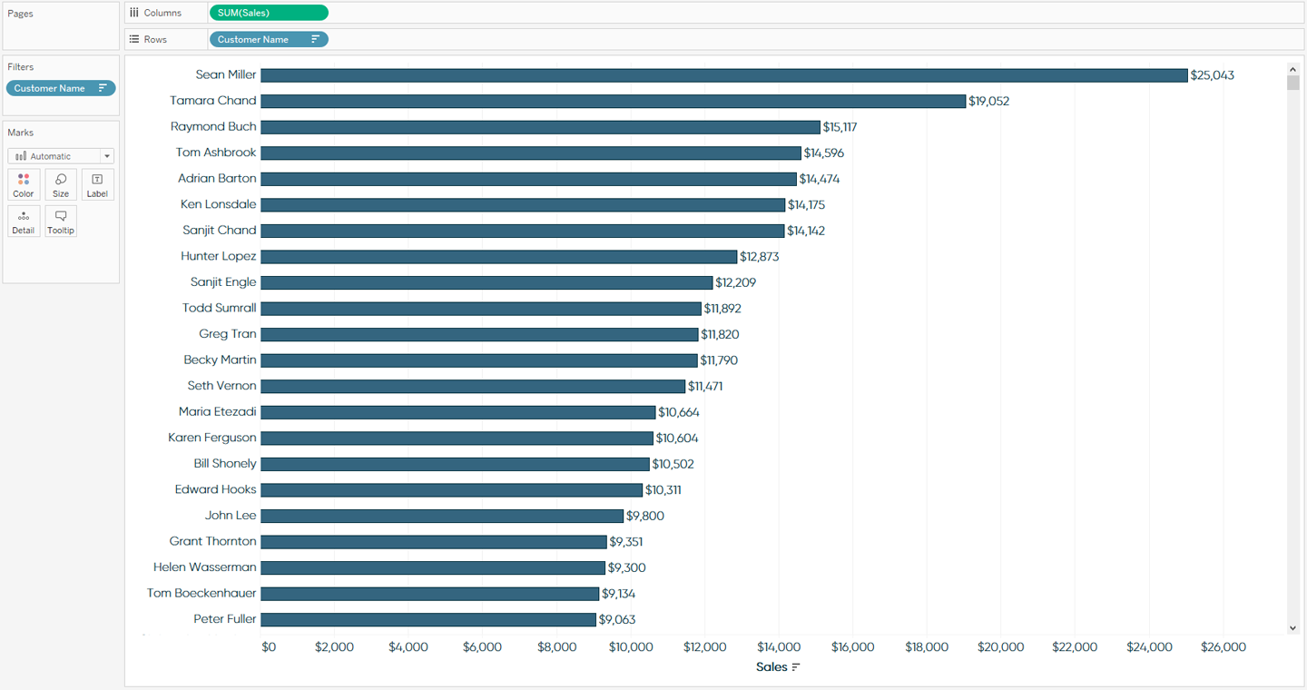
Note that there is also an option to Keep Only, which would do exactly what it sounds like, and keep only the selected names on the view.
After choosing Exclude, notice that the Customer Name dimension is added to the Filters Shelf in the upper-left corner of the view:

Slide 7
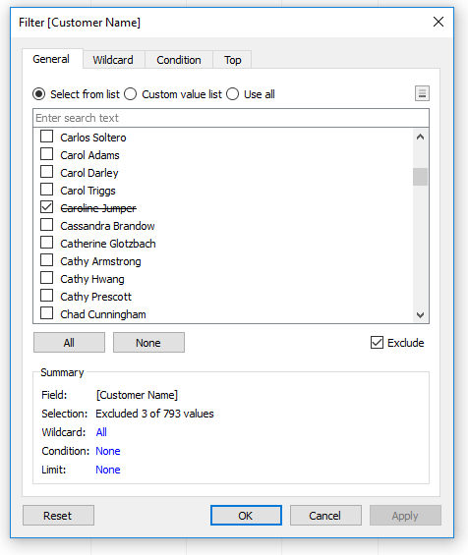

Slide 8
Notice that Tableau created an “Exclude” dimension filter for us when we chose to exclude the three names that start with the letter “C” from the view, as indicated by the box for “Exclude” being checked.
There is a summary box at the bottom of the filter that is telling us the criteria for our filter.
We currently are excluding 3 of 793 total marks, or customer names, from the view.
This manual selection of individual dimension members is the most precise form of filtering, but can also be quite tedious.
This is especially true when filtering on the Customer Name dimension, which has 793 individual dimension members.

Slide 9
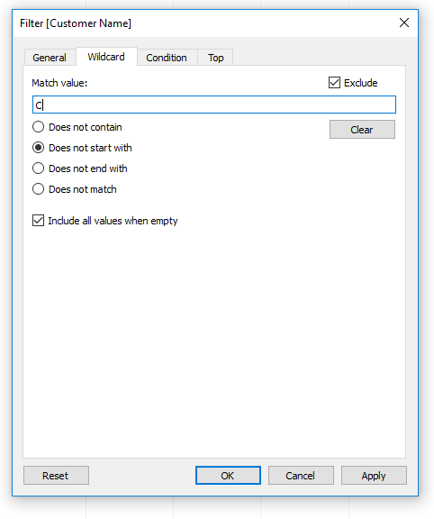
There are two additional tabs that can be used to add rules to a dimension filter.
The Condition tab allows you to add quantitative thresholds that must be met and the Top tab allows you to focus only on the Top or Bottom dimension members based on a
measure of your choosing.

Slide 10
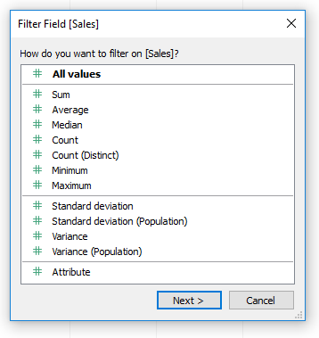
Measure Filters in Tableau
Measure filters are similar to dimension filters, but the filtering options are different between the two

Slide 11
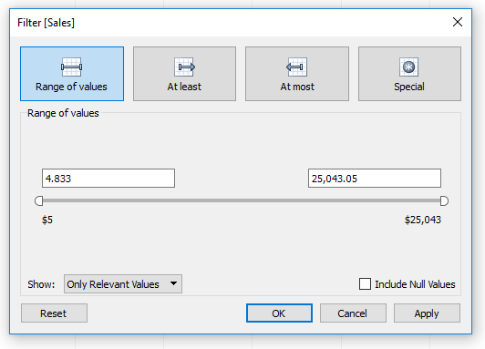
we will choose Sum, which is the default for most measures.
After making the choice of aggregation, you can choose to filter on a range of values, a minimum threshold, or a maximum threshold:

Slide 12
“Range of values” provides the most flexibility and is the best (and only) choice if you
want you and your end users to be able to control both the bottom end and top end
of the range. For now, I’ll change just the bottom end of the range to be $10,000.
After changing the low end to $10,000 and clicking OK, my view looks like this:
|

Slide 13
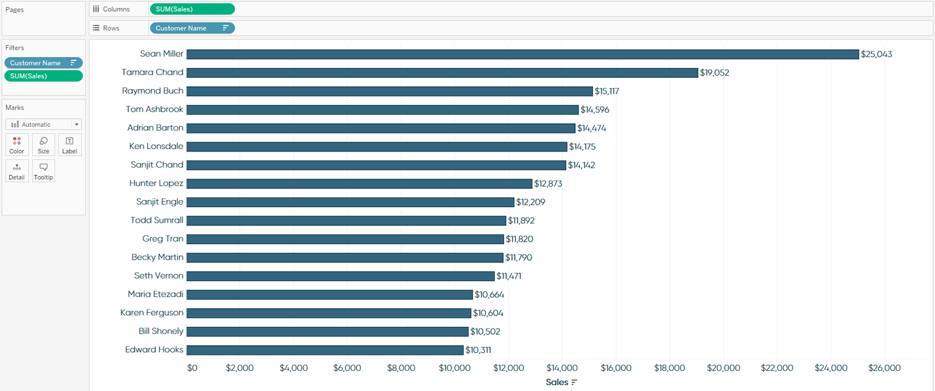
Note that I now have two filters on the Filters Shelf; one dimension filter and one
measure filter. All of the filters that you place here will act as a condition in an AND
statement. So at this point, in order for a customer name to be shown on the view, it
must not start with the letter “C” and sales must be between $10,000 and $25,043.05.

