Slide 1
Story

Slide 2
Story
In Tableau, a story is a sequence of visualizations that work together to convey information. You can create stories to tell a data narrative, provide context, demonstrate how decisions relate to outcomes, or to simply make a compelling case.
A story is a sheet, so the methods you use to create, name, and manage worksheets and dashboards also apply to stories (for more details, see Workbooks and Sheets). At the same time, a story is also a collection of sheets, arranged in a sequence. Each individual sheet in a story is called a story point.
When you share a story —for example, by publishing a workbook to Tableau Public, Tableau Server, or Tableau Cloud—users can interact with the story to reveal new findings or ask new questions of the data.

Slide 3
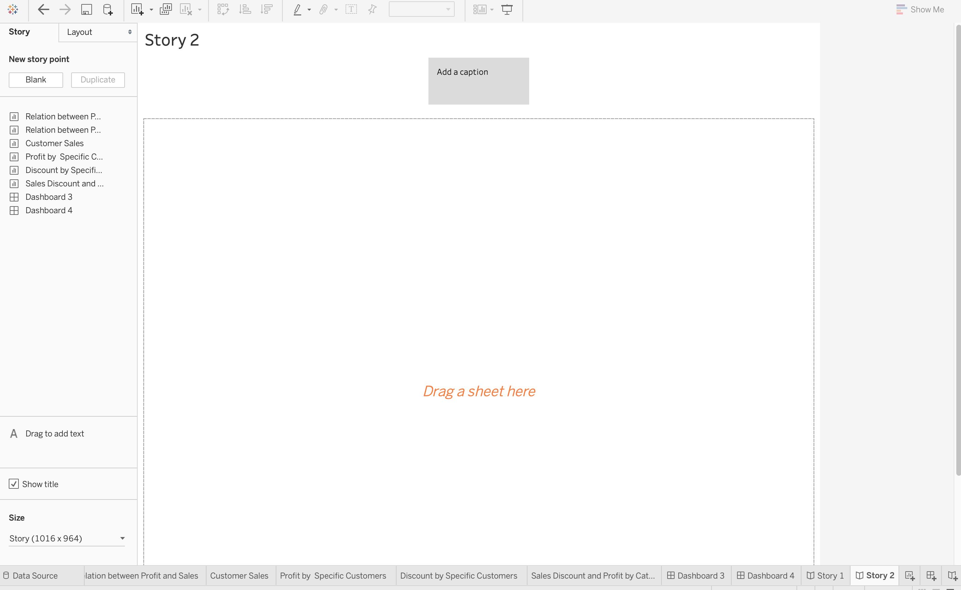
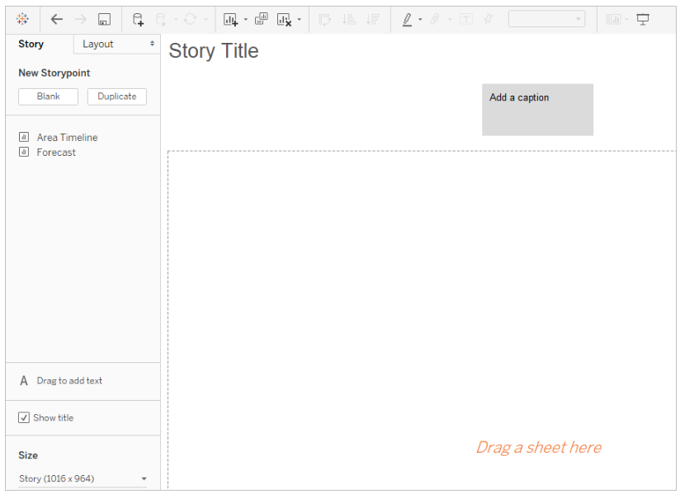
Step 1: Click on the new Story tab to create a new story. You can then add various sheets and dashboards to create a story point.

Slide 4
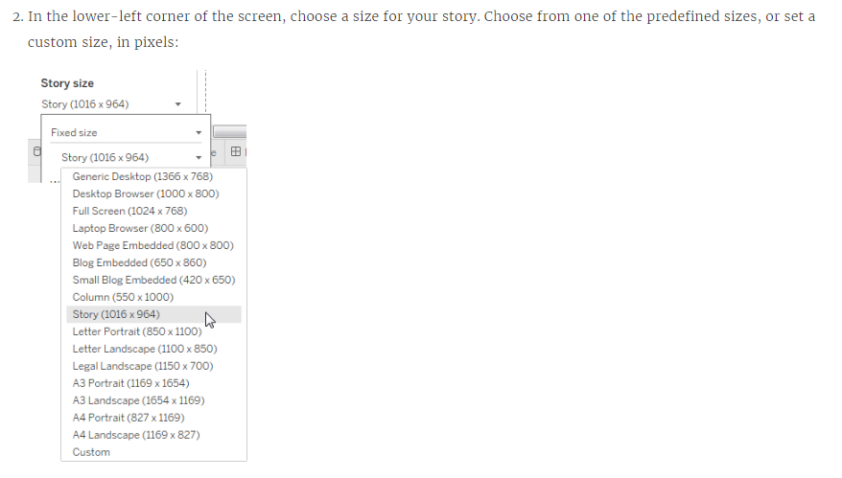

Slide 5
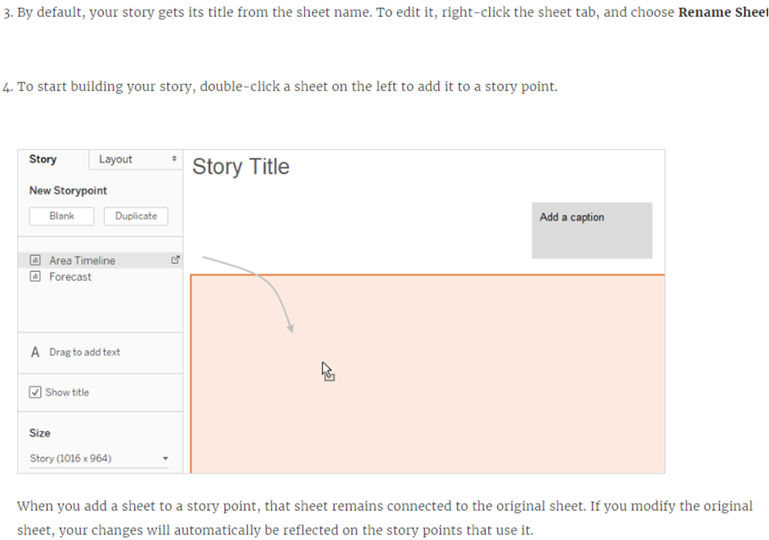

Slide 6
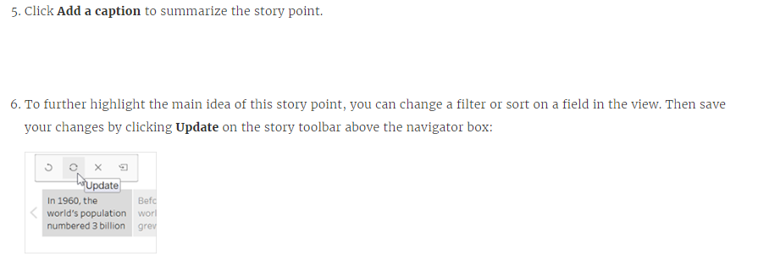

Slide 7
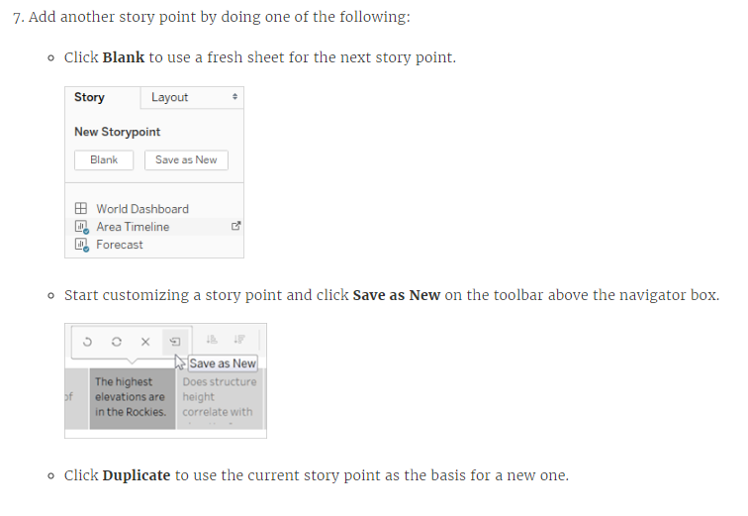

Slide 8
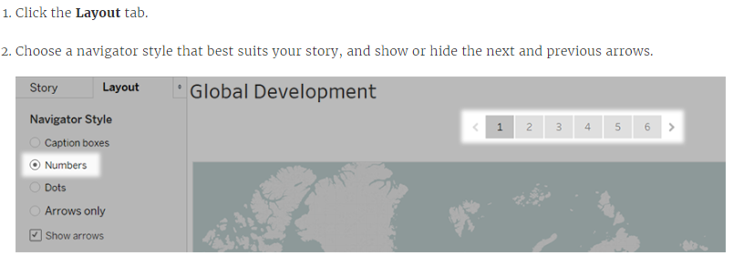
Explore layout options

Slide 9
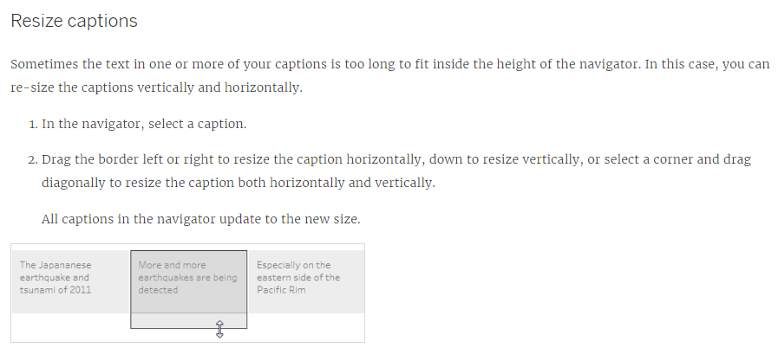
Format a story

Slide 10
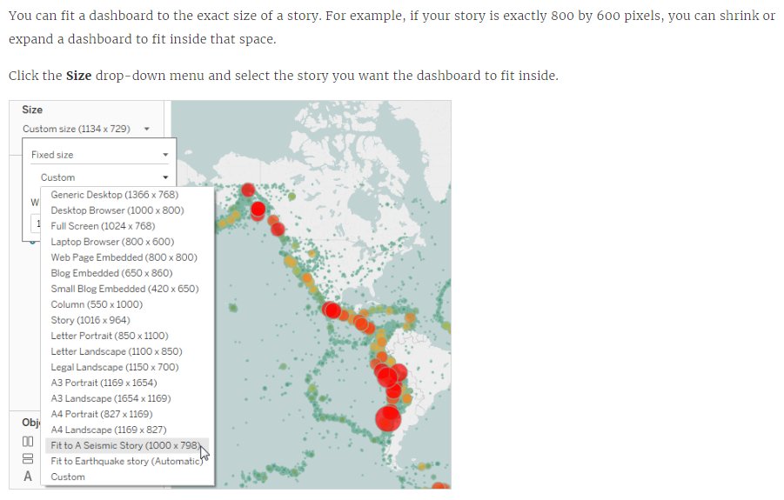
Fit a dashboard to a story

Slide 11
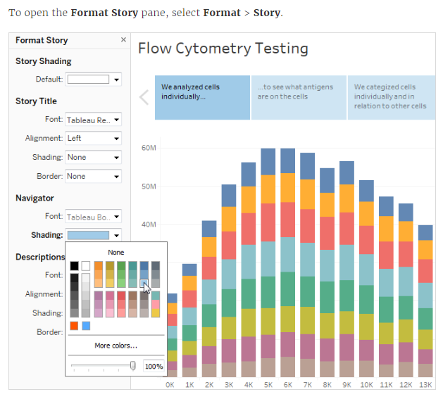
Format a story's shading, title, and text objects

Slide 12
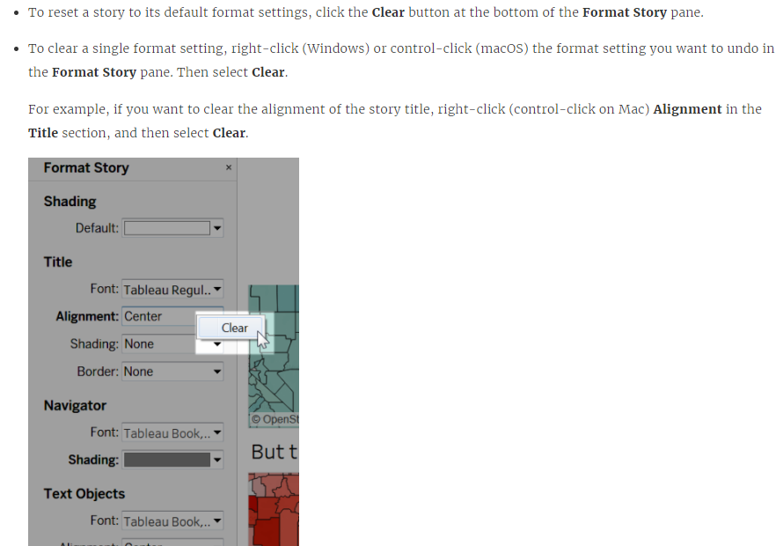
Clear all formatting

Slide 13
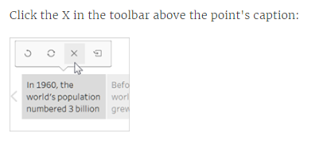
Delete a story point

Slide 14
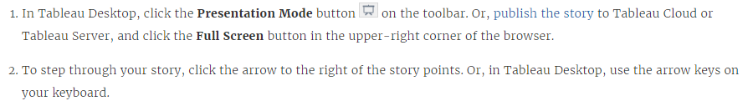
Present your story

