Slide 1
Dual-Axis Combination Chart

Slide 2
Introduction
Dual-axis combination charts, or Combo Charts, are an effective chart type for showing related information while saving real estate by combining views.
This chart type is created with one shared axis, such as an x-axis for date, and two separate axes, such as y-axes for two different measures.

Slide 3
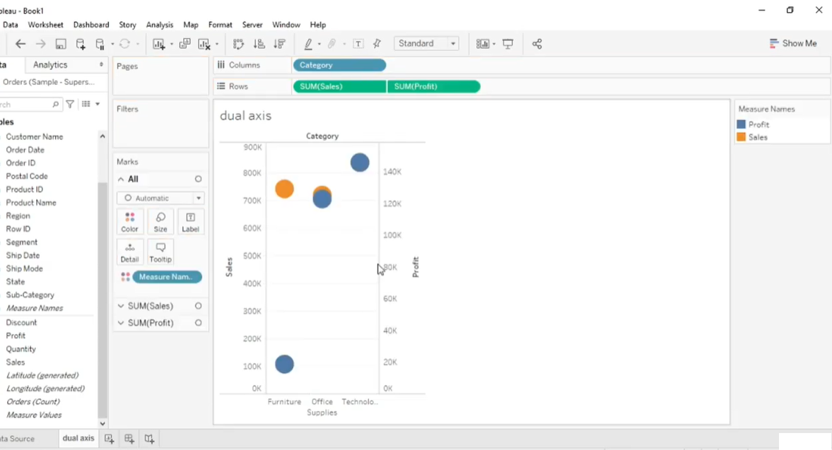
Creating Dual axis

Slide 4
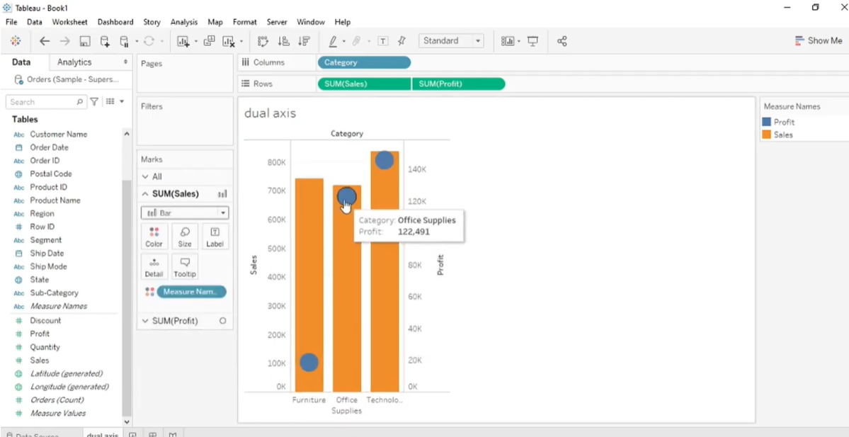
Creating Dual axis – Changing the type of sales measure to bar chart

Slide 5
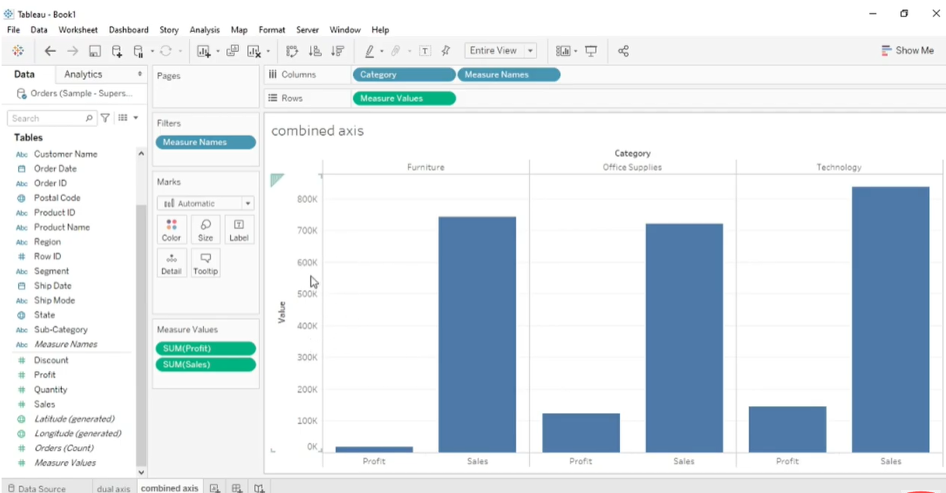
Creating Combined axis

Slide 6
Tree Maps
Use treemaps to display data in nested rectangles. You use dimensions to define the structure of the treemap, and measures to define the size or color of the individual rectangles.
Treemaps are a relatively simple data visualization that can provide insight in a visually attractive format.

Slide 7
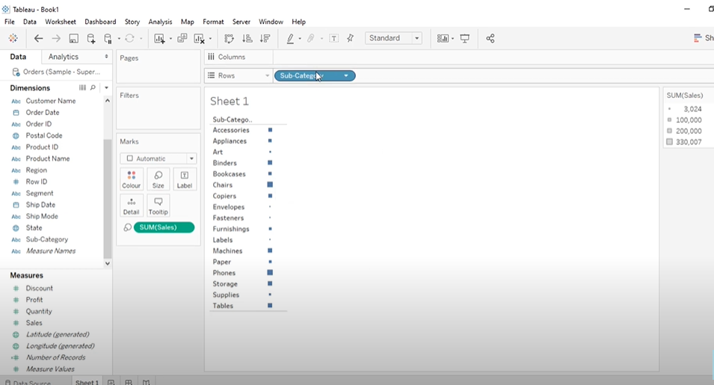
Tree Map

Slide 8
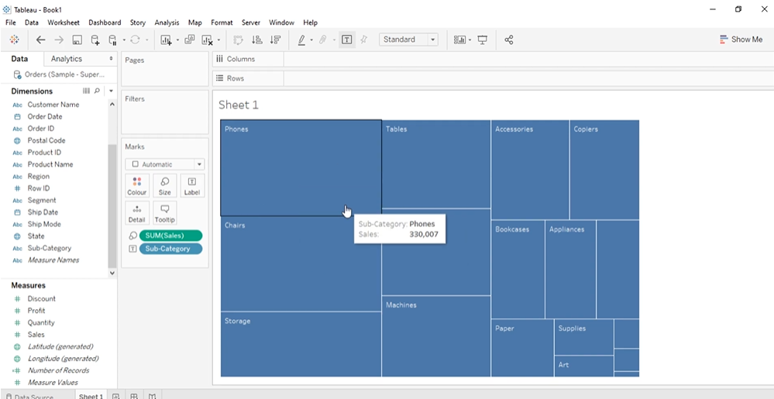

Slide 9
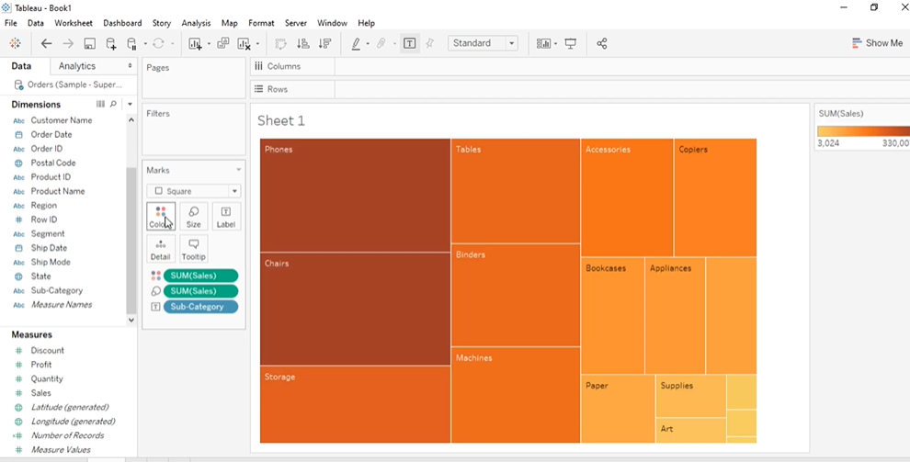

Slide 10
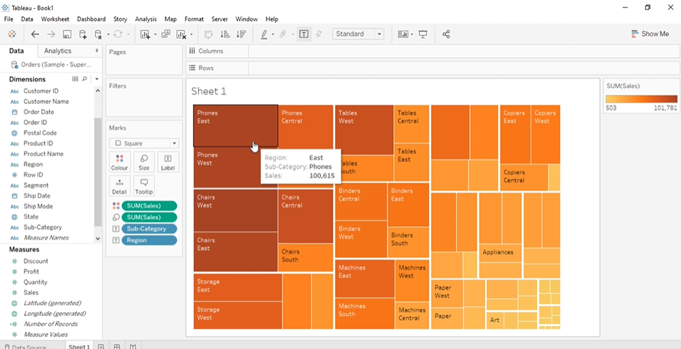

Slide 11
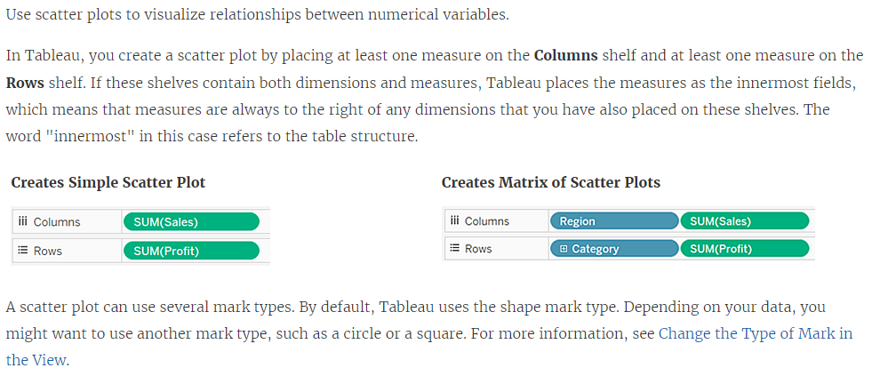
Scatter Plot

Slide 12
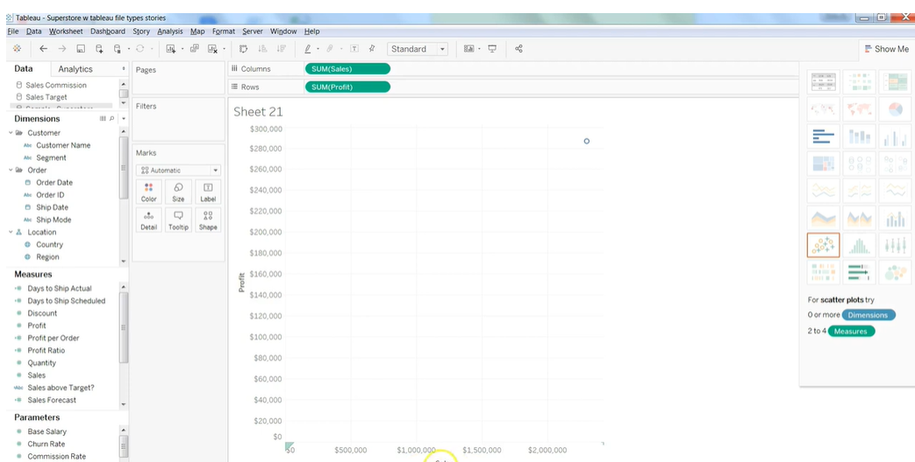

Slide 13
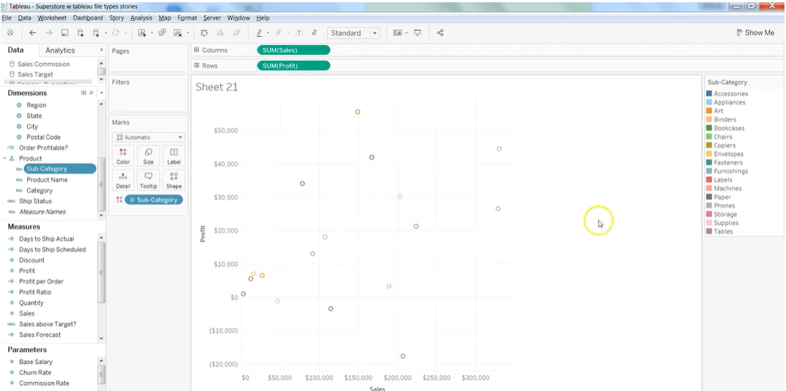

Slide 14
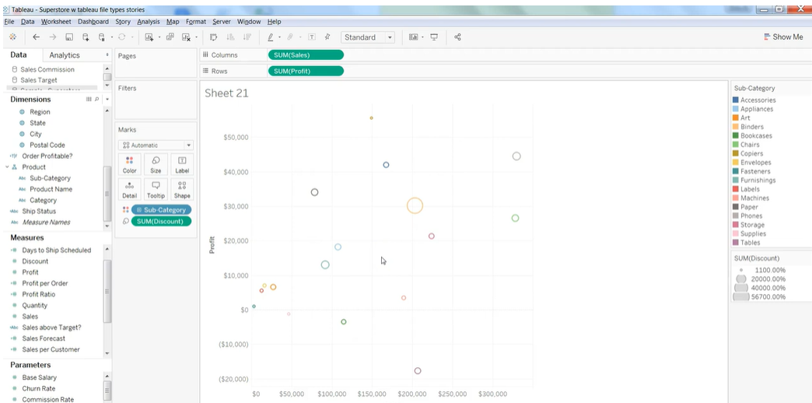

Slide 15
