Slide 1
SUDOKU GAME
Shreeshant Prajapati
Subigya Shrestha
Notes:
https://github.com/sauzzon/PenaltyFever/blob/master/Penalty_Fever.pptx

Slide 2
OBJECTIVES
To learn and implement the Object Oriented approach of C++.
To enhance our skill in C++ programming language.
To be familiar with SFML library for Graphical User Interface.
To learn basic
To learn to work in a group as team.

Slide 3
What have we created?
We have created a 2-D number game called Sudoku,where a player should enter a number ranging from 1-9 in the square boxes.The number shouldn’t be align in row or column or in the medium size 3x3 box.There are different levels present in the game mode where a unique board is created according to the difficulty level chosen.

Slide 4
What is behind the numbers?
Compiler: GNU GCC Compiler
IDE: Visual Studio
GUI Library: SFML-version 2.5.1
Hard Work and Communication

Slide 5
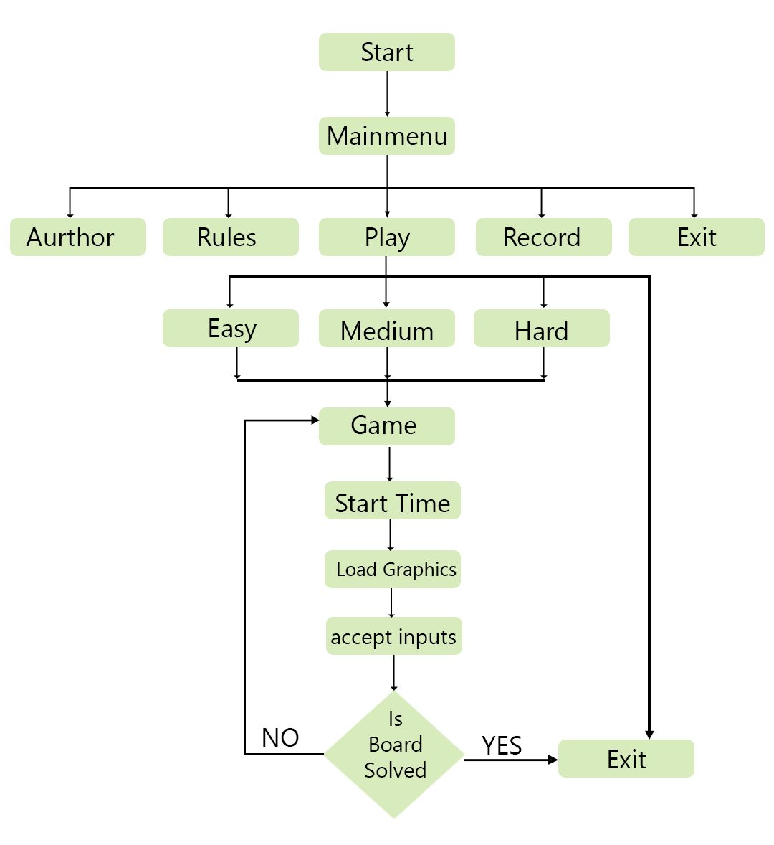
Flow of the program

Slide 6
Demonstration

Slide 7
Headers files included
Game.h
Mtime.h
Person.h
Engine.h
Player.h
Record.h
Rules.h
TextBox.h
button.h

Slide 8
Game Class
Game(v)
~Game(void);
enum GameState { MENU, GAME, AUTHOR, END, RULES ,RECORD};
GameState state;
void levels();
void author();
void menu();
void rules();
void records();

Slide 9
Engine Class
Engine();
~Engine();
void fillTable(int** m, int& size, RenderWindow& window);
void setLevel(int** m, bool** b, int size, int difficulty);
void selectCell(RenderWindow& window, int size, int& index, int**matrix, bool** bloc, Input& input);
void drawSquare(RenderWindow& window, int** matrix, bool** bloc, int size, int index);

Slide 10
Engine Class(*continued)
bool checkRow(int** m, int size, int row, int value);
bool checkColumn(int** m, int size, int column, int value);
bool checkSquare(int** m, int size, int row, int column, int value);
bool removing(bool bol[16], int t);
bool checkWin(int** m, int size);

Slide 11
Engine Class(*continued)
void reset(int** m, bool** b, int size);
bool solveSudoku(RenderWindow &window,int** m, bool** b, int size);
int findmty(int** m, int size);
void starttime();
Text displaytime();

Slide 12
Button Class
void setPosition(sf::Vector2f pos);
void setFont(sf::Font& font);
void drawTo(sf::RenderWindow& window);
bool isMouseOver(sf::RenderWindow& window);
float getGlobalBound();
void setFillColors(sf::Color color);
void set(Color color, Color c, std::string s, int i, Vector2f size);

Slide 13
TextBox Class
void inputLogic(int charTyped);
void deletLastCharacter()
void setFont(sf::Font& font);
bool selectornot();
void setFillColors(sf::Color color);
void drawBox(sf::RenderWindow& window);

Slide 14
TextBox Class(*continued)
void setboundery(sf::Color color) ;
void setPosition(sf::Vector2f pos) ;
void setLimit(bool TOF) ;
void setLimit(bool TOF, int lim);
void setSelected(bool sel);

Slide 15
TextBox Class(*continued)
void reset();
std::string getText();
void drawTo(sf::RenderWindow& window);
void typedOn(sf::Event evnt);
bool isMouseOver(sf::RenderWindow& window);

Slide 16
Record Class
void setPos(sf::Vector2f pos);
void getText(sf::RenderWindow& window, sf::Font& font, int& pageno, int& max);

Slide 17
Mtime Class
Mtime();
Mtime(float f);
void settime(float f);
void gettime();
int Rsecond();
int Rminute();
int Rhour();

Slide 18
Person Class
Person();
Person(string n);
string getname();
void setname(string n);

Slide 19
Player Class
Player();
Player(string n, float time, int dificulty);
Mtime getTime();
string getDifficulty();
void setTime(float f);
void writeToFile(string name, string level, Mtime time,bool &once);
void setDifficluty(int n);

Slide 20
Rule Class
void set(std::string s, Font& font);
void drawTo(sf::RenderWindow& window);
void setPos(Vector2f pos);

Slide 21
Limitations
Hints or guess add is not available
Entered number is right or not.
Records are not sorted
Level design needs work
It’s offline single player?

Slide 22
Is this the end?
Future Enhancements
Addition of hints.
Solving using backtracking could be visualised.
Sorting records based on difficulty and time.
Improvement in level design.
Experience could be made responsive and smooth.
Graphics could be improved with added animations
Adding a feature to select the boxes with mouse.

Slide 23
Conclusion this is the end
Better understanding of the OOP and its implementation was done in this project.
Successful implementation of a practical program was done working together as a team.
We became familiar with the SFML Library for the GUI Interface in C++.
Remote working was learned as a team.

Slide 24
THANK YOU
Any queries!

